Slide 1

Inserting and Viewing Data on a Webpage
Sakib Mollah
Roll: 38s7
Shifati Rabbi
Roll: 371
Mohammad
Mizanur Rahman
Roll: 2145
Presented By-
Asmaul Shahana
Begum
Roll:360
Nurun Nahar Fiha
Roll: 361

Slide 2
CONTENTS
Introduction
Result and Discussion
Objective
Conclusion
Methodology

Slide 3
1
Introduction

Slide 4
Introduction
In this presentation we will show how to connect a
database in PHP, insert data in a database from a
webpage and finally view the tables on a webpage.
For this, we will use the cinema database, insert
data into it and finally view the movie,
person and role tables.

Slide 5
2
Objective

Slide 6

Objective
Connecting the “Cinema” database to web page
To insert data in the “Cinema” Database from a web page
To fetch data from the database in the web page
To design and organize the webpage using CSS
Show the tables on a web page

Slide 7
3
Methodology

Slide 8
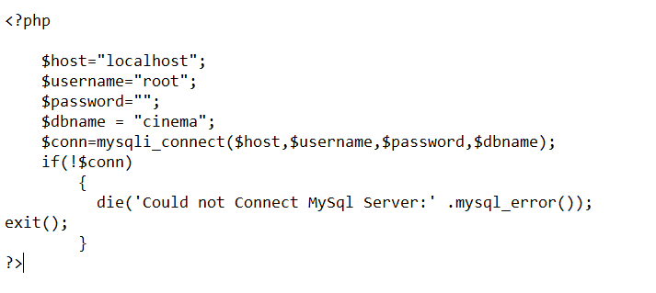
Methodology
Connecting to the database in PHP
In this step, we will create a file name
“cinema.php” and save it in the www
directory and update the below code
into the file. The below code is used to
create a MySQL database connection
in PHP. When we fetch, insert, update
or delete data from MySQL database,
there we will include this file.
Fig: PHP Code

Slide 9
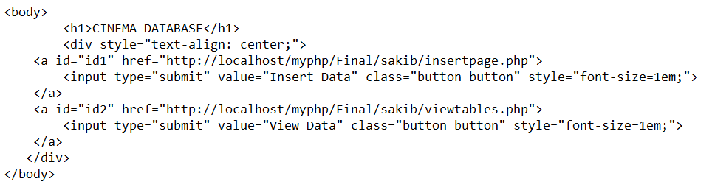
Methodology Cont.
Creating Homepage
We create a home page with two options Insert Data & View Data for inserting and viewing data in the page.

Slide 10
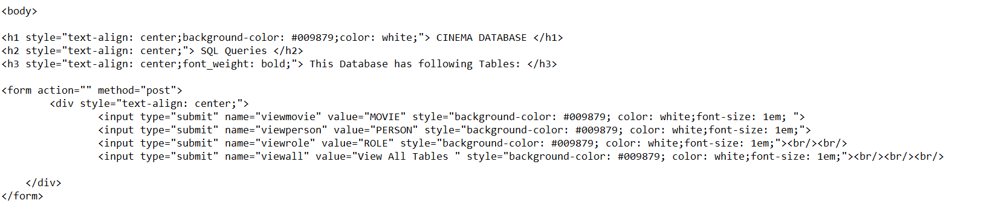
Methodology Cont.
Fetch data from the database and display in table
The below HTML code for creating table names where we can click to show table data:
Fig: PHP Code

Slide 11
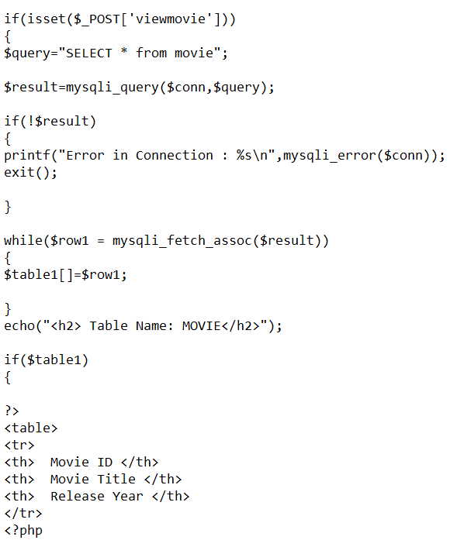
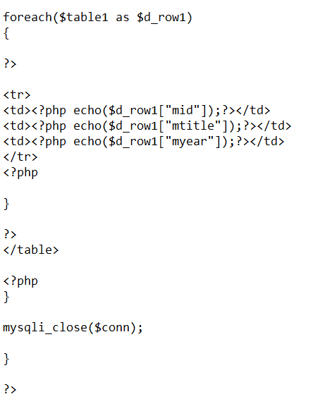
Methodology Cont.
Fetch data from MOVIE table
In the webpage there will be four option, one of these is movie option that will show the table of movie of cinema database.
This code is to show the
“MOVIE” table only.
Fig: PHP Code

Slide 12
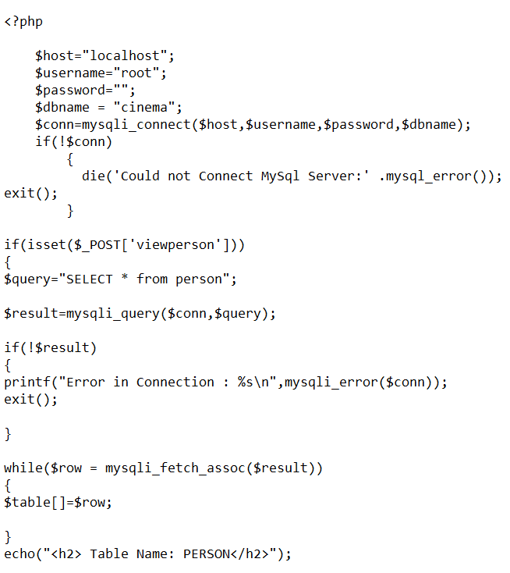
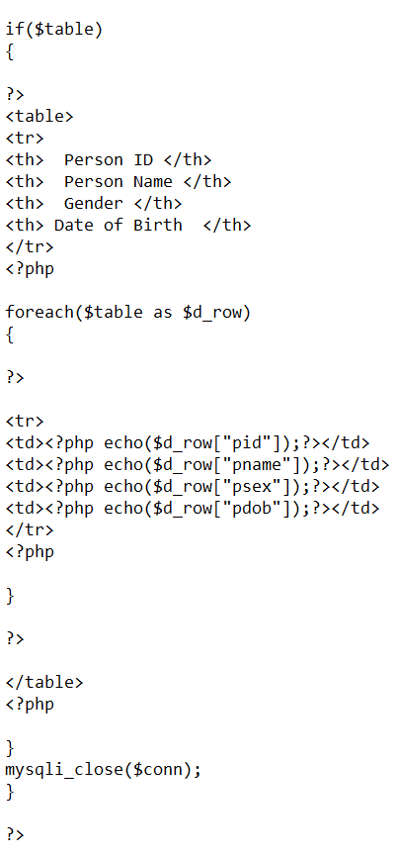
Methodology Cont.
Fetch data from PERSON table
The 2nd option will be PERSON option that will show the table of person of cinema database.
This code is to show the
“PERSON” table only.
Fig: PHP Code
Fig: PHP Code

Slide 13
Methodology Cont.
Fetch data from ROLE table
The 3rd option will be PERSON option that will show the table of role of cinema database.
This code is to show the
“ROLE” table only.
Fig: PHP Code
Fig: PHP Code

Slide 14
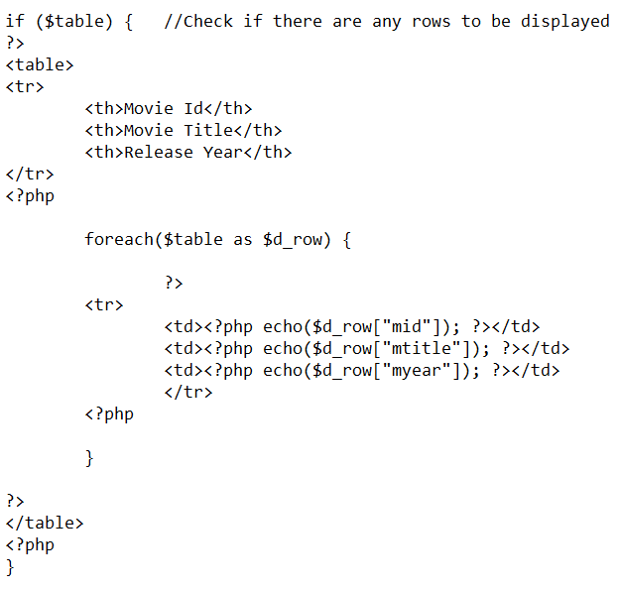
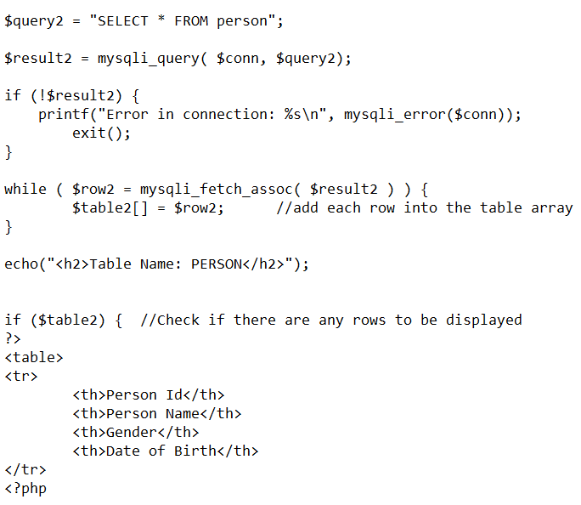
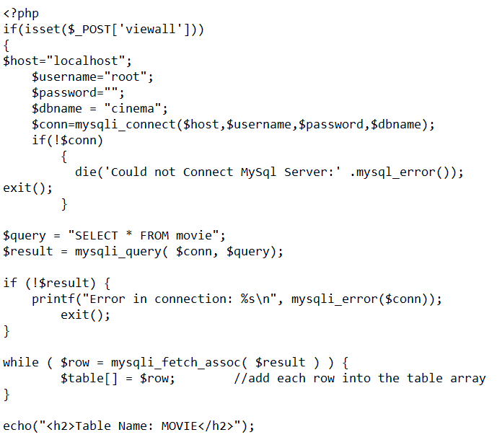
Methodology Cont.
Fetch data from All tables
The 4th option will be VIEWALL option that will show all table of cinema database. This code is for showing All the Tables together:
Fig: PHP Code

Slide 15
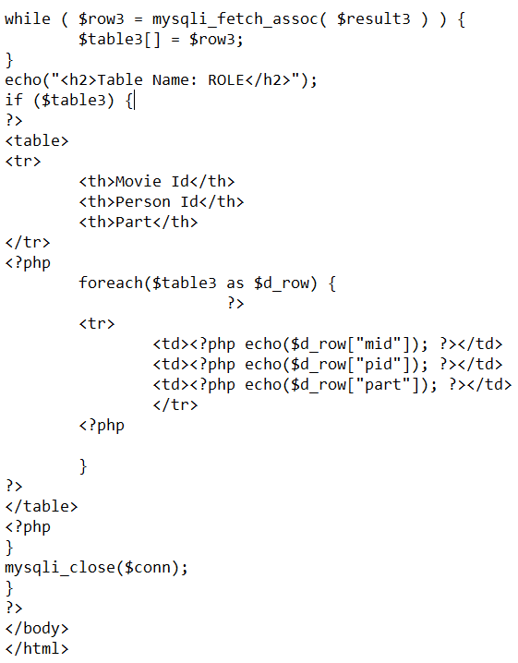
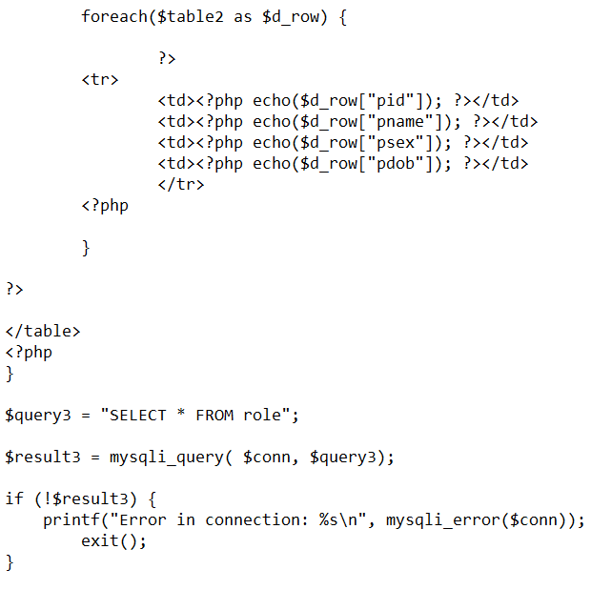
Methodology Cont.
Fetch data from All tables
Fig: PHP Code

Slide 16
Result and Discussion
4

Slide 17
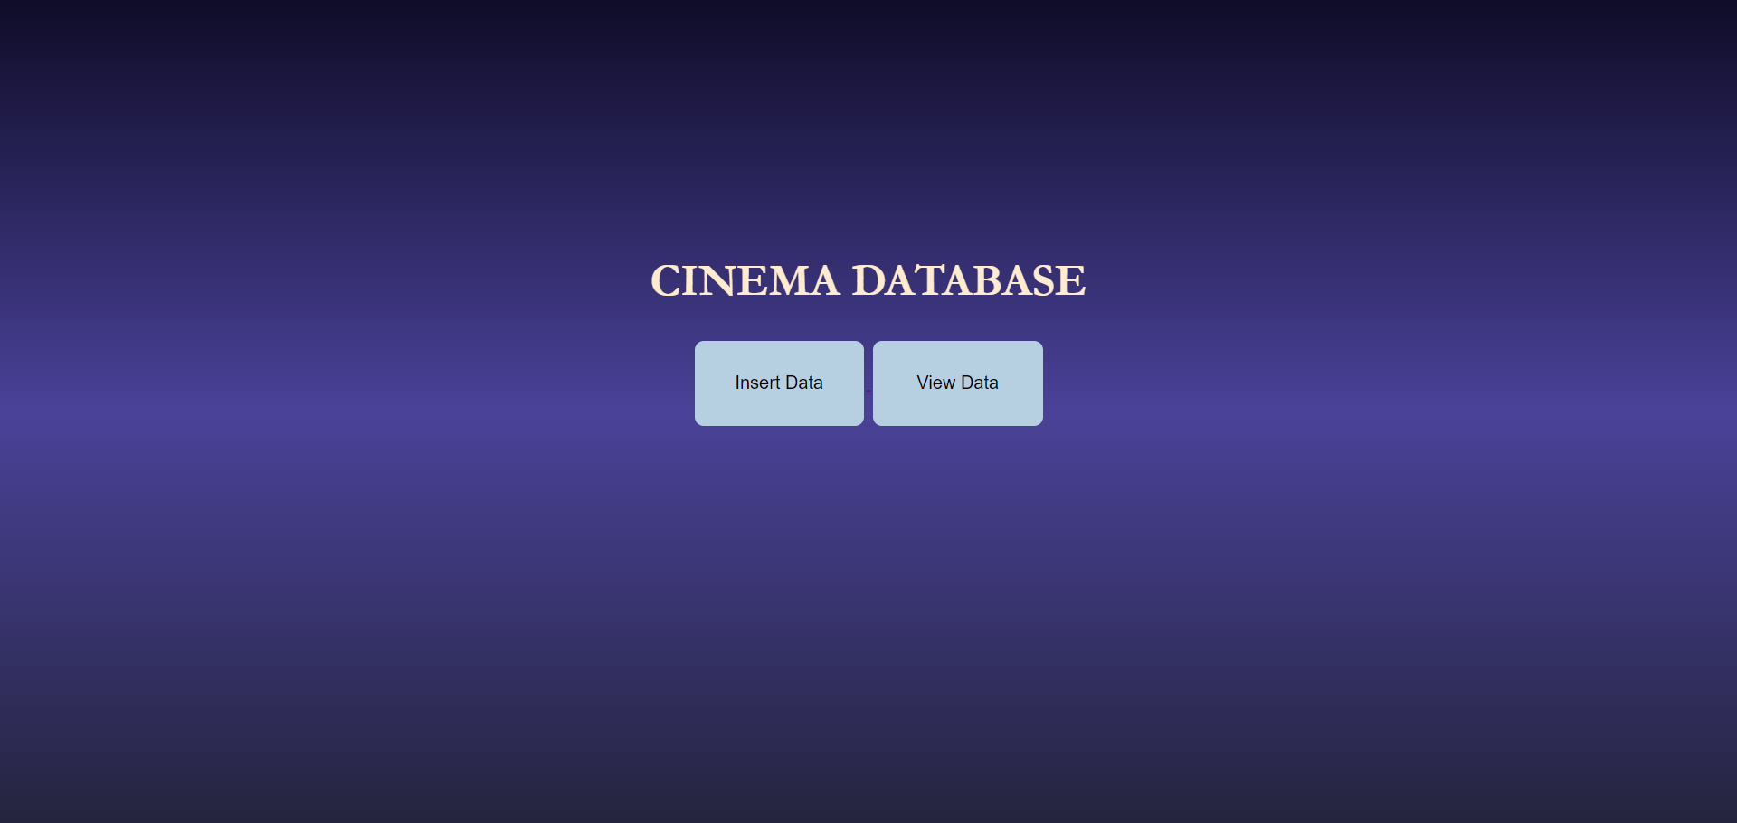
Result and Discussion
1
This is our Home page:
Fig: Home Page View

Slide 18
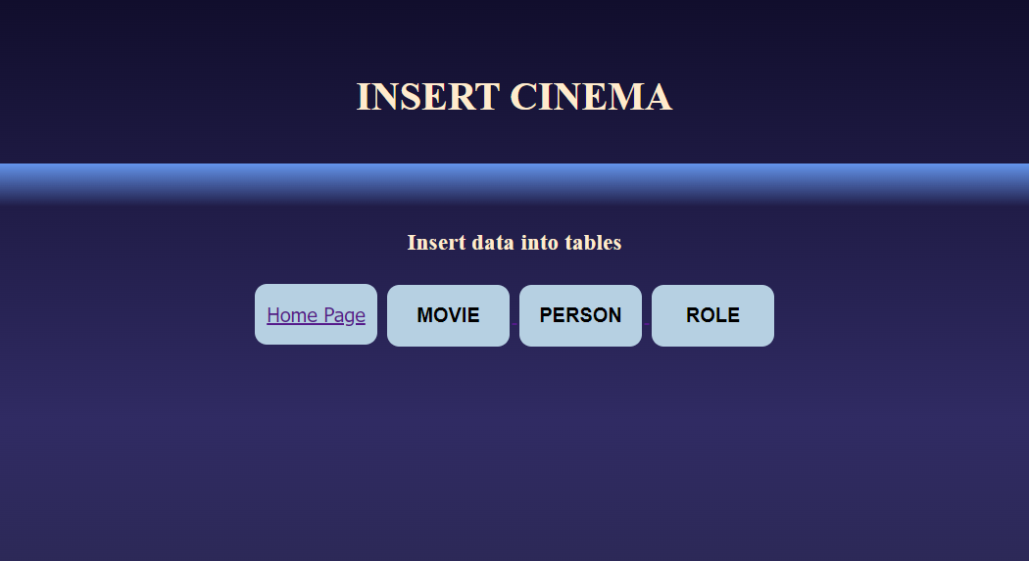
Result and Discussion Cont.
2
Insert Cinema page:
Fig: Insert Page

Slide 19
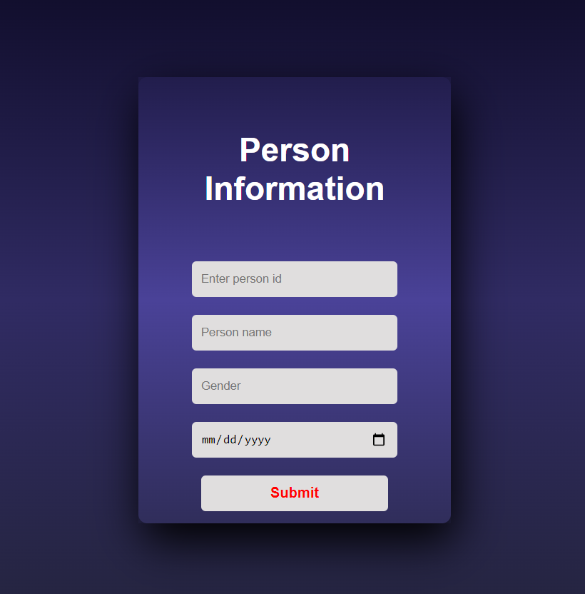
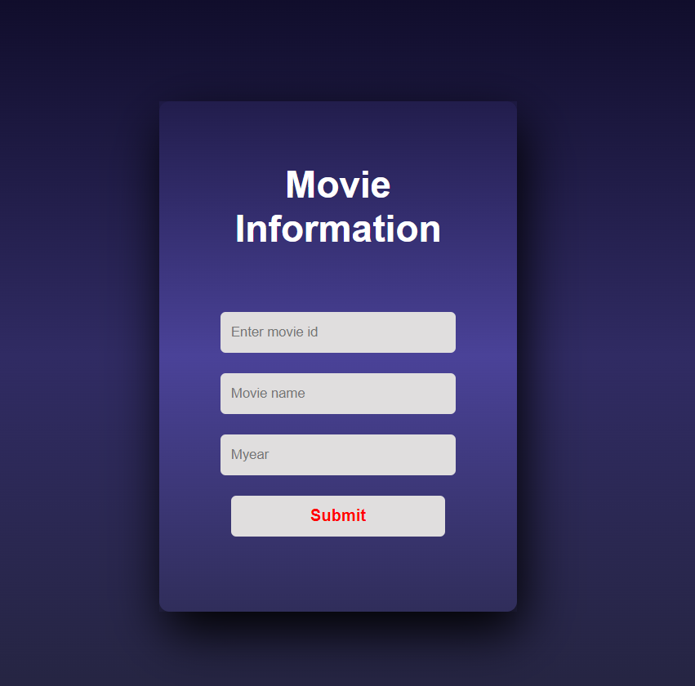
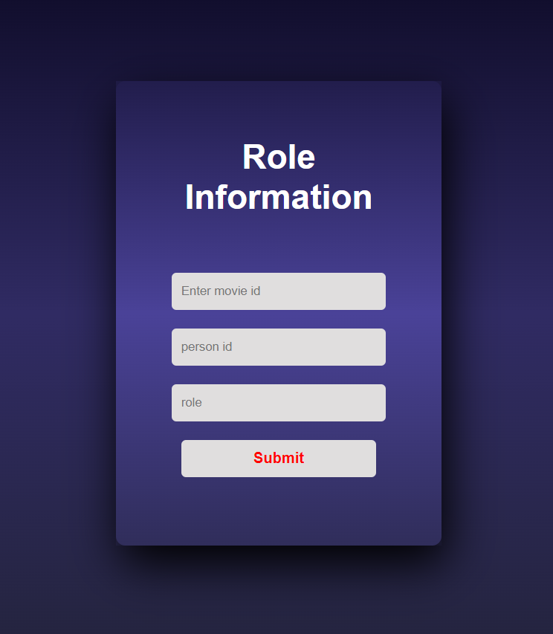
Methodology Cont.
3
Form page:
Fig: Forms for inserting data

Slide 20
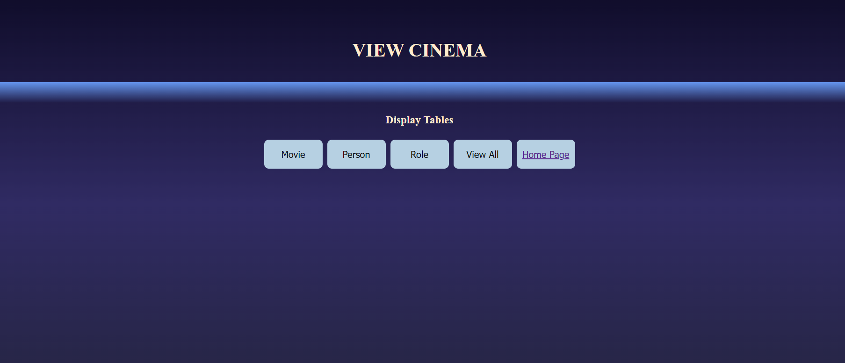
Methodology Cont.
4
View page:
Fig: Webpage View

Slide 21
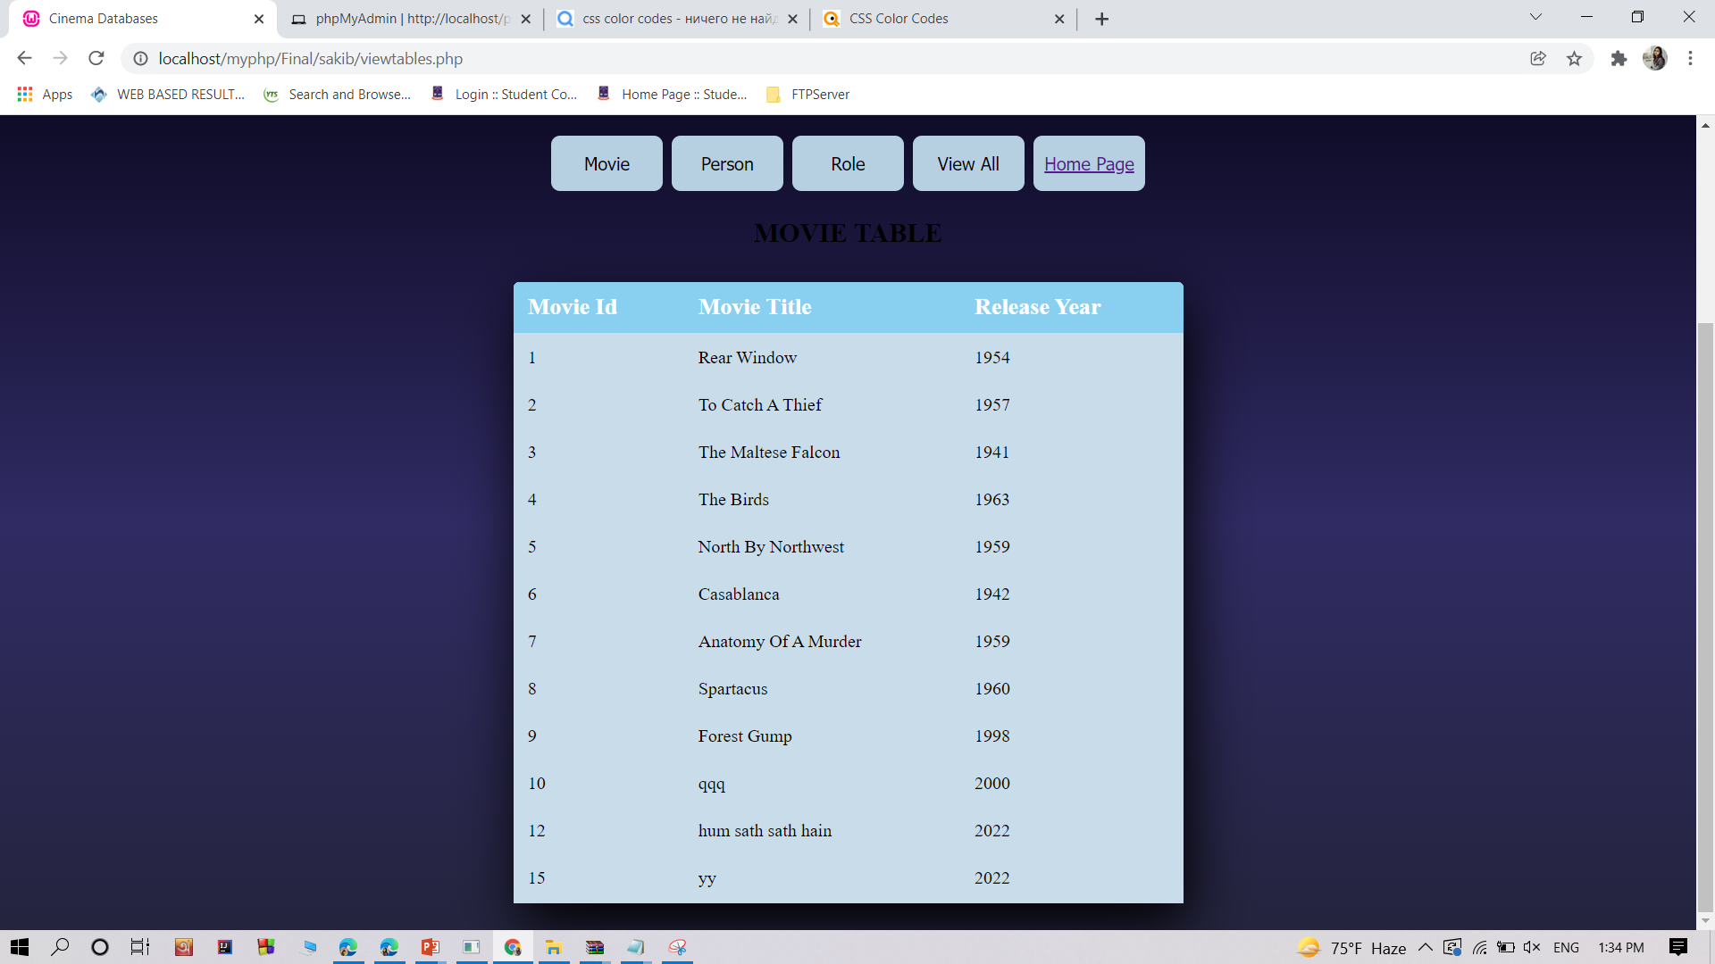
Result and Discussion Cont.
5
MOVIE Table page:
Fig: Movie Table

Slide 22
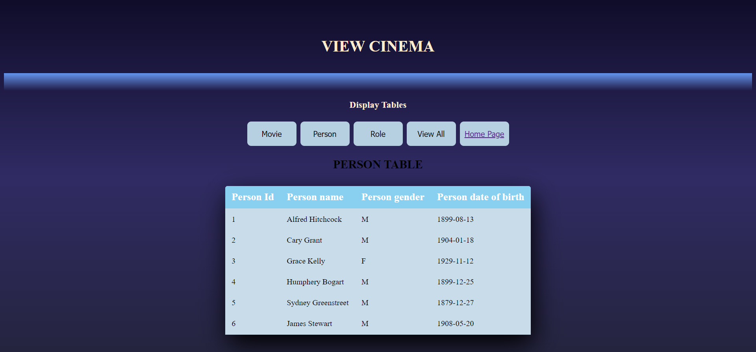
Result and Discussion Cont.
6
PERSON Table page:
Fig: Person Table

Slide 23
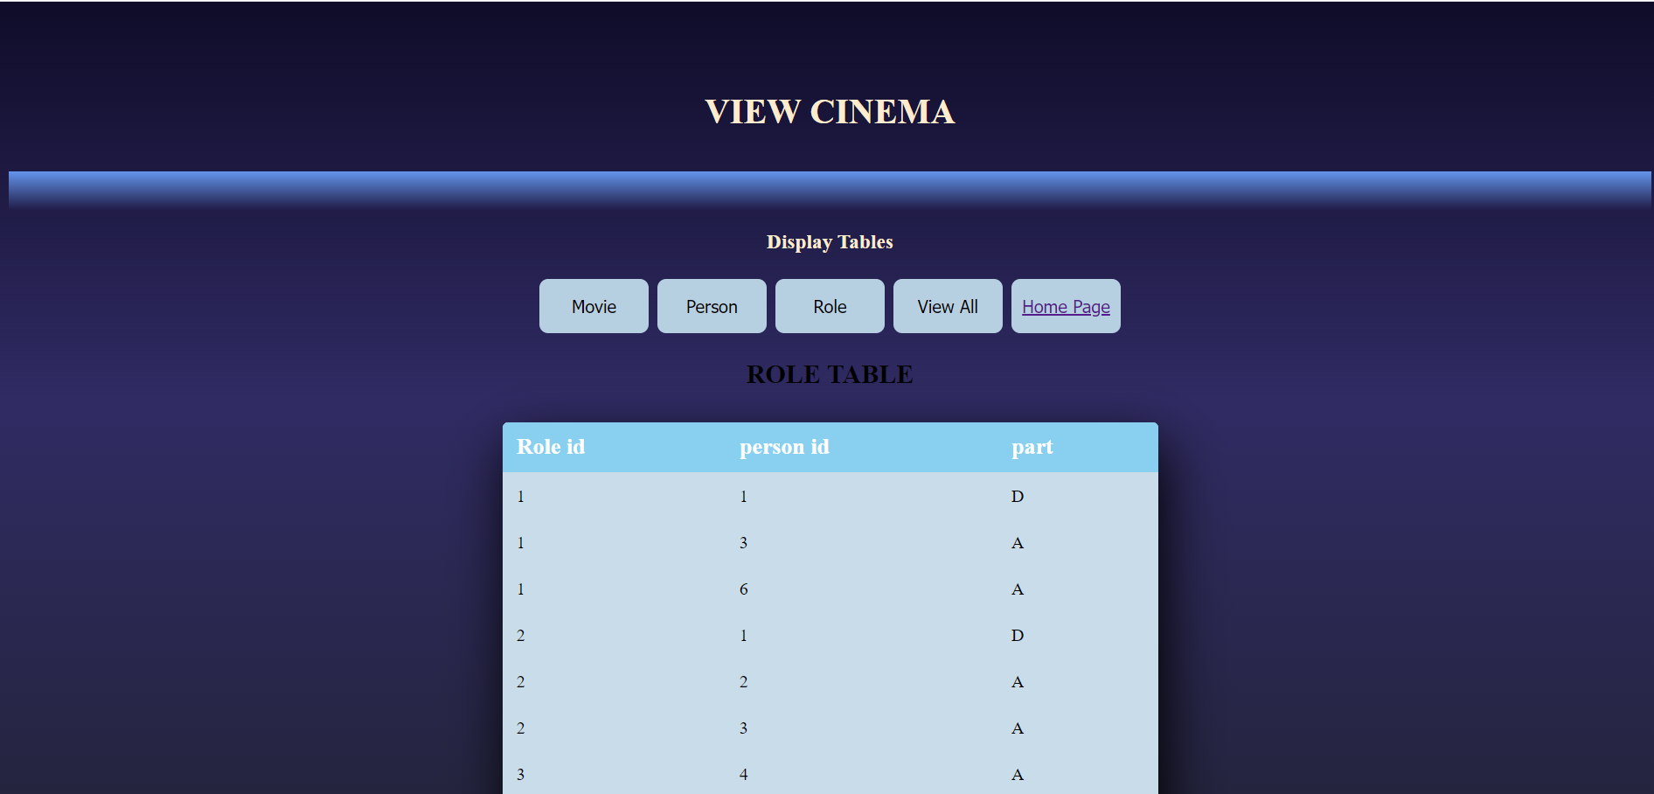
Result and Discussion Cont.
7
ROLE Table page:
Fig: Role Table

Slide 24
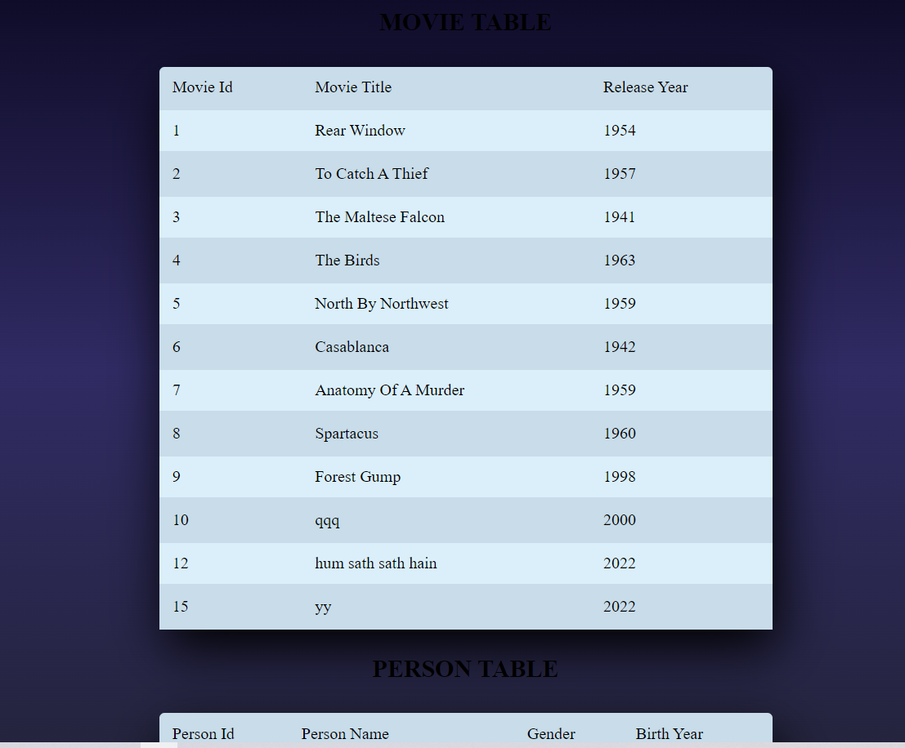
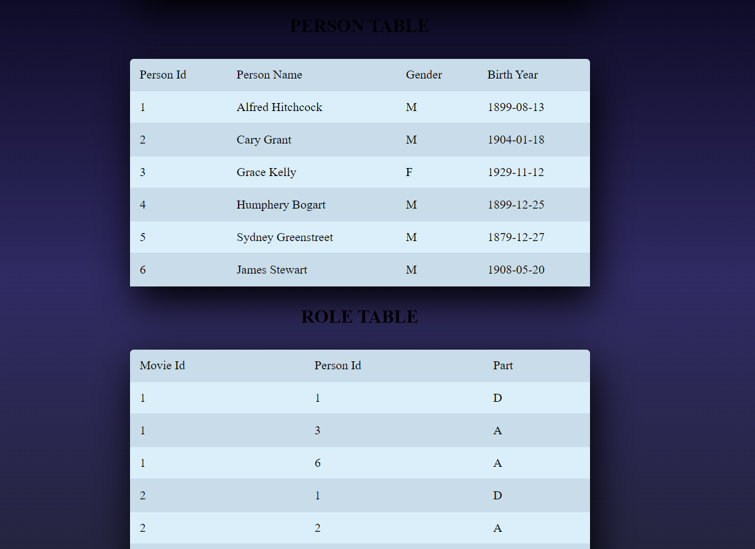
Result and Discussion Cont.
8
All Table page:
Fig: All Tables

Slide 25
5
Conclusion

Slide 26
Conclusion
Very often we will need to use a MySQL table to store data inside it and then output that data by using a PHP script. To display the table data it is best to use HTML, which upon filling in some data on the page invokes a PHP script which will update the MySQL table.
So here we have learned how to insert data ,fetch and display data in an HTML table using PHP MySQL.
MySQL
HTML
PHP

Slide 27
THANK YOU !

