Slide 1
CTEC 2712 Web Application Development
Introduction to Human Computer Interaction

Slide 2
Acknowledgements
Some slides originated in
Lectures developed by Howell Istance
Lectures developed by John Burns
Supporting PowerPoint materials for Interaction Design by Sharp, Preece and Rogers
Examples of bad designs courtesy of www.baddesigns.com

Slide 3
Designing as if people mattered
“We must design for the way people behave, not for how we would wish them to behave.”
— Donald A. Norman

Slide 4
Human Computer Interaction
What happens when humans interact with computers
How can we design usable interactive systems?
How can we design for a good user experience?
Not just usability
Not just hardware and software

Slide 5
Interactive Systems
Things (including virtual things inside computers) that
People use for some purpose
People interact with directly
Do things in response to user inputs
Usually (nowadays) computerized
Relationship between inputs and outputs programmed
Mapping between inputs and outputs can be whatever the programmer wants
Inputs, outputs and behaviour, and the relationship between them need to be actively designed

Slide 6
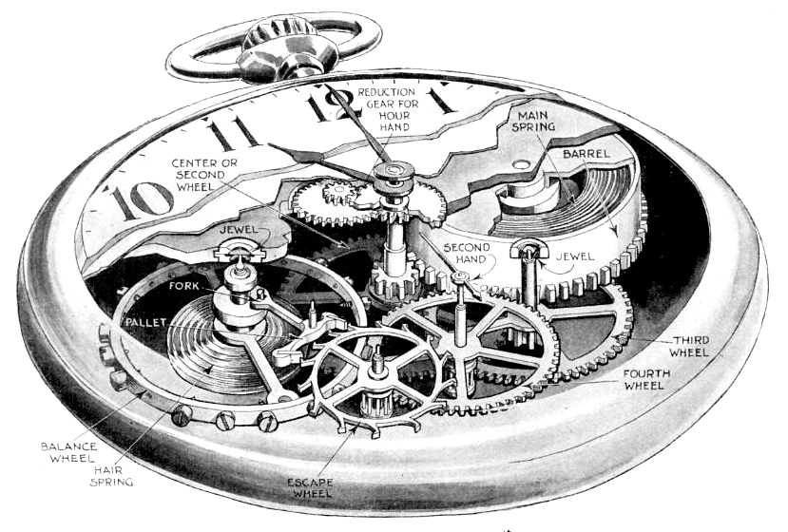

Mechanical or programmed?

Slide 7
Interactive Systems
MS Word
Tetris
Fortnite
iPhone
Dishwasher
DVD remote
Windows Control Panel
Boeing 737 Max cockpit
Nintendo Wii
Microwave oven
Car
Second Life
Coffee maker
Toy helicopter
Nuclear power station
control room
Ship-borne radar
Amazon website
MS PowerPoint
...

Slide 8
User Interface
Interactive systems have user interfaces
Shape
Feel
Controls
Information displays
Behaviour
Includes help facility, user manuals, etc
What the user sees
What the user manipulates
Determines how the user thinks the system works
Doesn’t necessarily show how the system really works

Slide 9
User Interface
Any boundary between the human user and the computer system
Not restricted to screens, keyboards and mice
Includes documentation and training material

Slide 10
Design
Interactive systems need to be designed to be usable
Being capable of doing something isn’t enough
But what does it mean for a system to be usable?
‘Easy to use’ isn’t good enough
Fast, safe, easy to understand, easy to remember, few errors, enjoyable...
... Still too crude
What do you really care about getting right?
Which task? Which users? Which environment?
Essential to understand real usability requirements

Slide 11
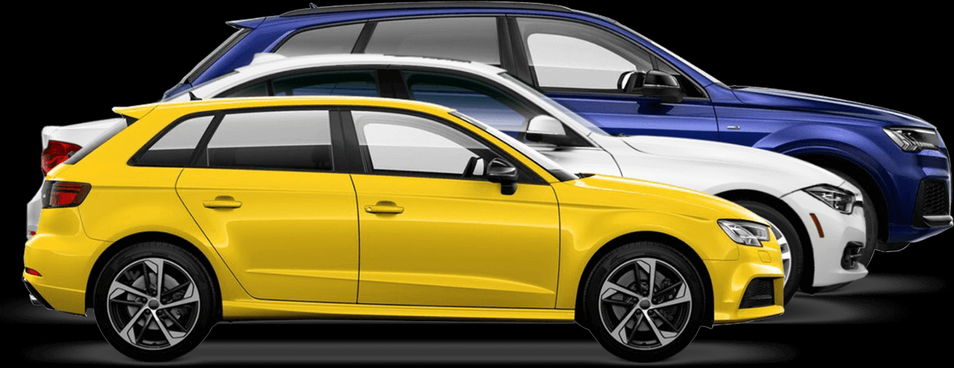
Some interactive systems

Slide 12
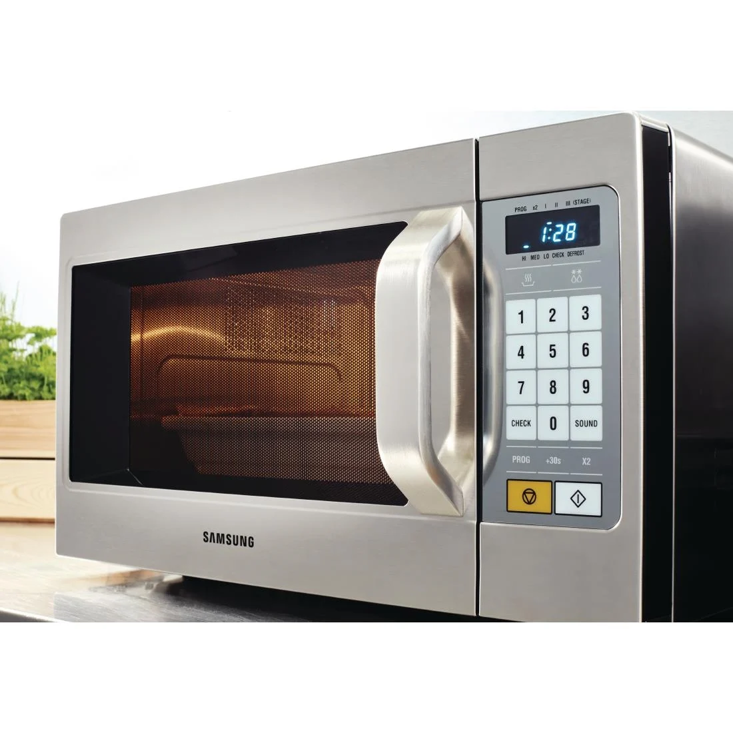
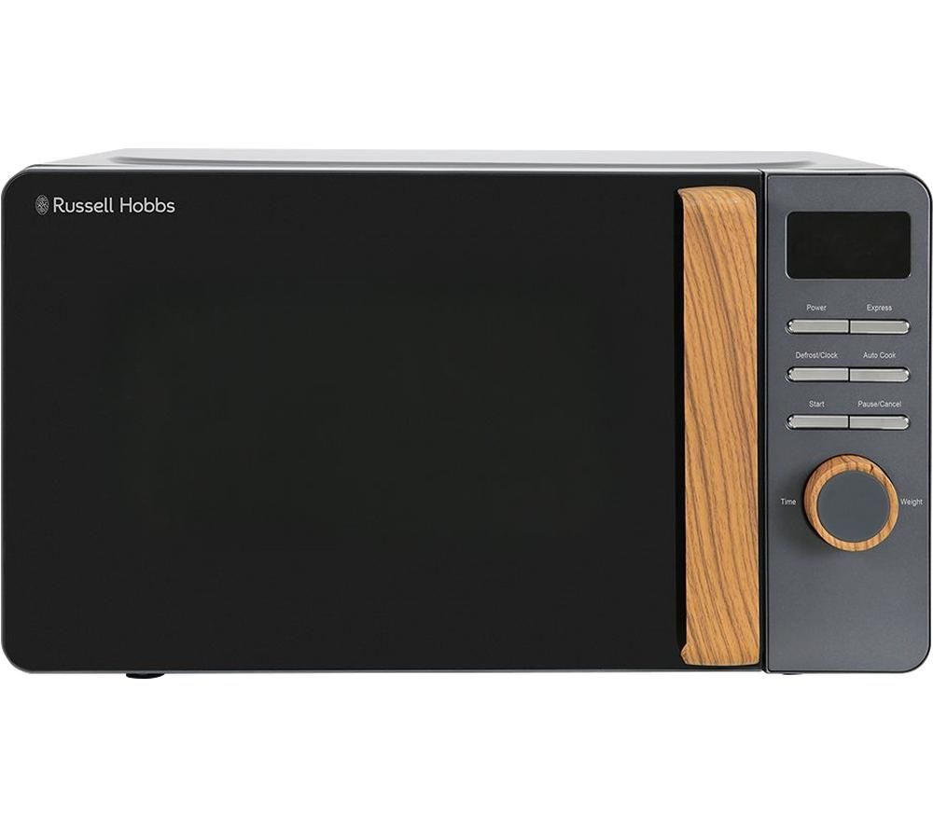
Some other interactive systems

Slide 13
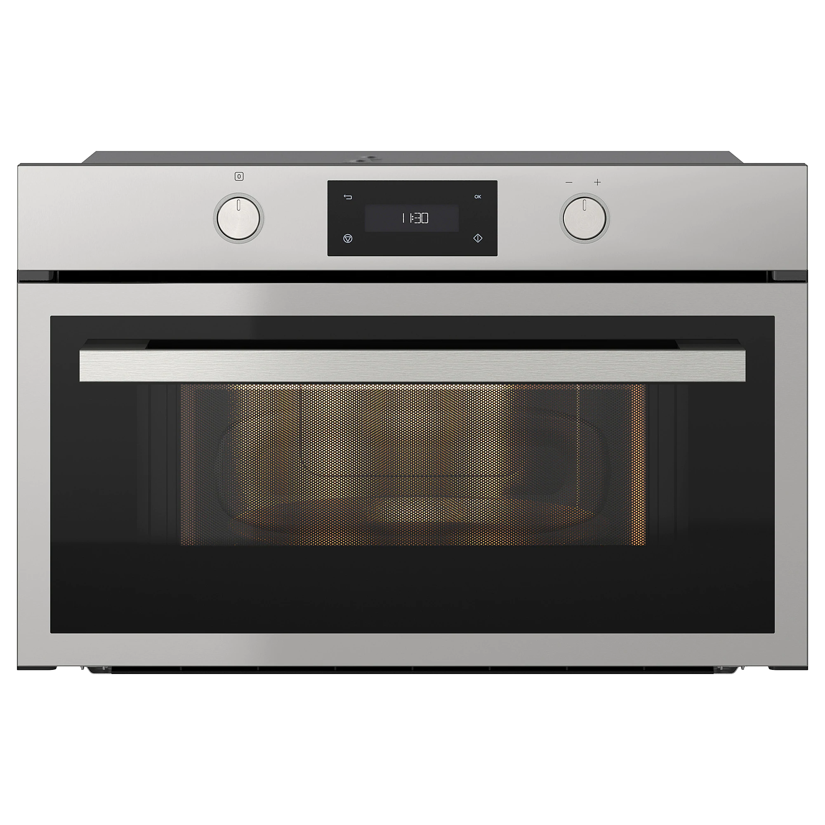
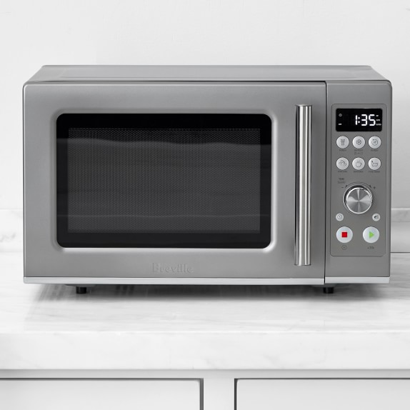
Some more interactive systems

Slide 14
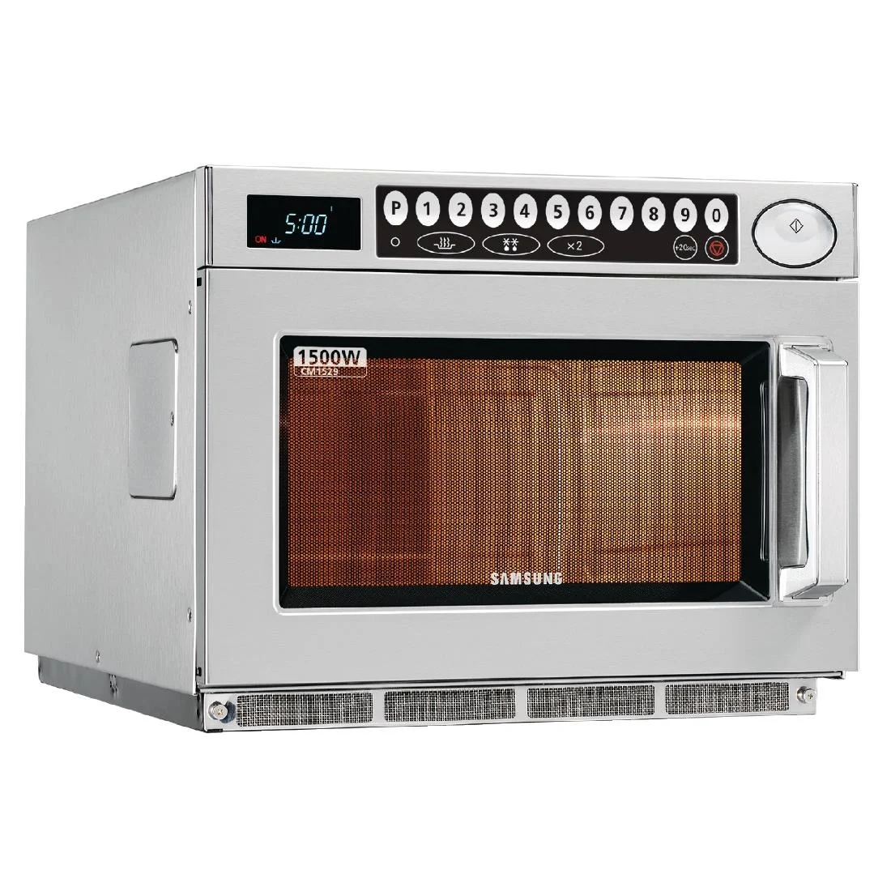
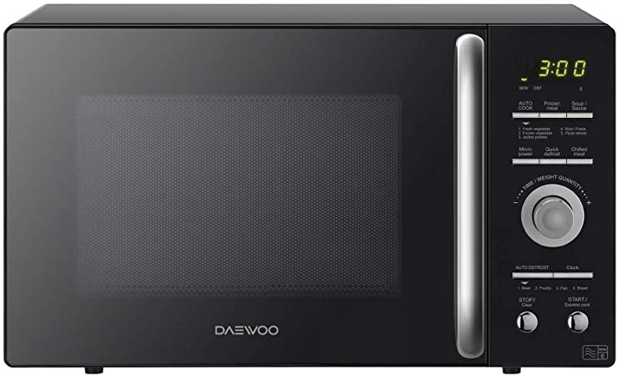
Some more interactive systems

Slide 15
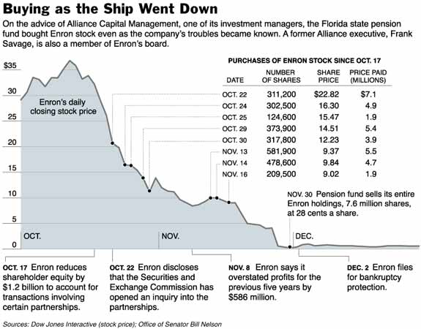
Non-interactive systems
People use static displays of information (what for? how?)
Information displays are often important components of interactive systems
Many of the same design principles apply
Take information design seriously!

Slide 16
Getting it right
You need to consider
Users
Tasks
Environments
General principles of good design
Lots of different aspects of usability
Priorities and trade-offs between usability goals

Slide 17
Usability
Jakob Nielsen’s definition
“Usability is defined by 5 quality components:
Learnability: How easy is it for users to accomplish basic tasks the first time they encounter the design?
Efficiency: Once users have learned the design, how quickly can they perform tasks?
Memorability: When users return to the design after a period of not using it, how easily can they reestablish proficiency?
Errors: How many errors do users make, how severe are these errors, and how easily can they recover from the errors?
Satisfaction: How pleasant is it to use the design?”
http://www.nngroup.com/articles/usability-101-introduction-to-usability/

Slide 18
User Experience (UX)
Not just user interface design....
Usability is central
But more to it than having a usable system: all aspects of what it’s like to interact with the system
Don Norman’s definition
"User experience" encompasses all aspects of the end-user's interaction with the company, its services, and its products. The first requirement for an exemplary user experience is to meet the exact needs of the customer, without fuss or bother. Next comes simplicity and elegance that produce products that are a joy to own, a joy to use. True user experience goes far beyond giving customers what they say they want, or providing checklist features.

Slide 19
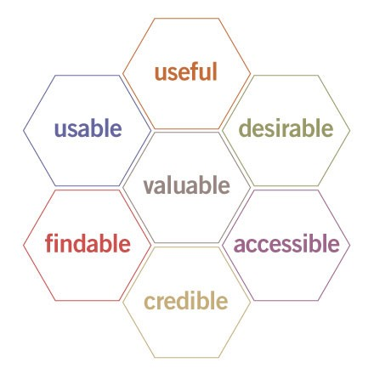
Aspects of user experience
Peter Morville’s honeycomb
Valuable
Useful
Usable
Findable
Desirable
Accessible
Credible
What are your priorities?
All these interact

Slide 20
Service Design
Designing whole of customer/client/user interaction with organization, as an integrated whole
Across services and client needs
Buying, advice, problem handling, information seeking, etc
Across modes
In person, by phone, web on smartphone, web on desktop, by letter, etc
Across contributors
People, computer systems, paper, physical environments
Service design is now a recognised design discipline

Slide 21
Service design
Think big!
Think about the whole of the user’s interaction with the organization
If your organization is providing a service, design the entire service, including problem handling
Also...
If you are designing people’s jobs, think about what your design choices entail for them

Slide 22
Evaluation
Designing usable systems is hard
User interfaces likely to have lots of mistakes
Spotting the mistakes is hard
So, we need to evaluate prototypes and running systems
How well do they work?
Do they have unexpected usability problems?
Do they reveal additional user requirements?
Do they create new possibilities?
Evaluation is essential part of development process

Slide 23
If you get it wrong...
System that may ‘work’ but be
Slow
Difficult to control
Confusing
Induce lots of mistakes
Dangerous
Frustrating
...
Not usable by real people in practice

Slide 24
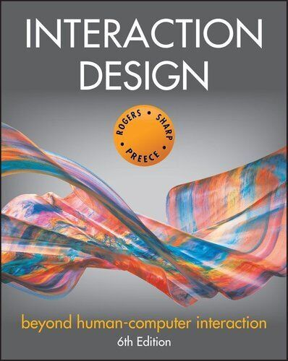
Reading
Chapter 1 of Rogers, Sharp, Preece, Interaction Design
Martin Stacey’s incomplete list of usability factors (on Blackboard)

Slide 25
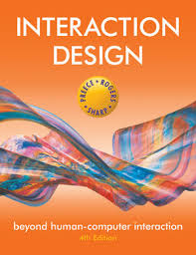
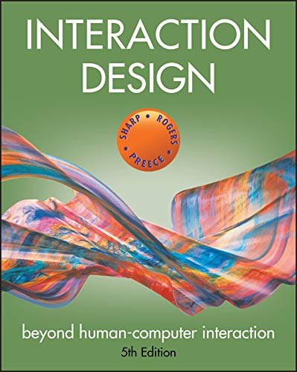
Our preferred HCI textbook
Yvonne Rogers
Helen Sharp
Jenny Preece
Interaction Design, 6th ed
Wiley, 2023
ISBN ‎ 978-1119901099

Slide 26
Web Resources
Nielsen Norman Group articles
https://www.nngroup.com/articles/
UX Matters
https://www.uxmatters.com/
Interaction Design Foundation
https://www.interaction-design.org/literature

Slide 27
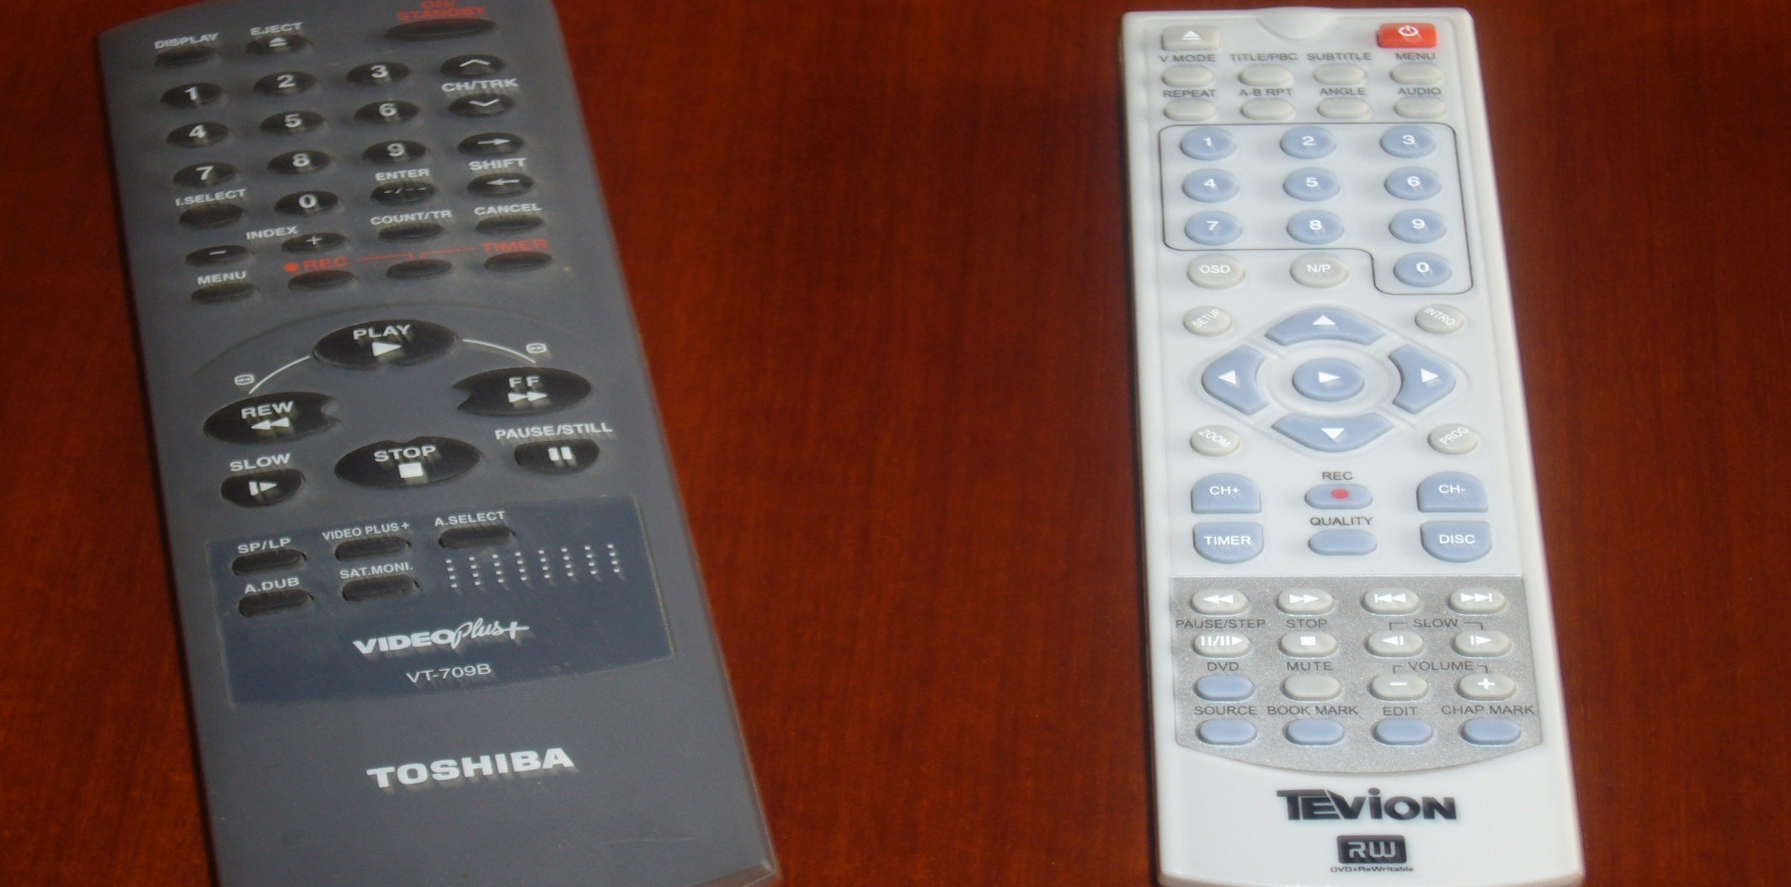
Not the easiest, either

Slide 28
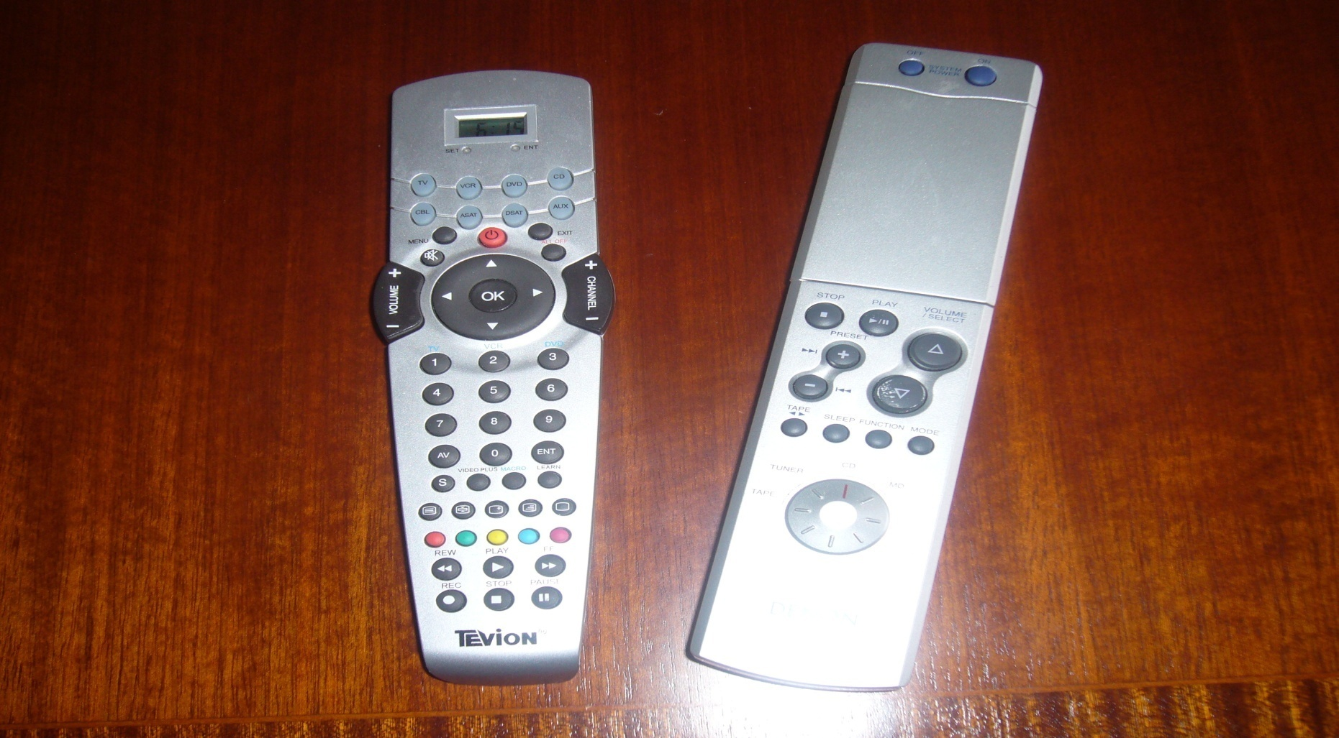
Nor the most standardized

Slide 29
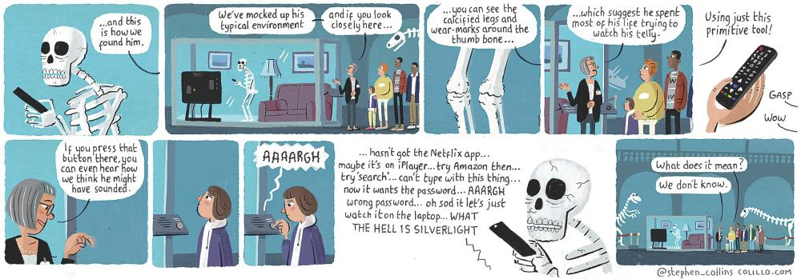
Hominid computer interaction

Slide 30
