Slide 1
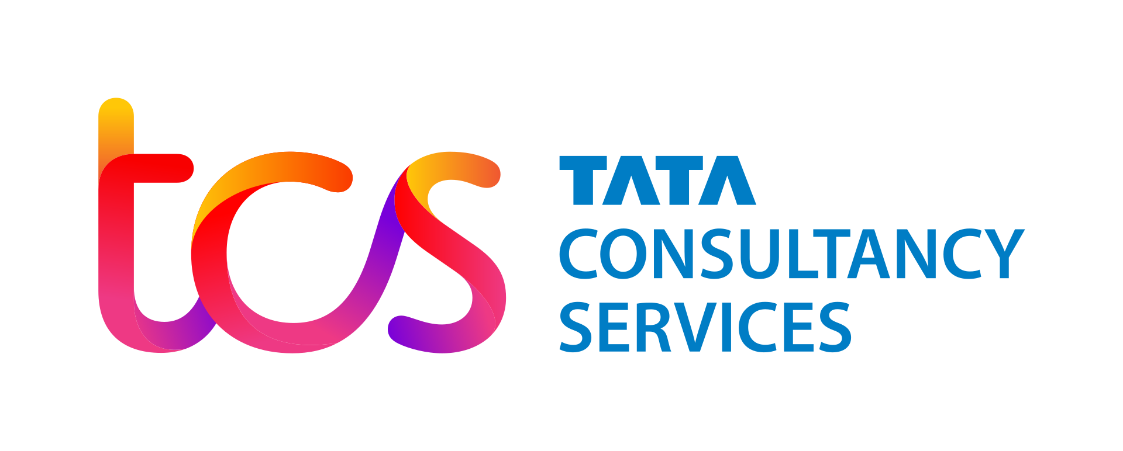
Internship Showcase
Learning Journey and Practical work across 3 projects
By Asmi Shirke Samant
Tata Consultancy Services Data Science Intern
01

Slide 2




INTRODUCTION & LEARNING SUMMARY
Building a Foundation in Supervised Learning
01
02
03
Iris Dataset
Practical Learning
Final Deliverable
1) Classification fundamentals
2) Pipelines
3) Cross-validation, Splitting, etc
1) Kaggle loan dataset cleaning
2) Exploratory Data Analysis
3) Modelling on real-world data
Bank Term Deposit Subscription Propensity Model
CORE CONCEPTS APPLIED
Train/test splitting & stratified cross-validation
Classification algorithms: Logistic Regression, Decision Trees, Random Forest, XGBoost, KNN, SVM, Naive Bayes
Preprocessing pipelines: scaling, power transforms, one-hot encoding
Evaluation beyond accuracy: ROC-AUC, F1, precision/recall trade-offs
Feature engineering & feature importance interpretation
Handling class imbalance and outlier treatment
02

Slide 3
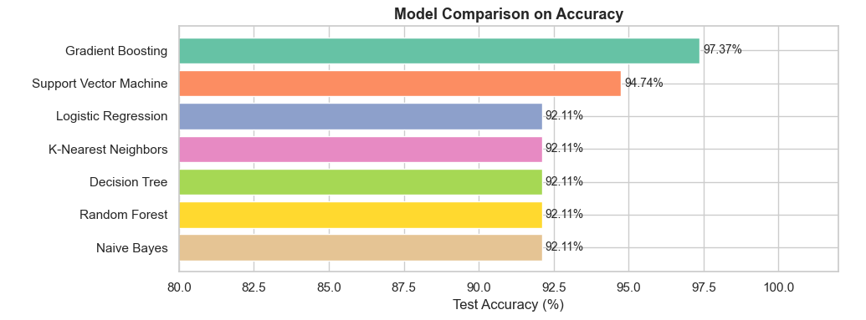
INTRODUCTION & LEARNING SUMMARY
Project 1: Iris Dataset
MODEL COMPARISON ON ACCURACY
Classify the observations into 3 different orchid species based on sepal length, sepal width, petal length, and petal width.
150 samples, 4 features, 3 balanced flower species classes
7 classification models compared
Compared CV stability vs held-out test accuracy
03

Slide 4
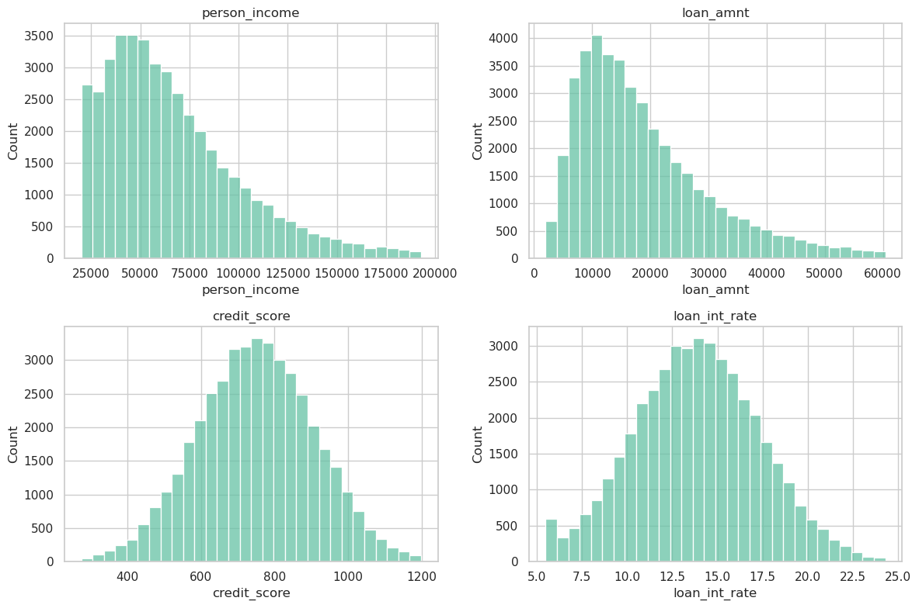
PRACTICAL LEARNING
Project 2: Loan Approval Prediction
FEATURE DISTRIBUTION
DATA CLEANING PIPELINE
2 part project: data cleaning pipeline & modelling.
45000 samples, 20 features, Binary classification
Cleaned messy, Real-life adjacent synthetic data
Model | CV Accuracy | F1
Logistic Regression | 70.10% | 0.70
Decision Tree (depth 5) | 69.68% | 0.69
Random Forest | 69.60% | 0.70
Baseline: Random Guessing | 51% | -
04

Slide 5
MAIN PROJECT
Propensity Modeling for
Marketing Campaigns
Predicting term deposit subscription for a Portuguese banking institution
05

Slide 6
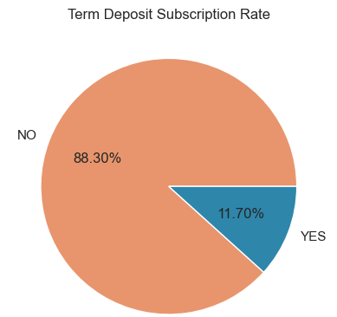
OVERVIEW
Objective
To build a Propensity model that predicts the likelihood of a bank customer subscribing to a term deposit, based on their demographic profile, financial standing, and direct marketing contact history to prioritize outreach efforts toward high-propensity customers.
Eligible Group
All existing retail banking customers who have been or can be contacted through the bank's direct marketing channels (phone/cellular) for a term deposit campaign.
Response Group
Customers who confirmed subscription to a term deposit product following direct marketing contact.
Dataset Overview
Observations | 45,211
Features | 17
Null values | 0
Duplicate values | 0
NOTE: ‘unknown’ is not considered null, since it has real business value
06

Slide 7
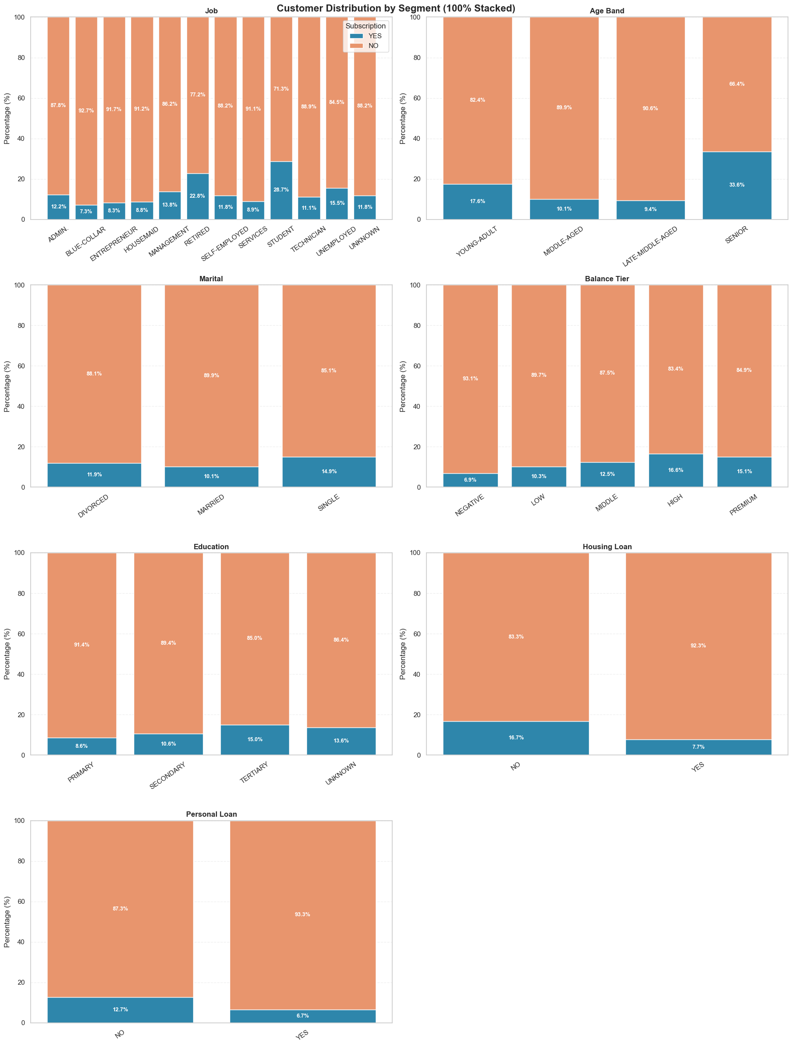
PROPENSITY MODELING
EDA Insights
Customer Demographics Distribution vs subscription rate
Age Band: Middle-aged are the majority but convert below baseline (10.1%).
Seniors and young adults have highest rates.
Job: Students and Retired have the highest subscription rates.
Blue-collar biggest source of wasted calls.
Balance Tier: Subscription rates are relatively consistent across tiers.
Marital: Single customers convert slightly better than married.
Housing/Personal Loan: Customers without housing or personal loan convert better.
07

Slide 8
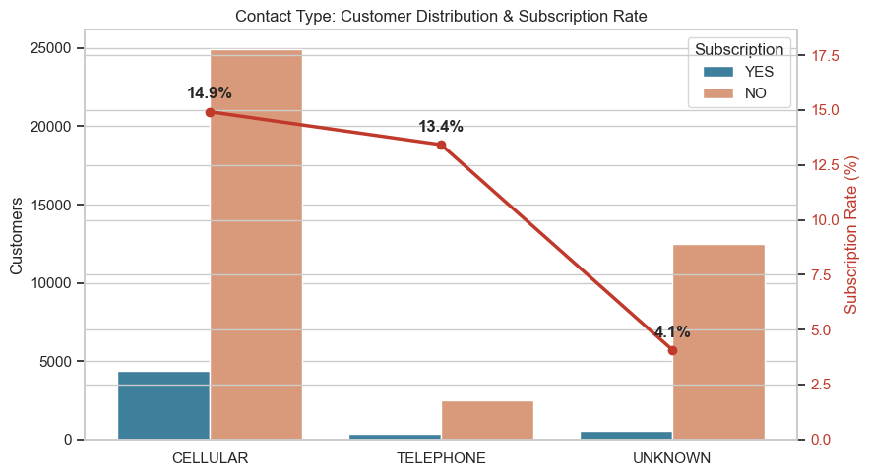
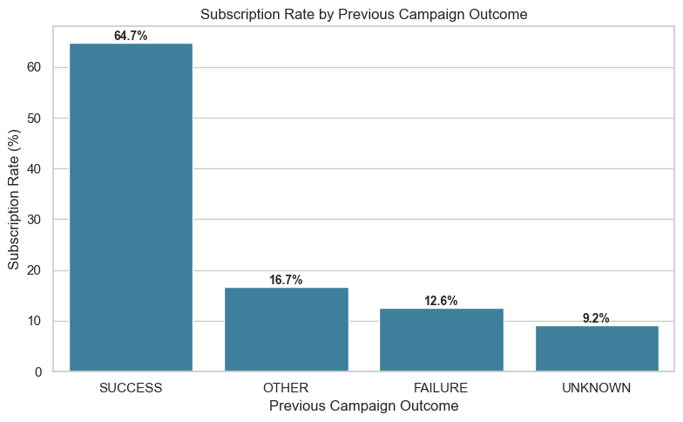
PROPENSITY MODELING — EDA INSIGHTS
Who Converts, and Through Which Channel
SUBSCRIPTION RATE BY CONTACT CHANNEL
CONVERSION RATE BY PREVIOUS CAMPAIGN OUTCOME
INFERENCE
A prior campaign subscriber is most likely to subscribe again (~65%).
Primary outreach channel: Cellular (14.9%)
Even an unknown prior outcome (first-time contact) outperforms a recorded failure, so failures should be the lowest priority, not unknowns.
"Unknown" contact customers likely self-initiated through mail or in-branch channels, making them warmer leads than cold telephone calls despite the modest rate.
08

Slide 9
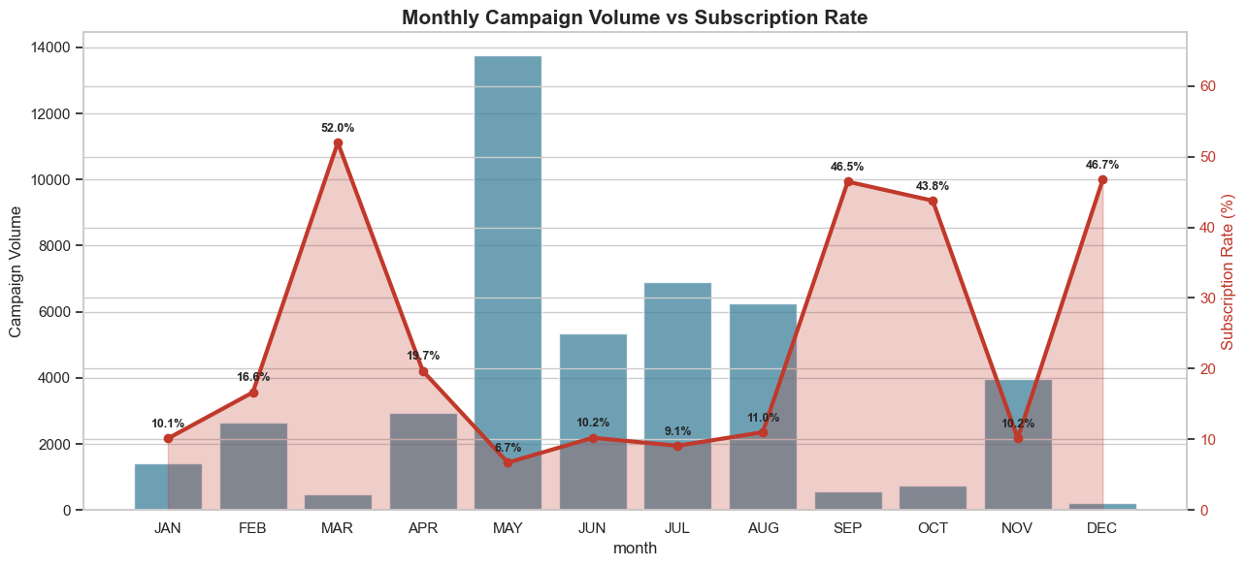
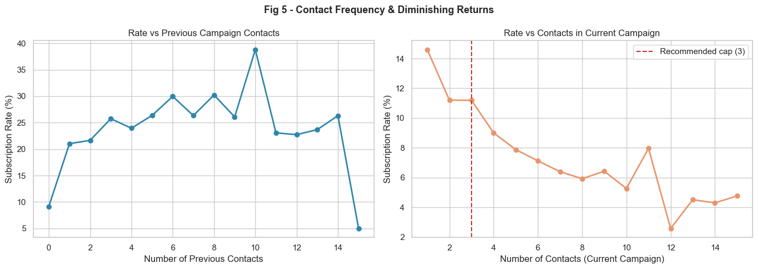
PROPENSITY MODELING — EDA INSIGHTS
When to Call, and How Many Times
CONVERSION RATE BY MONTH (SELECTED)
CONVERSION RATE VS. NUMBER OF CONTACTS
Number of calls
Max cap | 3
Min cap | 5
Beyond 10 attempts it approaches zero.
INFERENCES
Flag 4+ contact customers for suppression to protect budget and goodwill.
March, has the lowest call volume and the highest conversion rate (52.0%).
May has highest call volume but lowest conversion rates (6.7%).
Focus campaign efforts in Q1 and Q4.
09

Slide 10
MODEL DEVELOPMENT
Modelling And Evaluation
Algorithm | ROC-AUC | F1 | Precision | Recall
Logistic Regression (baseline) | 0.7466 | 0.3432 | 0.2347 | 0.6389
Random Forest | 0.770 | 0.410 | 0.2642 | 0.5885
XGBoost | 0.787 | 0.4100 | 0.4572 | 0.3718
Model Summary
Training Data size: 36,168
Testing Data Size: 9,043
Algorithms evaluated: XGBoost, Random Forest, Logistic Regression
Selected Model: XGBoost
INFERENCE
The champion model XGBoost leads on all three meaningful metrics [ROC-AUC (0.756), F1 (0.410), and precision (0.457)].
Lower recall (0.372) is an acceptable trade-off; the model is deliberately selective rather than exhaustive, prioritising call efficiency over total subscriber coverage.
Precision is the deciding factor for campaign use.
XGBoost flags fewer customers but about 1 in 2 actually subscribe. Logistic Regression and Random Forest flag more but only 1 in 4 converts.
Precision: among customers predicted to subscribe, how many actually subscribed.
Recall: among all customers who actually subscribed, how many the model identified.
10

Slide 11
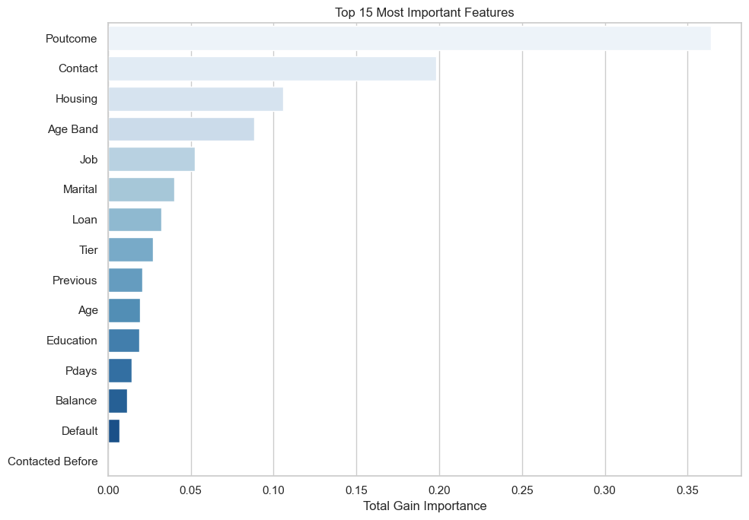
MODELLING
Feature Evaluation
TOP 15 FEATURES BY IMPORTANCE
INTERPRETATION
Poutcome dominates by a wide margin (~0.37 total gain)
Contact channel ranks (2nd): (~0.20) Unknown contact type signals self-initiated customer interest
Housing loan status (3rd): debt-free customers have more disposable savings
Age Band (4th): Seniors and Young Adults over-index, Middle-aged under-index
11

Slide 12
BUSINESS APPLICATION
Targeting Suggestions
CAMPAIGN EXECUTION TOP DECILES
HIGH-PRIORITY SEGMENT
Cellular · max 3 attempts · call immediately
57.6%
Tertiary-educated, often student or retired, contacted via cellular
HIGH PRIORITY
Top 10%
Previously contacted with a recorded campaign SUCCESS (30% of segment vs 3% baseline)
Cellular · max 2 attempts
14.2%
MEDIUM PRIORITY
No housing loan, no personal loan, financially unencumbered
Next 30%
Senior age band over-represented at 19.5% vs 3.9% baseline
LOW PRIORITY
Digital / mail only; no outbound calls
3.9%
Next 35%
4,521
~4,530
4.9×
customers in HIGH PRIORITY tier
estimated leads from top 2 deciles
(High + Medium, at observed rates)
lift over a blanket, untargeted campaign
(57.6% vs 11.7% base rate)
Bottom line: calling only the top 2 priority deciles (40% of the base) is projected to capture the large majority of likely subscribers — at a fraction of the calling effort of an untargeted campaign.
12

Slide 13
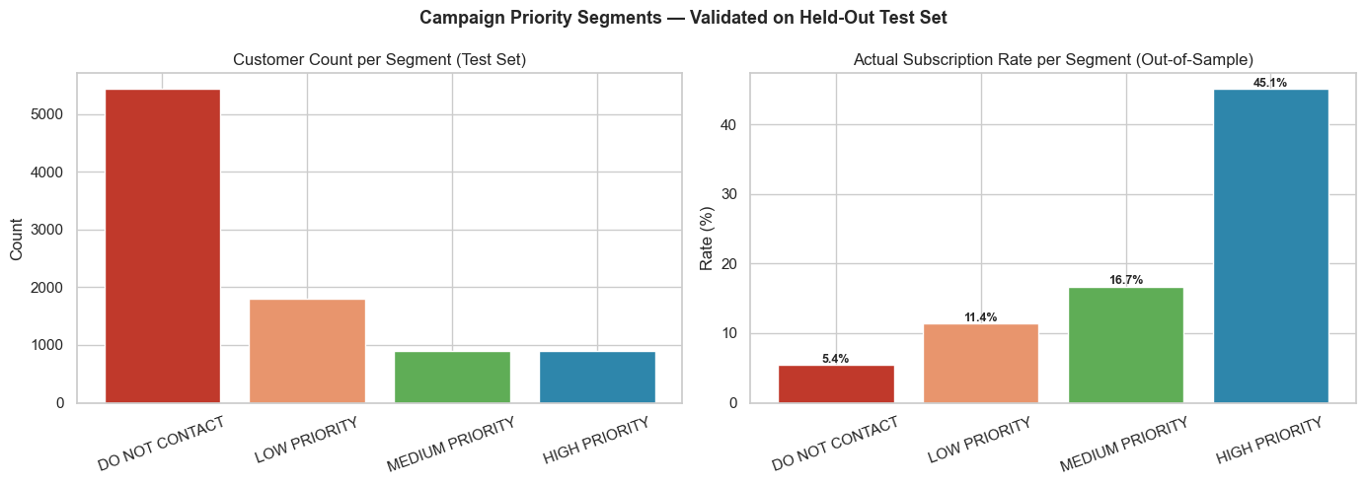
BUSINESS APPLICATION
Targeting Suggestions
CAMPAIGN EXECUTION TOP DECILES
HIGH-PRIORITY SEGMENT
Tertiary-educated, often student or retired, contacted via cellular
Previously contacted with a recorded campaign SUCCESS (30% of segment vs 3% baseline)
No housing loan, no personal loan, financially unencumbered
Senior age band over-represented at 19.5% vs 3.9% baseline
4,521
~4,530
4.9×
customers in HIGH PRIORITY tier
estimated leads from top 2 deciles
(High + Medium, at observed rates)
lift over a blanket, untargeted campaign
(57.6% vs 11.7% base rate)
Bottom line: calling only the top 2 priority deciles (40% of the base) is projected to capture the large majority of likely subscribers — at a fraction of the calling effort of an untargeted campaign.
13

Slide 14
THANK YOU
14

