Slide 1
Git Commands

Slide 2
Git
Git is a distributed version control system used for source code management.
Git used to track changes in the source code.
Allows multiple developers to work together.
Git is a software tool and git hub is a services.
In git hub ,it uses graphical interface to store the files were as in git ,It provides command line to interact with files.

Slide 3
Git commands
git --version : Shows the version number of the git that is installed.
git config --global user.name “username” : identity configuration
git config --global email.name ”email ID” : email configuration
git config --global core.editor “code --wait”: setting up the editor
git config --global –e :Edit global config from editor
git init : Initialized Empty Git Repository.
git add. : Everything in a project is added to the index.
git add <filename> : The corresponding file is added to the index.

Slide 4
Git commands
git commit -m “msg” : the project is placed into the Repository.
git commit -a : adding and commiting files
git remote add origin url: to add files to remote repository,
git log : shows the information about the file such as commit Id ,Author, Date of file created.
git log 1: it returns only last staged file.
git log --oneline : list the information of all the file in one line.
git log --s: get more information about the file.
git status : shows the state of working directory and the staging area.

Slide 5
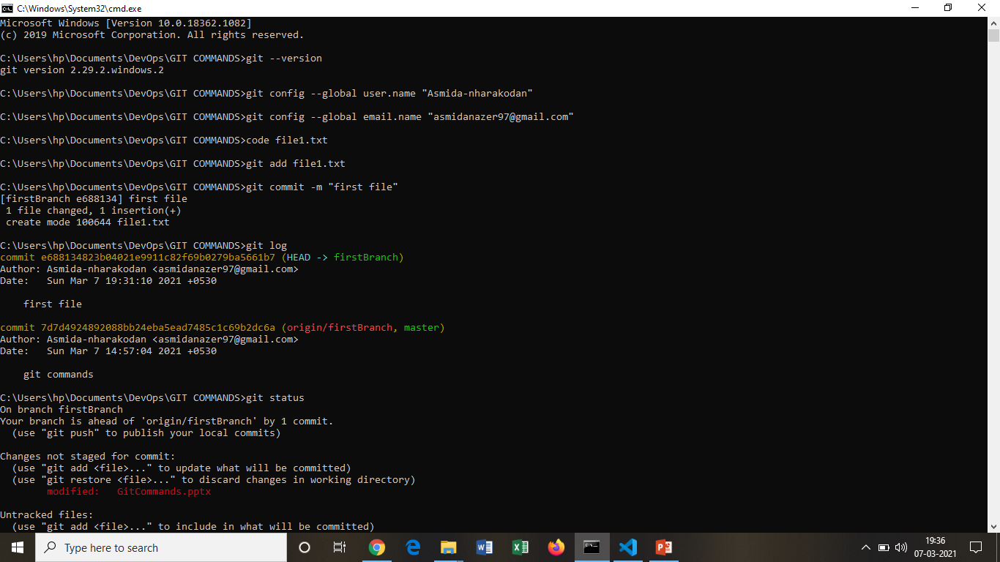
Git version, add, commit, status commands

Slide 6
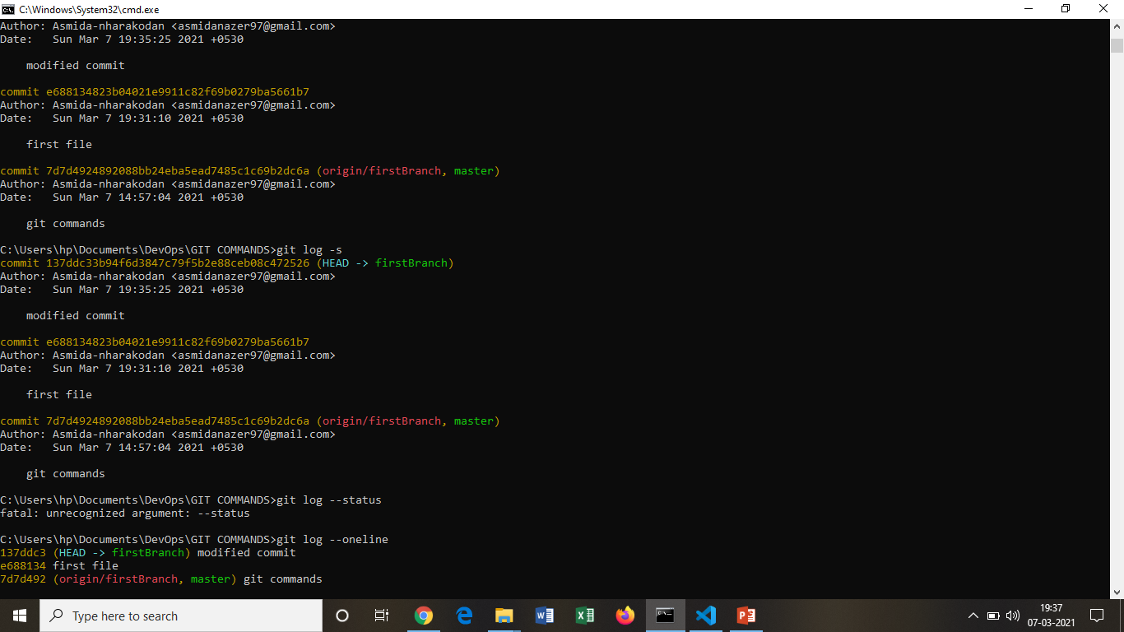

Slide 7
Git commands
git diff : track the difference between the changes made on a file.
git diff --staged: To check the already staged changes
git rm file name: remove the file
git rm --cached filename: Remove file from staged not from the local directory.
git restore : to restore the file
git restore <file name>
Branching:
git checkout –b <branch name>: create a new branch
git checkout <branch name>: to navigate between the branches and master.
git push origin <branch name> / git push –u origin <branch name> : push branch to Remote repo

Slide 8
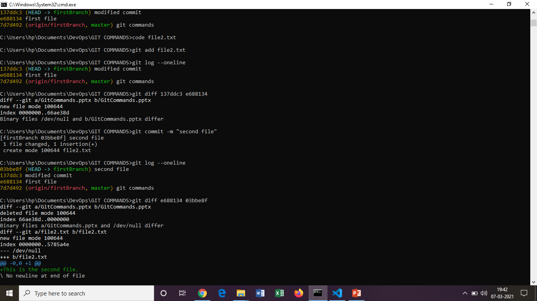
diff command

Slide 9
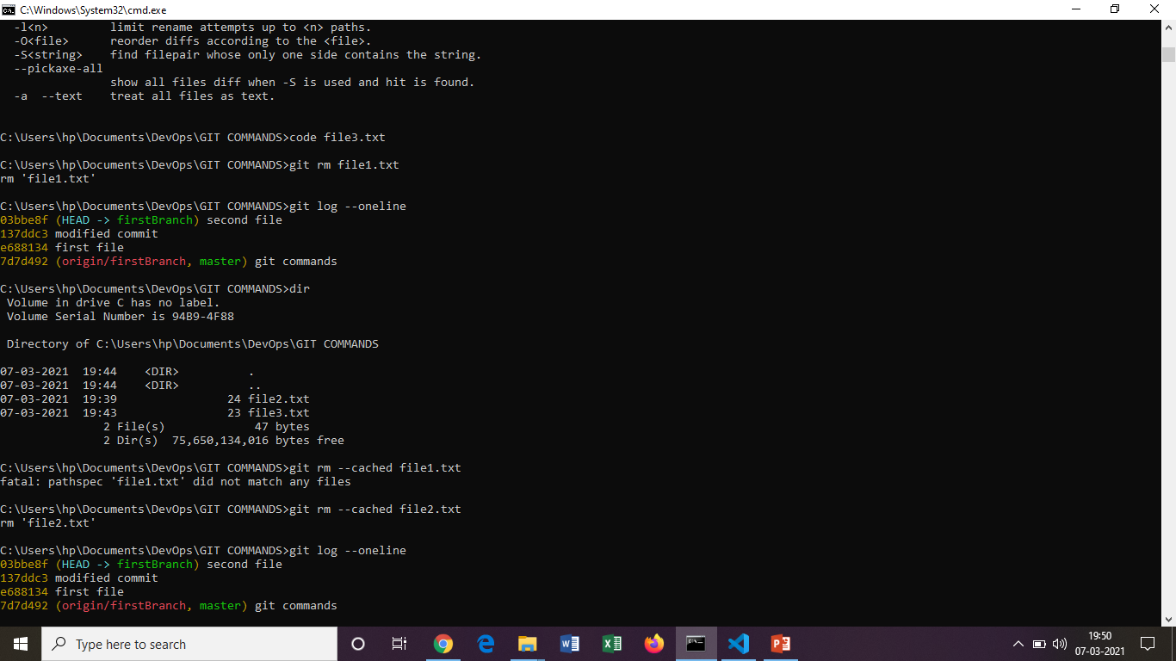
Remove ,log commands

Slide 10
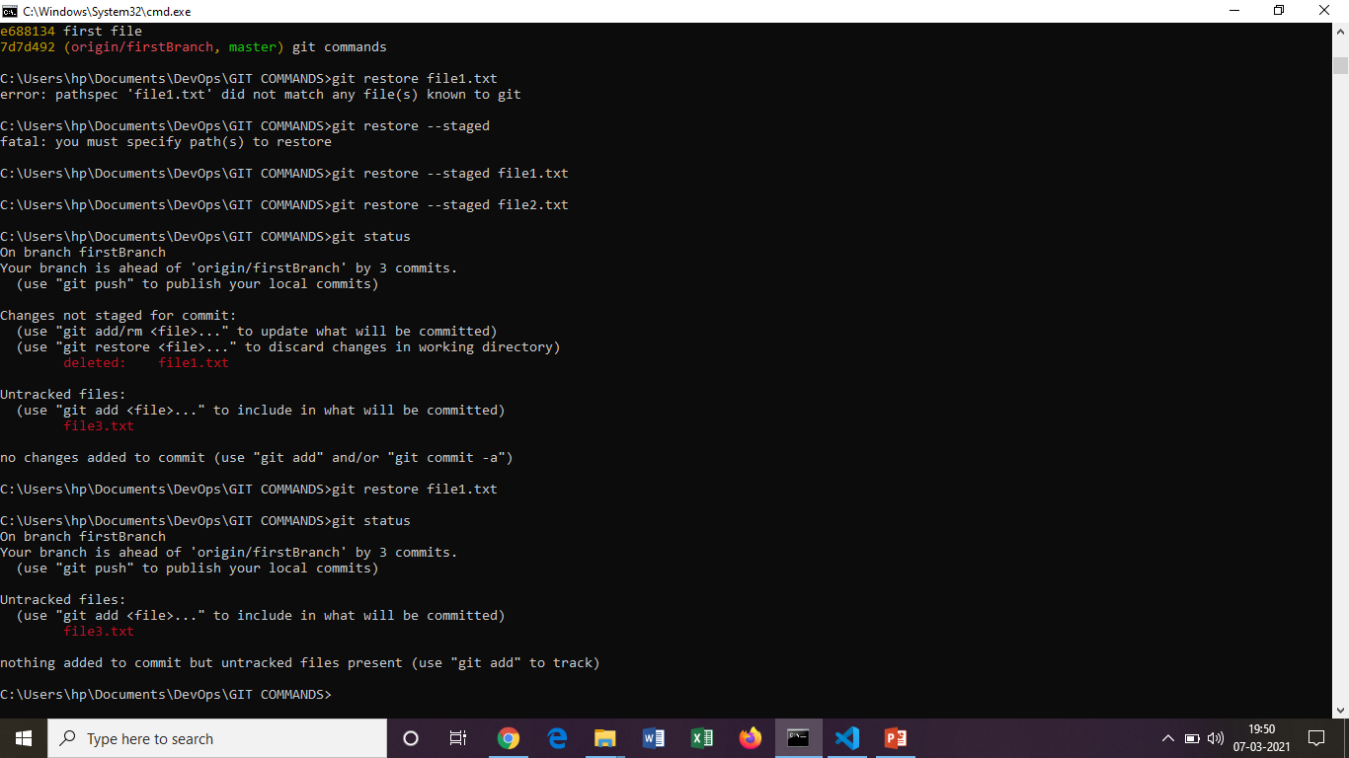
Restoring the removed files.

Slide 11
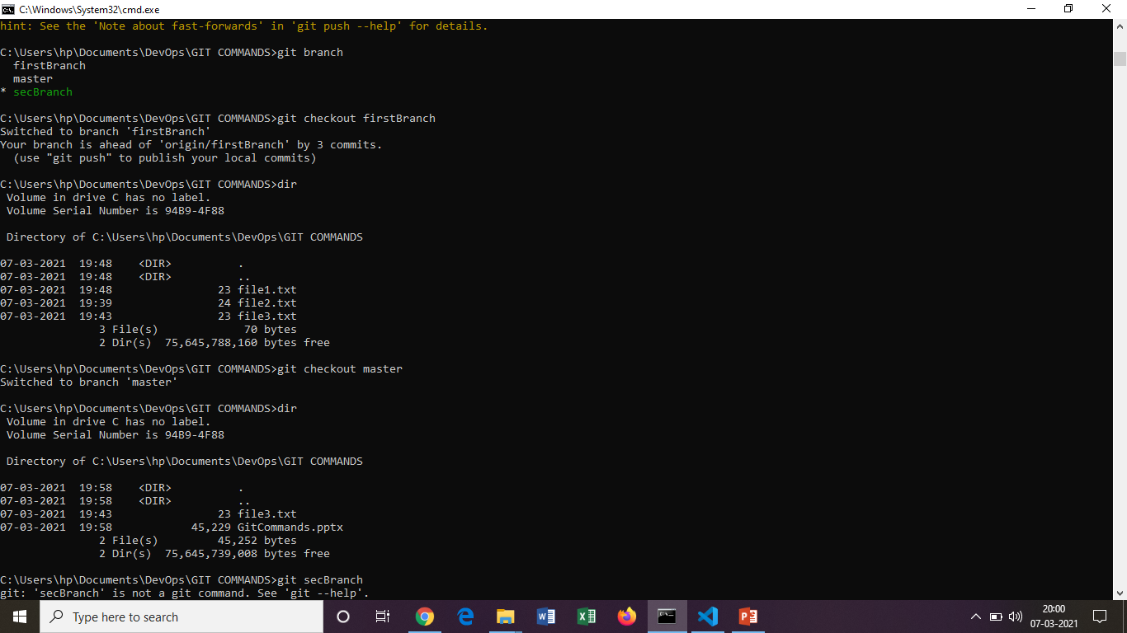
Commands related to branching

Slide 12
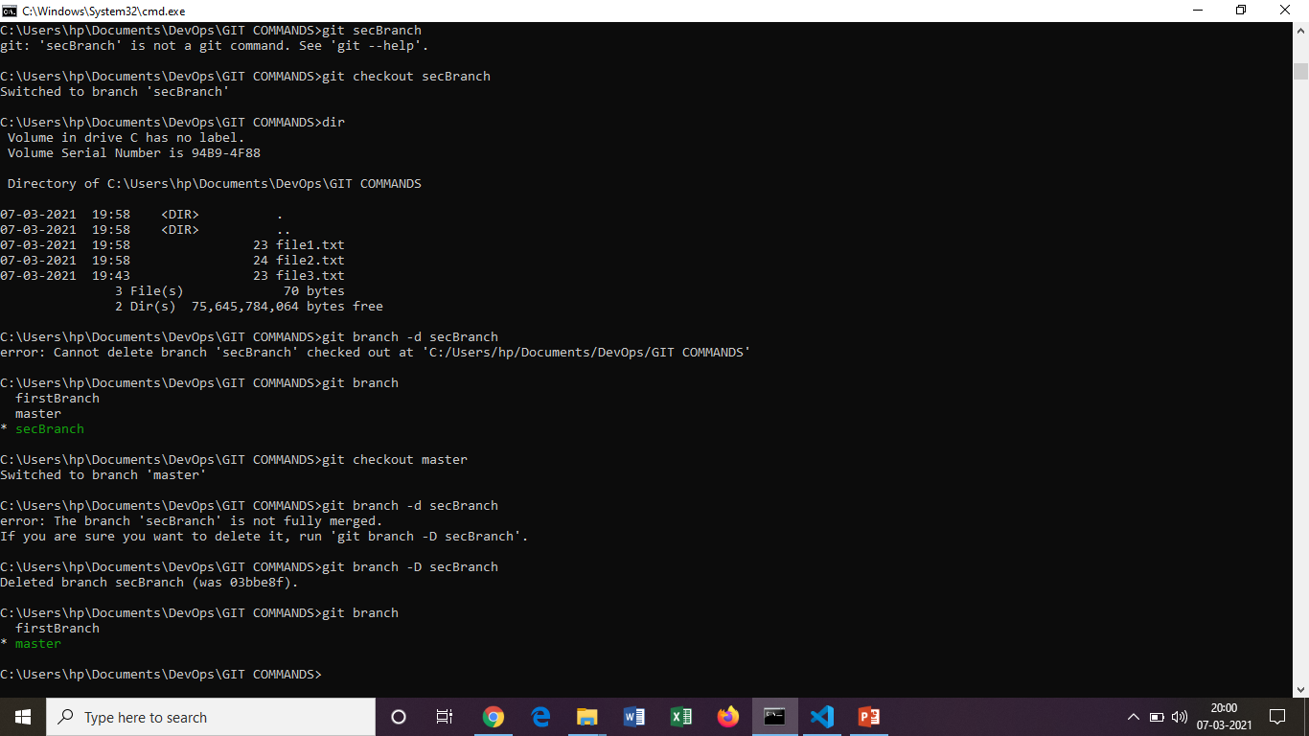
Commands related to branching

Slide 13
Git commands
git merge <branch name> : Merge a branch into active branch.
git diff <branch 1> <branch 2> : shows the difference between tips of the branches.
Renaming a branch :
git branch –m <old name> <new name>
Deleting a branch:
git branch –d <branch name>
git branch –D <branch name> : forcefully deleting a branch
git branch : list all the branches .
cherry-pick:
Copy specific commit to another branch or master

Slide 14
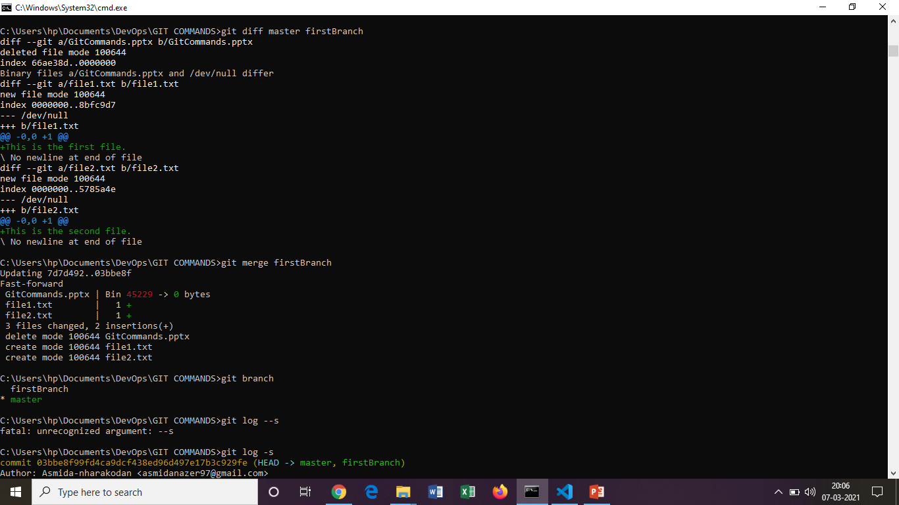
Commands on branch

Slide 15
Git commands
git cherry-pick master
git cherry-pick <branch –id>
git fetch: Retrieve the latest meta-data in the form of original context.
git pull : Retrieve complete copy of remote repository.
Pull requests:
1. Submitting contributions to open development project.
2. pull request occurs when a developer asks for changes committed to an external repository to be considered for inclusion in a project's main repository
git stash: takes all the dirty state of the working directory.
git merge : merge the branches with the master.

Slide 16
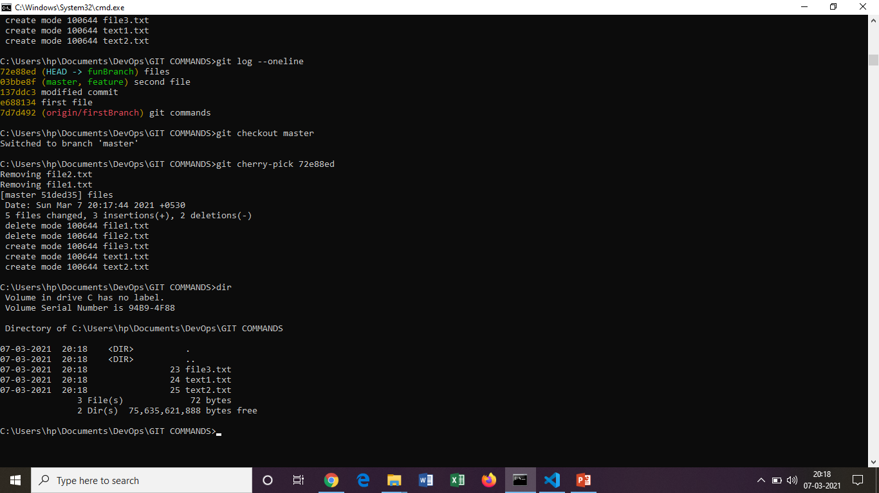
Cherry-pick command

Slide 17
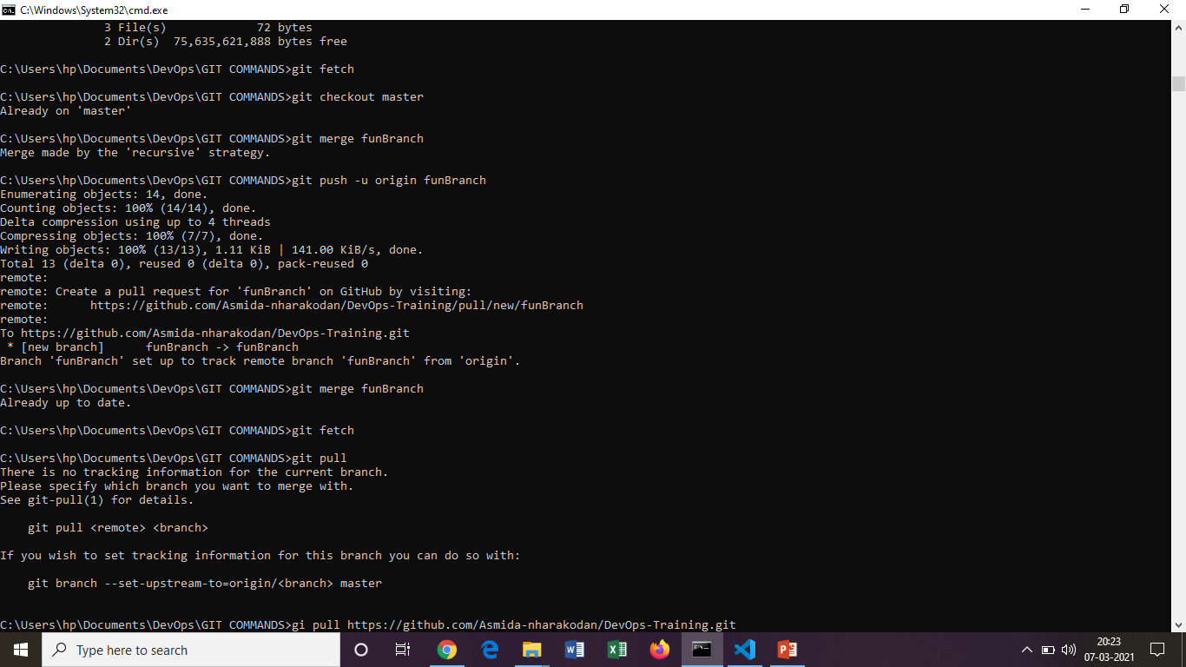
Fetch , merge, pull, push commands

Slide 18
Git commands
git clone :
1. clone a Repository into new directory.
git clone <remote-url>
2. To clone a specific branch:
git clone –b <branch-name> <remote-url>
git remote –v : list remotes and urls.

Slide 19
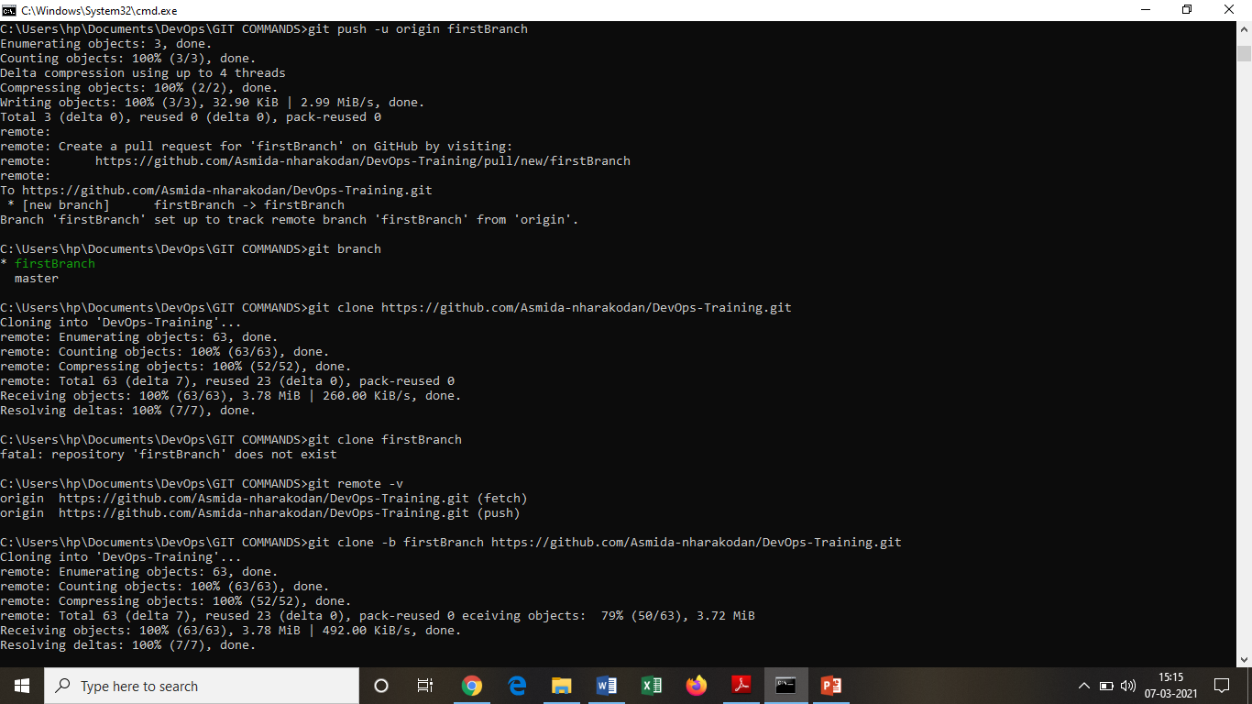

Slide 20
Squash :
It is a keyword not a command. It is used to combine multiple commits into one. This can be done by using Rebase feature.
git merge-base <branch-name> master : Find as good common ancestors as possible for a merge
Rebase:
Moves feature branch into master branch.
git rebase master
git rebase –i master-Id

Slide 21
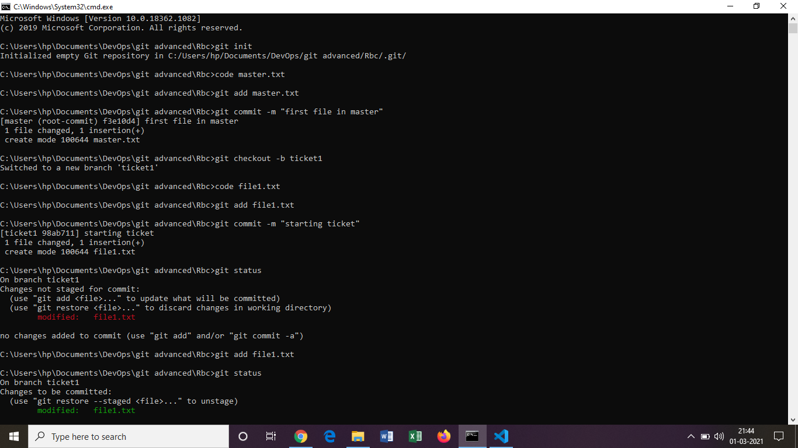

Slide 22
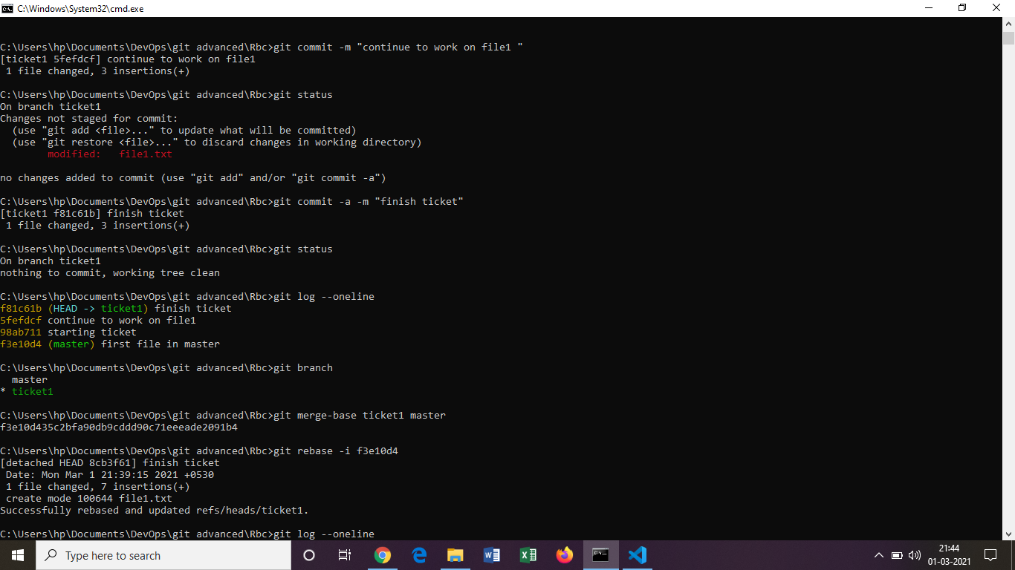

Slide 23
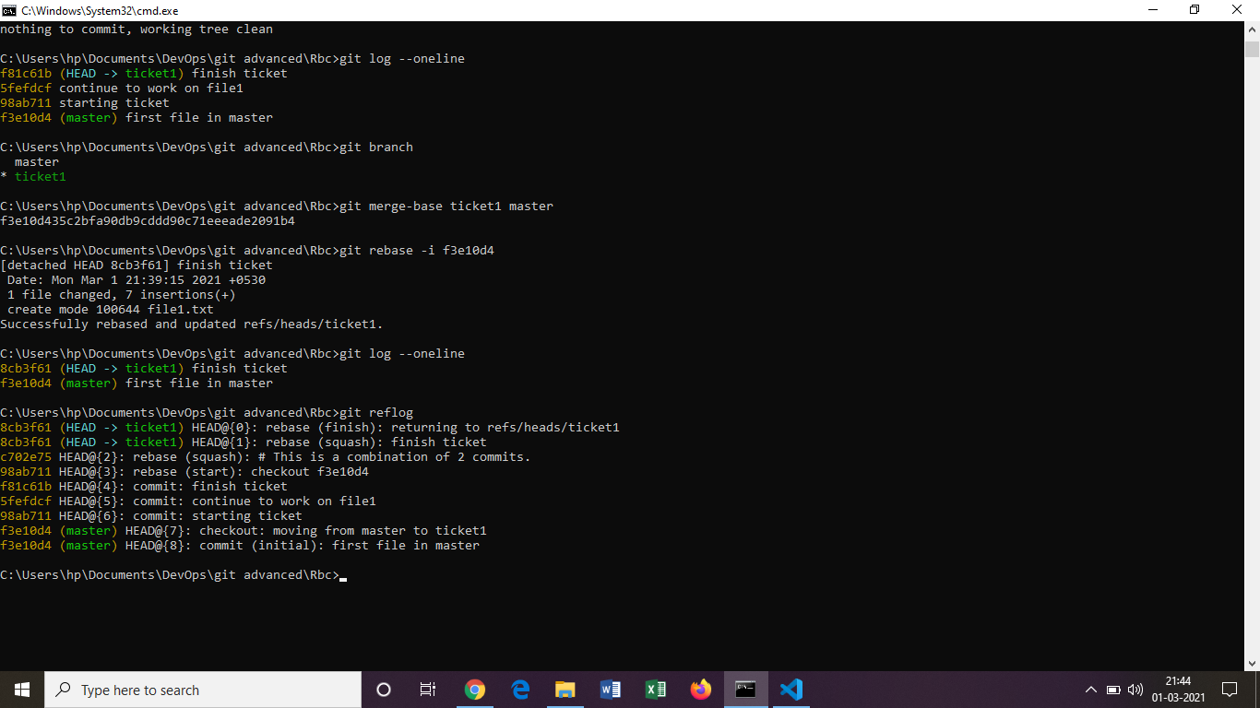

Slide 24
Stash:
It takes the dirty state of working directory. (temporary backUp)
git stash save “file name”
git stash list
git stash apply stash@{2}
git reset –hard
git stash pop
git stash show

Slide 25
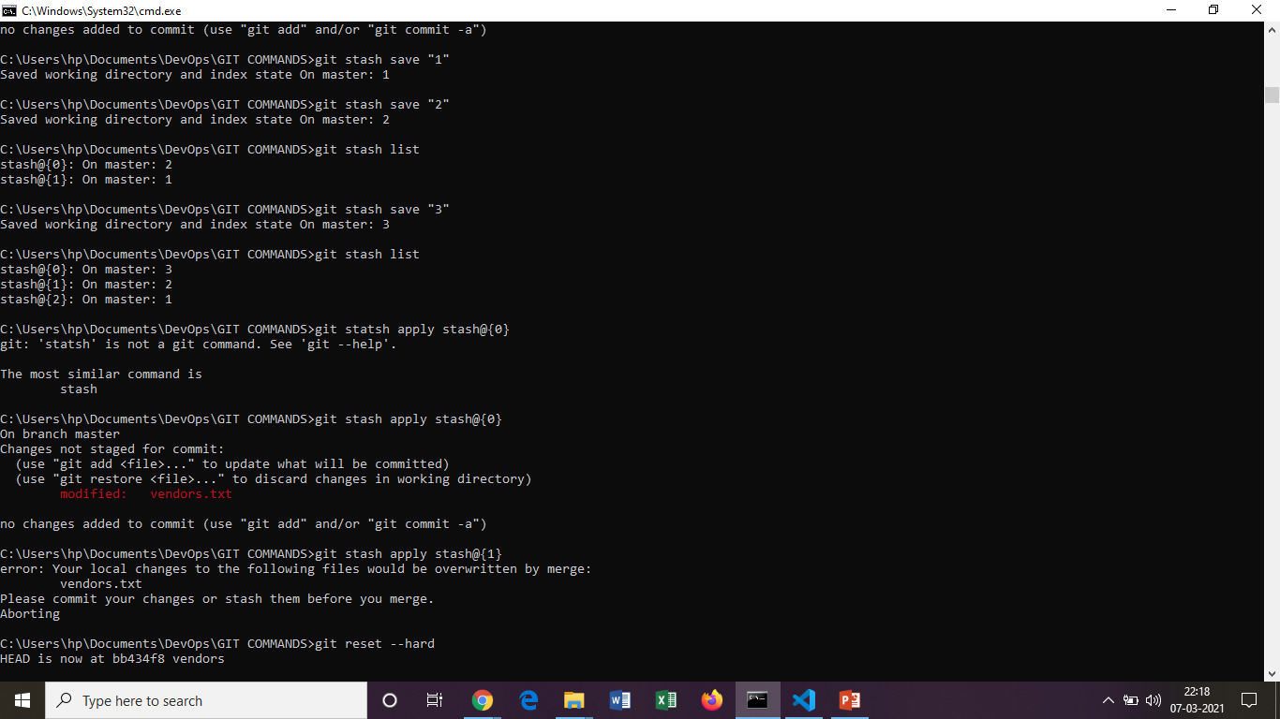
Stash commands

Slide 26
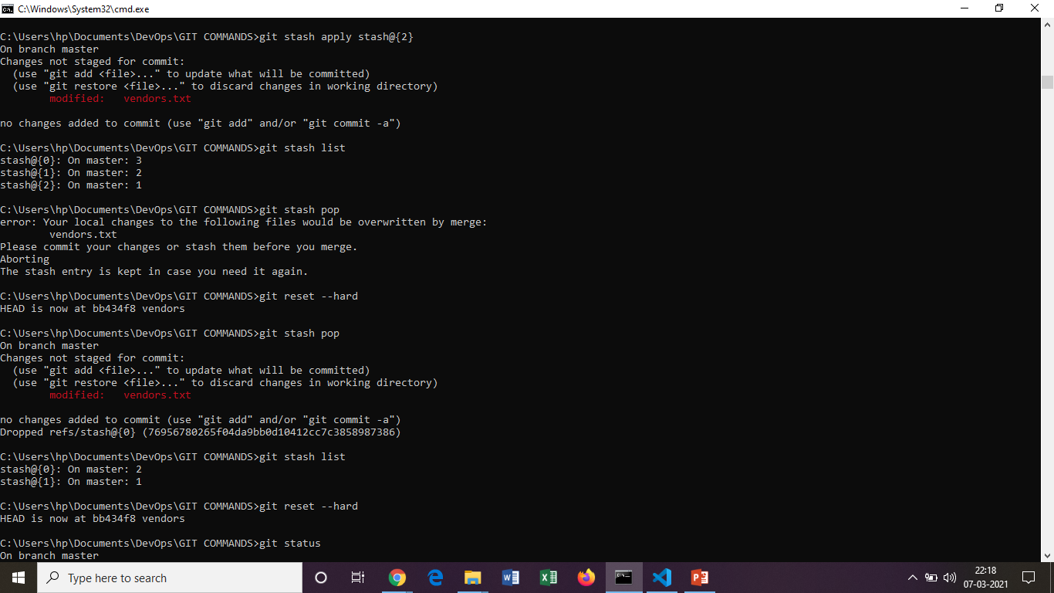
Stash commands

Slide 27
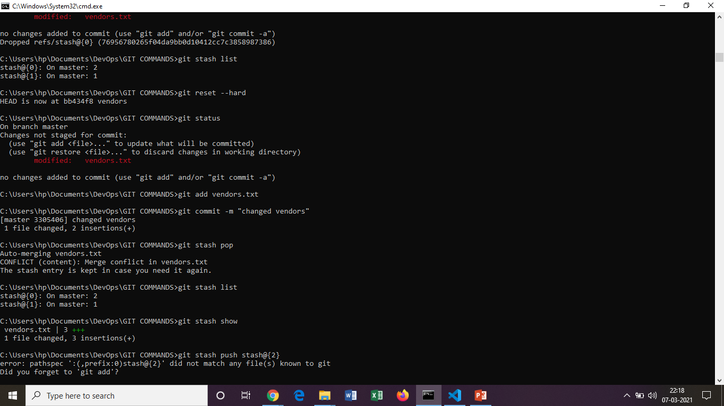
Stash commands

Slide 28
THANK YOU…

