Slide 1
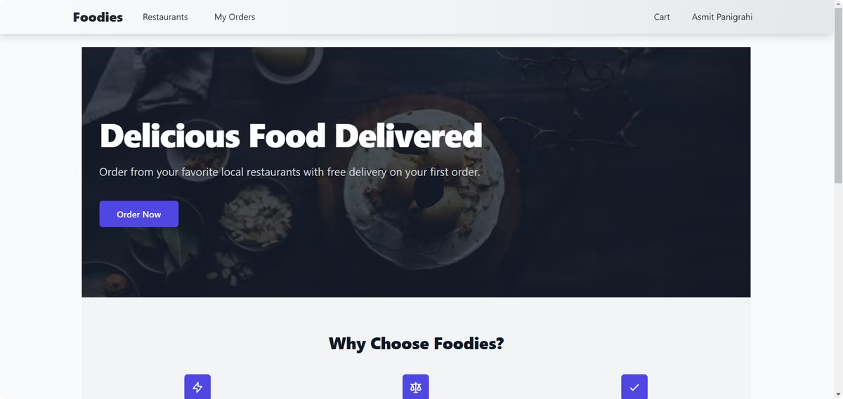
Foodies: Food Delivery Application
Foodies, a comprehensive food delivery platform designed for modern users. Foodies leverages cutting-edge technologies and strategic integrations to deliver a seamless and user-centric experience.

Slide 2
Project Overview
What is Foodies?
Key Features
Foodies is a full-stack food delivery web application. It simplifies food ordering and delivery processes for both users and restaurants.
Users can browse menus, place orders, and make secure payments.
Restaurants can upload and manage menus, handle orders, and track customer analytics.

Slide 3

Technology Stack
Frontend
Backend
React, React Router, Axios, Tailwind CSS, React Hot Toast, React Icons.
Node.js, Express.js, MongoDB, Mongoose, JWT, bcrypt.js, Multer, Compression, cors
Third-Party Integrations
Deployment
Stripe for secure payment processing, Cloudinary for image storage and optimization.
Frontend hosted on Vercel, backend deployed on Render.

Slide 4
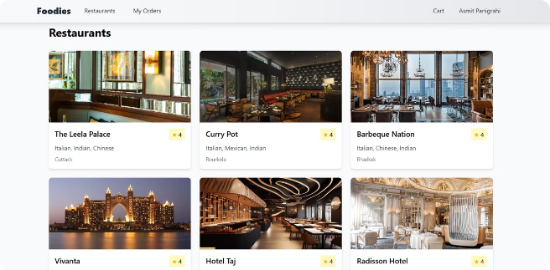
Frontend Implementation
1
React
2
React Router
3
Axios
Leveraged reusable components for modular and maintainable frontend, simplified dynamic updates for a smooth user experience.
Enabled Single Page Application (SPA) behavior, allowing navigation between pages without reloading.
Facilitated communication with backend APIs for tasks like fetching menu data, processing user details, and submitting orders.

Slide 5
Backend Implementation
1
Node.js
2
Express.js
3
MongoDB
Efficient runtime environment, ensuring scalability for server-side operations.
RESTful APIs for core functionalities: user authentication, menu retrieval, order creation and tracking.
Primary database to store structured data related to users, orders, and menu items.

Slide 6
Payment Integration with Stripe
Why Stripe?
Benefits
Stripe is renowned for its robust fraud prevention mechanisms, ease of implementation, and extensive developer resources.
Users experience a secure, reliable checkout process with options for credit cards and digital wallets.
Business owners gain access to streamlined reporting and automated reconciliation.

Slide 7



Image Management with Cloudinary
Why Cloudinary?
User Benefits
Developer Benefits
Cloudinary is a cloud-based image management platform optimized for performance, scalability, and ease of use.
Enhanced page loading speed due to optimized image delivery, high-quality visuals, regardless of the device or screen resolution.
Automated storage and optimization reduced server workload, flexible APIs ensured easy integration with existing backend systems.

Slide 8



Addressing Challenges
User Authentication
1
Securely managing user sessions and protecting sensitive credentials like passwords.
Payment Processing
2
Handling payments securely and in real-time while protecting sensitive financial data.
Image Management
3
Managing and delivering images such as food photos and restaurant logos in a fast and optimized manner.

Slide 9

Future Scope
Real-time order tracking with location sharing.
AI-powered menu recommendations based on user preferences.
Expanding payment options, including cryptocurrency.

