Slide 1
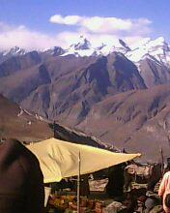
Exciting journey to Manali
MADE BY:-
ASMITA CHANDRAKAR

