Slide 1
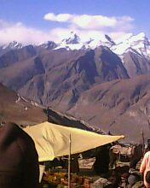
Exciting journey to Manali
MADE BY:-
ASMITA CHANDRAKAR

Slide 2
It was a 7 day journey to Manali , Shimla , Mussoorie & Dehradun.
It was a school educational trip with teachers and students.
We went to the place in the month of October in the year 2014.
We went to Ambala Cantt. Station by train and then took a night bus to Manali.
This trip was organized to learn about forests and hill stations of India.
WHAT
WHERE
&
WHO
WHEN
HOW
WHY

Slide 3
We reached to Rohtang Pass by bus then started our trekking after having breakfast.
Our task was to reach to the topmost point of Rohtang and to hoist a flag.
We all started our journey together slowly we all were scattered in different groups depending on our pace ,also we faced certain hurdles on our way and many times we felt exhausted and lack of oxygen but we carried it anyways .It was a test of perspiration!!
Finally we reached to the topmost point ,hoisted the flag and celebrated the joy.
ENTRY
TASK
EXIT

Slide 4
THANKYOU

