Slide 1
PROJECT TITLE: EASINESS IN MEASURING BLOOD PRESSURE AND SUGAR LEVELS IN BLOOD

Slide 2
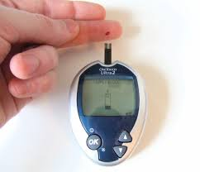
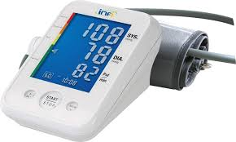
PROBLEM STATEMENT:
We have devices to measure blood pressure and sugar levels in blood but it does not simplify our work because we need to carry those devices and also sometimes those devices are not portable everywhere, it is common human phycology to forget things and people find it uncomfortable in remembering where those devices are .also we have two different devices for blood pressure and sugar level measurement.

Slide 3
SOLUTION:
HARDWARE POINT OF VIEW:
Why to have two separate devices for blood pressure and sugar level measurement and also why to take the responsibility of keeping the track of these devices. life can be easier if we just have a single device for both the check-ups and also in a device which people never forget and that’s obviously our android phones.
In hardware we will make the phone do all the work.
We will have two slots one for sugar level measurement and other for blood pressure measurement

Slide 4
Sugar measurement:
Our device will provide readings by detecting the level of glucose in a person's blood. To get a reading, a person pricks the skin — most commonly, a finger — and applies the blood sample gained to a test strip inserted in the meter. The glucose in the blood reacts with the chemicals in the strip. Then, electrical currents pass through, determining the level of glucose in the sample and providing numerical results within seconds.
Blood pressure measurement:
The other slot will be used for blood pressure measurement. our device will produce a digital readout and work on the principle that blood flowing through an artery between systolic and diastolic pressures causes vibrations in the arterial wall which can be detected and transduced into electrical signals. which will give information individual’s blood pressure

Slide 5
As all this features will be in a phone one doesn't need to have the burden of having separate devices .every individual having an android device will be able to do both the check-ups from phone itself.
Software approach:
We will develop an android app which will give the users the information either about the blood pressure or the sugar levels in blood.

