Slide 1
Presentation On
reReads
Anmol Regmi|Asmita Paudel|Simran Tamang

Slide 2
INTRODUCTION
“reReads” will be a web app that focuses on selling, buying, and donating used Nobel books
Users can upload photos of their used books to sell or donate.
The goal is to ensure sellers get the best value for their books and buyers can find affordable prices.
Additionally, the platform features a donation option to provide books to those in need.

Slide 3
PROBLEMS STATEMENTS
Users are facing problem of right market to sell their products with appropriate price.
There is no direct connection between buyers and sellers.
Many readers cannot afford new books due to their high prices.

Slide 4
OBJECTIVES
To provide a platform to help users to buy, sell, and donate their used books.

Slide 5
LITERATURE REVIEW
Features | reReads | SajhaKitab | Sastobooks | Bizzpur | KitabKinBech
Sell | Yes | Yes | Yes | Yes | Yes
Buy | Yes | Yes | Yes | Yes | Yes
Donate | Yes | No | No | No | No
C2C | Yes | Yes | No | Yes | Yes
Notes:
dfafsafasfa

Slide 6
REQUIRED TOOLS
TOOLS | PURPOSE
HTML , CSS And JAVASCRIPT | For Front End
PHP | For Back End
MySQL | For Managing Database
Git Hub | To Store Source Code and Collaboration With Teams
VS Code | For Writing Source Code
MS Word | Documentation
Draw.io | Diagram
Figma | Wireframe Design

Slide 7
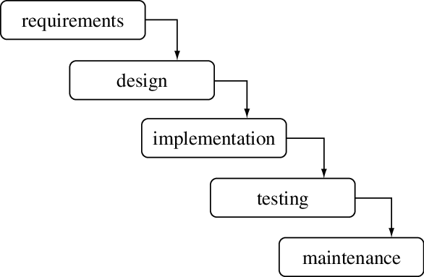
APPROACH USED
The waterfall model follows a sequential approach, where each phase must be completed before moving to the next.
There is no overlapping between phases in the waterfall model.
It was the first widely used SDLC model in software engineering.
The software development process is divided into separate phases in the waterfall model.

Slide 8
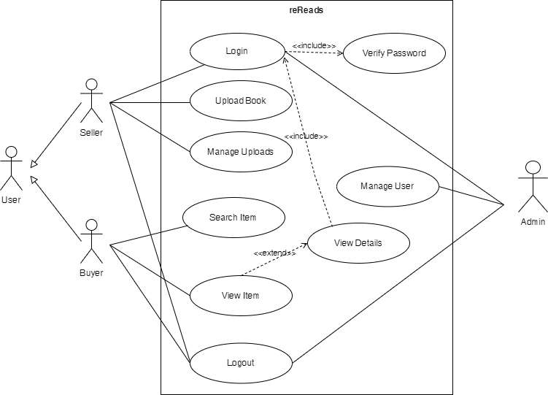
USE CASE DIAGRAM

Slide 9
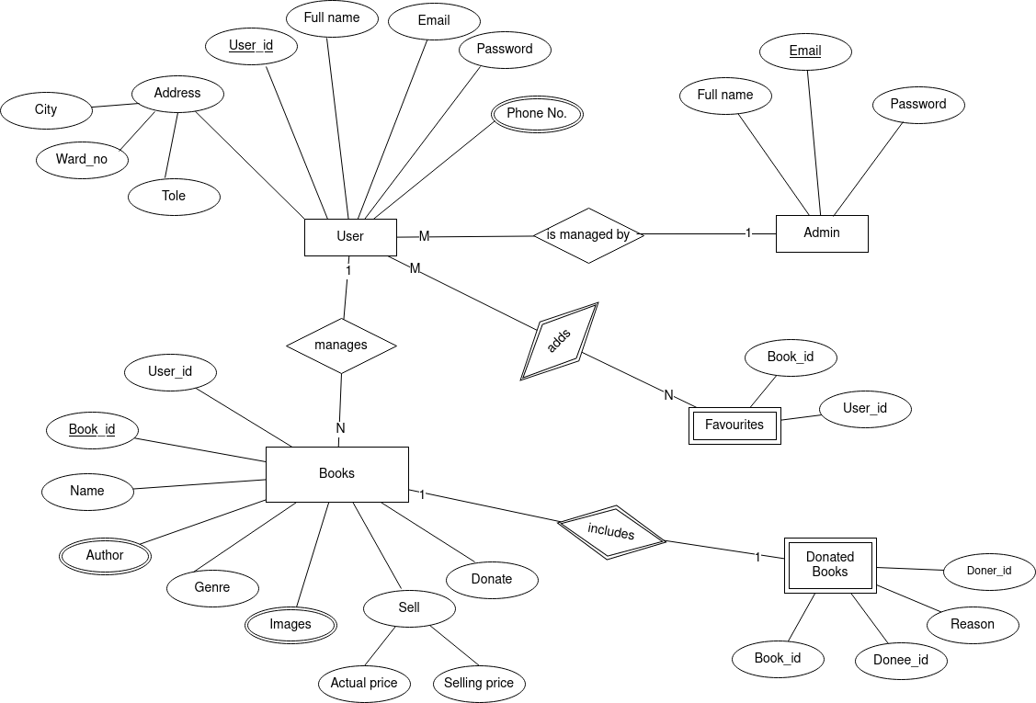
ENTITY RELATIONSHIP DIAGRAM

Slide 10
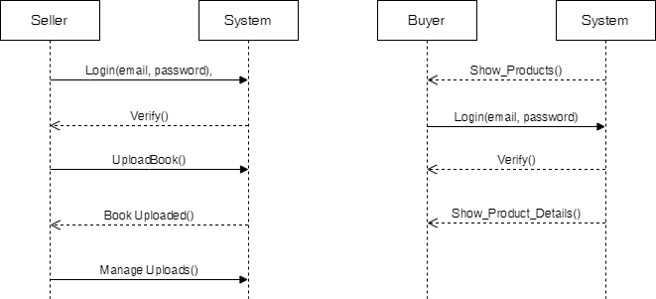
SYSTEM SEQUENCE DIAGRAM FOR SELLER AND BUYER

Slide 11
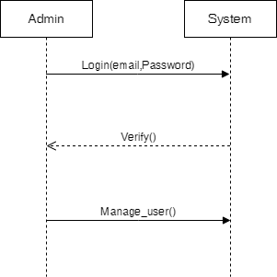
SYSTEM SEQUENCE DIAGRAM FOR ADMIN

Slide 12
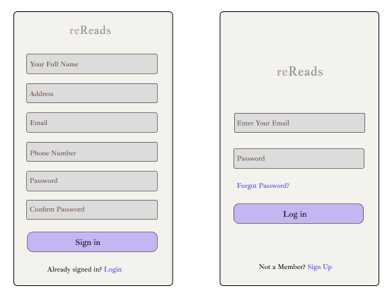
WIREFRAMES
LOGIN / SIGN UP SCREEN

Slide 13
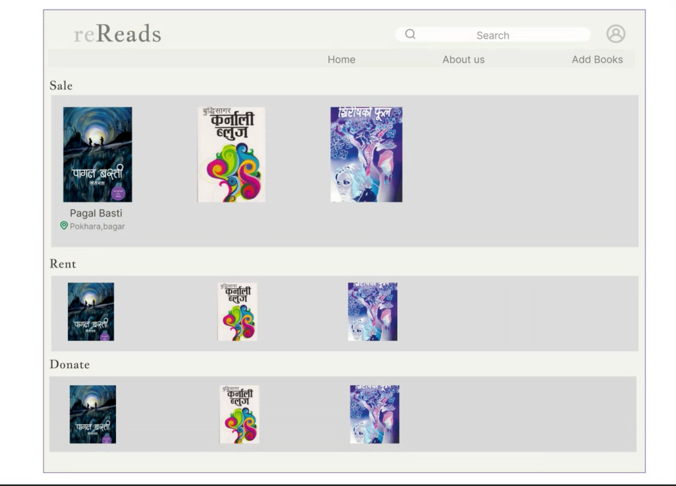
WIREFRAMES
HOME PAGE

Slide 14
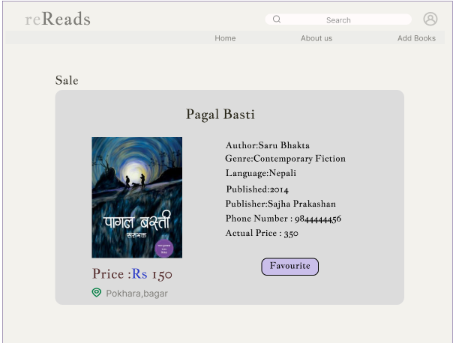
WIREFRAMES
Single page View

Slide 15
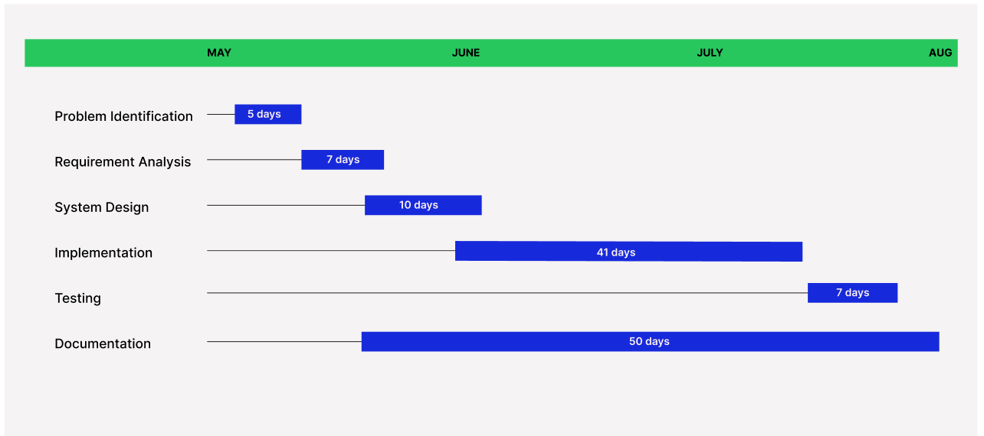
TIMELINE CHART

Slide 16
Thank You !

