Slide 1

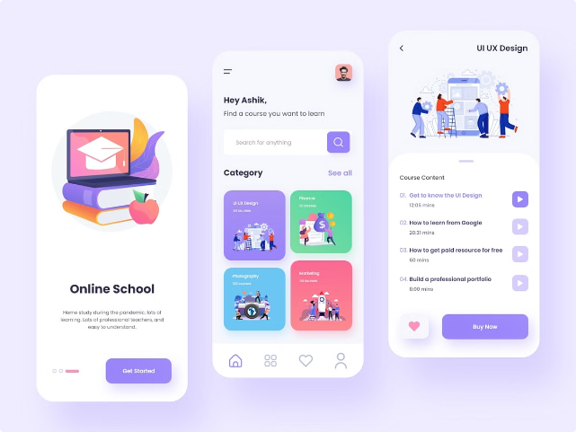
E-learning Website Design: A Comprehensive Guide
This presentation outlines the key aspects of designing an effective and engaging e-learning website.

Slide 2

Defining the Target Audience
1
Identify Learners
2
Tailor Content
Understanding the target audience's demographics, learning styles, and technical proficiency is crucial.
Content should be tailored to their specific needs and interests, catering to different learning styles.
3
Assess Knowledge
4
Feedback & Iteration
Evaluate their prior knowledge and skill level to ensure the content is appropriate and challenging.
Gather feedback from learners to refine content and design based on their specific needs and feedback.

Slide 4

Establishing the Brand Identity
Logo & Colors
Typography & Fonts
Visual Style & Tone
A memorable logo and consistent color scheme should reflect the brand's personality and values.
Choosing clear and readable fonts that enhance readability and create a cohesive visual experience is important.
Establish a consistent visual style that aligns with the brand's message and target audience.

Slide 5
Designing the Homepage Layout
Clear Navigation
Compelling Content
Call to Action
A user-friendly navigation menu makes it easy to access key information and features.
Highlight popular courses, testimonials, and success stories to engage visitors and showcase the value proposition.
A clear call to action, such as "Start Learning" or "Explore Courses," encourages users to take the next step.

Slide 6

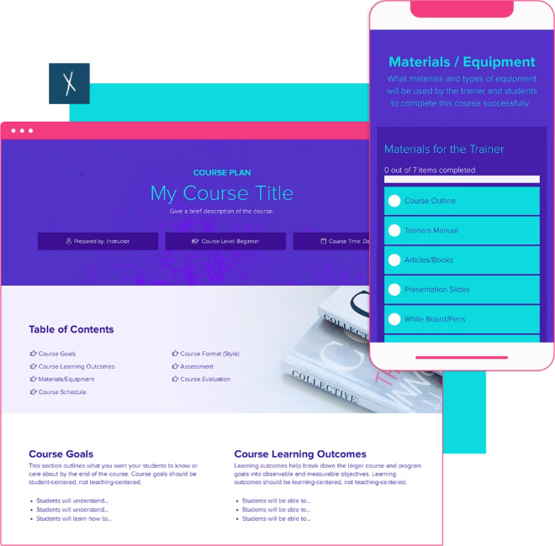
Crafting Engaging Course Modules
1
Interactive Content
Integrate videos, quizzes, interactive exercises, and discussion forums to keep learners engaged.
2
Bite-Sized Lessons
Break down complex topics into smaller, digestible units to improve comprehension and retention.
3
Visual Appeal
Utilize visually appealing elements, such as images, infographics, and animations, to enhance learning.
4
Progress Tracking
Allow learners to track their progress and monitor their learning journey.

Slide 7


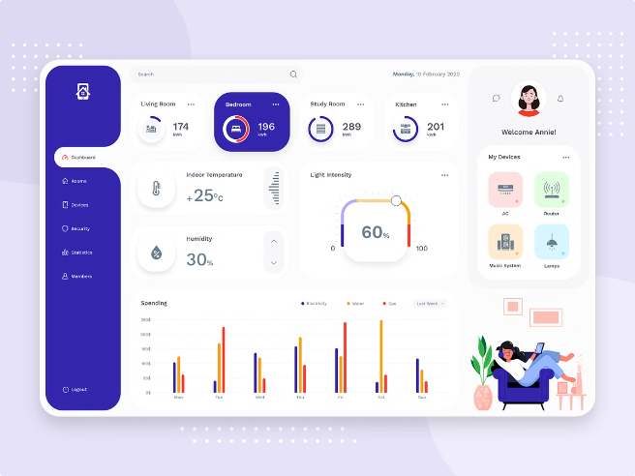



Optimizing the User Interface
Intuitive Navigation
Ensure a smooth and intuitive user experience with clear navigation menus and easy-to-find information.
Consistent Layout
Maintain a consistent layout across the website to create a familiar and predictable user experience.
Clear Call to Actions
Use clear and concise calls to action to guide users through the desired steps.
Visual Hierarchy
Employ visual hierarchy to prioritize important information and guide users' attention.

Slide 8


Enhancing the Learning Experience
Gamification
Integrate game mechanics, such as points, badges, and leaderboards, to motivate and engage learners.
Personalized Learning
Offer personalized learning paths based on individual needs and preferences.
Community Features
Enable learners to connect and collaborate with peers through discussion forums and chat rooms.
Feedback Mechanisms
Provide regular feedback and opportunities for learners to ask questions and get support.

Slide 9


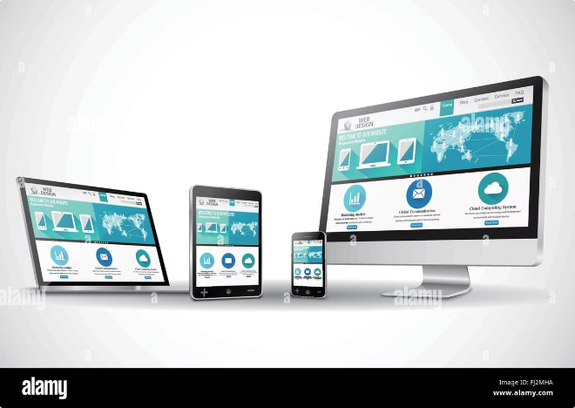


Incorporating Responsive Design
Desktop
Ensure the website is optimized for desktop viewing, providing a clear and spacious layout.
Tablet
Adapt the layout to smaller screens, ensuring content remains readable and interactive.
Mobile
Optimize for mobile devices, providing a streamlined experience with easy-to-navigate content.

Slide 10

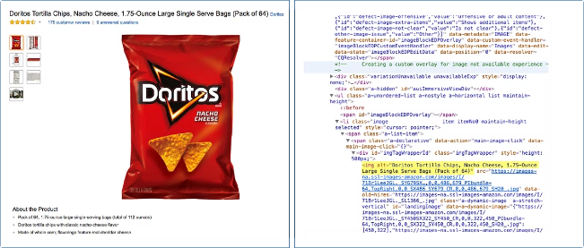
Ensuring Accessibility and Inclusivity
1
Screen Reader Compatibility
2
Keyboard Navigation
Allow users to navigate the website using only their keyboard, providing an alternative to mouse interaction.
Ensure the website is accessible to users with disabilities, including those who rely on screen readers.
3
Color Contrast
4
Closed Captions
Choose color combinations that provide sufficient contrast for users with visual impairments.
Provide closed captions for videos and multimedia content to make it accessible to deaf and hard-of-hearing users.

Slide 11

Conclusion and Next Steps
By implementing these principles, you can create a user-friendly and engaging e-learning website that facilitates effective online learning.

