Slide 1

GROWGUARDIAN
AI FOR FARMING
GUIDE:Ms.Divya Maheshwari
A.Ajith kumar – 2011cs030004
a.Asmitha – 2011cs030006
g.Mounika – 2011cs030060

Slide 2
INTRODUCTION
Since there have been climate changes which have resulted in an increasing amount of unexpected rainfalls, par below temperatures and heatwaves in the region, which result in significant loss of ecosystem. Deep learning has helped develop various utility tools to tackle world problems. This problem of agriculture can be solved by using various DL algorithms. This project aims to create two things - a)A crop recommendation system and b) a Plant disease identification system embedded into a single website. The datasets were publicly available over the internet. Once the features for task one are extracted, then the dataset is trained on five different algorithms - logistic regression, decision tree, support vector machine(SVM), multilayer perceptron and random forest. For the second task, three CNN architectures, VGG16, ResNet50 and EfficientNetV2, are trained, and a comparative study is done between them. For the task one, random forest achieved an accuracy of 99.31%, and for the second task, EfficientNetV2 achieved an accuracy of 96.06%.

Slide 3
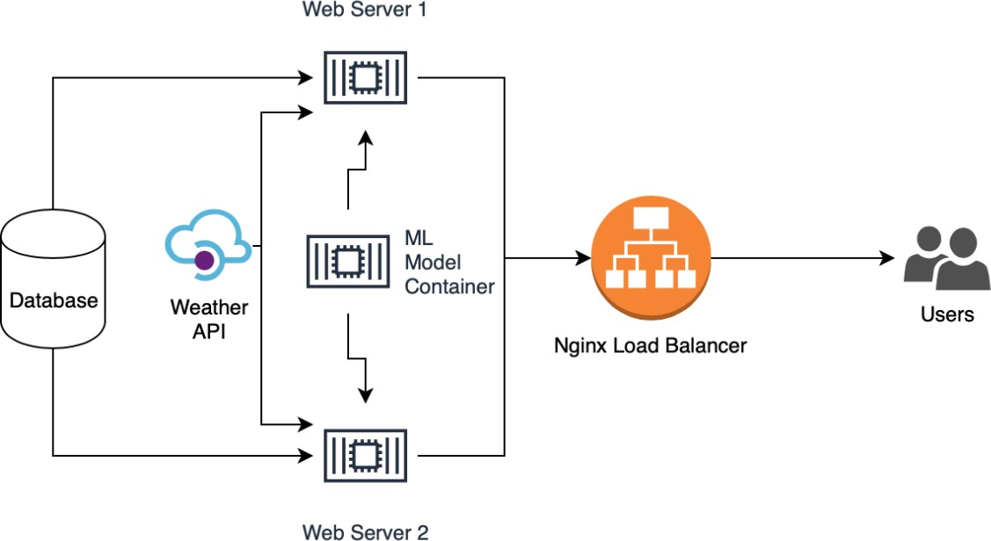
SYSTEM ARCHITECTURE

Slide 4
TECHNOLOGIES
Tensorflow
Keras
MySQL
Flask
CNN’S
VGG16
ResNet50
EfficientNetv2S

Slide 5
ALGORITHMS
Random Forest
Logistic Regression
Multi Layer perceptron
Decision Tree
Support Vector Machine

Slide 6
RESULTS
Algorithm | Accuracy | Precision | Recall | F1-Score
Logistic Regression | 94.54 | 0.95 | 0.95 | 0.94
Decision Tree | 97.72 | 0.98 | 0.98 | 0.98
SVM | 9.09 | 0.59 | 0.09 | 0.11
Multi- Layer Perceptron | 95.22 | 0.96 | 0.95 | 0.95
Random Forest | 99.31 | 0.99 | 0.99 | 0.99
Architecture | Training Acc. | Validation Acc. | Test Accuracy.
VGG16 | 92.18 | 91.33 | 91.78
ResNet50 | 96.02 | 95.41 | 95.53
EfficientNetV2 | 96.06 | 95.53 | 95.83
Plant Disease Classification task accuracy over various architectures.
Crop recommendation task accuracy over various algorithm

Slide 7

WEBSITE

Slide 8
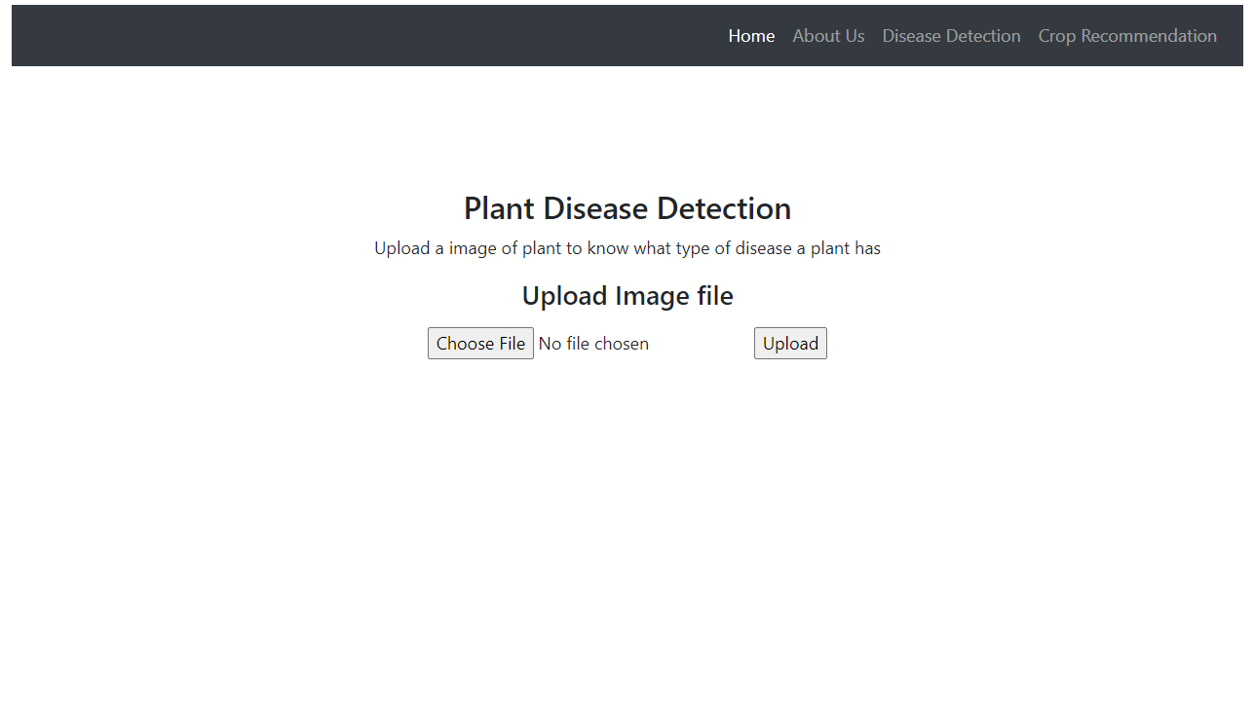
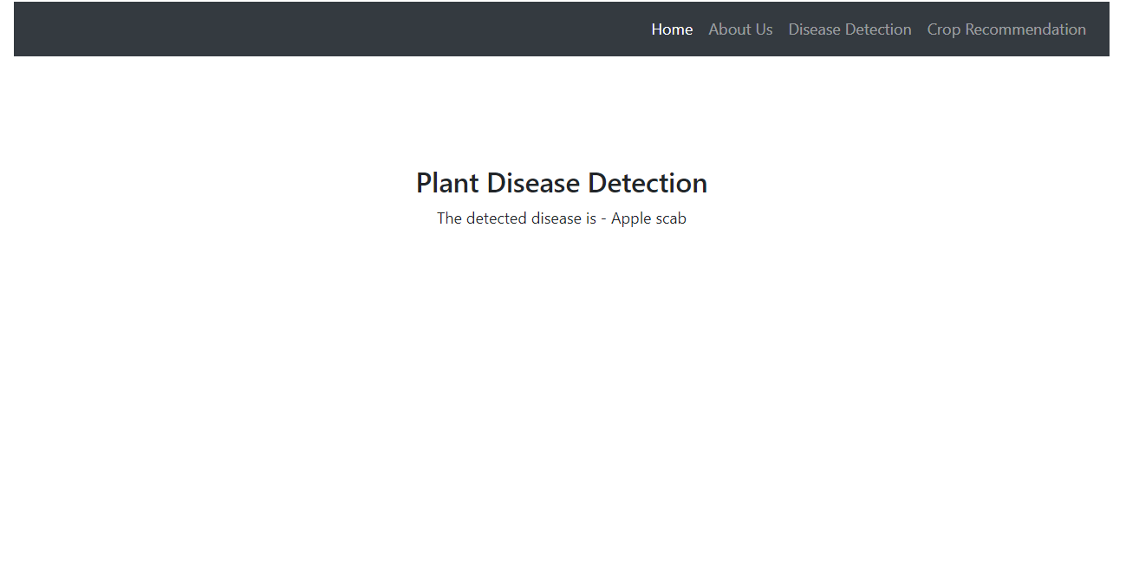
WEBSITE

Slide 9
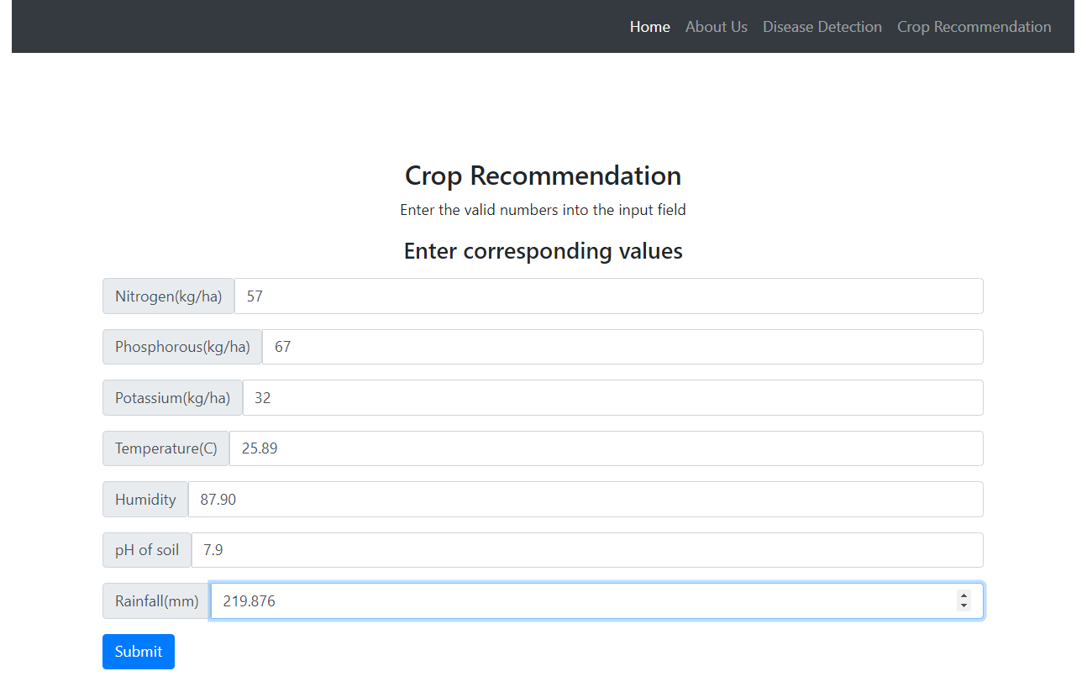
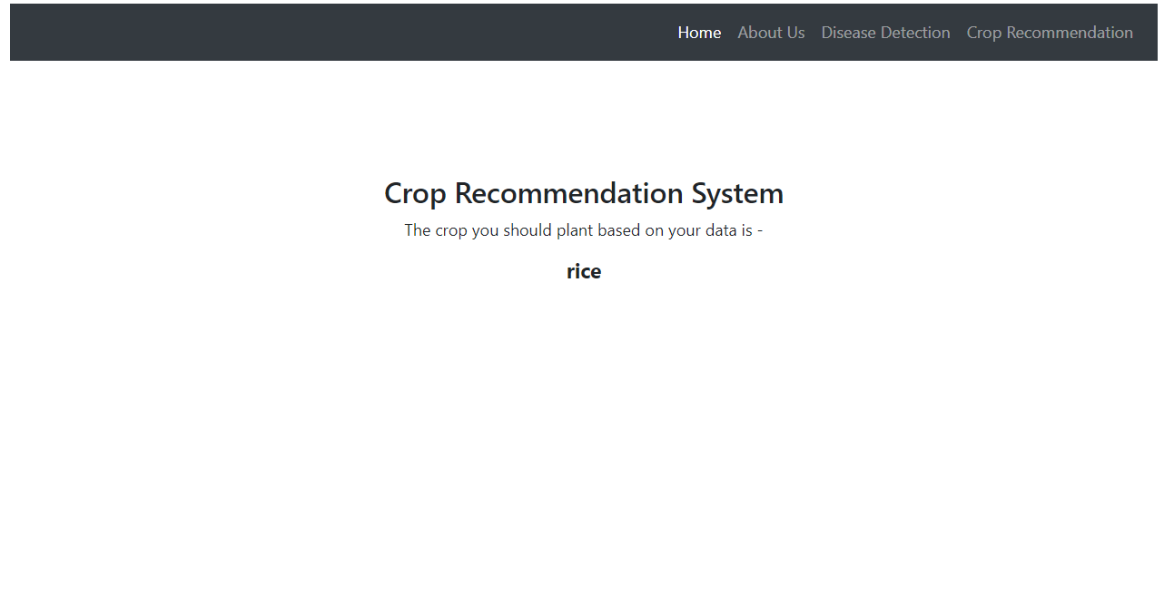
WEBSITE

Slide 10
CONCLUSION
In summary, this groundbreaking project leverages machine learning to tackle the pressing challenges posed by climate change in agriculture. The Crop Recommendation System, powered by five advanced algorithms, notably the Random Forest, achieves an outstanding accuracy of 99.31%, providing tailored crop suggestions to bolster resilient farming practices. Simultaneously, the Plant Disease Identification System, employing three cutting-edge CNN architectures, particularly EfficientNetV2 with a 96.06% accuracy, addresses declining plant health. The integration of these systems into a unified website creates a dynamic decision-making tool for farmers, offering real-time insights into optimal crop choices and early disease detection. This initiative signifies the transformative potential of machine learning in fostering sustainable and adaptive agricultural practices amid escalating environmental challenges, showcasing technology as a crucialally in ensuring global food security.
FUTURE WORK
Transformer neural networks can be trained to achieve higher accuracy for plant disease detection. For crop recommendation system the dataset can be increased to cover more features. A device can be created which can directly detect the disease of the plant.

Slide 11
REFERENCES
1. Kulkarni, P., Karwande, A., Kolhe, T., Kamble, S., Joshi, A. and Wyawahare, M., 2021. Plant Disease Detection Using Image Processing and Machine Learn- ing. arXiv preprint arXiv:2106.10698.
2. G.Chauhan and A. Chaudhary, ”Crop Recommendation System using Machine Learning Algorithms,” 2021 10th International Conference on System Model- ing & Advancement in Research Trends (SMART), 2021, pp. 109-112, doi: 10.1109/SMART52563.2021.9676210.
3.Sharada Prasanna Mohanty, David Hughes, Marcel Salathe, 2016, Using Deep Learning for Image-Based Plant Disease Detection. arXiv preprint arXiv:2106.10698.

