Slide 1

Representing Data in a Computer
College of Computer Science, SCUEC

Slide 2
Expected outcome
You will be able to understand some common ways that data are represented in a micro-computer
Chap1 Representing Data in a Computer

Slide 3
Key language
Number systems
ASCII
2's complement representation
Chap1 Representing Data in a Computer

Slide 4
Anticipatory set(1-3)
When programming in a high-level language, you use variables of different types. Once you have declared variables, you don't have to worry about how the data are represented in the computer.
Chap1 Representing Data in a Computer

Slide 5
Anticipatory set(2-3)
When you deal with a computer at the machine level, however, you must be more concerned with how data are stored. Often you have the job of converting data from one representation to another.
Chap1 Representing Data in a Computer

Slide 6
Anticipatory set(3-3)
Most modern computer systems do not represent numeric values using the decimal system. Instead, they typically use a binary or 2’s complement numbering system.
To understand the limitations of computer arithmetic, you must understand how computers represent numbers.
Chap1 Representing Data in a Computer

Slide 7
Terminology(1-2)
Bit / Byte / Word /
Doubleword / Quadword
Binary / Octal/
Decimal / Hexadecimal
Uppercase / Lowercase
Quotient / Remainder
Character / ASCII
Chap1 Representing Data in a Computer

Slide 8
Terminology(2-2)
Complement Representation
Taking the Complement
Signed Integer / Unsigned Integer
Addition / Subtraction
Carry / Borrow / Overflow
Binary Coded Decimal (BCD)
Chap1 Representing Data in a Computer

Slide 9
Contents
Binary and hexadecimal numbers
Character codes
2's complement representation for signed integers
Addition and subtraction of 2's complement numbers
Other systems for representing numbers
Chap1 Representing Data in a Computer

Slide 10
1.1 Binary and hexadecimal numbers
Decimal
Binary
Hexadecimal(Hex)
Octal
Conversions among Binary, Hex
and Decimal
Chap1 Representing Data in a Computer

Slide 11
Decimal system
Each digit appearing to the left of the decimal point represents a value between 0 and 9 times an increasing power of 10.
Digits appearing to the right of the decimal point represent a value between 0 and 9 times an increasing negative power of 10.
For example, the value 123.456 means:
1*10²+ 2*10¹+ 3*10⁰+ 4*10⁻¹+ 5*10⁻²+ 6*10⁻³
Chap1 Representing Data in a Computer

Slide 12
Binary system(1-2)
Most modern computer systems (including the IBM PC) operate using binary logic. The computer represents values using two voltage levels (usually 0v and +5v). With two such levels we can represent exactly two different values.
A computer uses bits (binary digits, each an electronic state representing zero or one) to denote values. We represent such binary numbers using the digits 0 and 1 and a base 2 place-value system.
Chap1 Representing Data in a Computer

Slide 13
Binary system(2-2)
This binary number system is like the decimal system except that the positions (right to left) are 1's, 2's, 4's, 8's, 16's (and higher powers of 2) instead of 1's, 10's, 100's, 1000's, 10000's (powers of 10).
For example, the binary number 1101 can be interpreted as the decimal number 13,
1 |  | 1 |  | 0 |  | 1
one 8 | + | one 4 | + | no 2 |  | one 1 | = | 13
Chap1 Representing Data in a Computer

Slide 14
Hex system(1-3)
The hexadecimal (base 16) number system represents numbers using about one-fourth as many digits as the binary system.
Conversions between hexadecimal and binary are so easy that hex can be thought of as shorthand for binary.
Chap1 Representing Data in a Computer

Slide 15
Hex system(2-3)
The hexadecimal system requires sixteen digits:
0, 1, 2, 3, 4, 5, 6, 7, 8, 9, A, B, C, D, E, F
Either uppercase or lowercase letters can be used for the new digits
Chap1 Representing Data in a Computer

Slide 16
Hex system(3-3)
The positions in hexadecimal numbers correspond to powers of 16. From right to left, they are 1's, 16's, 256's, etc.
The value of the hex number 9D7A is 40314 in decimal since
9  4096 36864 [ 4096 = 16³ ]
+ 13  256 3328 [ D is 13, 256 =16²]
+ 7  16 112
+ 10  1 10 [ A is 10 ]
= 40314
Chap1 Representing Data in a Computer

Slide 17
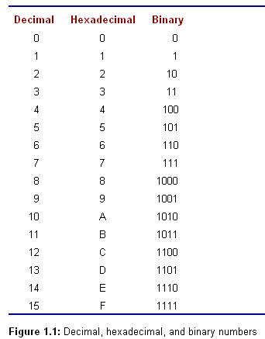
Chap1 Representing Data in a Computer

Slide 18
Conversions between Binary and Hex
Conversions Hex to Binary
Substitute four bits for each hex digit.
The bits are those found in the third column of Fig. 1.1, padded with leading zeros as needed .
For example,
3B8E2₁₆ = 0011 1011 1000 1110 00l0₂
Chap1 Representing Data in a Computer

Slide 19
Conversions between Binary and Hex
Conversions Binary to Hex
Break the binary number into groups of 4 bits, starting from the right, and substitute the corresponding hex digit for each group of 4 bits.
For example,
1011011101001101111₂
= 101 1011 1010 0110 1111
= 5BA6F₁₆
= 5 × 65536 + 11 × 4096 + 10 × 256 + 6 × 16 + 15 × 1
= 375407₁₀
Chap1 Representing Data in a Computer

Slide 20
Convert Decimal to Hex
until DecimalNumber = 0 loop
divide DecimalNumber by 16, and
getting Quotient and Remainder;
Remainder (in hex) is the next digit
(right to left);
DecimalNumber ：= Quotient;
end until;
Chap1 Representing Data in a Computer

Slide 21
Convert Decimal to Hex
• Divide 16 into 5876 (DecimalNumber).
367 Quotient the new value for DecimalNumber
4 Remainder the rightmost digit of the answer
Result so far: 4
• 367 is not zero. Divide it by 16.
22 Quotient the new value for DecimalNumber
15 Remainder the second digit of the answer
Result so far: F4
• 22 is not zero. Divide it by 16.
1 Quotient the new value for DecimalNumber
6 Remainder the next digit of the answer
Result so far: 6F4
• 1 is not zero. Divide it by 16.
0 Quotient the new value for DecimalNumber
1 Remainder the next digit of the answer
Result so far: 16F4
• 0 is zero, so the until loop terminates. The answer is 16F4₁₆
Chap1 Representing Data in a Computer

Slide 22
Octal system
Octal numbers are written using digits 0 through 7.
It is easy to convert a binary number to octal by writing the octal equivalent for each group of 3 bits, or to convert from octal to binary by replacing each octal digit by 3 bits.
To convert from decimal to octal, one can use an algorithm that is the same as the decimal to hex scheme except that you divide by 8 instead of 16 at each step.
Chap1 Representing Data in a Computer

Slide 23
Exercises 1.1
Complete the table below by supplying the missing two forms for each number.
Binary Hexadecimal Decimal
1. 10101101 __________ __________
2. 1101110101 __________ __________
3. __________ 8EF __________
4. __________ 10 __________
5. __________ __________ 100
6. __________ __________ 4128
Chap1 Representing Data in a Computer

Slide 24
Contents
Binary and hexadecimal numbers
Character codes
2's complement representation for signed integers
Addition and subtraction of 2's complement numbers
Other systems for representing numbers
Chap1 Representing Data in a Computer

Slide 25
1.2 Character codes
ASCII
Printable characters
Control characters
Chap1 Representing Data in a Computer

Slide 26
American Standard Code for Information Interchange —— ASCII
The ASCII system uses seven bits to represent characters, so that values from 000 0000 to 111 1111 are assigned to characters.
Appendix A has a complete listing of ASCII codes
Chap1 Representing Data in a Computer

Slide 27
ASCII
‘Computers are fun. ’ can be coded in ASCII using hex numbers
43 | 6F | 6D | 70 | 75 | 74 | 65 | 72 | 73 | 20 | 61 | 72 | 65 | 20 | 66 | 75 | 6E | 2E
C | o | m | p | u | t | e | r | s |  | a | r | e |  | f | u | n | .
Numbers can be represented using character codes.
For example, the ASCII codes for the date ‘October 21, 1976’ are
4F | 63 | 74 | 6F | 62 | 65 | 72 | 20 | 32 | 31 | 2C | 20 | 31 | 39 | 37 | 36
O | c | t | o | b | e | r |  | 2 | 1 | , |  | 1 | 9 | 7 | 6
ASCII for input and output, and binary for internal computations.
Chap1 Representing Data in a Computer

Slide 28
ASCII
Printable characters
  grouped together from 20₁₆ to 7E₁₆.
  such as space , Numerals 0, 1, .... 9.
Control characters
  The characters from 00₁₆ to 1F₁₆, along with 7F₁₆
  such as ESC, CR, LF.
The two ASCII control characters that will be used the most frequently are 0D₁₆ and 0A₁₆, for carriage return (CR) and line feed (LF).
Chap1 Representing Data in a Computer

Slide 29
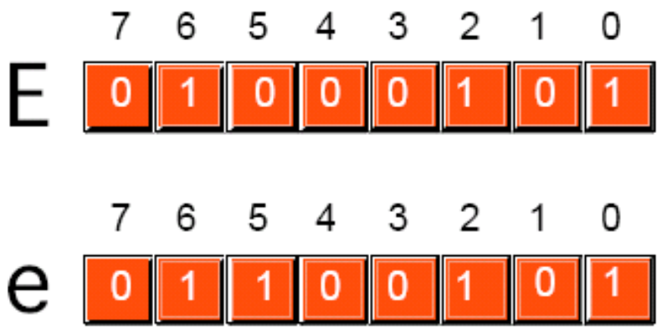
Letter characters
The codes for an uppercase letter and the corresponding lowercase letter differ by exactly one bit.
Bit 5 is 0 for an uppercase letter and 1 for the corresponding lower­case letter while other bits are the same.
Chap1 Representing Data in a Computer

Slide 30
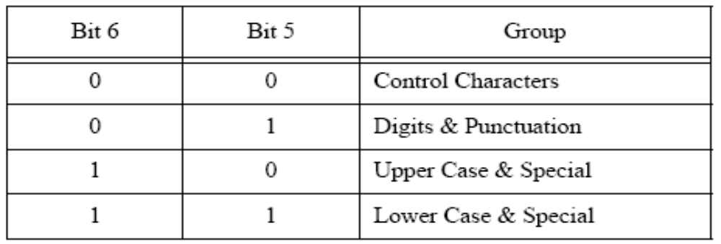
Chap1 Representing Data in a Computer

Slide 31
Exercise 1.2
Look up Appendix A，and fill in what is needed in the following blanks.
'0' - '9': （1） H - （2） H
'A'-'Z': （3） H - （4） H
'a' - 'z': （5） H - （6） H
CR: （7） H
LF: （8） H
' ': （9） H
Chap1 Representing Data in a Computer

Slide 32
Contents
Binary and hexadecimal numbers
Character codes
2's complement representation for signed integers
Addition and subtraction of 2's complement numbers
Other systems for representing numbers
Chap1 Representing Data in a Computer

Slide 33
1.3 2's complement representation for signed integers
Data organization
Unsigned number / Signed number
2’s complement
Convert 2’s complement to decimal
Chap1 Representing Data in a Computer

Slide 34
Data organization
Bit
Nibble
Byte
Word
Double word (Dword)
Quadword (QWord)
Chap1 Representing Data in a Computer

Slide 35
2’s complement
Representation of nonnegative numbers
  represent the number in binary with enough leading zeros to fill up the desired length. Only one additional restriction exists—for a positive number, the left­most bit must be zero.
Representation of negative numbers
  Taking the 2’ complement
Chap1 Representing Data in a Computer

Slide 36
Example
The word-length 2's complement representation of the decimal number -76 is found by :
first converting the unsigned number 76 to its
hex equivalent 4C,
then by subtracting 4C from 10000.
1 0 0 0 0
－ 4 C
' F F B 4
Chap1 Representing Data in a Computer

Slide 37
Taking the 2’ complement
Method 1
  Setp1: express the unsigned number in hex
  Setp2: Subtract this hex number from 10000₁₆ to get the word length representation.
    The number you subtract from is, in hex, a 1 followed by the number of 0’s in the length of the representation.
Chap1 Representing Data in a Computer

Slide 38
Convert 2’s complement to decimal
Determine the sign of a 2's complement number firstly
  Positive numbers
    a leading bit of 0, corresponding to hex digits of 0 through 7
  Negative numbers
    a leading bit of 1, corresponding to hex digits of 8 through F
    taking the 2’ complement
Chap1 Representing Data in a Computer

Slide 39
Negative numbers are distinguished by a leading bit of 1, corresponding to hex digits of 8 through F
FFFF is the representation of –1
The range of decimal numbers that can be represented in word-length 2's complement form is -32768 to 32767
Chap1 Representing Data in a Computer

Slide 40
Example
The word-length 2's complement number E973 represents a negative value since the sign bit is 1 (E = 1110). Taking the complement finds the corresponding positive number.
10000 − E973 = 168D = 5773₁₀
This means that the decimal number represented by E973 is −5773
Chap1 Representing Data in a Computer

Slide 41
Exercise
Find the byte-length 2's complement
representation of each of the following
decimal numbers:
111
-100
Chap1 Representing Data in a Computer

Slide 42
Contents
Binary and hexadecimal numbers
Character codes
2's complement representation for signed integers
Addition and subtraction of 2's complement numbers
Other systems for representing numbers
Chap1 Representing Data in a Computer

Slide 43
1.4 Addition and subtraction of
2's complement numbers
Addition
  Carry and overflow
Subtraction
  Borrow and overflow
Chap1 Representing Data in a Computer

Slide 44



Addition
Chap1 Representing Data in a Computer

Slide 45
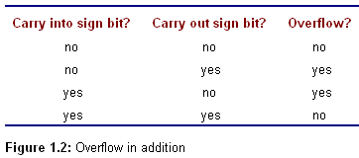
Overflow in addition
Chap1 Representing Data in a Computer

Slide 46
Subtraction(1-2)
In a computer, subtraction a − b of numbers a and b is usually performed by taking the 2's complement of b and adding the result to a. This corresponds to adding the negation of b.
Chap1 Representing Data in a Computer

Slide 47
Subtraction (2-2)
For example, for the decimal subtraction 195 - 618 = -423,
00C3 - 026A is changed to addition of FD96, the 2's complement of 026A.
00C3
+ FD96
FE59
The hex digits FE59 do represent −423
Chap1 Representing Data in a Computer

Slide 48
Overflow in Subtraction
Overflow is also defined for subtraction
A computer detects overflow in subtraction by determining whether or not overflow occurs in the corresponding addition problem
Chap1 Representing Data in a Computer

Slide 49
Contents
Binary and hexadecimal numbers
Character codes
2's complement representation for signed integers
Addition and subtraction of 2's complement numbers
Other systems for representing numbers
Chap1 Representing Data in a Computer

Slide 50
1.5 Other systems for representing numbers
1’ complement
Binary Coded Decimal (BCD)
Floating point
Chap1 Representing Data in a Computer

Slide 51
1’ complement
A fixed length is chosen for the representation
A positive integer is simply the binary form of the number, padded with one or more leading zeros on the left to get the desired length.
To take the negative of the number, each bit is "complemented"; that is, each 0 is changed to 1 and each 1 is changed to 0.
Chap1 Representing Data in a Computer

Slide 52
Example
The byte length 1 's complement representation of the decimal number 97 is just the value 0110 0001 in binary (61 in hex). Changing each 0 to 1 and each 1 to 0 gives 10011110 (9E in hex), the byte length 1's complement representation of -97.
Chap1 Representing Data in a Computer

Slide 53
Binary Coded Decimal (BCD)
each decimal digit is coded with a string of bits with fixed length, and these strings are pieced together to form the representation.
Most frequently four bits are used for each decimal digit; the choices for bit patterns are shown in Fig. 1.3.
Chap1 Representing Data in a Computer

Slide 54
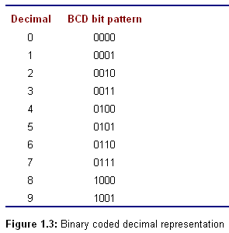
Chap1 Representing Data in a Computer

Slide 55
Example
One BCD representation of the decimal number 926708 is 1001 0010 0110 0111 0000 1000.
Using one hex digit as shorthand for four bits, and grouping two hex digits per byte, this BCD representation can be expressed in three bytes as
92
67
08
Chap1 Representing Data in a Computer

Slide 56
Summary(1-3)
Numbers can be written in decimal, hexadecimal, or binary forms.
For representing characters, most microcomputers use ASCII codes. One code is assigned for each character, including nonprintable control characters.
Chap1 Representing Data in a Computer

Slide 57
Summary(2-3)
Integer values are represented in a predetermined number of bits in 2's complement form
  positive number
  negative number
Chap1 Representing Data in a Computer

Slide 58
Summary(3-3)
Addition and subtraction are easy with 2's complement numbers.
Since the length of a 2's complement number is limited, there is the possibility of a carry, a borrow, or overflow.
Chap1 Representing Data in a Computer

Slide 59
preparation
Read chapter2
2.1 memory
2.2 CPU
Chap1 Representing Data in a Computer

