Slide 1

Input/Output
College of Computer Science, SCUEC

Slide 2
Review of last class
Two-Pass and One-Pass Assembly
Macro Definition and Expansion
Macros in IO.H
Input/Output

Slide 3
Expected outcome
You will be able to understand the input and output ways in assembly language
Input/Output

Slide 4
Key language
Input
Output
Input/Output

Slide 5
Anticipatory set(1-2)
Programs in previous chapters have used the input macro to input data from the PC console keyboard and the output macro to output data to the console display.
Input and output from an assembly language program have been limited to the keyboard and the monitor.
Input/Output

Slide 6
Anticipatory set(2-2)
This chapter examines the underlying operating system calls that are used by the input and output macros. It then examines similar operating system calls that make it possible to read and write sequential files to secondary storage.
Next it looks at the 80x86 instructions that actually do input and output and discusses alternative I/O schemes, including memory-mapped and interrupt-driven I/O.
Input/Output

Slide 7
Contents
Console I/O Using the Kernel32 Library
Sequential File I/O Using the Kernel32 Library
Lower-Level Input/Output
Input/Output

Slide 8
Example (fig. 12.1)
Figure 12.1 shows a simple example illustrating how kernel32 functions can write a simple message.
This example is similar to many of those seen previously in the book in its overall structure.
Input/Output

Slide 9
However, it is missing the "standard" directive INCLUDE io.h.
In addition to the familiar prototype for the ExitProcess function, it contains two new function prototypes. These functions are needed to write to the console.
Input/Output

Slide 10
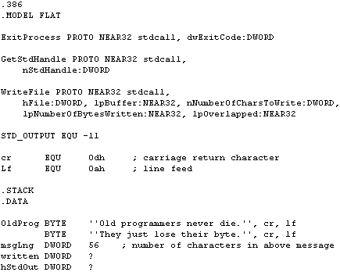
Input/Output

Slide 11
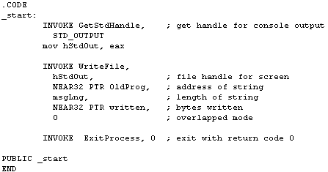
Input/Output

Slide 12
The Windows 95/98/NT operating systems are similar to many others in that they treat input/output devices and disk files in a uniform manner.
Note that in Fig. 12.1, a WriteFile call is used to display a message on the console.
This same function can be used to write to a disk file.
Input/Output

Slide 13
The device or file used for I/O is identified by its handle, a doubleword value in an assembly language program.
The handle value must be obtained before the WriteFile call is made.
There is more than one way to do this for a console file; GetStandardHandle provides an easy method.
Input/Output

Slide 14
Any GetStdHandle call has a single parameter; a numeric value, distinct from the handle, indicates the particular device.
There are three standard devices: one for input, one for output, and one to report errors (normally the same as the standard output device).
Each device number is usually equated to a symbol, and these symbols are used in code.
Input/Output

Slide 15
We will only use the input and output devices; their numbers and names appear in Fig. 12.2.
GetStdHandle is a function, returning in EAX a handle for the standard I/O device.
The handle value is usually stored in memory to be available later.
In the sample program, the returned value is immediately copied to the doubleword referenced by hStdOut.
Input/Output

Slide 16
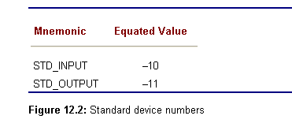
Input/Output

Slide 17
function Writefile
With five parameters, a WriteFile call is more complicated.
  The first is the handle that identifies the file—this handle is returned by GetStdHandle, not the device number.
  The second parameter is the address of the string—note the use of the NEAR32 PTR operator in the example to tell the assembler to use the address of OldProg rather than the value stored there.
  The third parameter is a doubleword containing the number of bytes to be displayed.
Input/Output

Slide 18
  The next parameter is used to return a value to the calling program.
    This value indicates how many bytes were actually written.
    In the case of output to the console, this will be the length of the message unless an error occurs.
  The fifth and final parameter will always be 0 in this book's examples.
  It can be used to indicate non-sequential access to some files, but we are going to deal only with sequential access.
Input/Output

Slide 19
Function -- Readfile
The new function Readfile is very similar to WriteFile except that
  the second parameter has the address of an input buffer
  the third parameter gives the maximum number of characters to read
  the fourth parameter returns the number of characters actually read.
Input/Output

Slide 20
the input and output macros that you have used in most of this book expand into procedure calls that use the kernel32 console input/output functions.
The relevant portion of the file IO.ASM is shown in Fig. 12.4.
Input/Output

Slide 21
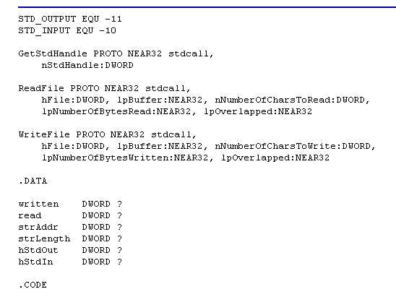
Input/Output

Slide 22
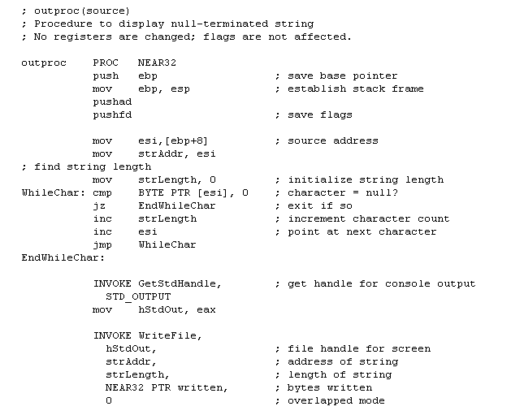
Input/Output

Slide 23
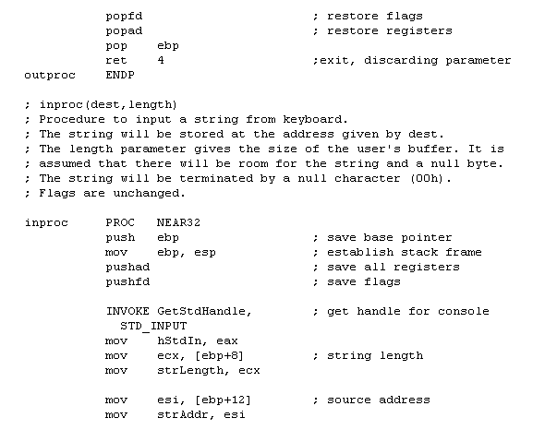
Input/Output

Slide 24
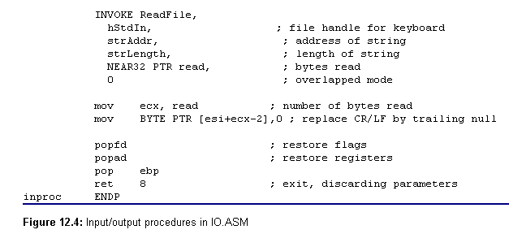
Input/Output

Slide 25
At this point there is nothing surprising in the input/output code in IO.ASM.
It starts with the same directives that appeared in the previous two examples.
The data area does not include an input buffer since this will be in the user's calling program.
It does have the variable strAddr to locally store the input or output buffer address that is passed as a parameter.
Input/Output

Slide 26
The output procedure outproc expects this to be the address of a null-terminated string.
After standard procedure entry code, it computes the length of that string.
It then gets the handle for the console and writes to the console, exactly as in the earlier example in Fig. 12.1.
Input/Output

Slide 27
Contents
Console I/O Using the Kernel32 Library
Sequential File I/O Using the Kernel32 Library
Lower-Level Input/Output
Input/Output

Slide 28
File processing applications generally involve opening the file, reading from or writing to the file, and finally closing the file.
At the level of the kernel32 library, opening the file means to obtain a handle for it.
Closing the file that has been read may be important to free it up for access by another user.
Closing a file that has been written may be necessary to force the operating systems to save the final characters.
In this section we investigate how to do some of these operations for sequential disk files.
File operations like these are usually more appropriately done using a high-level language, so the primary purpose of this section is to give you a sense of what is "under the hood" of a high-level language.
Input/Output

Slide 29
Figure 12.5 shows a program that prompts for inputs the name of a file and then displays the contents of the file on the console.
It includes two new kernel32 function prototypes, CreateFileA and CloseHandle.
In spite of its name, CreateFileA is used both to open an existing file or to create a new file. CloseHandle is used to close a file.
Input/Output

Slide 30
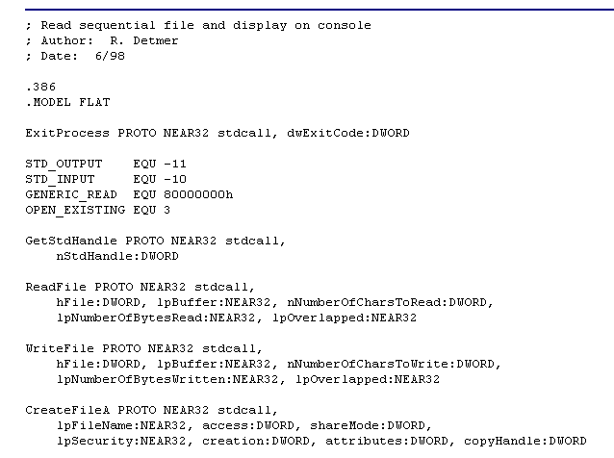
Input/Output

Slide 31
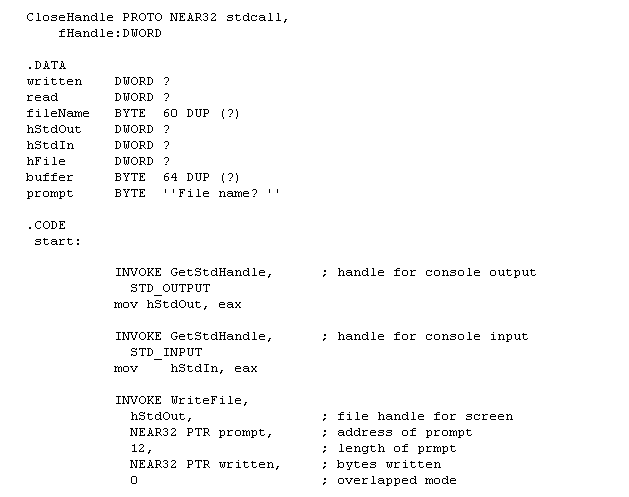
Input/Output

Slide 32
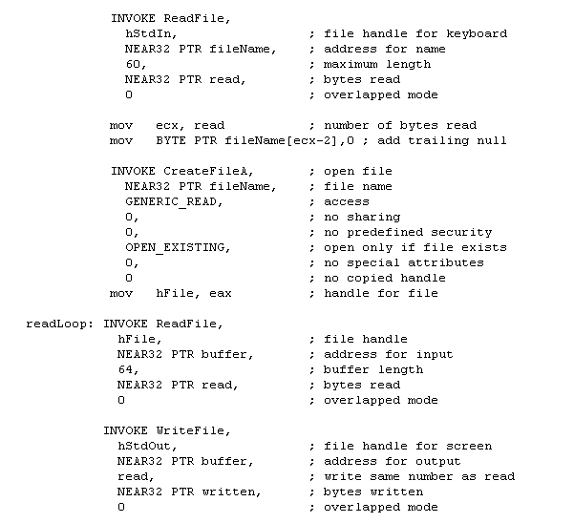
Input/Output

Slide 33
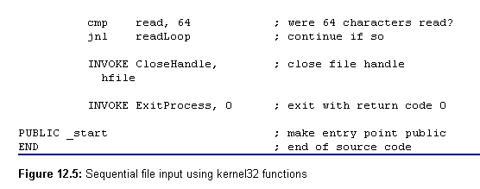
Input/Output

Slide 34
CreateFileA(1-3)
CreateFileA returns the handle of a file that it opens or creates, or returns 1 (FFFFFFFF₁₆) if the operation fails. It has seven parameters
The address of a null-terminated string giving the name of the file
A doubleword giving the desired access. We will only use GENERIC_READ (80000000₁₆) and GENERIC_WRITE (40000000₁₆).
A doubleword indicating how the file can be shared. We will use 0 to indicate that it cannot be shared.
Input/Output

Slide 35
CreateFileA(2-3)
4. This parameter is used to indicate whether this file can be used by child processes. We will use 0 to indicate that it cannot.
5. A doubleword containing flags indicating what to do if the file does not exist. We will use OPEN_EXISTING (3) when opening an existing file; the CreateFileA function will fail if the file does not exist. We will use CREATE_NEW (1) when creating a new file; the CreateFileA function will fail if the file already exists. In other applications, CREATE_ALWAYS (2) may be appropriate; this creates a new file if one does not exist and overwrites an existing file if it does exist.
Input/Output

Slide 36
CreateFileA(3-3)
6. This parameter is used to set various file attributes. We will use a value of 0 to indicate no special attributes.
7. The final parameter can be used to indicate the handle of a template file whose attributes will be used for the newly created file. We will always use 0 to indicate no template.
As we will use CreateFileA, we will specify parameters 1, 2 and 5, and supply zeros for the other four.
Input/Output

Slide 37
CloseHandle
The CloseHandle function is very simple. It has a single parameter, the handle of the file to be closed.
Input/Output

Slide 38
The main read loop in Fig. 12.5 uses ReadFile to read 64 characters at a time from the source file.
End of file is detected by comparing the number of characters actually read to 64. If it is smaller, then the end of the file has been reached.
However, note that the characters read are displayed first, so that you don't lose the last partial buffer.
Input/Output

Slide 39
Figure 12.6 (skipped) shows a program that will create a disk file from console input.
It first prompts for and inputs the name of the file.
It creates that file, fails if it already exists, and copies lines from the console keyboard to the file until the user begins a line with %%, a character combination chosen to be unlikely to appear at the beginning of a line in ordinary text.
Input/Output

Slide 40
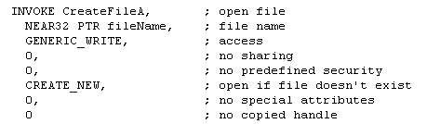
Input/Output

Slide 41
There is very little new in this example. The call to CreateFileA uses GENERIC_WRITE and CREATE_NEW for creation of a new file. The main loop reads a string of up to 128 characters from the keyboard and writes the string to the file.
Loop control is accomplished by checking the first two characters of the string before writing it to the file.
Input/Output

Slide 42
Contents
Console I/O Using the Kernel32 Library
Sequential File I/O Using the Kernel32 Library
Lower-Level Input/Output
Input/Output

Slide 43
Standard ports
In an IBM-compatible PC, common I/O devices normally have standard port assignments.
For example, the parallel printer port known as LPT1 uses three port addresses: 0378, 0379, and 037A.
  The first port is used to send characters to a printer
  The second is to determine its status
  The third is to send control information to the printer
Input/Output

Slide 44
I/O port
An I/O port is a device that looks like a memory cell to the computer but contains connections to the outside world.
An I/O port typically uses a latch rather than a flip-flop to implement the memory cell.
When the CPU writes to the address associated with the latch, the latch device captures the data and makes it available on a set of wires external to the CPU and memory system
Input/Output

Slide 45
Addressing I/O devices
The hardware designer chooses whether to use memory-mapped I/O or the separate I/O address space when building the system.
Other architectures, for example the Motorola 680x0 designs, use only memory-mapped I/O.
Input/Output

Slide 46
In & Out instructions
Form:
  in eax/ax/al , port
  in eax/ax/al , dx
  out port , eax/ax/al
  out dx , eax/ax/al
Operation
  The in instruction reads the data at the specified I/O port and copies it into the accumulator
  The out instruction writes the value in the accumulator to the specified I/O port.
Input/Output

Slide 47
Example of in/out instructions
in al , 60h ;Read keyboard port
mov dx , 378h ;Point at LPT1: data port
in al , dx ;Read data from printer port.
inc ax ;Bump the ASCII code by one
out dx , al ;Write data in AL to printer port
Input/Output

Slide 48
Interrupt-driven I/O
Interrupt-driven I/O relies on hardware interrupts to inform the CPU of a device's change in status.
An interrupt is a hardware signal generated by the device and received by the CPU.
When the CPU receives such a signal, it normally finishes executing the current instruction, and then transfers control to an interrupt procedure.
This is very similar to a regular procedure call.
Input/Output

Slide 49
An Intel 80x86 system provides for up to 256 different interrupts.
The address for an interrupt procedure comes from a table of addresses in the very bottom of memory.
Memory locations 0 to 1024₁₀ contain 256 addresses corresponding to interrupt levels 0 through 255. In general, for interrupt type t, the interrupt procedure's address is stored at address 4*t.
Input/Output

Slide 50
A computer system may be designed to generate an interrupt when a key on the keyboard is pressed.
The associated interrupt procedure would capture the character and store it in a buffer for later processing before returning, allowing the computer to go back to whatever it was doing.
Input/Output

Slide 51
The 80x86 architecture includes an int instruction that enables a program to invoke an interrupt procedure.
Not all interrupt types are used by hardware devices, and some operating systems, notably Microsoft DOS, use int instructions to call operating system functions.
Input/Output

Slide 52
Summary
Input and output can be done at many levels, from high-level language procedures down to in and out instructions.
The kernel32 library illustrates the operating-system level example of I/O.
This library has functions for getting a file or device handle, reading from a file or device, writing to a file or device, and releasing the file or device.
Input/Output

