Slide 1

Parts of a Computer System
college of Computer Science, SCUEC

Slide 2
Review of last class
Numbers can be written in decimal, hexadecimal, or binary forms
Convert among decimal, hexadecimal, or binary
ASCII codes for representing characters
2’s complement
Other formats data representations

Slide 3
Expected outcome
You will be able to understand how the memory and CPU look to the assembly language programmer for a particular class of microcomputers, the IBM PC and compatible systems.

Slide 4
Key language
Hardware & Software
Memory & Memory model
CPU & Register

Slide 5
Anticipatory set
Parts of a Computer System
  Hardware
    Physical equipments used in data processing
  Software
    Refer to the programs that the hardware executes, including system software and application software

Slide 6
Terminology
Central processing unit(CPU)
Hardware / Software
Physical address / Logical address
Integrated circuit (IC)
Random access memory (RAM)
Read-only memory (ROM)
Flat memory / segmented memory

Slide 7
Terminology
General registers
Memory-mapped input/output
Disk operating system (DOS)
Command line interface
Graphical user interface
Integrated development environment

Slide 8
Contents
PC hardware: memory
PC hardware: the CPU
PC hardware: input/output devices
PC software

Slide 9
PC hardware: memory
Memory address
RAM and ROM
Memory model

Slide 10
Memory address(1-3)
The memory in an IBM PC or compatible microcomputer is logically a collection of "slots," each of which can store one byte of instructions or data.
To differentiate memory locations and I/O devices, the system designer assigns a unique memory address to each memory element and I/O device.
Each memory byte has a 32-bit numeric label called its physical address.

Slide 11
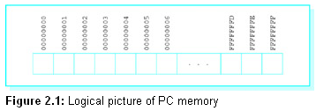
Memory address(2-3)
A physical address can always be expressed as eight hex digits. The first address is 00000000₁₆ and the last address can be as large as the unsigned number FFFFFFFF₁₆.

Slide 12
Memory address(3-3)
Prior to the 80386 chip, the Intel 80x86 family of processors could only directly address 2²⁰ bytes of memory. They used 20-bit physical addresses, often expressed as 5-hex-digit addresses ranging from 00000 to FFFFF.

Slide 13
RAM and ROM
Random access memory (RAM)
  which can be written to or read from by program instructions. The contents of RAM chips are lost when the computer's power is turned off.
Read-only memory (ROM)
  which permanently retain their contents and can be read from but not written to

Slide 14
Memory model
Segmented memory model
Flat memory model

Slide 15
Segmented memory model
With the 8086/8088, the PC's memory is visualized as a collection of segments, each segment 64 Kbytes long, starting on an address that is a multiple of 16
The segment number of a segment consists of the first four hex digits of its physical address
The offset is the distance from the first byte of the segment to the byte being addressed

Slide 16
Logical address
Each memory reference depends on its segment number and a 16-bit offset from the beginning of the segment.
The notation for a logical (segment-offset) address is the four-hex-digit segment number followed by a colon (:) followed by the four-hex-digit offset.

Slide 17
Logical address
Example
18A3:5B27
18A30 starting address of segment 18A3
+ 5B27 offset
1E557 five-hex-digit address

Slide 18
Flat memory model
The 80x86 flat memory model is really a 32-bit segmented model with all segment registers containing the same value
A segment number is used as an index into a table that contains the actual 32-bit starting address of the segment.
A 32-bit offset is added to that starting address to compute the actual address of the memory operand

Slide 19
Exercises 2.1
1. Suppose that you buy a PC with 32 MBytes of RAM. What is the 8-hex-digit address of the "last" byte?
3. Suppose that you have an Intel 8086. Find the five-hex-digit address that corresponds to each of these segment:offset pairs:
(c) 1234:5678

Slide 20
Contents
PC hardware: memory
PC hardware: the CPU
PC hardware: input/output devices
PC software

Slide 21
PC hardware: the CPU
The most visible component of the CPU is the register set
the 80x86 chips have a set of on-board registers, each an internal storage location that can be accessed much more rapidly than a location in RAM
The application registers are of most concern to the programmer.

Slide 22
Application Programmer Visible
Registers
General Purpose Registers
Segment Registers
Special Purpose Registers

Slide 23
General Purpose Registers
Data registers
  EAX, EBX, ECX, EDX
Index registers
  ESI, EDI
Stack pointer (ESP)
Base pointer (EBP)

Slide 24
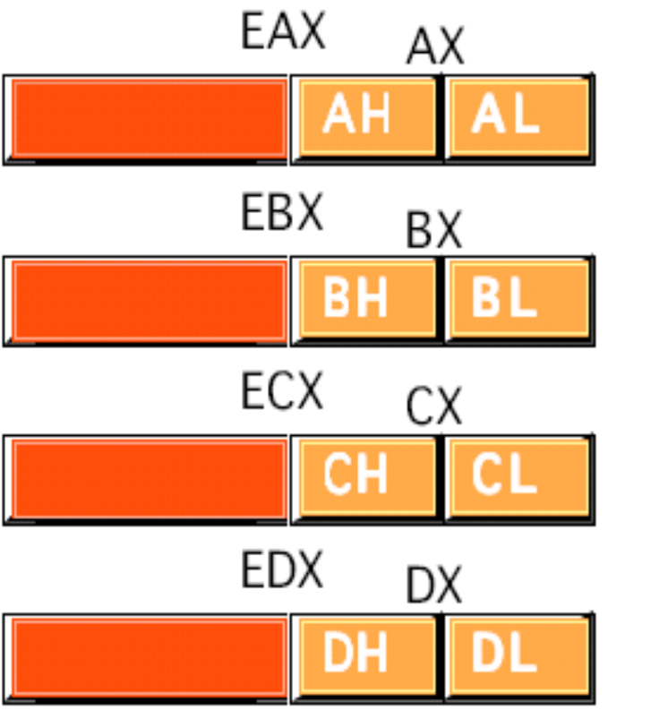
Data registers
EAX register (Accumulator) is where most arithmetic and logical computations take place
EBX register (Base) is commonly used to hold indirect addresses
ECX register (Count) is often used to count off the number of iterations in a loop or specify the number of characters in a string
EDX register (Data) holds the overflow from certain arithmetic operations, and holds I/O addresses when accessing data on the 80x86 I/O bus.
31 16 15 8 7 0

Slide 25
Example
Add eax, 254
Sub ax, 10
Mov ah, ‘1’

Slide 26
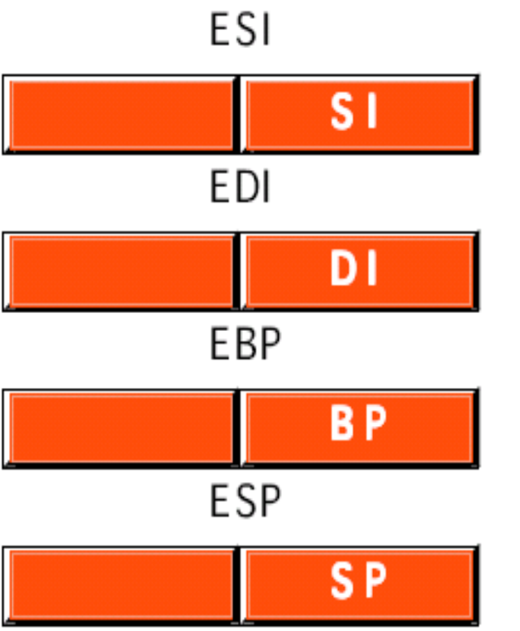
ESI stands for source index and EDI stands for destination index. One of their uses is to indicate memory addresses of the source and destination when strings of characters are moved from one place to another in memory. They can also be used to implement array indexes.
EBP (base pointer) register is often used to mark a fixed point in the stack other than the stack top
ESP register is the stack pointer for the system stack.
31 16 15 0

Slide 27



Segment Registers
CS register contains the segment number of the code segment, the area of memory where the instructions currently being executed are stored
15 0
DS register contains the segment number of the data segment, the area of memory where most data is stored
ES register contains the segment number of the extra data segment that could have multiple uses
SS register contains the segment number of the stack segment, where the stack is maintained
FS and GS registers were added with the 80386 and make possible easy access to two additional data segments

Slide 28
Special Purpose Registers
Instruction pointer (EIP)
Flags register (EFLAGS)

Slide 29
EIP (Extended instruction pointer)
The EIP register cannot be directly accessed by an assembly language programmer.
The CPU has to fetch instructions to be executed from memory, and EIP keeps track of the-address of the next instruction to be fetched.

Slide 30

EFLAGS
Some of its 32 bits are used to set some characteristic of the 80x86 processor. Other bits, called status flags, indicate the outcome of execution of an instruction
31 16 15 0

Slide 31
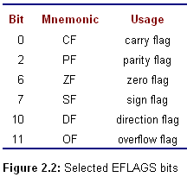

Slide 32
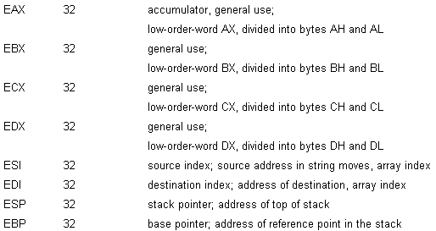
80x86 register(1-2)

Slide 33
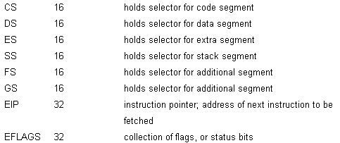
80x86 register(2-2)

Slide 34
Registers are so important in assembly language programming for various reasons
The variety of instructions using registers tends to be greater than that for operating on values stored at memory locations
  These instructions tend to be shorter (i.e., take up less room to store in memory)
  Register-oriented instructions operate faster than memory-oriented instructions

Slide 35
Contents
PC hardware: memory
PC hardware: the CPU
PC hardware: input/output devices
PC software

Slide 36
PC hardware: input/output devices
Typical input/output (I/O) devices include a keyboard or a mouse for input, a monitor to display output, and a disk drive for data and program storage.

Slide 37
An assembly language programmer has multiple ways to look at I/O devices
  I/O-mapped I/O (the lowest level )
    Each device uses a collection of addresses or ports in the I/O address space
    An I/O port is a device that looks like a memory cell to the computer but contains connections to the outside world
  Memory-mapped input/output
  Direct memory access (DMA)

Slide 38
Contents
PC hardware: memory
PC hardware: the CPU
PC hardware: input/output devices
PC software

Slide 39
PC software
Software refers to the programs or procedures executed by the hardware
  Operating System (OS)
  Text Editors
  Language Translators
  Linker
  Debugger
  Integrated development environments

Slide 40
Operating System (OS)
DOS(disk operating system )
  PC-DOS, MS-DOS
  provide a command line interface
Windows
  Windows32, Windows95, Windows…
  provide graphical user interface that displays icons representing tasks or files
UNIX, Linux

Slide 41
Text Editors
A text editor is a program that allows the user to create or modify text files that are stored on disk. A text file is a collection of ASCII codes
  EDIT (text editor)
  Notepad
  Word
  Open office
  Edit plus
  ….

Slide 42
Language Translators
Language translators are programs that translate a programmer's source code into a form that can be executed by the computer
  Interpreter
  Compiler
  Assembler

Slide 43
Interpreter
Interpreters directly decipher a source program. To execute a program, an interpreter looks at a line of source code and follows the instructions of that line.
Basic or Lisp language programs are often executed by an interpreter.

Slide 44
Compiler
Compilers start with source code and produce object code that consists mostly of instructions to be executed by the intended CPU
High-level languages such as Pascal, Fortran, Cobol, C, and C++ are commonly compiled

Slide 45
Assembler
An assembler is used much like a compiler, but translates assembly language rather than a high-level language into machine code
Assembly language is commonly Assembled
Main assembler
  Masm.exe , Tasm.exe, ml.exe

Slide 46
Linker
The object code produced by a compiler must often be linked or combined with other object code to make a program that can be loaded and executed
The resulting files produced by an assembler must normally be linked to prepare them for execution too
This requires a utility called a linker
  Link.exe

Slide 47
Debugger
Allow a programmer to control execution of a program, pausing after each instruction or at a preset breakpoint. When the program is paused, the programmer can examine the contents of variables in a high-level language or registers or memory in assembly language
  Debug.exe, windbg.exe

Slide 48
Integrated development environments
Use a single interface to access an editor, a compiler, and a linker.
Initiate execution of the program being developed and frequently provide other utilities, such as a debugger
Be convenient, but may not always be available for a particular programming language

Slide 49
Summary
Hardware
  Memory & memory address
  CPU & registers
  Input/output & ports
Software
  Operating system
  Text editor, assembler, linker and debugger

Slide 50
Assignment
Exercise 2.1 3(b)
Exercise 2.2 3
Exercise 2.3 1, 2

Slide 51
preparation
Read chaper3

