Slide 1

Basic Instructions
College of Computer Science, SCUEC

Slide 2
Review of last class
Type and format of statement
A complete ASM program
How to implement an executable program
Constant operands
Instruction operands
Addressing modes
Basic Instructions

Slide 3
Expected outcome
You will be able to copy data between memory and CPU registers, and between two registers.
You will also be able to use addition, subtraction, multiplication, and division instructions.
Basic Instructions

Slide 4
Key language
Destination (dest)
Source (src)
Accumulator(acc)– AL, AX, EAX
Basic Instructions

Slide 5
Anticipatory set
What instructions have been mentioned ?
Can you use them correctly?
Basic Instructions

Slide 6
Terminology
Time efficiency
Space efficiency
Clock cycles
Flag
Sign-extended
Product
Dividend
Divisor
Quotient
Remainder
Basic Instructions

Slide 7
Contents
Copying Data
Integer Addition and Subtraction Instructions
Multiplication Instructions
Division Instructions
Addition and Subtraction of Larger Numbers
Basic Instructions

Slide 8
4.1 Copying Data
Mov(move) instruction
Time efficiency & space efficiency
Flag effects of instructions
Unavailable logical combinations
Xchg(exchange) instruction
Basic Instructions

Slide 9
Mov instruction(1-3)
Move
Form: mov destination, source
Operation
  Copies a byte, word, or doubleword value from the source operand location to the destination operand location
Basic Instructions

Slide 10
Mov instruction(2-3)
The value stored at the source location is not changed
The destination location must be the same size as the source
Basic Instructions

Slide 11
Mov instruction(3-3)
A mov instruction is similar to a simple assignment statement in a high-level language
For example, the C assignment statement
Count = Number;
might corresponds directly to the assembly language Instruction
mov Count, ecx ; Count : = Number
Assuming that the ECX register contains the value of Number and that Count references a doubleword in memory
Basic Instructions

Slide 12
Time efficiency & space efficiency
Although little production programming is actually done in assembly language, some assembly language code is written in the interest of obtaining very efficient procedures
Basic Instructions

Slide 13
Time efficiency
Time efficiency is often measured by the length of time it takes to execute a program, and this depends on the number of clock cycles it takes to execute its instructions
The length of time an instruction takes to execute is measured in clock cycles. To determine the actual time, you must know the clock speed of the processor
Basic Instructions

Slide 14
Space efficiency
Space efficiency refers to the size of the code(the number of bytes )—a small executable file may be important if the program must be stored in ROM
Basic Instructions

Slide 15
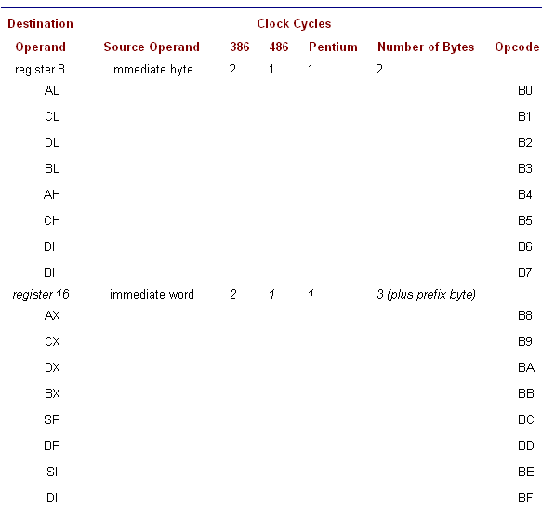
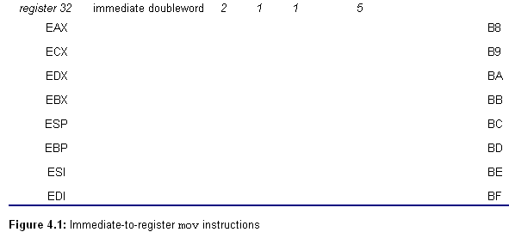
Basic Instructions

Slide 16
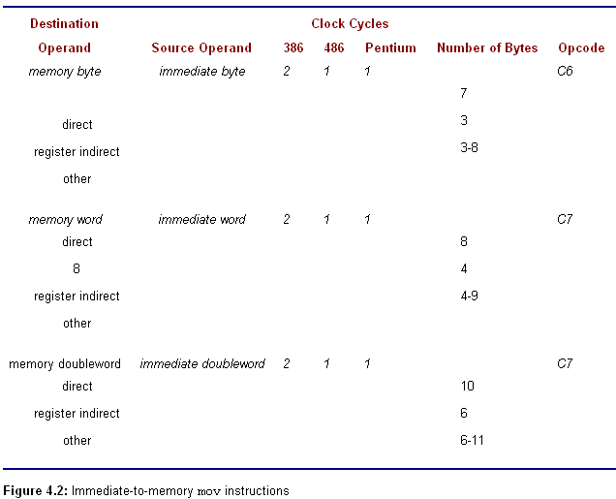
Basic Instructions

Slide 17
Flag effects of instructions
No flags are altered
Specific flags are given values depending on the results of the instruction
Some flags may be altered, but their settings cannot be predicted
All mov instructions fall in the first category: No mov instruction changes any Flag
Basic Instructions

Slide 18
Unavailable logical combinations
A move with both source and destination in memory
Immediate source to segment register destination
Any move from the EFLAGS and EIP register and to the EFLAGS, EIP and CS register
A move from one segment register to another segment register
Any move where the operands are not the same size
A move of several objects
Basic Instructions

Slide 19
Xchg instruction(1-3)
Exchange
Form: xchg operand1, operand2
Operation
  exchanges the contents of the source and destination operands
Basic Instructions

Slide 20
Xchg instruction(2-3)
Suppose Value1 and Value2 are being exchanged. In a design of a high-level language, this might be done using
Temp = Value1; // swap Value1 and Value2
Value1 = Value2;
Value2 = Temp;
Basic Instructions

Slide 21
Xchg instruction(3-3)
Assume that value1 is stored in the EAX register and Value2 is stored in the EBX register
The above swap can be coded as
xchg eax, ebx ; swap Value1 and Value2
Instead of using the xchg instruction, one could code
mov ecx, eax ; swap Value1 and Value2
mov eax, ebx
mov ebx, ecx
Basic Instructions

Slide 22
Exercise 4.1
For each part of this problem, assume the "before" values when the given mov instruction is executed. Give the requested "after" values.
Before
(a) BX: FF 75
CX: 01 A2
(b) AL: 64
(c) EBX: 00003A4C
Value: DWORD -1
instruction
mov bx, cx
mov al, -1
mov Value, ebx
After
BX,CX
AL
EBX, Value
Basic Instructions

Slide 23
Exercise 4.1
For each part of this problem, assume the "before" values when the given xchg instruction is executed. Give the requested "after" values.
Before
(a) BX: FF 75
CX: 01 A2
(b) AX: 12 34
(c) EBX: 00003A4C
Temp: DWORD -1
instruction
xchg bx, cx
xchg al, ah
xchg Temp, ebx
After
BX,CX
AX
EBX, Temp
Basic Instructions

Slide 24
Contents
Copying Data
Integer Addition and Subtraction Instructions
Multiplication Instructions
Division Instructions
Addition and Subtraction of Larger Numbers
Basic Instructions

Slide 25
4.2 Integer Addition and
Subtraction Instructions
Add(add) instruction
Inc(increment) instruction
Sub(subtract) instruction
Dec (decrement) instruction
Neg (negate) instruction
Basic Instructions

Slide 26
Add, sub, inc, dec, and neg instructions all update flags in the EFLAGS register. The SF, ZF, OF, PF, CF, and AF flags are set according to the value of the result of the operation.
Basic Instructions

Slide 27
Add instruction
Form : add dest, src
Operation
  dest := dest + src
  Add the integer at source to the integer at destination and the sum replaces the old value at destination
Basic Instructions

Slide 28
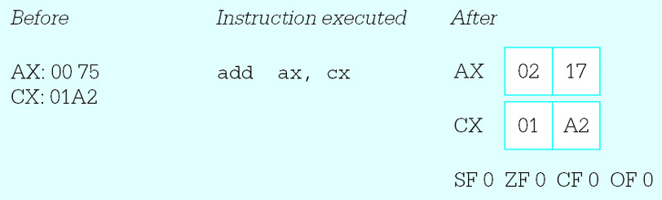
Example
Basic Instructions

Slide 29
Sub instruction
Form: sub dest, src
Operation
  dest := dest - src
  Subtract the integer at source from the integer at destination and the difference replaces the old value at destination
Basic Instructions

Slide 30
Inc & Dec instructions
The inc (increment) and dec (decrement) instructions are special-purpose addition and subtraction instructions, always using 1 as an implied source.
Forms :
  inc dest
    Operation: dest := dest + 1
  dec dest
    Operation: dest := dest - 1
Basic Instructions

Slide 31
Inc & Dec instructions
The inc and dec instructions treat the value of the destination operand as an unsigned integer
They affect the OF, SF, and ZF flags just like addition or subtraction of one, but they do not change the carry flag CF.
Basic Instructions

Slide 32
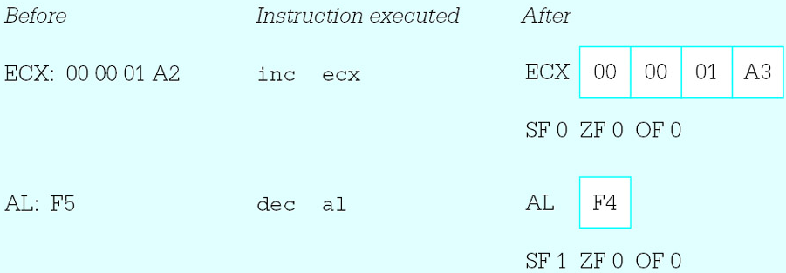
Example
Basic Instructions

Slide 33
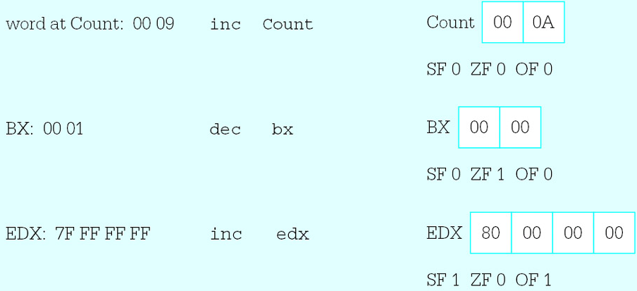
Example
Basic Instructions

Slide 34
Efficiency of inc & dec(1-2)
The inc and dec instructions are especially useful for incrementing and decrementing counters.
They sometimes take fewer bytes of code and execute in fewer clock cycles than corresponding addition or subtraction instructions.
Basic Instructions

Slide 35
Efficiency of inc & dec(2-2)
For example, the instructions
add cx, 1 ; increment loop counter and
inc cx ; increment loop counter
are functionally equivalent.
But, the add instruction requires three bytes, while the inc instruction requires one byte
Basic Instructions

Slide 36
Neg instruction
Form : neg dest
Operation
  dest := - dest
  Negate, or take the 2’s complement of its single operand
  When a positive value is negated the result is negative; a negative value will become positive. Zero remains zero
Basic Instructions

Slide 37
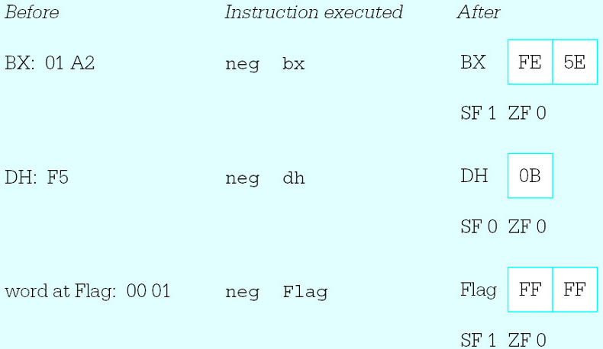
Example
Basic Instructions

Slide 38
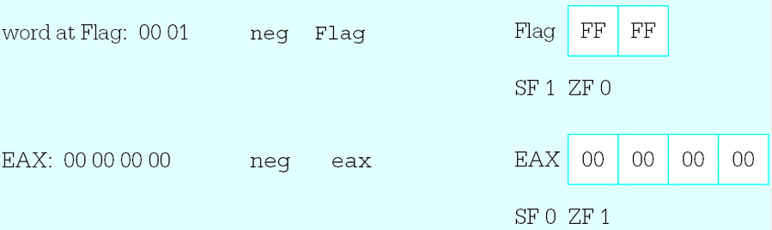
Example
Basic Instructions

Slide 39
Example of program
Input values for three numbers, x, y and z, evaluate the expression −(x + y −2z + 1) and display the result
Basic Instructions

Slide 40
Design implemented
prompt for and input value for x;
convert x from ASCII to 2’s complement form;
expression := x;
prompt for and input value for y;
convert y from ASCII to 2’s complement form;
add y to expression, giving x + y;
prompt for and input value for z;
convert z from ASCII to 2’s complement form;
calculate 2*z as (z + z);
subtract 2*z from expression, giving x + y −2*z;
add 1 to expression, giving x + y −2*z + 1;
negate expression, giving −(x + y −2*z + 1);
convert the result from 2’s complement to ASCII;
display the result;
Basic Instructions

Slide 41
Plan the registers and memory
The values of x, y, and z are not stored in memory
Assume that the numbers are not very large, so that values can be stored in words
Since the atoi macro always uses AX as its destination. This leaves the general registers BX, CX, and DX to keep the expression value; this program will use DX.
Basic Instructions

Slide 42
Program to evaluate(1-4)
; program to input values for x, y and z
; and evaluate the expression - (x + y - 2z + 1)
; author: R. Detmer
; date: revised 8/97
.386
.MODEL FLAT
ExitProcess PROTO NEAR32 stdcall, dwExitCode:DWORD
include io.h ; header file for input/output
cr equ 0dh ; carriage return character
Lf equ 0ah ; line feed
.STACK 4096 ; reserve 4096-byte stack
Basic Instructions

Slide 43
Program to evaluate(2-4)
.DATA ; reserve storage for data
Prompt1 BYTE "This program will evaluate the "
BYTE " expression",cr,Lf,Lf
BYTE " - (x + y - 2z + 1)",cr,Lf,Lf
BYTE "for your choice of integer values.",cr,Lf,Lf
BYTE "Enter value for x: ",0
Prompt2 BYTE "Enter value for y: ",0
Prompt3 BYTE "Enter value for z: ",0
Value BYTE 16 DUP (?)
Answer BYTE cr,Lf,"The result is "
Result BYTE 6 DUP (?)
BYTE cr,Lf,0
Basic Instructions

Slide 44
Program to evaluate(3-4)
.CODE ; start of main program code
_start:
output Prompt1 ; prompt for x
input Value,16 ; read ASCII characters
atoi Value ; convert to integer
mov dx,ax ; x
output Prompt2 ; prompt for y
input Value,16 ; read ASCII characters
atoi Value ; convert to integer
add dx,ax ; x + y
output Prompt3 ; prompt for z
input Value,16 ; read ASCII characters
atoi Value ; convert to integer
Basic Instructions

Slide 45
Program to evaluate(4-4)
add ax,ax ; 2*z
sub dx,ax ; x + y - 2*z
inc dx ; x + y - 2*z + 1
neg dx ; - (x + y - 2*z + 1)
itoa Result,dx ; convert to ASCII characters
output Answer ; output label and result
INVOKE ExitProcess, 0 ; exit with return code 0
PUBLIC _start ; make entry point public
END ; end of source code
Basic Instructions

Slide 46
Sample run of program
This program will evaluate the
expression - (x + y - 2z + 1) for your
choice of integer values.
Enter value for x: 10
Enter value for y: 3
Enter value for z: 5
The result is -4
Basic Instructions

Slide 47
Exercise4.2
2. For each part of this problem, assume the
"before" values when the given instruction is
executed. Give the requested "after" values.
(f), (g), (h), (k), (l)
Basic Instructions

Slide 48
Program exercises 4.2
2：input x,y,z and then calculate the value 2(-x+y-1)+z，x,y,z are 32-bits lengthed.
Basic Instructions

Slide 49
Contents
Copying Data
Integer Addition and Subtraction Instructions
Multiplication Instructions
Division Instructions
Addition and Subtraction of Larger Numbers
Basic Instructions

Slide 50
4.3 Multiplication Instructions
Mul instruction
iMul instructions
Basic Instructions

Slide 51
Mul (Unsigned multiplication)
Form: mul src
Operation
  xacc := acc × src
  If src is byte, ax := al × operand₈
  If src is word, dx:ax := ax × operand₁₆
  If src is dword, edx:eax := eax × operand₃₂
Source is unsigned
Basic Instructions

Slide 52
Imul (signed multiplication)
Form: imul src
Operation (same as mul)
  xacc := acc × src
  If src is byte, ax := al × operand₈
  If src is word, dx:ax := ax × operand₁₆
  If src is dword, edx:eax := eax × operand₃₂
Source is signed
Basic Instructions

Slide 53
Example of program
Input the length and width of a rectangle and calculate its area (length*width)
Basic Instructions

Slide 54
Plan the registers and memory
Prompt messages
EAX, AX, DX
Basic Instructions

Slide 55
Program to evaluate(1-4)
; program to find the area of a rectangle
;
; author: R. Detmer
; date: revised 9/97
.386
.MODEL FLAT
ExitProcess PROTO NEAR32 stdcall, dwExitCode:DWORD
include io.h ; header file for input/output
cr equ 0dh ; carriage return character
Lf equ 0ah ; line feed
.STACK 4096 ; reserve 4096-byte stack
Basic Instructions

Slide 56
Program to evaluate(2-4)
.DATA ; reserve storage for data
prompt1 BYTE "This program will find “
BYTE " the area of a rectangle",cr,Lf,Lf
BYTE "Width of rectangle? ",0
Prompt2 BYTE "Length of rectangle? ",0
value BYTE 16 DUP (?)
answer BYTE cr,Lf,"The area of the rectangle is "
area BYTE 11 DUP (?)
BYTE cr,Lf,0
Basic Instructions

Slide 57
Program to evaluate(3-4)
.CODE ; start of main program code
_start:
Prompt:
output prompt1 ;prompt for width
input value,16 ; read ASCII characters
atod value ; convert to integer
mov ebx,eax ; width
output prompt2 ; prompt for length
input value,16 ; read ASCII characters
atod value ; convert to integer
mul ebx ; length * width
Basic Instructions

Slide 58
Program to evaluate(4-4)
dtoa area,eax ; convert to ASCII characters
output Answer ; output label and result
INVOKE ExitProcess, 0 ; exit with return code 0
PUBLIC _start ; make entry point public
END ; end of source code
Basic Instructions

Slide 59
Exercise4.3
1. For each part of this problem, assume the
"before" values when the given instruction is
executed. Give the requested "after" values.
a, h, k
Basic Instructions

Slide 60
Contents
Copying Data
Integer Addition and Subtraction Instructions
Multiplication Instructions
Division Instructions
Addition and Subtraction of Larger Numbers
Basic Instructions

Slide 61
4.4 Division Instructions
Div(unsigned divide)
Idiv (signed divide)
Basic Instructions

Slide 62
Div(unsigned divide)
Form: div src
Operation
  acc := xacc / src
Source is unsigned
Basic Instructions

Slide 63
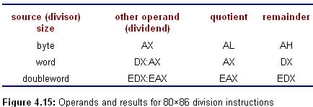
For all division operations, the dividend, divisor, quotient, and remainder must satisfy the equation
dividend = quotient*divisor + remainder
Basic Instructions

Slide 64
AL AH
-------------
C8 | AH AL
AX DX
-------------
C16 | DX AX
EAX EDX
-------------
C32 | EDX EAX

Slide 65
Idiv (signed divide)
Form: idiv src
Operation
  acc := xacc / src
Source is signed
Basic Instructions

Slide 66
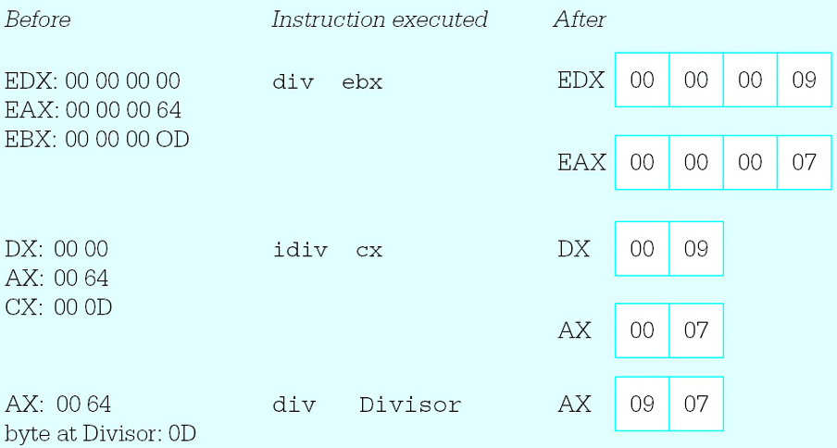
Example
Basic Instructions

Slide 67

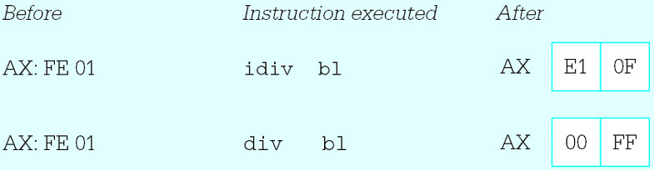
Example
Basic Instructions

Slide 68
Division instructions start with a double-length dividend and a single-length divisor, and produce a single-length quotient and a single-length remainder
Basic Instructions

Slide 69
When arithmetic is being done with operands of a given length, the dividend must be converted to double length before a division operation is executed
Basic Instructions

Slide 70
Unsigned convert
A doubleword-size dividend must be converted to quadword size with leading zero bits in the EDX register
Put a zero in DX prior to unsigned division by a word operand
Put a zero in AH prior to unsigned division by a byte operand
Basic Instructions

Slide 71
Signed Convert
Cbw (convert byte to word)
Cwd (convert word to double word)
Cdq (convert to quad)
Basic Instructions

Slide 72
Cbw (convert byte to word)
Extend the 2's complement number in the AL register half to word length in AX
Basic Instructions

Slide 73
Cwd (convert word to double word)
Extend the 2's complement number in the AX register half to doubleword length in DX and AX
Basic Instructions

Slide 74
Cdq (convert to quad)
Extend the 2's complement number in the EAX register half to quadword length in EDX and EAX
Basic Instructions

Slide 75
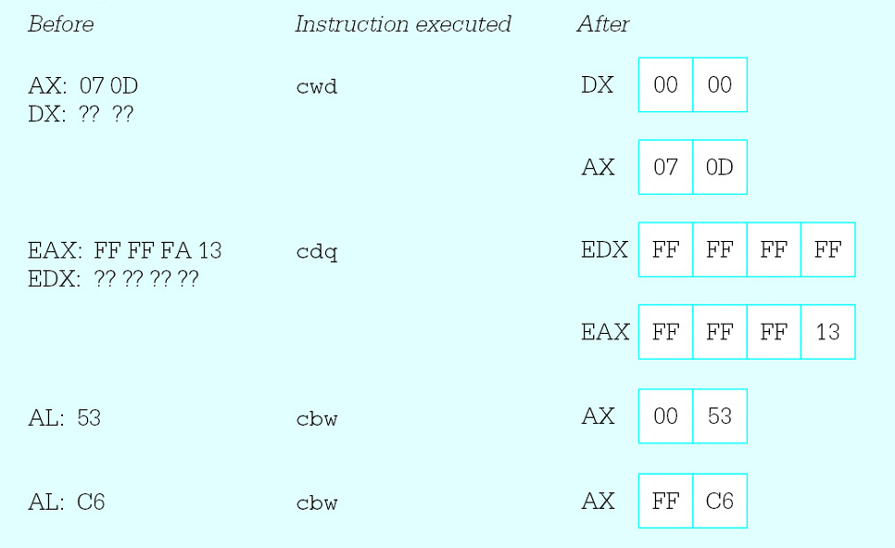
Example
Basic Instructions

Slide 76
Example of program
Convert Celsius (centigrade) temperatures to Fahrenheit
The formula implemented is
  F = (9/5)* C + 32
Basic Instructions

Slide 77
Plan the registers and memory
Basic Instructions

Slide 78
Program to evaluate(1-4)
; program to convert Celsius temperature to Fahrenheit
; author: R. Detmer
; date: revised 9/97
.386
.MODEL FLAT
ExitProcess PROTO NEAR32 stdcall, dwExitCode:DWORD
include io.h ; header file for input/output
cr equ 0dh ; carriage return character
Lf equ 0ah ; line feed
.STACK 4096 ; reserve 4096-byte stack
Basic Instructions

Slide 79
Program to evaluate(2-4)
.DATA ; reserve storage for data
prompt1 BYTE cr,Lf,Lf
BYTE "This program will convert a Celsius "
BYTE "temperature to the Fahrenheit scale",
BYTE cr,Lf,Lf
BYTE "Enter Celsius temperature: ",0
value BYTE 10 DUP (?)
answer BYTE CR,LF,"The temperature is“
Temperature BYTE 6 DUP (?)
BYTE " Fahrenheit",cr,Lf,0
Basic Instructions

Slide 80
Program to evaluate(3-4)
.CODE ; start of main program code
_start:
Prompt:
output prompt1 ;prompt for Celsius
input value,10 ; read ASCII characters
atoi value ; convert to integer
mov bx,9
imul bx ; C*9
add ax,2 ; rounding factor for division
mov bx,5 ; divisor
cwd ; prepare for division
idiv bx ; C*9/5
add ax,32 ; C*9/5 + 32
Basic Instructions

Slide 81
Program to evaluate(4-4)
itoa Temperature,ax ; convert to ASCII characters
output Answer ; output label and result
INVOKE ExitProcess, 0 ; exit with return code 0
PUBLIC _start ; make entry point public
END ; end of source code
Basic Instructions

Slide 82
Exercises 4.4
1. a, b
Basic Instructions

Slide 83
Contents
Copying Data
Integer Addition and Subtraction Instructions
Multiplication Instructions
Division Instructions
Addition and Subtraction of Larger Numbers
Basic Instructions

Slide 84
The add and sub instructions covered in Section 4.2 work with byte-length, word-length, or doubleword-length operands.
It is sometimes necessary to do arithmetic with even larger numbers.
Very large numbers can be added or subtracted a group of bits at a time.
Basic Instructions

Slide 85
4.5 Addition and Subtraction of Larger Numbers
Adc (add with carry) instruction
Sbb(subtract with borrow) instruction
Control of carry flag CF
Basic Instructions

Slide 86
Adc instruction
Form: adc dest, src
Operation
  Dest := dest + src +CF
Basic Instructions

Slide 87
Addition of Larger Numbers
How to add two 64-bit long numbers
  The idea is to start with the low-order 32 bits from each number and add them using an ordinary add instruction.
  The next 32 bits are added using a special addition instruction adc.
Basic Instructions

Slide 88
Example
Assume that the two numbers to be added are in four doublewords in the data segment.
      Nbr1Hi DWORD ?
      Nbr1Lo DWORD ?
      Nbr2Hi DWORD ?
      Nbr2Lo DWORD ?
Basic Instructions

Slide 89
mov eax, Nbr1Lo
add eax, Nbr2Lo
mov Nbr1Lo, eax
mov eax, Nbr1Hi
adc eax, Nbr2Hi
mov Nbr1Hi, eax
adds Nbr2 to Nbr1, storing the sum at the doublewords reserved for Nbr1
Basic Instructions

Slide 90
Sbb instruction
Form: sbb dest, src
Operation
  Dest := dest - src - CF
Basic Instructions

Slide 91
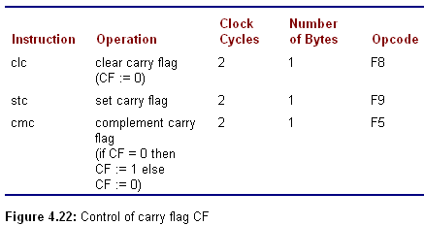
Control of carry flag CF
Basic Instructions

Slide 92
Exercises 4.5
1
3 a, c, e
Basic Instructions

Slide 93
Summary
Mov, xchg
Add, sub, inc, dec, neg
Mul, imul, div, idiv
Cbw, cwd, cdq
Adc, sbb
Clc, stc, cmc
Basic Instructions

Slide 94
Assignment
Programming exercises4.2
3
Basic Instructions

Slide 95
preparation
Read chapter5
Branching and Looping
Basic Instructions

