Slide 1

Branching and Looping
College of Computer Science, SCUEC

Slide 2
Review of last class
Copying data instructions
Integer arithmetic computation instructions
Addition and subtraction of Larger numbers
Branching and Looping

Slide 3
Expected outcome
You will be able to grasp the implementation of language structures in assembly language programming
Branching and Looping

Slide 4
Key language
Branching structure
Looping structure
Branching and Looping

Slide 5
Anticipatory set
Computer derive much of their power from their ability to execute code selectively and from the speed at which they execute repetitive algorithms
Branching and Looping

Slide 6
Terminology
Loop & branching
Backward / Forward reference
Intersegment / intrasegment
Compare
Algorithm
Branching and Looping

Slide 7
Contents
Unconditional jumps
Conditional jumps, compare instructions, and if structures
Implementing loop structures
For loops in assembly language
arrays
Branching and Looping

Slide 8
5.1 Unconditional jumps
Jmp(jump) instruction
Major groups of jmp instructions
Branching and Looping

Slide 9
Jmp(jump) instruction
Form: jmp target
  Usually form: jmp StatementLabel
Operation
  Jump to the target memory location
The 80X86 jmp (jump) instruction corresponds to goto in a high-level language
Branching and Looping

Slide 10
Example
jmp quit ; exit from program
…
…
quit:
INVOKE ExitProcess, 0 ; exit with return code 0
…
…
Branching and Looping

Slide 11
Complete example
A program that will input numbers repeatedly and, after each number is entered, display the count of the numbers so far, the cumulative sum, and the average.
Branching and Looping

Slide 12
Pseudocode design
display instructions;
sum := 0;
count := 0;
forever loop prompt for number;
input ASCII characters for number;
convert number to 2's complement form;
add number to sum;
add 1 to count;
convert count to ASCII;
display label and count;
convert sum to ASCII;
display label and sum;
average := sum / count;
convert average to ASCII;
display label and average;
end loop;
Branching and Looping

Slide 13
Program (Figure 5.1)
forever:
output prompt ; prompt for number
input number,16 ;
…
…
output avgLabel ; display label for average
output value ; output average
output nextPrompt; skip down, start next prompt
jmp forever ; repeat
Branching and Looping

Slide 14
Improvement
.DATA ; reserve storage for data
sum DWORD ?
…
.CODE ; start of main program code
_start:
output explain ; initial instructions
mov sum,0 ; sum := 0
mov ebx,0 ; count := 0
sum DWORD 0
Branching and Looping

Slide 15
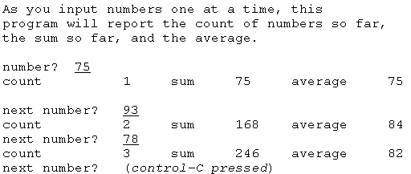
A sample run of this program
Branching and Looping

Slide 16
backward reference
  transfers control to a point that precedes the jmp statement itself
forward reference
  transfers control to a point that follows the jmp statement itself
Branching and Looping

Slide 17
Major groups of jmp instructions
Intrasegment
  changing the value in the instruction pointer register EIP
Intersegment
  changing the code segment register CS as well as EIP
Branching and Looping

Slide 18
Types of jmp instructions
Relative near
Relative short
Register indirect
Memory indirect
Branching and Looping

Slide 19
Relative jmp instructions(1-2)
Each relative jump instruction contains the displacement of the target from the jmp statement itself.
This displacement is added to the address of the next instruction to find the address of the target.
  The displacement is a signed number, positive for a forward reference and negative for a backward reference.
Branching and Looping

Slide 20
Relative jmp instructions(2-2)
relative short
  Only a single byte of displacement is stored.
  A short jump is used if the target is within the small range in order to generate more compact code.
Relative near
  includes a 32-bit displacement
  A near jump is used automatically if the target is more than 128 bytes away.
Branching and Looping

Slide 21
Indirect jump instructions(1-2)
The indirect jump instructions use a 32-bit address for the target rather than a displacement.
This address is not encoded in the instruction itself.
  Register indirect
  Memory indirect
Branching and Looping

Slide 22
Indirect jump instructions(2-2)
Example
  Jmp edx
  Jmp target
    Target is declared as a DWORD variable in the data section
  Jmp DWORD ptr [ebx]
Branching and Looping

Slide 23
Exercises 5.1
Identify the type (relative near, relative
short, register indirect, or memory
indirect) of each jmp instruction in the
following code fragment.
Branching and Looping

Slide 24
.DATA
...
addrStore DWORD ?
...
.CODE
...
doAgain:
... (3 instructions)
jmp doAgain
... (200 instructions)
jmp doAgain
...
jmp addrStore
...
jmp eax
...
jmp dword ptr [edi]
Branching and Looping

Slide 25
Contents
Unconditional jumps
Conditional jumps, compare instructions, and if structures
Implementing loop structures
For loops in assembly language
arrays
Branching and Looping

Slide 26
5.2 Conditional jumps, compare instructions, and if structures
Conditional jumps
Compare instructions
If structures
Branching and Looping

Slide 27
Conditional jumps(1-3)
Conditional jump instructions make it possible to implement if structures, other selection structures, and loop structures in 80×86 machine language.
Branching and Looping

Slide 28
Conditional jumps (2-3)
There are many of these instructions. Each has the format:
  j− targetStatement
  Where the last part of the mnemonic identifies the condition under which the jump is to be executed.
  If the condition holds, then the jump takes place
  Otherwise, the next instruction (the one following the conditional jump) is executed
Branching and Looping

Slide 29
Conditional jumps (3-3)
Conditional jump instructions do not modify the flags; they only react to previously set flag values.
Branching and Looping

Slide 30
Design label
Label will reference the address of whatever statement follows it.
Labels are not part of object code, so extra labels do not add to the length of object code or to execution time.
Some names, such as IF, ELSE, and ENDIF, are MASM directives, so they cannot be used as labels.
Branching and Looping

Slide 31
Example
The value in the EAX register is added to a sum representing an account balance, and three distinct treatments are needed, depending on whether the new balance is
negative, zero, or positive
Branching and Looping

Slide 32
Pseudocode
add value to balance;
if balance < 0
then
... { design for negative balance }
elseif balance = 0
then ... { design for zero balance }
else ... { design for positive balance }
end if;
end if;
Branching and Looping

Slide 33
Code fragment
add balance,eax ; add value to balance
jns elseIfZero ; jump if balance not negative
... ; code for negative balance
jmp endBalanceCheck
elseIfZero:
jnz elsePos ; jump if balance not zero
... ; code for zero balance
jmp endBalanceCheck
elsePos:
... ;code for positive balance
endBalanceCheck:
Branching and Looping

Slide 34
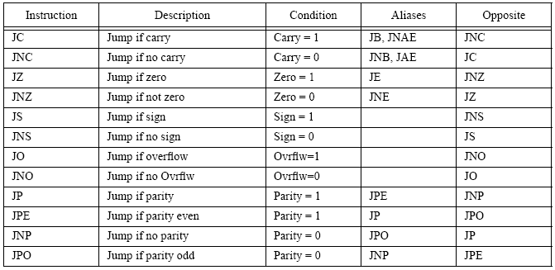
Jcc Instructions that test flags
Branching and Looping

Slide 35
Compare instructions(1-2)
Form: cmp operand1, operand2
Operation
  Executes by calculating operand1 minus operand2
  The value of the difference and what happens in doing the subtraction determines the flag settings.
  The value at the operand1 location is not changed
Branching and Looping

Slide 36
Compare instructions (2-2)
Each cmp instruction compares two operands and sets or resets AF, CF, OF, PF, SF, and ZF.
The only job of a cmp instruction is to fix flag values; this is not just a side effect of some other function.
Branching and Looping

Slide 37
Immediate operand
An immediate operand must be the second operand
cmp eax, 356
cmp pattern, 0d3a6h
cmp bh, '$'
cmp 100, total ; illegal
Branching and Looping

Slide 38
Conditional jcc instructions
Jcc Instructions for Unsigned comparisons
Jcc Instructions for signed comparisons
Branching and Looping

Slide 39
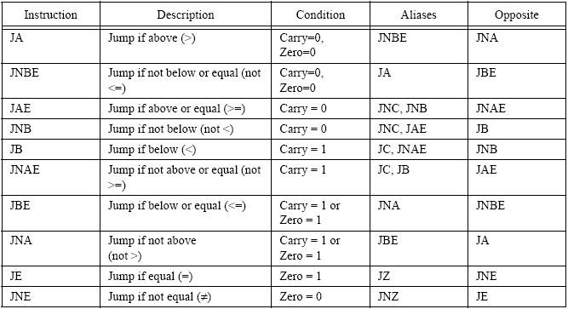
Jcc Instructions for Unsigned Comparisons
Branching and Looping

Slide 40
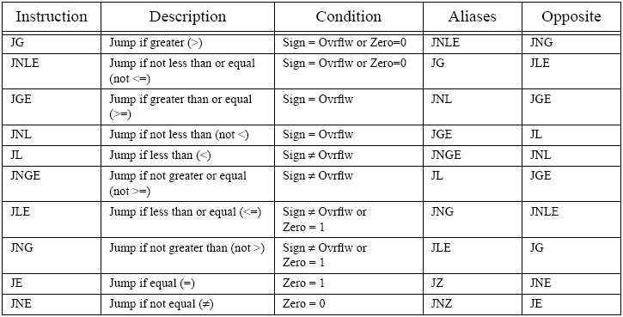
Jcc Instructions for Signed Comparisons
Branching and Looping

Slide 41
If structure --- 1
if value < 10
then
add 1 to smallCount;
else
add 1 to largeCount;
end if;
Branching and Looping

Slide 42
Suppose that value is stored in the EBX register and that smallCount and largeCount reference words in memory
cmp ebx, 10 ; value < 10 ?
jnl elseLarge
inc smallCount ; add 1 to small_count jmp endValueCheck
elseLarge:
inc largeCount ; add 1 to large_count
endValueCheck:
…
Branching and Looping

Slide 43
If structure --- 2
if (total ≥ 100) or (count = 10)
then
add value to total;
end if;
Branching and Looping

Slide 44
Assume that total and value reference double-words in memory and that count is stored in the CX register.
cmp total, 100 ; total >= 100 ?
jge addValue
cmp cx, 10 ; count = 10 ?
jne endAddCheck
addValue:
mov ebx, value ; copy value
add total, ebx ; add value to total
endAddCheck:
…
Branching and Looping

Slide 45
If structure --- 3
if (count > 0) and (ch = backspace)
then
subtract 1 from count;
end if;
Branching and Looping

Slide 46
assume that count is in the CX register, ch is in the AL register and that backspace has been equated to 08₁₆, the ASCII backspace character
cmp cx, 0 ; count > 0 ?
jng endCheckCh
cmp al, backspace ; ch a backspace?
jne endCheckCh
dec count ; subtract 1 from count
endCheckCh:
…
Branching and Looping

Slide 47
Example
The computer asks one player to enter a number.
After it is typed in, the screen is cleared, and the other player tries to guess the number.
After each guess the computer reports "too low," "too high," or "you got it."
After the number is finally guessed, the number of attempts is reported, and the players are asked if they want to play another game
Branching and Looping

Slide 48
Pseudocode design
until response='N' or response='n' loop
prompt first player for target;
input target and convert to 2's complement form;
clear screen;
count := 0;
until guess=target loop add 1 to count;
prompt second player for guess;
input guess and convert to 2's complement;
if guess=target
then display "you got it";
elseif guess<target
then display "too low";
else display "too high";
end if;
end until ;{guess=target}
convert count to ASCII;
display count;
display "Do you want to play again?";
input response;
end until; { response= 'N' or response='n' }
Fig. 5.8
Source code
Branching and Looping

Slide 49
Exercises 5.2
1 (a), (c) ,(e) ,(g)
2 (a), (c)
Branching and Looping

Slide 50
Contents
Unconditional jumps
Conditional jumps, compare instructions, and if structures
Implementing loop structures
For loops in assembly language
arrays
Branching and Looping

Slide 51
5.3 Implementing loop structures
While loop
For loop
Until loop
Branching and Looping

Slide 52
While loop
An 80×86 implementation of a while loop follows a pattern much like this one.
while: . . . ; code to check Boolean expression
. . .
body:
. . . ; loop body
jmp while ; go check condition again
endWhile:
Branching and Looping

Slide 53
While loop—example1
while (sum < 1000) loop
... { body of loop }
end while;
Branching and Looping

Slide 54
Code fragment
Assume that sum references a doubleword in memory
whileSum:
cmp sum, 1000 ; sum < 1000?
jnl endWhileSum ; exit loop if not
. . . ; body of loop
jmp whileSum ; go check condition again
endWhileSum:
jge endWhileSum
Branching and Looping

Slide 55
While loop—example2
Suppose that the integer base 2 logarithm of a positive number needs to be determined.
The integer base 2 logarithm of a number is the largest integer x such that
2^{x} ≤ number
Branching and Looping

Slide 56
Pseudocode
x := 0;
twoToX := 1;
while twoToX ≤ number
multiply twoToX by 2;
add 1 to x;
end while;
subtract 1 from x;
Branching and Looping

Slide 57
Code fragment
mov cx, 0 ; x := 0
mov eax, 1 ; twoToX := 1
whileLE:
cmp eax, number ; twoToX <= number?
jnle endWhileLE ; exit if not
body:
add eax, eax ; multiply twoToX by 2
inc cx ; add 1 to x
jmp whileLE ; go check condition again
endWhileLE:
dec cx ; subtract 1 from x
Branching and Looping

Slide 58
While loop—example3
while (sum < 1000) and (count ≤ 24) loop
... { body of loop }
end while;
Branching and Looping

Slide 59
Code fragment
Assume that sum references a doubleword in memory and the value of count is in CX.
whileSum:
cmp sum, 1000 ; sum < 1000?
jnl endWhileSum ; exit if not
cmp cx, 24 ; count <= 24
jnle endWhileSum ; exit if not
. . . ; body of loop
jmp whileSum ; go check condition again
endWhileSum:
Branching and Looping

Slide 60
While loop—example4
while (sum < 1000) or (count ≤ 24) loop
... { body of loop }
end while;
Branching and Looping

Slide 61
Code fragment
whileSum:
cmp sum, 1000 ; sum < 1000?
jl body
cmp cx, 24 ; count <= 24
jnle endWhileSum ; exit if not
body: . . . ; body of loop
jmp whileSum ; go check condition again
endWhileSum:
Branching and Looping

Slide 62
While loop—example5
Suppose that non-negative numbers entered at
the keyboard are to be added, with any negative
entry serving as a sentinel value
sum := 0;
while (number keyed in is not negative) loop add number to sum;
end while;
Branching and Looping

Slide 63
Code fragment
Assuming appropriate definitions in the data segment
mov ebx, 0 ;sum := 0
whileNotNeg:
output prompt ; prompt for input
Input number,10 ; get number from keyboard
atod number ; convert to 2's complement
js endWhile ; exit if negative
add ebx, eax ; add number to sum
Jmp whileNotNeg ; go get next number
endWhile:
Branching and Looping

Slide 64
For loop
A counter-controlled loop, is executed once for each
value of a loop index (or counter) in a given range.
for index := initialValue to finalValue loop
... { body of loop }
end for;
index := initialValue;
while (index ≤ finalValue) loop
... { body of loop }
add 1 to index;
end while;
Branching and Looping

Slide 65
Example
Suppose that a collection of numbers needs to be added and no value is convenient as a sentinel. Then one might want to ask a user how many numbers are to be entered and loop for that many entries
Branching and Looping

Slide 66
Pseudocode
prompt for tally of numbers;
input tally;
sum := 0
for count := 1 to tally loop
prompt for number;
input number;
add number to sum;
end for;
Branching and Looping

Slide 67
Code fragment
output prompt1 ; prompt for tally
input value, 20 ; get tally (ASCII)
atoi value ; convert to 2's complement
mov tally, ax ; store tally
mov edx, 0 ; sum := 0
mov bx, 1 ; count := 1
forCount:
cmp bx, tally ; count <= tally?
jnle endFor ; exit if not
output prompt2 ; prompt for number
input value, 20 ; get number (ASCII)
atod value ; convert to 2's complement
add edx, eax ; add number to sum
inc bx ; add 1 to count
jmp forCount ; repeat
endFor:
Branching and Looping

Slide 68
Until loop
until termination condition loop
... { body of loop }
end until;
until: . ; start of loop body
. . .
. . . ; code to check termination condition
endUntil:
Branching and Looping

Slide 69
Pseudocode
count := 0;
until ((sum > 1000) or (count = 100)) loop
... { body of loop }
add 1 to count;
end until;
Branching and Looping

Slide 70
Code fragment
Assume that sum references a word in the data
segment and that count is stored in CX.
mov cx, 0 ; count := 0
until:
… ; body of loop
inc cx ; add 1 to count
cmp sum, 1000 ; sum > 1000 ?
jg endUntil ; exit if sum > 1000
cmp cx, 100 ; count = 100 ?
jne until ; continue if count not = 100
endUntil:
Branching and Looping

Slide 71
Exercises 5.3
1(a)
2(a)
3(a)
Branching and Looping

Slide 72
Contents
Unconditional jumps
Conditional jumps, compare instructions, and if structures
Implementing loop structures
For loops in assembly language
arrays
Branching and Looping

Slide 73
5.4 For loops in assembly language
Loop instruction
Loope / loopz instructions
Loopne / loopnz instructions
Branching and Looping

Slide 74
For loops
for index := 1 to count loop
... { body of loop }
end for;
for index := count downto 1 loop
... { body of loop }
end for;
Branching and Looping

Slide 75
Loop instruction
Form: loop target
Operation
  The value in ECX is decremented
  If the new value in ECX is zero, then execution continues with the statement following the loop instruction
  If the new value in ECX is nonzero, then a jump to the instruction at target takes place
Branching and Looping

Slide 76
backward for loop
for count := 20 downto 1 loop
. . . { body of loop }
end for;
mov ecx, 20 ; number of iterations
forCount:
. . . ; body of loop
loop forCount ; repeat body 20 times
Branching and Looping

Slide 77
Loop---- example
mov ecx, number ; number of iterations
cmp ecx, 0 ; number = 0 ?
je endFor ; skip loop if number = 0
forIndex:
. . . ; body of loop
loop forIndex ; repeat body number times
endFor:
jle endFor ; skip loop if number <= 0
Branching and Looping

Slide 78
Forward loop(1-2)
for index := 1 to 50 loop
...{ loop body using index }
end for;
Branching and Looping

Slide 79
Forward loop(2-2)
The EBX register might be used to store index counting from 1 to 50
The ECX register counts down from 50 to 1.
mov ebx, 1 ; index := 1
mov ecx, 50 ; number of iterations for loop
forNbr:
. . . ; use value in EBX for index
inc ebx ; add 1 to index
loop forNbr ; repeat
Branching and Looping

Slide 80
Loope / loopz
Form: loope target
loopz target
Operation
  ecx := ecx - 1
  If ZeroFlag = 1 and ecx ≠0, goto target
Branching and Looping

Slide 81
Loopne / loopnz
Form: loopne target
loopnz target
Operation
  ecx := ecx - 1
  If ZeroFlag = 0 and ecx ≠0, goto target
Branching and Looping

Slide 82
Example
for year := 10 downto 1 until balance = 0 loop
... { body of loop }
end for;
mov ecx, 10 ; maximum number of iterations
forYear:
. . . ; body of loop
cmp ebx, 0 ; balance = 0 ?
loopne forYear ; repeat 10 times if balance not 0
Branching and Looping

Slide 83
Read code fragment
Assume the string ASCII_STR has L characters.
MOV ECX, L
MOV ESI, -1
MOV AL, 20H
NEXT:
INC ESI
CMP AL, ASCII_STR[ESI]
LOOPNE NEXT
JNZ NOT_FOUND
…
NOT_FOUND:
…
Branching and Looping

Slide 84
Exercises 5.4
1
2 (a)
Branching and Looping

Slide 85
Contents
Unconditional jumps
Conditional jumps, compare instructions, and if structures
Implementing loop structures
For loops in assembly language
Arrays
Branching and Looping

Slide 86
5.5 Arrays
Define 1-dimensional array
How to access arrays
Branching and Looping

Slide 87
Array
Arrays are probably the most commonly used composite data type.
An array is an aggregate data type whose members (elements) are all the same type.
Selection of a member from the array is by an integer index. Different indices select unique elements of the array.
Branching and Looping

Slide 88
Define 1-dimensional array(1-2)
Before you access elements of an array, you need to set aside storage for that array.
To allocate n elements in an array, you would use a declaration like the following:
arrayname basetype n dup (?)
Arrayname is the name of the array variable
Basetype is the type of an element of that array
Branching and Looping

Slide 89
Define 1-dimensional array(2-2)
Initialize each element of the array with a (possibly) different value
arrayname type value1, value2, …, valuen
Branching and Looping

Slide 90
Example
ByteArray byte 10 dup (?) ;array[0..9] of byte
PtrArray dword 4 dup (?) ;array[0..3] of dword
Squares word 0, 1, 4, 9, 16, 25, 36, 49, 64, 81, 100
word 121, 144, 169, 196, 225, 256, 289, 324
word 361, 400
BigArray word 256 dup (0, 1, 2, 3)
Branching and Looping

Slide 91
How to access arrays
Get address of first item of array
  lea ebx, nbrArray
Load effective address
  lea dest, source
Branching and Looping

Slide 92
Lea instruction
Form : lea dest, source
Operation
  It loads the specified 16 or 32 bit general purpose register(dest) with the effective address of the specified memory location(source).
  The effective address is the final memory address obtained after all addressing mode computations.
Branching and Looping

Slide 93
Example
Firstly, accept a collection of positive numbers from the keyboard, counting them and storing them in an array.
Then calculate the average of the numbers by going back through the numbers stored in the array, accumulating the total in sum.
Finally, the numbers in the array are scanned again, and this time the numbers larger than the average are displayed.
Branching and Looping

Slide 94
Pseudocode(1-3)
{ input numbers into array }
nbrElts := 0;
get address of first item of array;
while (number from keyboard > 0) loop convert number to 2's complement;
store number at address in array;
add 1 to nbrElts;
get address of next item of array;
end while;
Branching and Looping

Slide 95
Pseudocode(2-3)
{ find sum and average }
sum := 0;
get address of first item of array;
for count := nbrElts downto 1 loop
add doubleword at address in array to sum;
get address of next item of array;
end for;
average := sum/nbrElts;
display average;
Branching and Looping

Slide 96
Pseudocode(3-3)
{ list big numbers }
get address of first item of array;
for count := nbrElts downto 1 loop
if doubleword of array > average
then
convert doubleword to ASCII;
display value;
end if;
get address of next item of array;
end for;
Branching and Looping

Slide 97
Source file
P182 fig. 5.10
Branching and Looping

Slide 98
Improvement
The first two loops can be integrated in one loop. How ?
sum := 0;
nbrElts := 0;
while (number from keyboard > 0) loop
convert number to 2's complement;
store number at address in array;
add number to sum;
add 1 to nbrElts;
get address of next item of array;
end while;
Branching and Looping

Slide 99
Random access—— using register indirect addressing
Add nbrArray[count] to sum
mov edx,ecx ; count
dec edx ; count-1
add edx,edx ; 2*(count-1)
add edx,edx ; 4*(count-1)
lea ebx,nbrArray ; starting address of array
add ebx,edx ; address of nbrArray[count]
add eax,[ebx] ; add array[count] to sum
Element_Address =
Base_Address + ((Index - Initial_Index) * Element_Size)
Branching and Looping

Slide 100
Exercise
Fill the count of bytes that the assembler will generate for each directive below.
Branching and Looping

Slide 101
Summary
If statements
  Unconditional & conditional jumps
Various loops structures
  Loop instructions
  While, until, for…
Arrays
  dup directive
  Lea instruction
Branching and Looping

Slide 102
preparation
Read chaper6
Procedures
Branching and Looping

