Slide 1

Procedures
College of Computer Science, SCUEC

Slide 2
Review of last class
Unconditional jumps
Conditional jumps, compare instructions, and if structures
Implementing loop structures
For loops in assembly language
Arrays
procedure

Slide 3
Expected outcome
You will be able to write program using procedures and grasp how to call a procedure and return from one, parameter passing, local data.
procedure

Slide 4
Key language
Procedure
Call
Stack
procedure

Slide 5
Anticipatory set
The function in C language
  Define
  Invoke
  parameter
  Local variable
procedure

Slide 6
Terminology
Procedure
Function
Argument
Attribute
Push / Pop
Call
Return
FIFO /FILO
procedure

Slide 7
Contents
The 80×86 Stack
Procedure Body, Call and Return
Parameters and Local Variables
procedure

Slide 8
6.1 The 80×86 Stack(1-3)
. STACK 4096
.STACK directive tells the assembler to reserve 4096 bytes of uninitialized storage.
The stack is FILO(first in last out)
procedure

Slide 9
The 80×86 Stack(2-3)
The operating system initializes ESP to the address of the first byte above the 4096 bytes in the stack.
A larger or smaller stack could be allocated, depending on the anticipated usage in the program.
procedure

Slide 10
The 80×86 Stack(3-3)
The stack is most often used by pushing words or doublewords on it or by popping them off it. This pushing or popping is done automatically as part of the execution of call and return instructions (Section 6.2).
It is also done manually with push and pop instructions. This section covers the mechanics of push and pop instructions, describing how they affect the contents of the stack.
procedure

Slide 11
Push instruction
Form: push source
The source operand can be a register 16, a register 32, a segment register, a word in memory, a doubleword in memory, an immediate byte, an immediate word, or an immediate doubleword.
procedure

Slide 12
Push instruction
The only byte-size operand is immediate, and as you will see, multiple bytes are pushed on the stack for an immediate byte operand.
However, if there is ambiguity about the size of the operand (as would be with a small immediate value), then you can use pushw or pushd mnemonics to specify word or doublewordsize operands, respectively.
procedure

Slide 13
example of push instruction
It assumes that ESP initially contains 00600200.
The first push instruction (push ax ) decrements ESP to 006001FE and then stores the contents of AX at that address.
Notice that the low and high-order byte are reversed in memory.
The second push (pushd -240) decrements ESP to 006001FA and stores FFFFFF10 (−240₁₀) at that address.
procedure

Slide 14
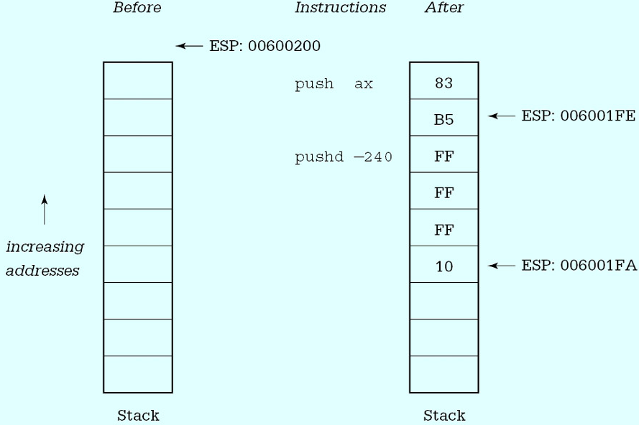
example of push instruction
procedure

Slide 15
Pop instruction
Form: pop destination
Pop instructions do the opposite job of push instructions.
where destination can reference a word or doubleword in memory, any register 16, any register 32, or any segment register except CS.
procedure

Slide 16
Pop instruction
The pop instruction gets a word-size value from the stack by copying the word at the address in ESP to the destination, then incrementing ESP by 2.
Operation for a doubleword value is similar, except that ESP is incremented by 4.
Figure 6.2 gives information about pop instructions for different destination operands.
procedure

Slide 17
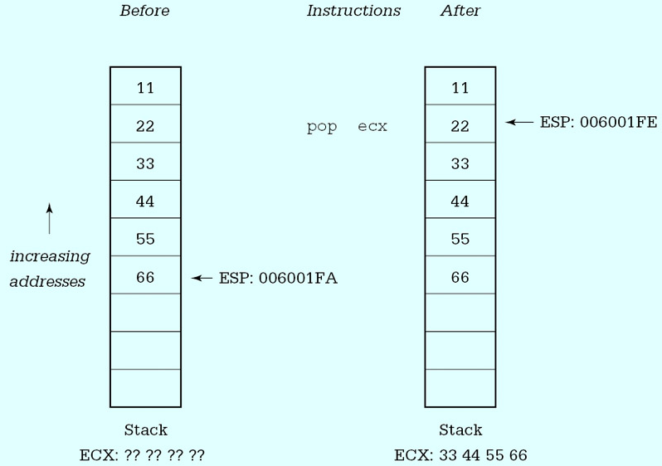
example of pop instruction
procedure

Slide 18
Exercises 6.1
For each part of this problem, assume the "before" values when the given instructions are executed. Give the requested "after" values. Trace execution of the instructions by drawing a picture of the stack
Before Instructions After
(a)ESP: 06 00 10 00 push ecx ESP,ECX
ECX: 01 A2 5B 74 pushw 10
(c)ESP:00 00 F8 3A push eax ESP,EAX,BX,ECX
EAX:12 34 56 78 pushw 30
pop bx
pop ecx
procedure

Slide 19
Contents
The 80×86 Stack
Procedure Body, Call and Return
Parameters and Local Variables
procedure

Slide 20
6.2 Procedure Body, Call and Return
Procedure Body
Calling a procedure
Return from a procedure
procedure

Slide 21
Procedure Body
The code for a procedure always follows a .CODE directive.
The body of each procedure is bracketed by two directives, PROC and ENDP. Each of these directives has a label that gives the name of the procedure.
procedure

Slide 22
Define procedure
procname PROC attribute; {NEAR or FAR}
…
…
RET
procname ENDP
procedure

Slide 23
Example
A procedure named Initialize.
The job of the procedure is to initialize several variables
procedure

Slide 24
Fig 6.5
; procedure structure example
; Author: R. Detmer
; Date: revised 10/97
.386
.MODEL FLAT
ExitProcess PROTO NEAR32 stdcall, dwExitCode:DWORD
.STACK 4096 ; reserve 4096-byte stack
.DATA ; reserve storage for data
Count1 DWORD 11111111h
Count2 DWORD 22222222h
Total1 DWORD 33333333h
Total2 DWORD 44444444h
; other data here
procedure

Slide 25
.CODE ; program code
Initialize PROC NEAR32
mov Count1,0 ; zero first count
mov Count2,0 ; zero second count
mov Total1,0 ; zero first total
mov Total2,0 ; zero second total
mov ebx,0 ; zero balance
ret ; return
Initialize ENDP
_start: ; program entry point
call Initialize ; initialize variables
; -- other program tasks here
call Initialize ; reinitialize variables
; -- more program tasks here
INVOKE ExitProcess, 0 ; exit with return code 0
PUBLIC _start ; make entry point public
END ; end of source code
procedure

Slide 26
Proc attribute
With the Microsoft Macro Assembler, the PROC directive allows several attributes to be specified; we are only going to use one, NEAR32.
This attribute says that the procedure will be located in the same code segment as the calling code and that 32-bit addresses are being used.
These choices are normal for flat 32-bit memory model programming.
procedure

Slide 27
Most of the statements of procedure Initialize are ordinary mov instructions. These could have been used in the main program at the two places that the call statements are coded
However, using the procedure makes the main code both shorter and clearer.
procedure

Slide 28
Calling a procedure
Form: call destination
Operation:
  Pushes the address of the next instruction (the one immediately following the call) onto the stack
  And then transfers control from the main code to the procedure code.
procedure

Slide 29
Return from a procedure
Form: ret
Operation:
  transfers control from the procedure back to the caller
There is almost always at least one ret instruction in a procedure and there can be more than one.
procedure

Slide 30
Although a call instruction must identify its destination, the ret does not-control will transfer to the instruction following the most recent call.
The 80x86 uses the stack to store the return address.
procedure

Slide 31
Near call and ret
  works by pushing the EIP to the stack and then changing EIP to contain the address of the first instruction of the procedure.
  A near return pops EIP
Far call and ret
  A far call pushes both EIP and CS onto the stack.
  A far return pops both off the stack.
procedure

Slide 32
Form: Ret count
Operation:
  The operand count is added to the contents of ESP after completion of the other steps of the return process
  This can be useful if other values (parameters in particular) have been saved on the stack just for the procedure call, and can be logically discarded when the procedure is exited.
procedure

Slide 33
Programming Exercises 6.2
Write a main program that will input an integer, call procedure Root (Fig. 6.11) to find the integer square root, and display the value of the square root. Include this program in the same file as procedure Root and assemble them together.
procedure

Slide 34
Contents
The 80×86 Stack
Procedure Body, Call and Return
Parameters and Local Variables
procedure

Slide 35
6.3 Parameters and Local Variables
Using a high-level language, a procedure definition often includes parameters or formal parameters that are associated with arguments or actual parameters when the procedure is called.
procedure

Slide 36
Parameter
In parameter
In-out parameter
procedure

Slide 37
In parameter
For the procedure’s in (pass-by-value) parameters, values of the arguments, which may be expressions, are copied to the parameters when the procedure is called.
These values are then referenced in the procedure using their local names, which are the identifiers used to define the parameters.
procedure

Slide 38
In-out parameter
In-out (pass-by-location or variable) parameters associate a parameter identifier with an argument that is a single variable and can be used to pass a value either to the procedure from the caller or from the procedure back to the caller.
procedure

Slide 39
Pass parameters
Stack
  Most procedures use the stack to pass parameters
Memory variables
Registers
procedure

Slide 40
Example
Calling program
push Value1 ; first argument value
push ecx ; second argument value
call Add2 ; call procedure to find sum
add esp,8 ; remove parameters from stack
Procedure Add2
Add2 PROC NEAR32 ; add two dwords passed on the stack
; return the sum in the EAX register
push ebp ; save EBP
mov ebp,esp ; establish stack frame
mov eax,[ebp+8] ; copy second parameter value
add eax,[ebp+12] ; add first parameter value
pop ebp ; restore EBP
ret ; return
Add2 ENDP
procedure

Slide 41
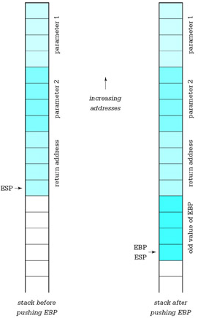
Fig. 6.13
procedure

Slide 42
Local variable
We now show how the stack can provide space for local variables.
For this purpose, we revisit the algorithm for computing the greatest common divisor of two integers
procedure

Slide 43
Pseudocode
gcd := number1;
remainder := number2;
until (remainder = 0) loop
dividend := gcd;
gcd := remainder;
remainder := dividend mod gcd;
end until;
procedure

Slide 44
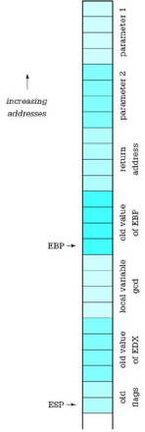
Fig. 6.15
Fig. 6.14 procedure
procedure

Slide 45
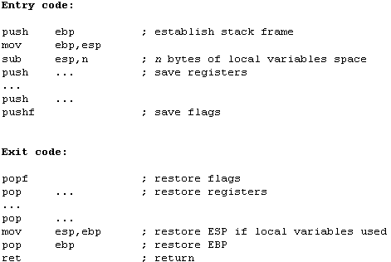
Typical procedure entry and exit code
procedure

Slide 46
Programming exercises 6.3
1. Write a procedure Min2 to find the minimum of two word-size integer parameters. Return the minimum in the AX register.

Slide 47
Variable parameters
How can a high-level language implement variable parameters?
How can large parameters such as an array, a character string, or a record be efficiently passed to a procedure?
procedure

Slide 48
Variable parameters
Either of these can be implemented by passing the address of an argument rather than the value of the argument to the procedure.
The procedure can then either use the value at the address or store a new value at the address.
procedure

Slide 49
Example
Figure 6.17 shows a procedure that might implement the Pascal procedure with header
PROCEDURE Minimum(
A : IntegerArray;
Count : INTEGER;
VAR Min : INTEGER);
procedure

Slide 50
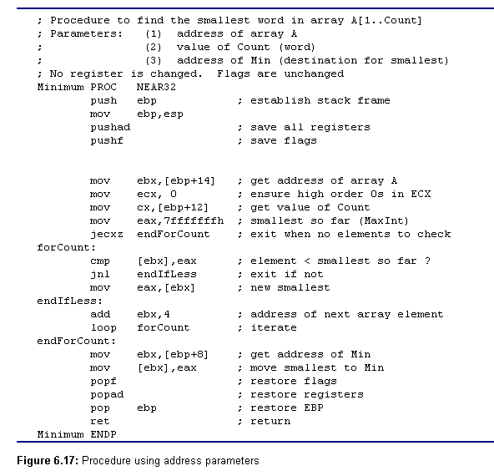
procedure

Slide 51
In this implementation the addresses of arguments corresponding to A and Min are passed to procedure Minimum.
The procedure uses register indirect addressing, first to examine each array element, and at the end to store the smallest value.
procedure

Slide 52
The instructions pushad and popad save and restore all general registers.
These instructions are convenient, but they cannot be used if the procedure generates a value to be returned in a register.
procedure

Slide 53
Calling code for procedure Minimum could look like the following.
  lea eax, Array ; Parameter 1: address of Array
  push eax
  push Count ; Parameter 2: value of Count
  lea eax, Min ; Parameter 3: address of Min
  push eax
  call Minimum ; call procedure
  add esp, 10 ; discard parameters
After this code is executed, the smallest value from Array will be in the dword referenced by Min.
procedure

Slide 54
Note that since the Count parameter is word-size, the address of the first parameter is 14 bytes above the fixed base point—four bytes for EBP, four bytes for the return address, four bytes for the address of Min, and two bytes for the value of Count. (Draw the stack picture.)
procedure

Slide 55
Programming exercises 6.3
3. Write a procedure Avg to find the average of collection of doublewordsize integers in an array. Procedure Avg will have three parameters:
  the address of the array
  the number of integers in the array (passed as a doubleword)
  the address of a doubleword at which to store the result
procedure

Slide 56
Summary
This chapter has discussed techniques for implementing procedures in the 80x86 architecture.
The stack serves several important purposes in procedure implementation.
When a procedure is called, the address of the next instruction is stored on the stack before control transfers to the first instruction of the procedure.
A return instruction retrieves this address from the stack in order to transfer control back to the correct point in the calling program.
Argument values or their addresses can be pushed onto the stack to pass them to a procedure
procedure

Slide 57
preparation
Read Chapter 7
String Operations
procedure

