Slide 1

String Operations
College of Computer Science, SCUEC

Slide 2
Review of last class
The 80×86 Stack
Procedure Body, Call and Return
Parameters and Local Variables
String Operations

Slide 3
Expected outcome
You will be able to grasp the ways of handle strings in assemble language
You will be able to convert
  a character string to an internal numerical format when a number is entered at the keyboard
  an internal format to a character string for display purposes
String Operations

Slide 4
Anticipatory set
Computers are frequently used to manipulate characters strings as well as numeric data
Text editor and word processor programs must be capable of searching for and moving strings of characters.
String Operations

Slide 5
Terminology
Movs
Scas
Stos
Lods
Cmps
String Operations

Slide 6
Contents
Using String Instructions
Repeat Prefixes and More String Instructions
Character Translation
Converting a 2’s Complement Integer to an ASCII String
String Operations

Slide 7
7.1 Using String Instructions
String instructions
Source and destination string
Suffix of string instructions
Movement direction
String Operations

Slide 8
String instructions
Five 80x86 instructions are designed for string manipulation:
  movs (move string): copy a string from one memory location to another
  cmps (compare string): compare the contents of two strings
  scas (scan string): search a string for one particular value
  stos (store string): store a new value in some position of a string
  lods (load string): copy a value out of some position of a string
String Operations

Slide 9
Source and destination string(1-3)
Each string instruction applies to a source string, a destination string, or both.
Register indirect addressing is used to locate the individual byte, word, or doubleword elements.
String Operations

Slide 10
Source and destination string(2-3)
The 80x86 instructions access elements of the source string using the address in the source index register ESI.
Elements in the destination string are accessed using the address in the destination index register EDI.
String Operations

Slide 11
Source and destination string(3-3)
If you program using a segmented memory model, then you also must know that the source element is in the data segment (at address DS:ESI) while the destination element is in the extra segment (at address ES:EDI).
With flat memory model programming, both segment registers contain the same segment number and no distinction between segments.
String Operations

Slide 12
Suffix of string instructions(1-3)
Since the source and destination addresses of string elements are always given by ESI and EDI, respectively, no operands are needed to identify these locations.
Without any operand, however, the assembler cannot tell the size of the string element to be used.
String Operations

Slide 13
Suffix of string instructions(2-3)
use special versions of the mnemonics that define the element size-instructions that operate on bytes use a b suffix, word string instructions use a w suffix, and doubleword string instructions use a d suffix.
  movsb is used to move byte strings
  movsw is used to move word strings
  movsd is used to move doubleword strings
Any of these instructions assemble as a movs and none uses an operand since the assembler knows the element size from the mnemonic.
String Operations

Slide 14
Suffix of string instructions(3-3)
Although a string instruction operates on only one string element at a time, it always gets ready to operate on the next element.
It does this by changing the source index register ESI and/or the destination index register EDI to contain the address of the next element of the string(s).
When byte-size elements are being used, the index registers are changed by one; for words, ESI and EDI are changed by two; and for doublewords, the registers are changed by four.
String Operations

Slide 15
Movement direction(1-3)
The 80x86 can move either forward through a string, from lower to higher addresses, or backward, from higher to lower addresses.
The movement direction is determined by the value of the direction flag DF.
If DF is set to 1, then the addresses in ESI and EDI are decremented by string instructions, causing right to left string operations.
If DF is clear (0), then the values in ESI and EDI are incremented by string instructions, so that strings are processed left to right.
String Operations

Slide 16
Movement direction(2-3)
The 80x86 has two instructions whose sole purpose is to reset or set the direction flag DF.
cld instruction
  Form: cld
  Operation:clears DF to 0
std instruction
  Form: std
  Operation:sets DF to 1
String Operations

Slide 17
Movement direction(3-3)
The move string instruction movs transfers one string element (byte, word, or doubleword) from a source string to a destination string.
The source element at address DS:ESI is copied to address ES:EDI.
After the string element is copied, both index registers are changed by the element size (1, 2, or 4), incremented if the direction flag DF is 0 or decremented if DF is 1. The movs instruction does not affect any flag.
String Operations

Slide 18
For example: Movsw
Form: Movsw
Operation
  The source element at address DS:ESI is copied to address ES:EDI
  If DF=0, then both index registers are incremented by the element size 2
  Else if DF=1, then both index registers are decremented by the element size 2
String Operations

Slide 19
Example (fig. 7.3)
A program that uses the movs instruction. The important part of the example is the procedure strcopy.
This procedure has two parameters passed on the stack, which give the destination and source addresses of byte or character strings. The source string is assumed to be null-terminated.
Procedure strcopy produces an exact copy of the source string at the destination location, terminating the destination string by a null byte.
String Operations

Slide 20
Calling code
…
lea eax, stringOut ; destination address
push eax ; first parameter
lea eax, stringIn ; source
push eax ; second parameter
call strcopy ; call string copy procedure
…
String Operations

Slide 21
strcopy PROC NEAR32
push ebp ;save base pointer
mov ebp,esp ;copy stack pointer
push edi ;save registers and flags
push esi
Pushf
mov esi,[ebp+8] ;initial source address
mov edi,[ebp+12] ;destination
cld ;clear direction flag
whileNoNull:
cmp BYTE PTR [esi],0 ;null source byte?
je endWhileNoNull ;stop copying if null
movsb ;copy one byte
jmp whileNoNull ;go check next byte
endWhileNoNull:
mov BYTE PTR [edi],0
popf ;restore flags and registers
pop esi
pop edi
pop ebp
ret 8 ;exit procedure, discarding parameters
strcopy ENDP
String Operations

Slide 22
Exercises 7.1
1
2
String Operations

Slide 23
Contents
Using String Instructions
Repeat Prefixes and More String Instructions
Character Translation
Converting a 2’s Complement Integer to an ASCII String
String Operations

Slide 24
7.2 Repeat Prefixes and
More String Instructions
Repeat prefixes
More string instructions
String Operations

Slide 25
Repeat prefixes
Rep
Repz / Repe
Repnz / Repne
String Operations

Slide 26
The 80x86 architecture includes three repeat prefixes that change the string instructions into versions that repeat automatically either for a fixed number of iterations or until some condition is satisfied.
String Operations

Slide 27
Rep prefix
The rep prefix is normally used with the movs instructions and with the stos instruction (discussed below).
It causes the following design to be executed:
  while count in ECX > 0 loop
  perform primitive instruction;
  decrement ECX by 1;
  end while;
String Operations

Slide 28
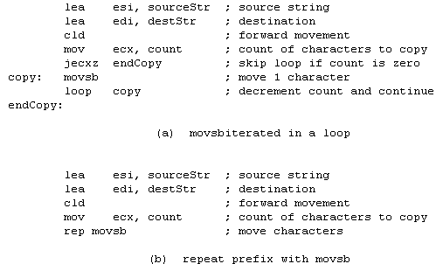
Fig. 7.4
String Operations

Slide 29
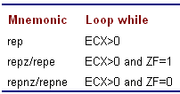
Repeat prefixes
String Operations

Slide 30
Repz / Repe, Repnz / Repne, each of these repeat prefixes is appropriate for use with the two string instructions cmps and scas, which affect the zero flag ZF
String Operations

Slide 31
Cmps
Cmpsb
Cmpsw
Cmpsd
String Operations

Slide 32
For example: cmpsw
Form: cmpsw
Operation
  cmps subtracts two string elements and sets flags based on the difference; neither operand is changed.
  If DF=0, then both index registers are incremented by the element size 2
  Else if DF=1, then both index registers are decremented by the element size 2
String Operations

Slide 33
Scas
scasb
scasw
scasd
String Operations

Slide 34
For example: scasw
Form: scasw
Operation
  scan a string for the presence or absence of a particular string element.
    The address of the element being examined is in the destination index register EDI
    element searched for is the word in the AX register
  If DF=0, then EDI registers are incremented by the element size 2
  Else if DF=1, then EDI registers are decremented by the element size 2
String Operations

Slide 35
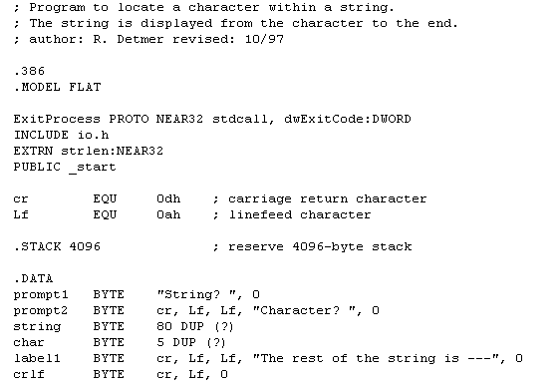
Example(Fig. 7.10)
String Operations

Slide 36
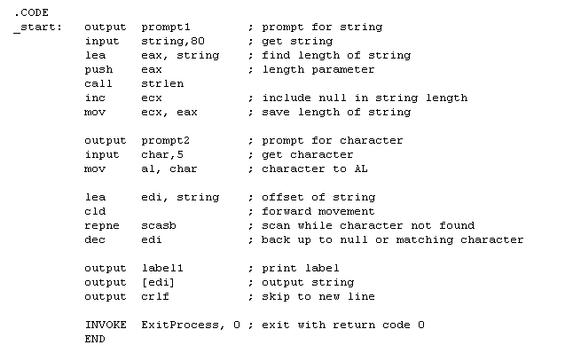
String Operations

Slide 37
STOSB
Operation
(AL)->ES:[EDI];
IF DF=0
THEN EDI=EDI+1
ELSE EDI=EDI-1;
REP STOSB Will make a string containing (ecx) same characters (al).

Slide 38
LODSB
Operation
DS:[ESI]->AL;
IF DF=0
THEN ESI=ESI+1
ELSE ESI=ESI-1;
No REP/REPE/REPNE prefixes are needed in LODS instruction usually.

Slide 39
Exercises 7.2
2
4
6
8
String Operations

Slide 40
Contents
Using String Instructions
Repeat Prefixes and More String Instructions
Character Translation
Converting a 2’s Complement Integer to an ASCII String
String Operations

Slide 41
7.3 Character translation
The 80x86 instruction set includes the xlat instruction to translate one character to another character.
In combination with other string-processing instructions, it can easily translate all the characters in a string.
String Operations

Slide 42
Xlat(1-3)
Prior to execution, the character to be translated is in the AL register.
The instruction works by using a translation table in the data segment to look up the translation of the byte in AL.
String Operations

Slide 43
Xlat(2-3)
This translation table normally contains 256 bytes of data, one for each possible 8-bit value in AL.
The byte at offset zero in the table-the first byte-is the character to which 00 is translated.
The byte at offset one is the character to which 01 is translated.
String Operations

Slide 44
Xlat(3-3)
In general xlat uses the character being translated as an offset into the table, and the byte at that offset then replaces the character in AL.
The xlat instruction has no operand. The EBX register must contain the address of the translation table.
String Operations

Slide 45

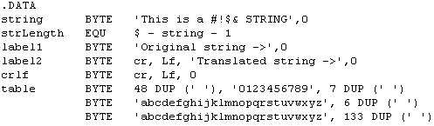
Translation program(Fig. 7.13)
…
String Operations

Slide 46
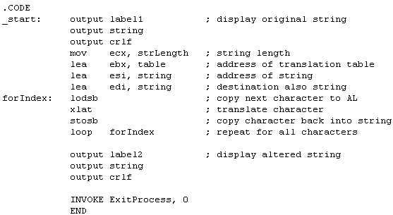
String Operations

Slide 47
Contents
Using String Instructions
Repeat Prefixes and More String Instructions
Character Translation
Converting a 2’s Complement Integer to an ASCII String
String Operations

Slide 48
The dtoa and itoa macros have been used to convert 2’s complement integers to strings of ASCII characters for output.
The code for these operations is similar.
In this section we examine the slightly shorter code for itoa.
String Operations

Slide 49
The itoa macro expands into the following sequence of instructions:
push ebx ; save EBX
mov bx, source
push bx ; source parameter
lea ebx, dest ; destination address
push ebx ; destination parameter
call itoaproc ; call itoaproc(source,dest)
pop ebx ; restore EBX
String Operations

Slide 50
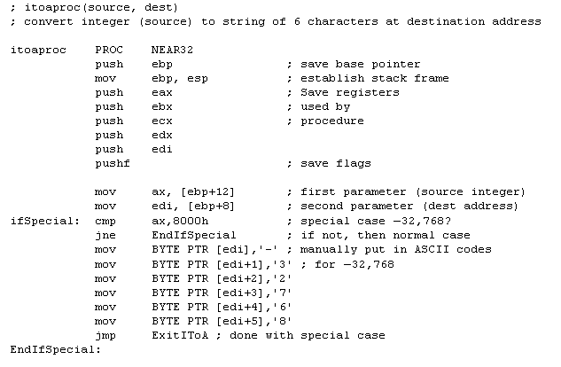
String Operations

Slide 51
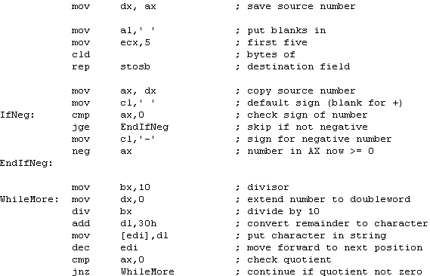
String Operations

Slide 52
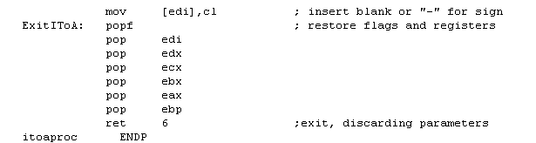
String Operations

Slide 53
Summary
word string refers to a collection of consecutive bytes, words, or doublewords in memory.
The 80x86 instruction set includes five instructions for operating on strings:
  movs (to move or copy a string from a source to a destination location)
  cmps (to compare two strings)
  scas (to scan a string for a particular element)
  stos (to store a given value in a string)
  lods (to copy a string element into EAX, AX, or AL).
String Operations

Slide 54
preparation
Read Chapter 8
Bit Manipulation
String Operations

