Slide 1

Bit Manipulation
College of Computer Science, SCUEC

Slide 2
Review of last class
Using string instructions, repeat prefixes and more string instructions
Character translation
Converting a 2’s complement integer to an ASCII string
Bit Manipulation

Slide 3
Expected outcome
You will be able to grasp the instructions about bit manipulation in assembly language
Bit Manipulation

Slide 4
Key language
Logical Operations
Shift
Rotate
Bit Manipulation

Slide 5
Anticipatory set
A computer contains many integrated circuits that enable it to perform its functions.
Each chip incorporates from a few to many thousand logic gates, each an elementary circuit that performs Boolean and, or, exclusive or, or not operations on bits that are represented by electronic states.
The CPU is usually the most complex integrated circuit in a PC.
Bit Manipulation

Slide 6
Terminology
Boolean calculation
Logic operation
Bit manipulation
Mask
Not
And
Or
Xor
Shift
Rotate
Carry Flag (CF)
Bit Manipulation

Slide 7
Contents
Logical Operations
Shift and Rotate Instructions
Converting an ASCII String to a 2's Complement Integer
Bit Manipulation

Slide 8
8.1 Logical Operations
Many high-level languages allow variables of Boolean type; that is, variables that are capable of storing true or false values.
Virtually all high-level languages allow expressions with Boolean values to be used in conditional (if) statements.
In assembly language the Boolean value true is identified with the bit value 1 and the Boolean value false is identified with the bit value 0.
Bit Manipulation

Slide 9
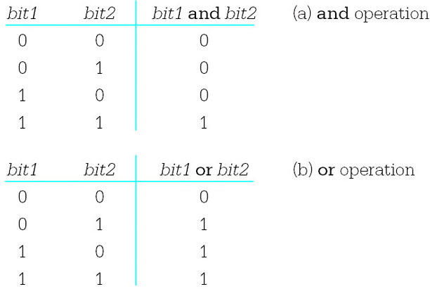
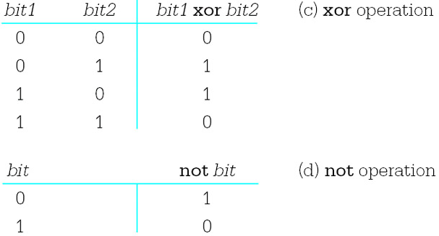
Bit Manipulation

Slide 10
The 80x86 has and, or, xor, and not instructions that implement the logical operations. The formats of these instructions are
  and destination, source
  or destination, source
  xor destination, source
  not destination
Bit Manipulation

Slide 11
And, or, and xor
The first three instructions act on pairs of doublewords, words, or bytes, performing the logical operations on the bits in corresponding positions from the two operands.
For example, when the instruction and bx,cx is executed, bit 0 from the BX register is "anded" with bit 0 from the CX register, bit 1 from BX is "anded" with bit 1 from CX, and so forth to bit 15 from BX and bit 15 from CX.
The results of these 16 and operations are put in the corresponding positions in the destination.
Bit Manipulation

Slide 12
Not instruction
The not instruction has only a single operand.
It changes each 0 bit in that operand to 1 and each 1 bit to 0.
For example, if the AH register contains 10110110 and the instruction not ah is executed, then the result in AH will be 01001001.
This is sometimes called "taking the one's complement" of the operand.
Bit Manipulation

Slide 13
Flag effects
The not instruction does not affect any flag.
However, each of the other three Boolean instructions affects CF, OF, PF, SF, ZF, and AF.
  CF and OF flags are both reset to 0
  The value of the auxiliary carry flag AF may be changed but is undefined.
  PF, SF, and ZF are set or reset according to the value of the result of the operation.
For instance, if the result is a pattern of all 0 bits, then ZF will be set to 1; if any bit of the result is not 0, then ZF will be reset to 0.
Bit Manipulation

Slide 14
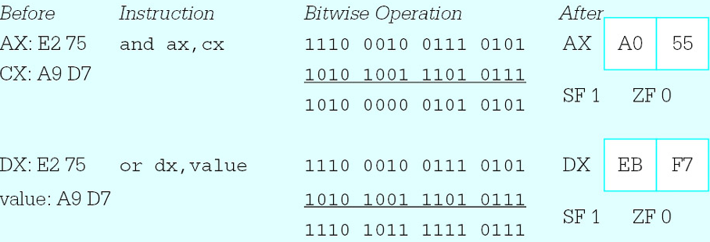
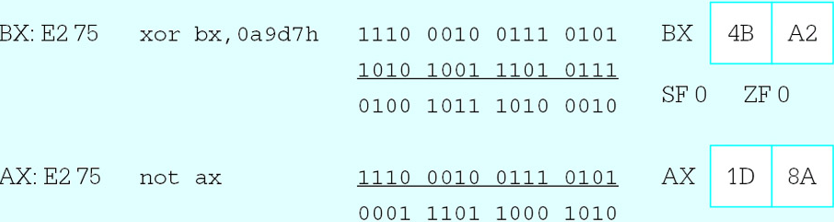
Example
Bit Manipulation

Slide 15
Test instruction
The 80x86 instruction set includes test instruction that function the same as and instruction except that destination operands are not changed.
This means that the only job of a test instruction is to set flags. (Remember that a cmp instruction and sub instruction)
One application of a test instruction is to examine a particular bit of a byte or word.
Bit Manipulation

Slide 16
Applications of logical instructions
Alter bit values
Implement high-level language Boolean operations
Perform certain arithmetic operations
Manipulate ASCII codes
Bit Manipulation

Slide 17
Questions?-- Alter bit values
How to set a bit in a byte,word or dword? (or)
How to clear a bit? (and)
How to get the 1’s complement? (xor)
How to keep several bits and clear another?
Bit Manipulation

Slide 18

Example
Bit Manipulation

Slide 19
Implement high-level language Boolean operations
Bit Manipulation

Slide 20

Perform certain arithmetic operations
Suppose that the value in the EAX register is interpreted as an unsigned integer. The expression (value mod 32) could be computed using the following sequence of instructions.
Bit Manipulation

Slide 21
Manipulate ASCII codes
Bit Manipulation

Slide 22
Exercises 8.1
3
4
Bit Manipulation

Slide 23
Contents
Logical Operations
Shift and Rotate Instructions
Converting an ASCII String to a 2's Complement Integer
Bit Manipulation

Slide 24
8.2 Shift and Rotate Instructions
Shift and rotate instructions enable the programmer to change the position of bits within a doubleword, word, or byte.
  Shift instructions
  Rotate instructions
Bit Manipulation

Slide 25
Shift instructions
Shift instructions slide the bits in a location given by the destination operand to the left or to the right.
The direction of the shift can be determined from the last character of the mnemonic—sal and shl are left shifts; sar and shr are right shifts.
Shifts are also categorized as logical or arithmetic—shl and shr are logical shifts; sal and sar are arithmetic shifts.
Bit Manipulation

Slide 26
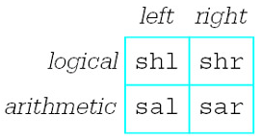
Bit Manipulation

Slide 27
Shift instructions
Form: s- destination, count
There are three versions of the count operand.
  This operand can be the number 1
  Another number serving as a byte-size immediate operand
  The register specification CL.
Bit Manipulation

Slide 28
s- destination, 1
s- destination, immediate8
s- destination, cl
Bit Manipulation

Slide 29
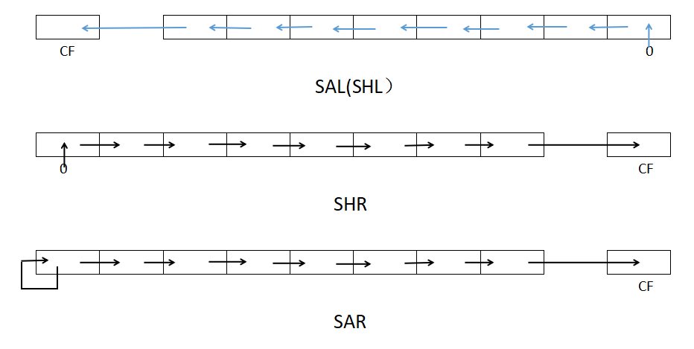

Slide 30
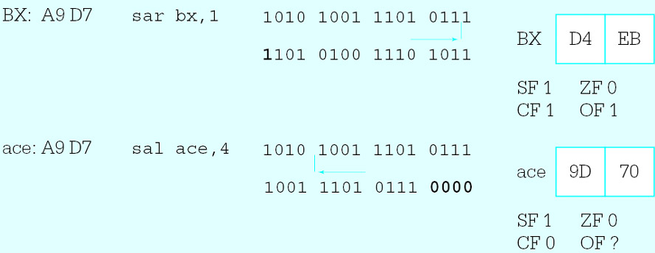
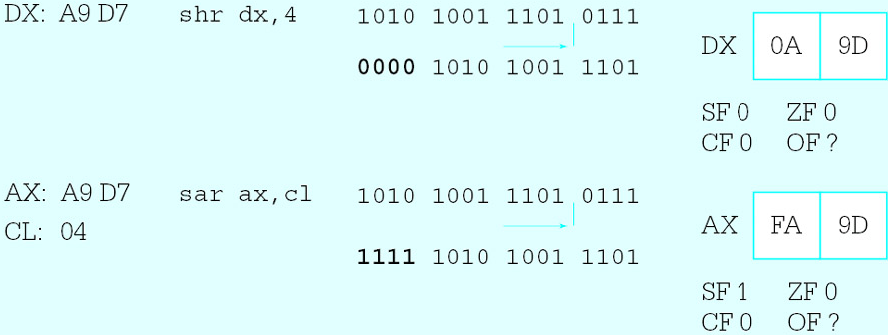
Bit Manipulation

Slide 31
Example (fig. 8.7)
The program shown below prompts for an integer, uses the atod macro to convert it to 2’s complement form in the EAX register, and then displays the word in the EAX register as eight hexadecimal digits.
Bit Manipulation

Slide 32
To accomplish this display, eight groups of four bits must be extracted from the value in EAX.
Each group of four bits represents a decimal value from 0 to 15, and each group must be converted to a character for display.
This character is a digit 0 through 9 for integer value 0 (0000₂) through 9 (1001₂) or a letter A through F for integer value 10 (1010₂) through 15 (1111₂).
Bit Manipulation

Slide 33
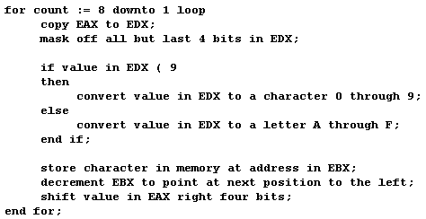
Pseudocode
Bit Manipulation

Slide 34
Rotate instructions
Rotate instructions are very similar to single shift instructions.
With rotate instructions the bits that are shifted off one end of the destination are used to fill in the vacated space at the other end.
Bit Manipulation

Slide 35
Rotate instruction formats are the same as single shift instruction formats. A single-bit rotate instruction has the format
r- destination, 1
and there are two multiple-bit versions
r- destination, immediate8
r- destination, cl
Bit Manipulation

Slide 36
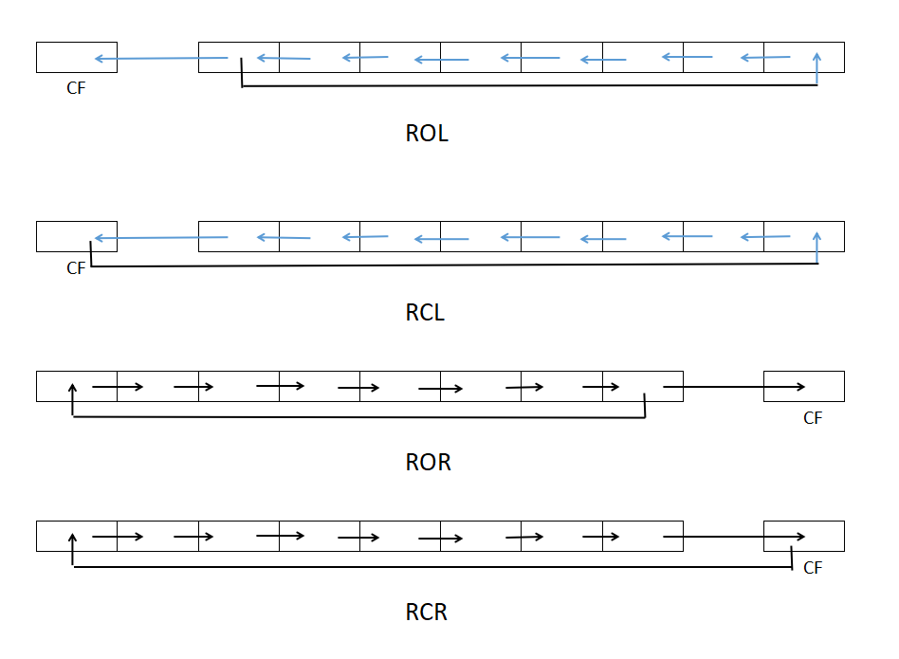

Slide 37

Example
Suppose that the DX register contains D25E and the instruction
rol dx, 1
is executed. In binary, the operation looks like
resulting in 1010 0100 1011 1101 or A4BD.
The carry flag CF is set to 1 since a 1 bit rotated from the left end to the right.
Bit Manipulation

Slide 38
Exercises 8.2
5. The instructions
mov ebx , eax ; value
shl eax , 1 ; 2*value
add eax , ebx ; 3*value
multiplies the value in EAX by 3.
Write similar code sequences that use
shift and addition instructions to
efficiently multiply by 10.
Bit Manipulation

Slide 39
Contents
Logical Operations
Shift and Rotate Instructions
Converting an ASCII String to a 2's Complement Integer
Bit Manipulation

Slide 40
The atoi and atod macros have been used to scan an area of memory containing an ASCII representation of an integer, producing the corresponding word-length 2's complement integer in the EAX register.
These macros and the procedures they call are very similar.
This section uses atod as an example.
Bit Manipulation

Slide 41

Example (fig. 8.9)
The atod macro expands into the following sequence of instructions.
Bit Manipulation

Slide 42
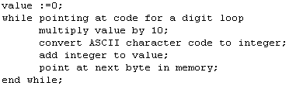
Pseudocode
Bit Manipulation

Slide 43
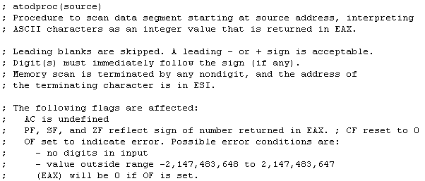
Comments
Bit Manipulation

Slide 44
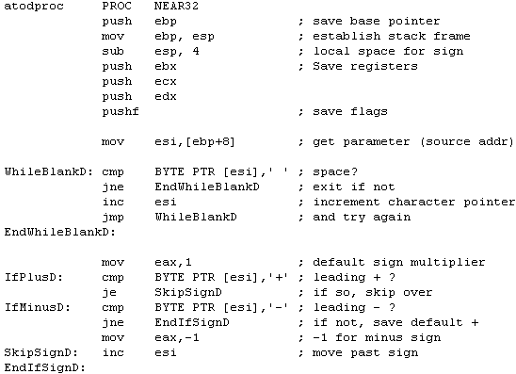
Bit Manipulation

Slide 45
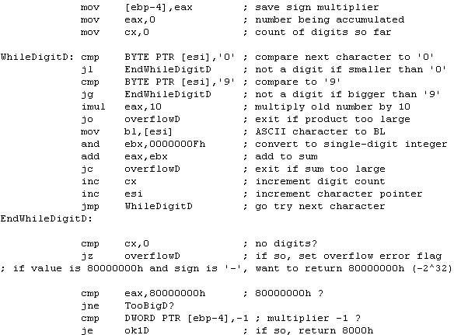
Bit Manipulation

Slide 46
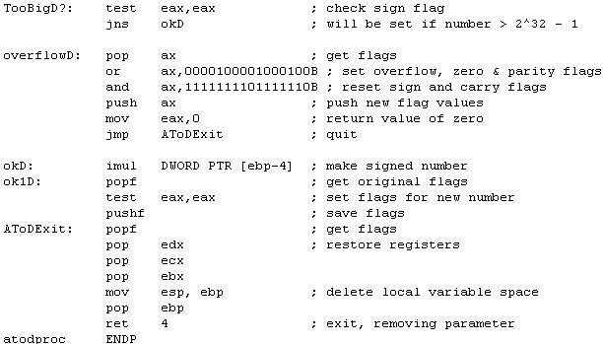
Bit Manipulation

Slide 47
Summary(1-2)
This chapter has explored the various 80x86 instructions that allow bits in a byte, word, or doubleword destination to be manipulated.
  And
  Or
  Xor
  Not
  Test
Bit Manipulation

Slide 48
Summary(2-2)
Shift instructions
  Shl Shr
  Sal Sar
Rotate instrcutions
  Rol Ror
  Rcl Rcr
Bit Manipulation

Slide 49
preparation
Read Chapter 9
The Assembly Process
Bit Manipulation

