Slide 1

Basic Details of the Team and Problem Statement
Ministry/Organization Name/Student Innovation: Ministry Of Home Affairs
PS Code: SIH1408
Problem Statement Title: IT System log analyzer
Team Name: Enigma Hunters
Team Leader Name: Durjoy Majumdar
Institute Code (AISHE): U-0020
Institute Name: Koneru Lakshmaiah Education Foundation
Theme Name: Blockchain And Cybersecurity

Slide 2
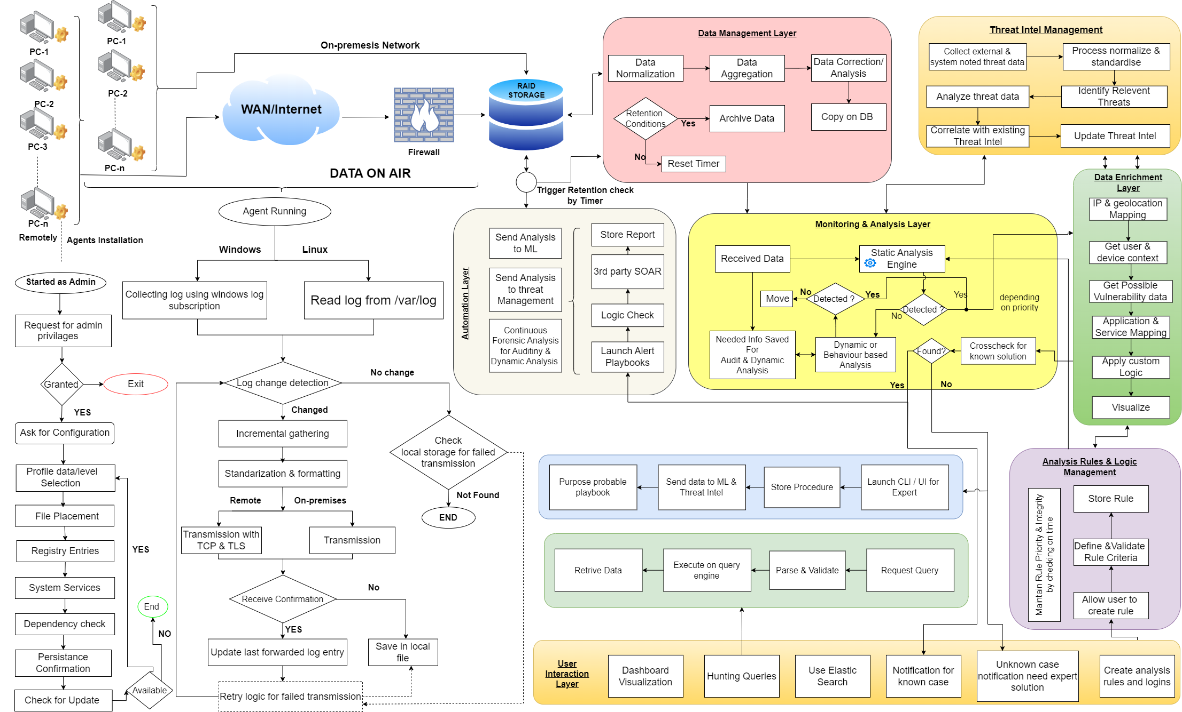
Idea/Approach Details
To get a more clear view of the Flowchart kindly follow - THE LINK

Slide 3
Idea/Approach Details
Idea Description:
Log files will be gathered from various CRPF units across the geography via Agents (Uses Syslog Protocol) installed in the local machines.
The transmission occurs in a dual layer encrypted channel that uses SSH and TLS.
After storing the logs in the central repository, our Monitoring & Analysis Layer (compute optimized system) kicks in for Static Signature(s) based threat detection.
Upon analysis, the log data goes under data-enrichment layer which exposes the insight to the Analysis & Logic management layer to make the expert interaction a frictionless experience.
Threat remedies in form of playbooks can be triggered via the Automation Layer and 0-Day threats needs expert interaction.
Our ML program continues learns from the expert interaction and 3rd party DBs and make our threat intel a robust system.
The Expert interaction layer allows to write custom detection rules & logics. It also facilitates the alerts management system.
Our system also have data retention engine, that works using life-cycle policy for the backup and archival of our log files.
The Agent Software(s) are capable of receiving updates and patches from the central system.
Use Cases: Only the Expert analyst is the User here with the use case.
Expert Threat Analysis: Cybersecurity experts analyze incoming log data to identify potential threats and vulnerabilities.
Automated Playbook Execution: Experts develop and deploy automated playbooks to respond to known threats swiftly and effectively.
Manual Threat Analysis: In cases of novel or complex threats, experts manually investigate and analyze the situation to develop tailored responses.
Expert Guidance: Experts provide guidance to on-site personnel on how to respond to specific threats, ensuring a coordinated and effective response.
Technology stack:
Django Python.
ReactJS with ChartJS.
Syslog, SSH, TLS.
SQL based RDBMS.
PowerShell & Bash.
Dependencies :
Elastic Search
Kibana
MITRE ATT&CK® Navigator
Fluentd
Graylog
Grafana

Slide 4
Team Member Details
Team Leader Name: Durjoy Majumdar
Branch : B.Tech Stream : CSE-H Year : III
Team Member 1 Name: Arjun S
Branch : B.Tech Stream : CSE-H Year : III
Team Member 2 Name: Anuj Kandel Sharma
Branch : B.Tech Stream : CSE-H Year : III
Team Member 3 Name: Sambandha Bhattarai
Branch : B.Tech Stream : CSE-H Year : III
Team Member 4 Name: Pranavi Boyina
Branch : B.Tech Stream : CSE-H Year : III
Team Member 5 Name: Sri Sai Priya Rayidi
Branch : B.Tech Stream : CSE-H Year : III
Team Mentor 1 Name: Dr. Radhika Rani Chintala
Category : Academic Expertise : Network Security Domain Experience : 17 Years
Team Mentor 2 Name: Dr. Prashant Kumar Shukla
Category : Academic Expertise : Innovation Management Domain Experience : 20 Years

