Slide 1

Using Neural Network based Approximation to improve HPC Application
Asoke Datta
Rahul S Hoskeri
Shubham S Rohal
Dept: EECS
Professor of Instruction:
Dong Li
Dept: EECS

Slide 2
Contents
Introduction
SOFC & Simulation Model
TensorFlow (Neural Network Approach)
Model Used
Results
Summary

Slide 3
Introduction
What is HPC Application ?
HPC Applications are algorithmically designed specifically to take advantage of the parallel nature of high-performance computational computing systems.
What is Neural Network based approach ?
Neural Networks are those algorithms that are used to recognize the pattern in data by mimicking the way the human brain works.
They are good at recognizing hidden pattern in data set.

Slide 4
SOFC &Simulation Model
What is SOFC ?
Solid oxide fuel cell (SOFC) is a type of fuel cell which converts chemical energy into electrical energy.
Simulation model used
OpenFuelCell and Cantera.
30000 data points are collected using cantera.

Slide 5
TensorFlow
TensorFlow is core open source library to develop and train the machine learning models.
Keras API is used with TensorFlow to develop neural network in this project.
TensorFlow is a dataflow graph with edges as tensor or data and nodes carrying out the mathematical operation.

Slide 6
Model Used
Multi layer perceptron (MLP) model is being used in this project.
MLP is widely used in solving the problems that requires supervised learning which make’s it suitable for this project.
This model consists of 4 hidden layers of 5 neurons in each layer.

Slide 7
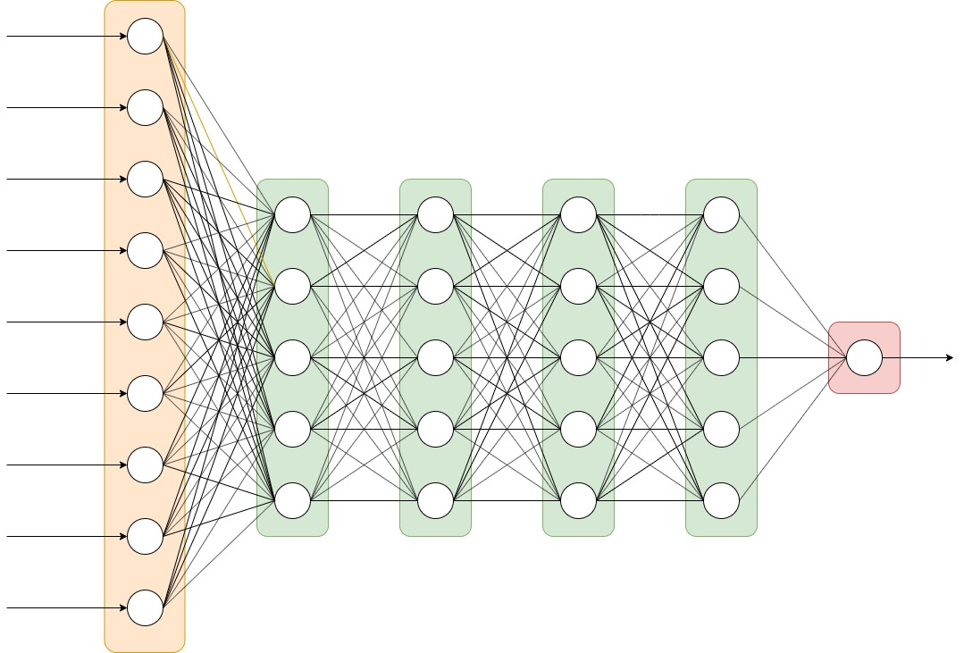
Multi-Layer Perceptron
Hidden Layer1
Hidden Layer 2
Hidden Layer 3
Hidden Layer 4
Input Layer
Output Layer
Activation function: Relu
Activation function: tanh
Activation function: elu
Activation function: Relu

Slide 8
Results

Slide 9
Summary
References

