Slide 1
PROJECT TITLE:
RECOMMENDATION SYSTEM
FROM SALES DATA USING
DEEP LEARNING

Slide 2
PRESENTED BY,
HELTRIN LADO J Nm id: (au962821104034) ASOLIN SOWMIYA A Nm id: (au962821104014) GOKILA K Nm id: (au962821104032) DEPARTMENT: COMPUTER SCIENCE AND ENGINEERING COLLEGE NAME: UNIVERSITY COLLEGE OF ENGINEERING NAGERCOIL.

Slide 3
Outline:
1.Problem Statement
2. Data Description
3. Data Preprocessing
4. Model Selection
5. Algorithm Overview
6. Training Procedure
7. Evaluation Metrics
8. Deployment Strategy
9. Result
10. Conclusion

Slide 4
Problem statement:
The Project aims to develop a deep learning-based recommendation system to analyze customer transactions and product details. Enhance user engagement and satisfaction by delivering personalized product suggestions tailored to individual preferences. Optimize sales performance by leveraging data-driven insights to increase the conversion rate of recommendations into purchases.

Slide 5
Data description:
The sales dataset includes customer transactions, product details, timestamps, and key attributes essential for recommendation system development.
Customer transactions encompass purchase history and browsing behavior.
Timestamps provide temporal context for customer interactions.
Challenges such as data sparsity and missing values require preprocessing for data quality assurance.

Slide 6
Data preprocessing:
Data Cleaning : Address missing values, outliers, and inconsistencies.
Feature Engineering: Extract relevant features and encode categorical variables.
Normalization : Scale numerical features for balanced model training.
Handling Temporal Data: Extract insights from timestamps for improved model understanding.
Data Splitting : Divide the dataset for training, validation, and testing to assess model performance accurately.

Slide 7
Model selection:
Neural Collaborative Filtering: Utilize neural networks for collaborative filtering, leveraging user-item interactions.
Auto encoder Approaches : Employ auto encoders for learning latent representations of users and items, facilitating personalized recommendations.
Hybrid Models : Combine collaborative filtering with content-based or context-aware methods for enhanced recommendation accuracy.

Slide 8
Algorithm overview:
Embedding Layers : Represent users and items as dense vectors, capturing latent preferences.
Neural Network Structure : Design a tailored architecture incorporating embedding and fully connected layers.
Loss Functions : Define appropriate loss functions to optimize model parameters.
Optimization Algorithms : Utilize techniques like SGD or Adam for iterative weight updates.
Regularization Techniques : Apply dropout or L2 regularization to prevent overfitting.

Slide 9
Training procedure:
Data Splitting : Divide data into training, validation, and test sets.
Batch Processing : Train model efficiently using mini-batch gradient descent.
Parameter Optimization : Fine-tune hyper Parameters to optimize performance.
Model Training : Update weights iteratively using optimization algorithms.
Validation Monitoring : Monitor model performance to prevent overfitting.

Slide 10
Evaluation metrics:
Accuracy : Measures overall recommendation effectiveness.
Precision : Gauges recommendation relevancy by assessing relevant items among recommendations.
Recall : Measures recommendation completeness by assessing retrieved relevant items.
MAP (Mean Average Precision) : Quantifies recommendation quality across all users comprehensively.
F1 Score : Balances precision and recall for a holistic evaluation of recommendation performance.

Slide 11
Deployment strategy:
Integration : Seamlessly integrate the model into the production environment.
Scalability : Ensure efficient handling of large data volumes and user traffic.
Latency Optimization : Minimize response time for real-time recommendations.
A/B Testing : Evaluate system effectiveness before full deployment.
Continuous Monitoring : Track performance and user feedback for ongoing improvements.

Slide 12
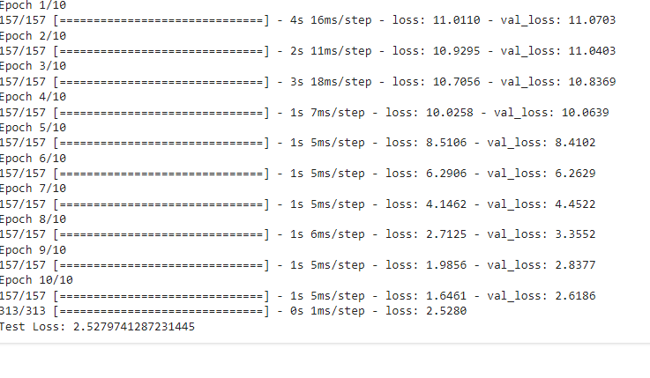
RESULT:

Slide 13
Conclusion:
The recommendation system developed using deep learning techniques offers personalized product suggestions, enhancing sales performance and customer satisfaction. Through meticulous preprocessing, model selection, and testing, we've demonstrated its efficacy in driving sales growth. Further refinement and ongoing monitoring will ensure continued success and adaptation to evolving market demands.

Slide 14
Thank you

