Slide 1
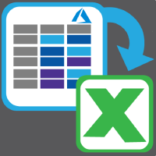
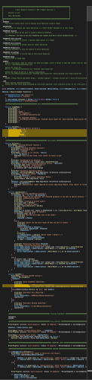
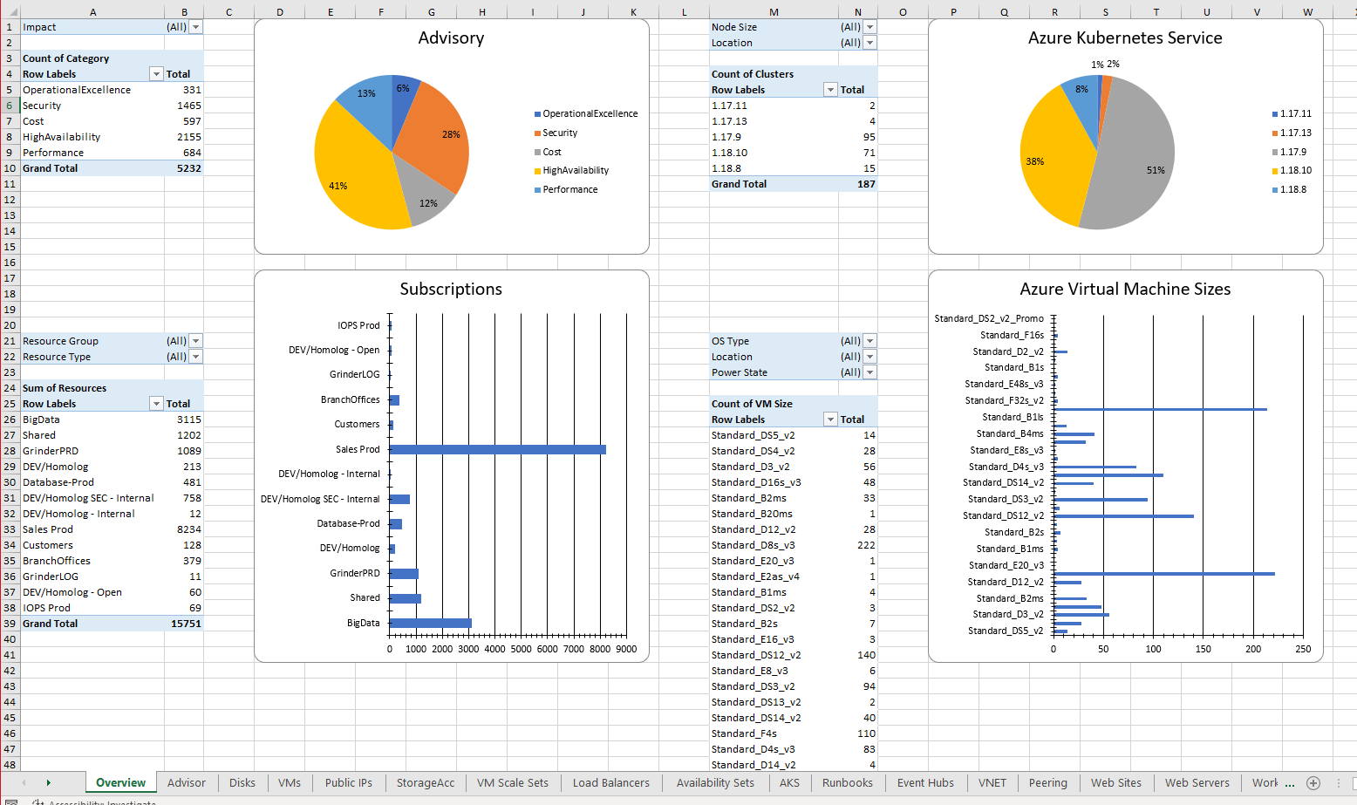
Azure Resource Inventory V1
Main Script: AzureResourceInventory.ps1
One Script Only: AzureResourceInventory.ps1
Close to 6000 code lines
A lot of loopings
Complex and difficult to maintain and improve
Authentication
Extraction
Resource Types
Virtual Machine
Azure Kubernetes Service
Virtual Networks
Storage Accounts
EventHub
Load Balancer
…
Excel Creation

Slide 2
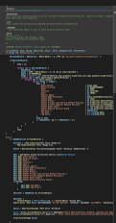


Azure Resource Inventory V2
Main Script: AzureResourceInventory.ps1
Modularization:
Modularization
AzureResourceInventory.ps1 : Close to 1500 code lines + Modules.ps1
Easy to create new modules and improve
Easy to collaborate
Native extraction:
ARI V1: 34 Resource Providers
ARI V2: 45 Modules
Online Modules
New Dashboard Overview
Azure Diagram Inventory
Quota Usage
Service Principal Authentication
Much Faster
VM.ps1
VirtualNetwork.ps1
AKS.ps1
ARI V1:
EvHub.ps1
ARI V2:
Authentication
Extraction
StorageAcc.ps1
Your Module.ps1

