Slide 1
Agentic Calendar
An Intelligent Planning Assistant with LLM-Powered Task Decomposition

Slide 2
Motivation
• Traditional calendars only provide reminders, not actionable guidance
• Users struggle to break down complex goals into manageable tasks
• Finding relevant learning resources is time-consuming
• Manual scheduling often ignores realistic time constraints
• Gap between goal-setting and execution leads to abandoned plans
• Need: An intelligent assistant that understands goals and creates actionable, scheduled plans with real resources

Slide 3
Purpose & Goals
• Goal-Driven Planning: Understand user objectives, not just reminders
• Intelligent Decomposition: Break complex goals into concrete tasks using LLM
• Availability-Aware Scheduling: Respect user's time constraints
• Seamless Integration: Export to Apple Calendar, Google Calendar, Outlook
• HCI-Focused Design: Simple, intuitive interface following Nielsen's heuristics

Slide 4
System Architecture
Frontend (Streamlit)
OpenAI/ Anthropic
LLM Client
Planner
Web Search
Storage (JSON)
Calendar Export

Slide 5
User Flow: 5-Step Process
1. Input
2. Analysis
3. Review
4. Schedule
5. Export
Enter goal via text/link/image
LLM understands and decomposes
Edit tasks and resources
Set availability and generate
Download .ics for calendar

Slide 6
Design Principles (Nielsen's Heuristics)
• H1 - Visibility: Progress stepper shows current step clearly
• H2 - Match Real World: Familiar calendar metaphors and icons
• H3 - User Control: Cancel, go back, edit, regenerate at any step
• H5 - Error Prevention: Input validation, confirmation dialogs
• H6 - Recognition: Pre-filled examples, auto-complete suggestions
• H10 - Help: In-app guidance, tooltips, and user manual

Slide 7
Code: LLM Task Decomposition
The LLM generates tasks with search queries, then we fetch real resources from the Internet.
def decompose_goal(self, goal_summary, deadline):
"""Break down goal into tasks with search queries."""
prompt = TASK_DECOMPOSITION_PROMPT.format(
goal_summary=goal_summary,
deadline=deadline,
today=datetime.now()
)
# Get tasks from LLM
tasks = self._call_llm(prompt)
# Search real resources for each task
resource_results = search_resources_parallel(tasks)
for idx, task in enumerate(tasks):
task["resources"] = resource_results.get(idx, [])
return tasks

Slide 8
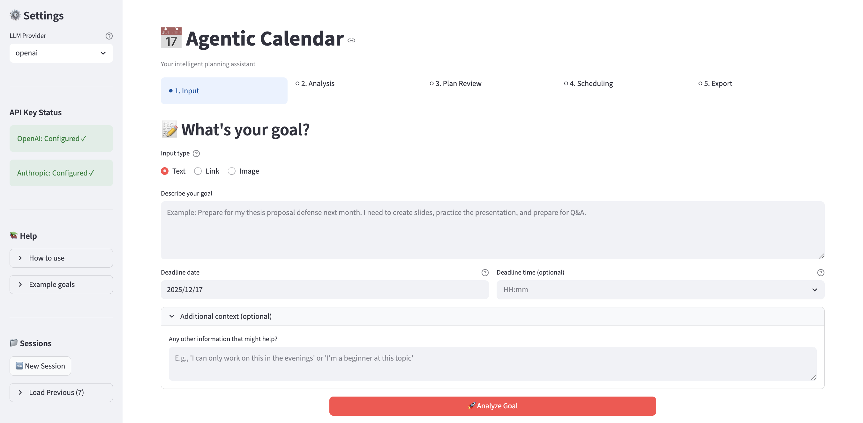
Demo: Goal Input & Analysis

Slide 9
Demo: Task Review & Resources
📷 INSERT SCREENSHOT HERE
Take a screenshot showing tasks with YouTube/web resources

Slide 10
Future Work
• Progress tracking and task completion monitoring
• Collaborative planning for team projects
• Smart rescheduling when tasks are missed or delayed
• Mobile app version for iOS and Android
• Learning path recommendations based on user history

