Slide 1

















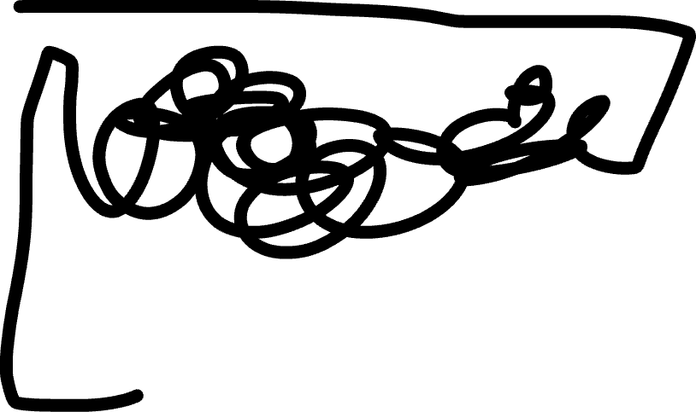

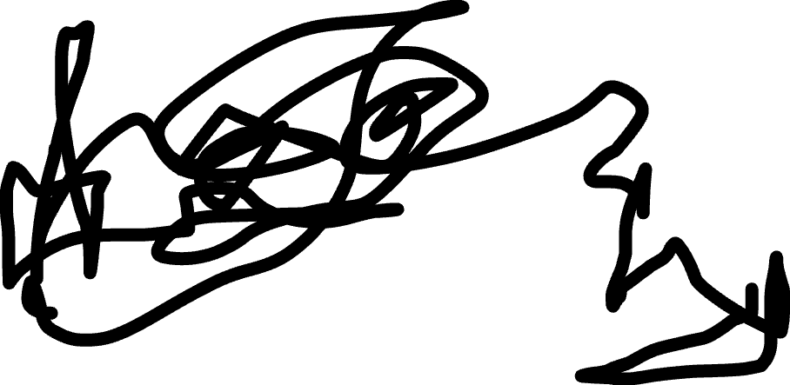




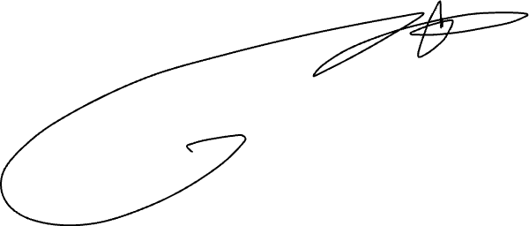




SENTINEL
Date Inspo Log-In
Motivation is a False God.
DISCIPLINE is Manhood
The AI Brother that helps men rebuild Confidence, Discipline, and Self-Respect one day at a time
> Take Control… |

Slide 2
















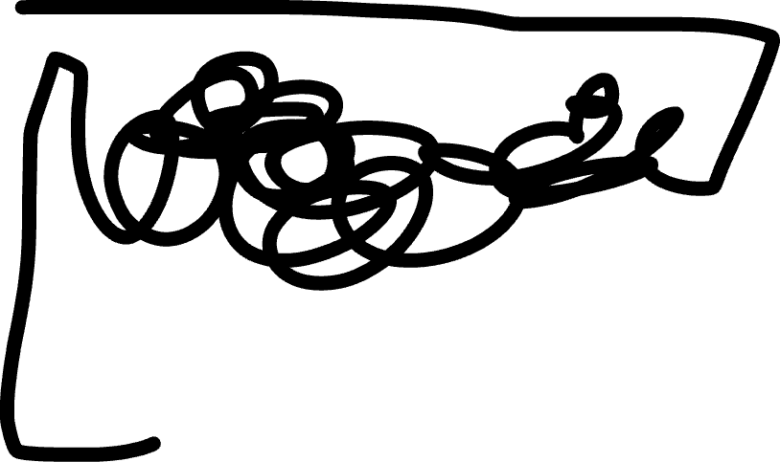

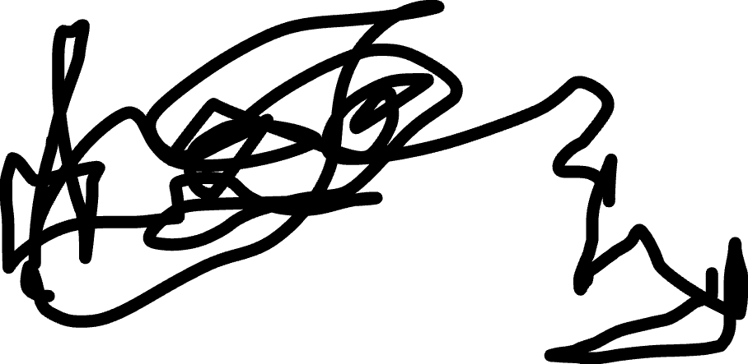




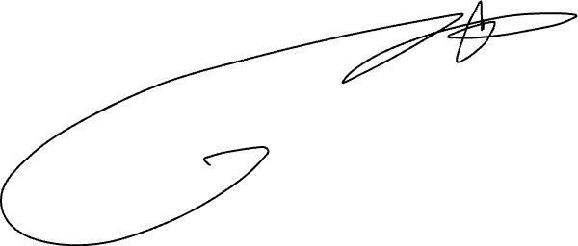




SENTINEL
29 Jan’26
Inspo
Log-In
Motivation is a False God.
DISCIPLINE is Manhood
The AI Brother that helps men rebuild Confidence, Discipline, and Self-Respect one day at a time
> Take Control… |

Slide 3
SENTINEL
Date
Inspo
Log-In
Motivation is a False God.
DISCIPLINE is Manhood
The AI Brother that helps men rebuild Confidence, Discipline, and Self-Respect one day at a time
> Take Control… |

Slide 4
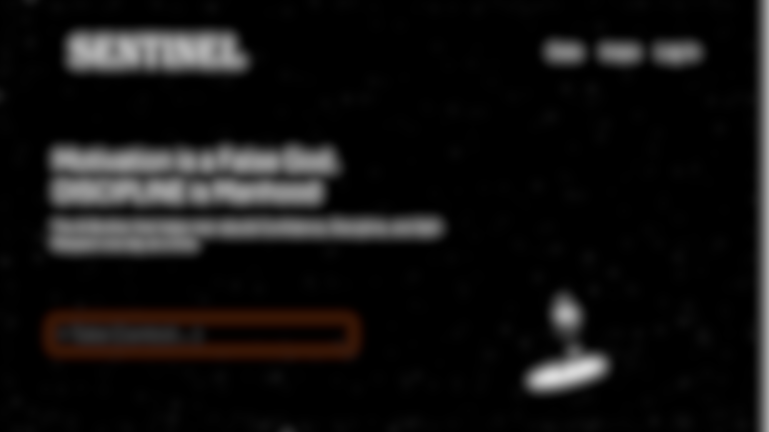

Slide 5

So, what’s been weighing on you lately?
Feeling invisible socially?

Slide 6

SENTINEL
Username
Vent-Out +
Chat-1
Chat-2
Chat-3
Daily-Goals
Goal1
Goal2
Weekly-Goals
Goal1
Goal2
Vent Out
Bro Tip
Bro-Tip +
Chat-1
Chat-2
Chat-3
For Deep, unfiltered talks that feel like therapy
For quick short and to-the-point advices that remove self doubts
Long-Term Goals
Goal1
Goal2
Saved Tips
Tip1
Tip2

Slide 7
SENTINEL
Username
Vent-Out +
Chat-1
Chat-2
Chat-3
Daily-Goals
Goal1
Goal2
Weekly-Goals
Goal1
Goal2
Bro-Tip +
Chat-1
Chat-2
Chat-3
Long-Term Goals
Goal1
Goal2
Saved Tips
Tip1
Tip2
Go ahead, I am here for you

