Slide 1
Security Policies and Procedures
Notes:
This chapter focuses on the topic of policies. As a security professional or working on data security office, you must strive not only to prevent losses, but also to make contingency plans for recovering from any losses that do occur.
It also looks at incident response and the basic forensic procedures with which you should be familiar. This chapter deals with the crucial aspects of business continuity, vendor support, security policies and procedures, and privilege management from an operations perspective.
It will also help you become a more proficient and professional security team member. The process of working with, helping to design, and maintaining security in your organization is a tough job.

Slide 2
This Chapter:
Understanding Business continuity
Summarize the various authentication models and identify the components of each
Execute proper logging procedures and evaluate the results
Conduct periodic audits of system security settings
Explain redundancy planning and its components.
Implement disaster recovery procedures
Identify and explain applicable legislation and organizational policies.

Slide 3
Understanding Business Continuity
Utilities
Water, Electricity
To keep it comfortable and functioning properly
High Availability
The process of keeping services and systems operational during an outage
Notes:
One of the oldest phrases still in use today is “the show must go on.” Nowhere is that more true than in the world of business, where downtime means the loss of significant revenue. Same scenario sa mga nangyare nung starting nang covid (Businesses Close)
Business continuity is primarily concerned with the processes, policies, and methods that an organization follows to minimize the impact of a system failure, network failure, or the failure of any key component needed for operation, whatever it takes to ensure that the business continues, that the show does indeed go on.
Disaster-recovery plan or planning make up a significant part of business continuity. The plans that you formulate for dealing with disasters are known as schemes and scheming is a key part of maintaining the infrastructure of a secure network. Utilities, high-availability environments, and disaster recovery are all parts of business continuity. In the following sections, we’ll look at them and examine the roles that they play.
Utilities - Basic utilities such as electricity, water are key aspects of business continuity. In the majority of cases, electricity and water are restored—at least on an emergency basis. The damage created by typoon, and other natural disasters is managed and repaired by utility companies and government agencies. Other disasters, such as a major earthquake can overwhelm them and services may be interrupted for quite a while. When these types of events occur, critical infrastructure may be unavailable for days, weeks, or even months. (Davao Board Meeting Experience Typhoon) Plan B like having a extra internet.
Consider the impact of weather on your contingency plans. What if you needed to relocate your facility to another region of the country? How would you get personnel there? What personnel would be relocated? You should consider these possibilities in advance. Although the likelihood that a crippling disaster will occur is relatively small, you still need to evaluate the risk.
As an administrator, you should always be aware of problems that can occur and have an idea of how you’ll approach them. It’s impossible to prepare for every emergency, but you can plan for those that could happen.
High Availability - High availability refers to the process of keeping services and systems operational during an outage. In short, the goal is to provide all services to all users, where they need them and when they need them. With high availability.

Slide 4
Understanding Business Continuity
Redundancy
Redundancy refers to systems that are either duplicated or that fail over to other systems in the event of a malfunction.
Fail-over refers to the process of reconstructing a system or switching over to other systems when a failure is detected. In the case of a server, the server switches to a redundant server when a fault is detected.
Notes:
There are several ways to accomplish this, including implementing redundant technology, fault-tolerant systems, and backup communications channels. A truly redundant system won’t utilize just one of these methods but rather some aspect of all of them. The following sections address these topics in more detail.
Redundant systems can be designed in different ways, including:
Active redundancy: In this type of redundancy, multiple components are active at the same time and perform the same function simultaneously. If one component fails, the others continue to operate.
Standby redundancy: In this type of redundancy, one component is active, while the others are on standby, ready to take over if the active component fails.
Hybrid redundancy: This type of redundancy combines active and standby redundancy to provide maximum reliability and availability.
Fail-over refers to the process of reconstructing a system or switching over to other systems when a failure is detected. In the case of a server, the server switches to a redundant server when a fault is detected. This allows service to continue uninterrupted until the primary server can be restored. In the case of a network, processing switches to another network path in the event of a network failure in the primary path.
Fail-over systems can be very expensive to implement. In a large corporate network or e-commerce environment, a fail-over might entail switching all processing to a remote location until your primary facility is operational. The primary site and the remote site would synchronize data to ensure that information is as up-to-date as possible.
Many newer operating systems, such as Linux, Windows Server 2008, are capable of clustering to provide fail-over capabilities. Clustering involves multiple systems connected together cooperatively and networked in such a way that if any of the systems fail, the other systems continue to operate. The overall capability of the server cluster may decrease, but the network or service will remain operational.

Slide 5
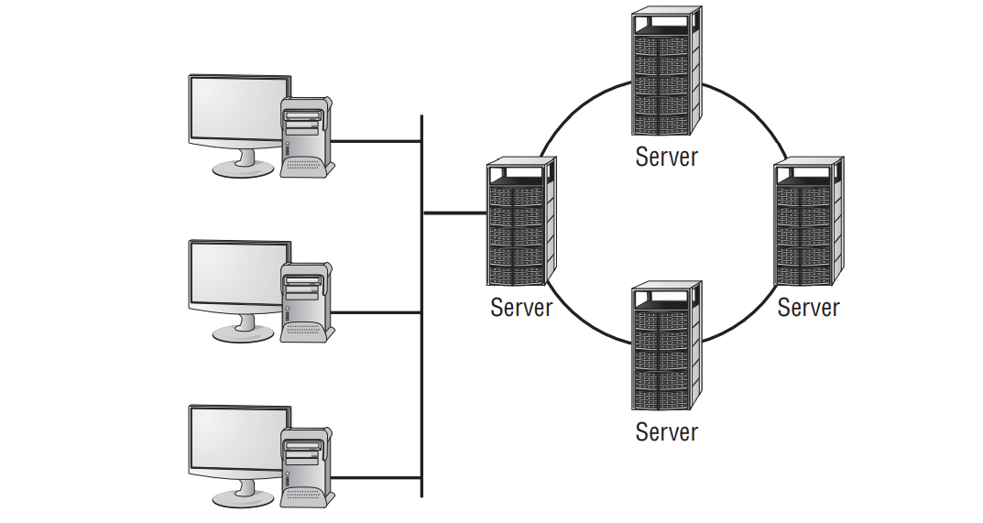
Server Clustering in a networked environment
Notes:
To appreciate the beauty of clustering, contemplate the fact that it is this technology upon which Google is built. Clustering not only allows the company to have redundancy, it also offers it the ability to scale as demand increases.
In this cluster, each system has its own data storage and data-processing capabilities. The system that is connected to the network has the additional task of managing communication between the cluster and its users. Many clustering systems allow all the systems in the cluster to share a single disk system. In either case, reliability is improved when clustering technologies are incorporated in key systems. Most ISPs Internet service provider and network providers have extensive internal fail-over capability to provide high availability to clients. Business clients and employees who are unable to access information or services tend to lose confidence. The trade-off for reliability and trustworthiness, of course, is cost: Fail-over systems can become prohibitively expensive. You’ll need to carefully study your needs to determine whether your system requires this capability. For example, if your environment requires a high level of availability, your servers should be clustered. This will allow the other servers in this network to take up the load if one of the servers in the cluster fails.

Slide 6
Understanding Business Continuity
Fault Tolerance - Fault tolerance is primarily the ability of a system to sustain operations in the event of a component failure
Spare Parts
Always be readily available to repair any system critical component if it should fail.
Electrical Power
Notes:
Fault-tolerant systems can continue operation even though a critical component, such as a disk drive, has failed. This capability involves over-engineering systems by adding redundant components and subsystems. Fault tolerance can be built into a server by adding a second power supply, a second CPU, and other key components. Several manufacturers (such as HP, Unisys, and IBM) offer fault-tolerant servers; these servers typically have multiple processors that automatically fail over if a malfunction occurs.
There are two key components of fault tolerance you should never overlook: spare parts and electrical power. Spare parts should always be readily available to repair any system critical component if it should fail. The redundancy strategy N+1 means that you have the number of components you need, plus one to plug into any system should it be needed. For example, a small company with five standalone servers that are all the same model should have a power supply in a box nearby to install in any one of the servers should there be a failure. (The redundancy strategy 1+1 has one spare part for every component in use.) Since computer systems cannot operate in the absence of electrical power, it is imperative that fault tolerance be built into your electrical infrastructure as well. At a bare minimum, an uninterruptible power supply (UPS)—with surge protection—should accompany every server and workstation. That UPS should be rated for the load it is expected to carry in the event of a power failure (factoring in the computer, monitor, and any other device connected to it) and be checked periodically as part of your preventative maintenance routine to make sure the battery is operational. You will need to replace the battery every few years to keep the UPS operational. A UPS will allow you to continue to function in the absence of power for only a short duration. For fault tolerance in situations of longer duration, you will need a backup generator. Backup generators run off of gasoline or diesel and generate the electricity needed to provide steady power. While some backup generators can come on instantly in the event of a power outage, most take a short time to warm up before they can provide consistent power, and thus you will find that you still need to implement UPSs within your organization

Slide 7
Redundant Array of Independent Disks
Redundant Array of Independent Disks to be discussed next meeting.
Notes:
Redundant Array of Independent Disks (RAID) is a technology that uses multiple disks to provide fault tolerance. There are several designations for RAID levels.

Slide 9
Redundant Array of Independent Disks
Redundant Array of Independent Disks (RAID) is a technology that uses multiple disks to provide fault tolerance. There are several designations for RAID levels.
Notes:
RAID stands for not only Redundant Array of Independent Disks, but also Redundant Array of Inexpensive Disks. While the latter term has lost its popularity, you might still encounter it in some texts.
Mean Time Between Failures (MTBF)

Slide 10
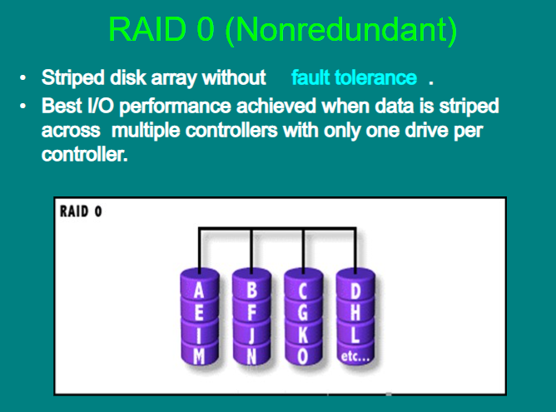
The most commonly implemented RAID levels are as follows:
RAID 0 is disk striping. It uses multiple drives and maps them together as a single physical drive.
Notes:
RAID 0 is disk striping. It uses multiple drives and maps them together as a single physical drive. This is done primarily for performance, not for fault tolerance. If any drive in a RAID 0 array fails, the entire logical drive becomes unusable.

Slide 11
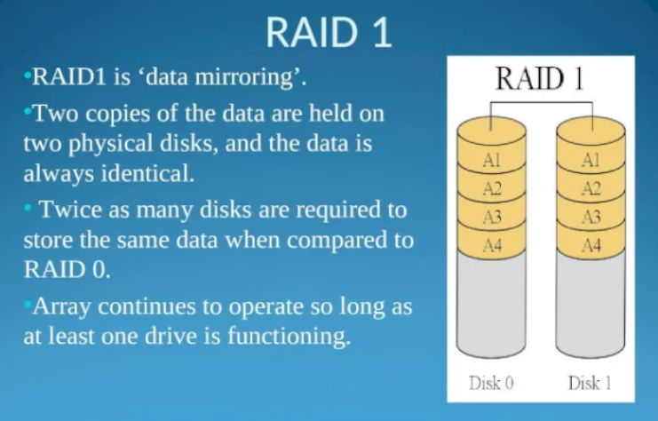
RAID 1
Notes:
RAID 1 is disk mirroring. Disk mirroring provides 100 percent redundancy because everything is stored on two disks. If one disk fails, another disk continues to operate. The failed disk can be replaced, and the RAID 1 array can be regenerated. This system offers the advantage of 100 percent data redundancy at the expense of doubling the storage requirements. Each drive keeps an exact copy of all information, which reduces the effective storage capability to 50 percent of the overall storage. Some implementations of disk mirroring are called disk duplexing (duplexing is a less commonly used term). The only difference between mirroring and duplexing is one more controller card. With mirroring, one controller card writes sequentially to each disk. With duplexing, the same data is written to both disks simultaneously. Disk duplexing has much faster write performance than disk mirroring. Many hardware implementations of RAID 1 are actually duplexing but they are still generally referred to as mirrors
The data is intact in a RAID 1 array if either one of the two drives fails. After the failed drive is replaced with a new drive, you remirror the data from the good drive to the new drive to re-create the array.

Slide 12
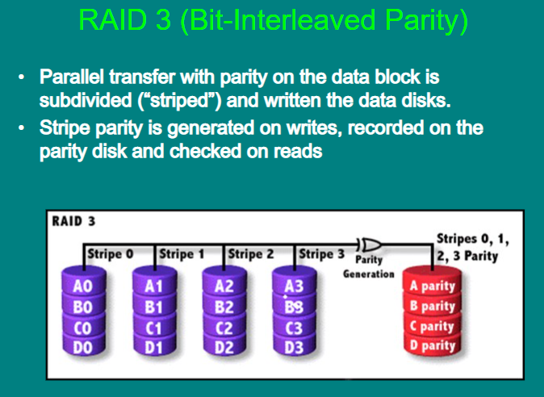
RAID 3
Notes:
RAID 3 is disk striping with a parity disk. RAID 3 arrays implement fault tolerance by using striping (RAID 0) in conjunction with a separate disk that stores parity information. Parity information is a value based on the value of the data stored in each disk location. This system ensures that the data can be recovered in the event of a failure. The process of generating parity information uses the arithmetic value of the data binary. This process allows any single disk in the array to fail while the system continues to operate. The failed disk is removed, a new disk is installed, and the new drive is then regenerated using the parity information. RAID 3 is common in older systems, and it’s supported by most Unix systems.

Slide 13
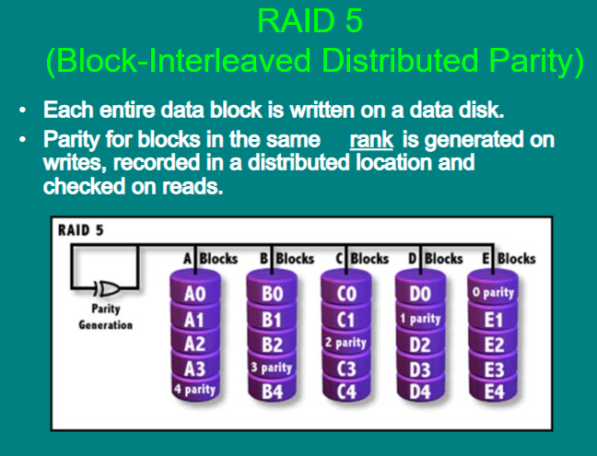
Raid 5
Notes:
RAID level 5 RAID 5 is disk striping with parity and is one of the most common forms of RAID in use today. It operates similarly to disk striping, as in RAID 0. The parity information is spread across all the disks in the array instead of being limited to a single disk, as in RAID 3. Most implementations require a minimum of three disks and support a maximum of 32. These four types of RAID drives, or arrays, are illustrated in Figure 8.2.
A RAID 5 array can survive the failure of any one drive and still be able to function. It can’t survive the failure of multiple drives.
RAID levels 0, 1, 3, and 5 are the most commonly implemented in servers today. RAID 5 has largely replaced RAID 3 in newer systems. RAID levels are implemented either in software on the host computer or in the disk controller hardware. A RAID hardware-device implementation will generally run faster than a software-oriented RAID implementation because the software implementation uses the system CPU and system resources. Hardware RAID devices generally have their own processors, and they appear to the operating system as a single device.
As a security administrator, you must determine how many RAID disks you’ll need. Compute how many disks will be needed for each scenario or the amount of storage capacity you’ll end up with (answers appear at the end of each scenario).
You must do a fair amount of planning before you implement RAID. Within the realm of planning, you must be able to compute the number of disks needed for the desired implementation.

Slide 14
Scenario
Your primary server is currently running four 300GB disks in a RAID 5 array. Storage space is at a premium, and a purchase order has just been approved for four 500GB disks. Still utilizing a RAID 5 array, what is the maximum data storage space this server will be able to host?
Notes:
The solution that will generate the most data storage capacity is to install all eight drives (the four current ones and the four new ones) into the server. The array must use the same size storage on each drive, thus all eight drives will appear as if they are 300GB drives. Under this scenario, 2100GB can be used for data storage and 300GB will be used for parity.

Slide 15
Disaster Recovery
Disaster recovery is the ability to recover system operations after a disaster. A key aspect of disaster-recovery planning is designing a comprehensive backup plan that includes backup storage, procedures, and maintenance.
Depending on Backups
Backups are duplicate copies of key information, ideally stored in a location other than the one where the information is currently stored.
Notes:
Disaster recovery is the ability to recover system operations after a disaster. A key aspect of disaster-recovery planning is designing a comprehensive backup plan that includes backup storage, procedures, and maintenance. Many options are available to implement disaster recovery. The following sections discuss backups and the disaster-recovery plan.
It’s important to recognize that during a recovery, it may not always be necessary to immediately bring all systems and services back up. Critical systems should be the priority; extraneous services (such as an informational website for the public) can often be of lesser priority and attended to after everything else is up and running.
Backups are duplicate copies of key information, ideally stored in a location other than the one where the information is currently stored. Backups include both paper and computer records. Computer records are usually backed up using a backup program, backup systems, and backup procedures.

Slide 16
Primary starting point for disaster recovery
Financial Statements
Incorporation Documents
Loan Documents
Personnel Information
Tax Record
Board Resolution
Notes:
The primary starting point for disaster recovery involves keeping current backup copies of key data files, databases, applications, and paper records available for use. Your organization must develop a solid set of procedures to manage this process and ensure that all key information is protected. A security professional can do several things in conjunction with system administrators and business managers to protect this information. It’s important to think of this problem as an issue that is larger than a single department. The following are examples of key paper records that should be archived:

Slide 17
Primary starting point for disaster recovery
Applications
Appointment Files
Customer List
Database Files
Email correspondence
Financial Data
User Files
User Information
Notes:
This list, while not comprehensive, gives you a place to start when you evaluate your archival requirements. Most of these documents can be easily converted into electronic form. However, keeping paper copies is strongly recommended because some government agencies don’t accept electronic documentation as an alternative to paper documentation. Computer files and applications should also be backed up on a regular basis. Here are some example of critical files that should be backed up: Again, this list isn’t all-inclusive, but it provides a place to start. In most environments, the volume of information that needs to be stored is growing at a tremendous pace. Simply tracking this massive growth can create significant problems.

Slide 18
You might need to restore information from backup copies for any number of reasons. Some of the more common reasons are listed here:
Accidental Deletion
Applications Errors
Natural Disasters
Physical Attacks
Server Failure
Virus Infection
Workstation Failure
Notes:
The information you back up must be immediately available for use when needed. If a user loses a critical file, they won’t want to wait several days while data files are sent from a remote storage facility. Several types of storage mechanisms are available for data storage:

Slide 19
Working copies - Working copy backups—sometimes referred to as shadow copies—are partial or full backups that are kept at the computer center for immediate recovery purposes. Working copies are frequently the most recent backups that have been made.
Onsite storage - Onsite storage usually refers to a location on the site of the computer center that is used to store information locally. Onsite storage containers are available that allow computer cartridges, tapes, and other backup media to be stored in a reasonably protected environment in the building
Notes:
Working copies Working copy backups—sometimes referred to as shadow copies—are partial or full backups that are kept at the computer center for immediate recovery purposes. Working copies are frequently the most recent backups that have been made. Working copies aren’t usually intended to serve as long-term copies. In a busy environment, they may be created every few hours
Many file systems used on servers include journaling. A journaled file system (JFS) includes a log file of all changes and transactions that have occurred within a set period of time (such as the last few hours). If a crash occurs, the operating system can check the log files to see what transactions have been committed and which ones have not. This technology works well and allows unsaved data to be written after the recovery, and the system is usually successfully restored to its precrash condition.
Onsite storage containers are designed and rated for fire, moisture, and pressure resistance. These containers aren’t fireproof in most situations, but they are fire rated: A fireproof container should be guaranteed to withstand damage regardless of the type of fire or temperature, whereas fire ratings specify that a container can protect the contents for a specific amount of time in a given situation. If you choose to depend entirely on onsite storage, make sure the containers you acquire can withstand the worst-case environmental catastrophes that could happen at your location. Make sure, as well, that they are in locations where you can easily find them after the disaster and access them (near exterior walls, on the ground floor, and so forth).

Slide 20
Offsite storage
Offsite storage refers to a location away from the computer center where paper copies and backup media are kept. Offsite storage can involve something as simple as keeping a copy of backup media at a remote office, or it can be as complicated as a nuclearhardened high-security storage facility.
Notes:
General-purpose storage safes aren’t usually suitable for storing electronic media. The fire ratings used for safes generally refer to paper contents. Because paper does not catch fire until 451º Fahrenheit, electronic media is typically ruined well before paper documents are destroyed in a fire.
Offsite storage Offsite storage refers to a location away from the computer center where paper copies and backup media are kept. Offsite storage can involve something as simple as keeping a copy of backup media at a remote office, or it can be as complicated as a nuclearhardened high-security storage facility. The storage facility should be bonded, insured, and inspected on a regular basis to ensure that all storage procedures are being followed. Determining which storage mechanism to use should be based on the needs of the organization, the availability of storage facilities, and the budget available. Most offsite storage facilities charge based on the amount of space you require and the frequency of access you need to the stored information.

