Slide 1



Slide 2


Slide 3
Hands On
lab.github.com

Slide 4
Accounts
Logging into your HighTechU account

Slide 5
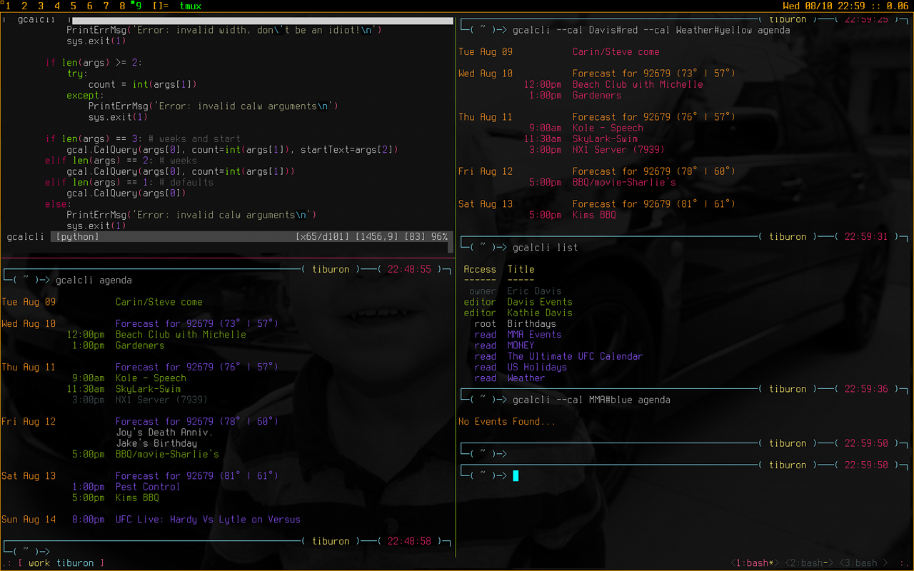
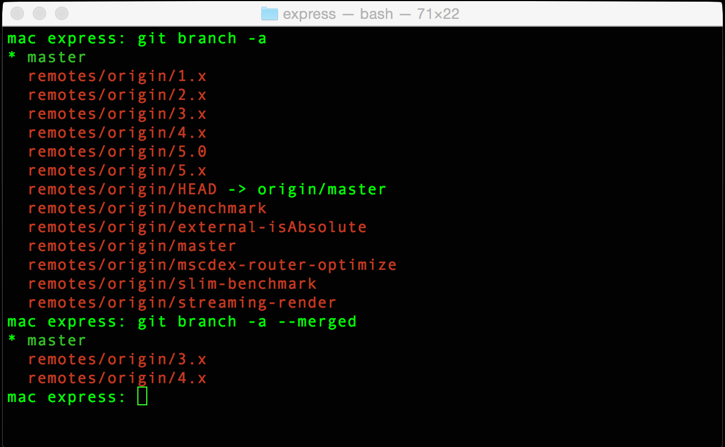
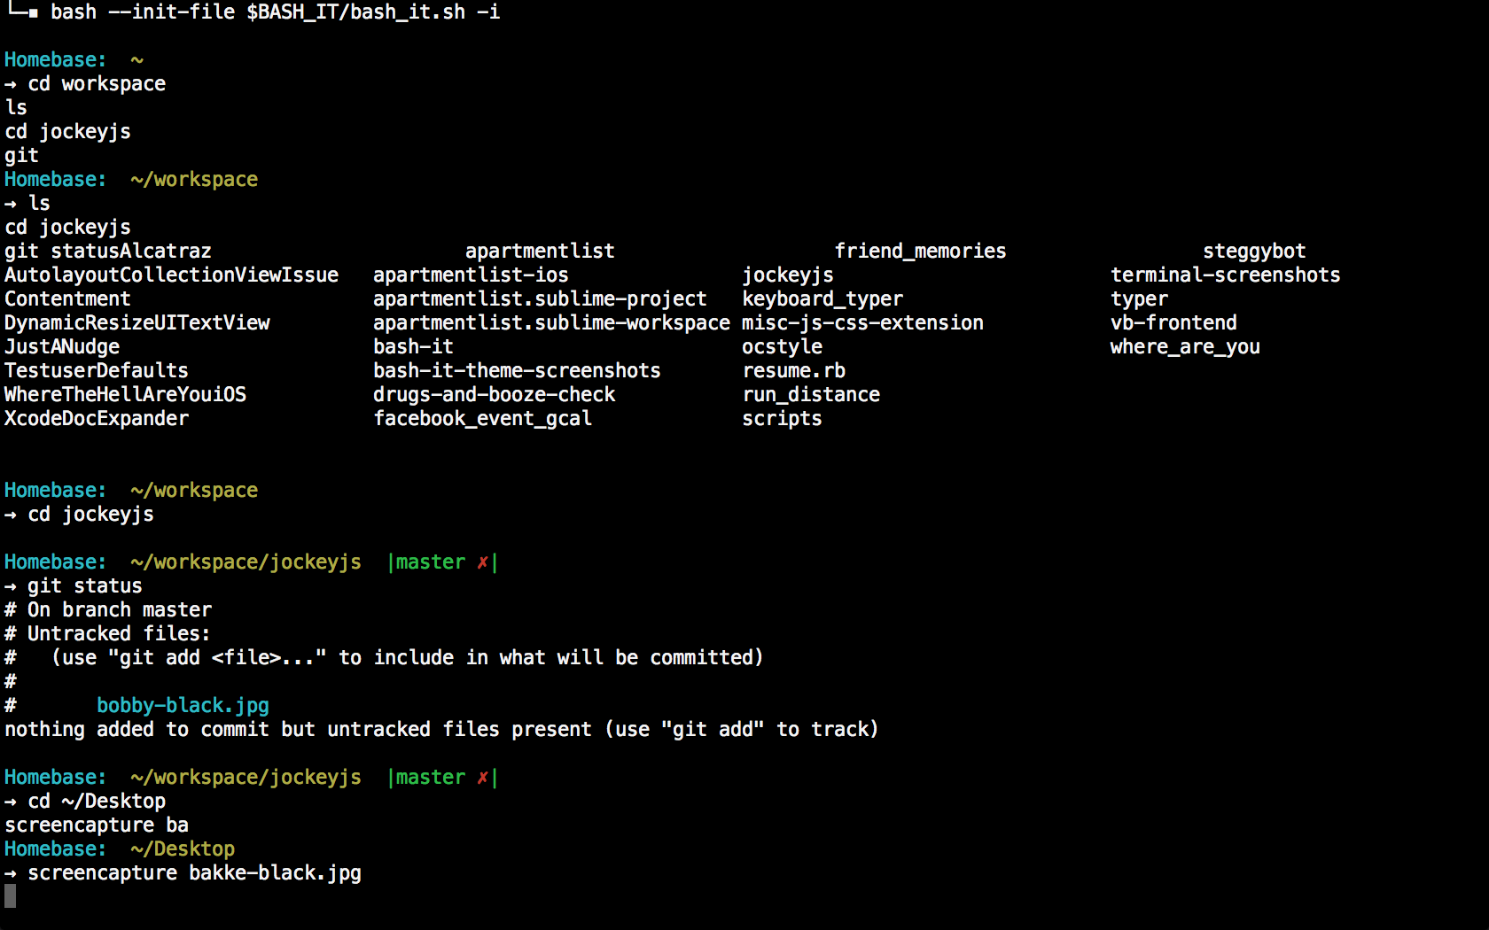
Command line interface?!?!
spooky

Slide 6
Reference Sheet
https://git-scm.com/docs

Slide 7
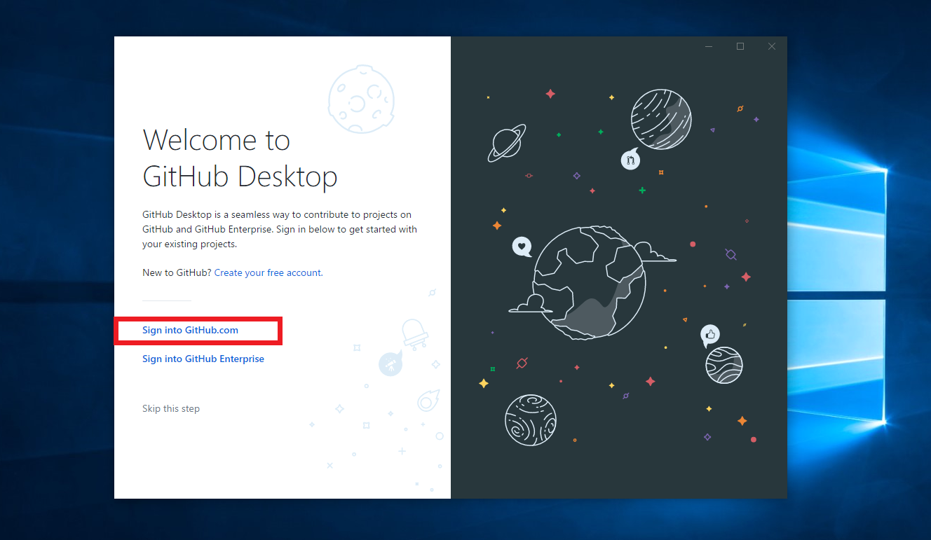
Github Desktop
Windows & Mac

