Slide 2
Design Thinking

Slide 3
What is Design Thinking (DT) ?
It’s a solution-based approach to finding what would-be users really need
A mindset and a methodology for generating creative solutions
Certain characteristics of DT make it effective in almost any field – from business innovation to product design to learning design
The approach to DT consists of five phases

Slide 4
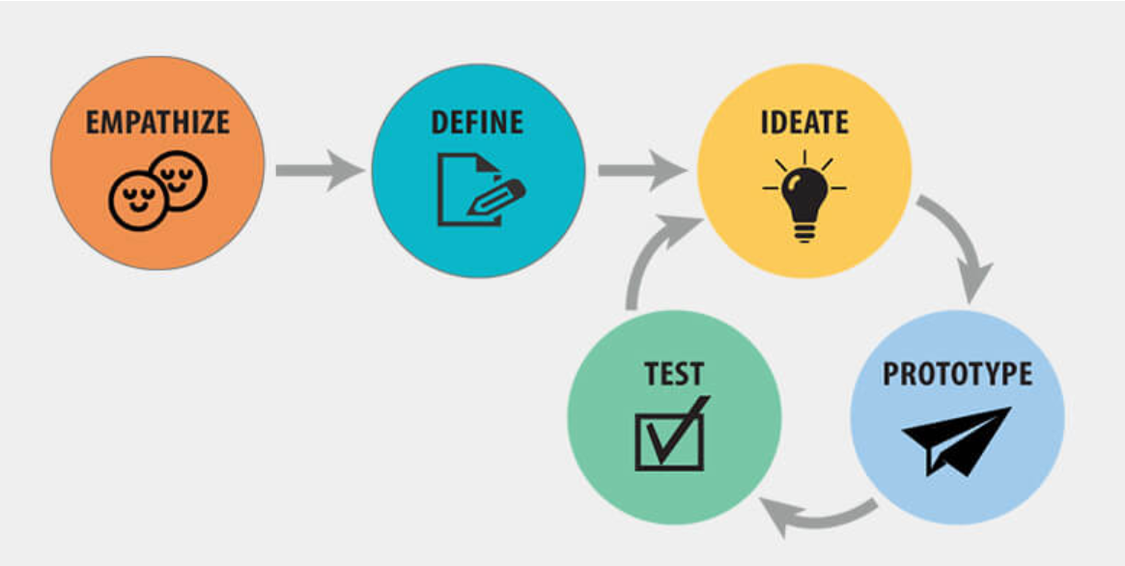

Slide 5
Empathize
This stage demands gaining an empathic understanding of the problem you’re trying to solve
Be non-judgemental - set aside your own assumptions about the world in order to gain insight into users and their needs
Seek to understand
“Becoming” them

Slide 6
Define
Put together the information you have created and gathered during the Empathize stage
Define the core problem/s you and your team have identified so far
Define your “PROBLEM STATEMENT”

Slide 7
Ideate
This stage finds you ready to start generating ideas
With the knowledge you have gathered in the first two phases, you can start identify new solutions to the problem statement you’ve created
You can start to look for alternative ways of viewing the problem

Slide 8
Prototype
The team produces a number of inexpensive, scaled-down versions of the product or specific features found within the product so you can investigate the problem solutions generated in the previous stage

Slide 9
Test
Rigorously test the completed product using the best solutions identified during the prototyping phase
This is the final stage; however, in an iterative process, the results generated during the testing phase are what you will often use to redefine one or more problems

Slide 10
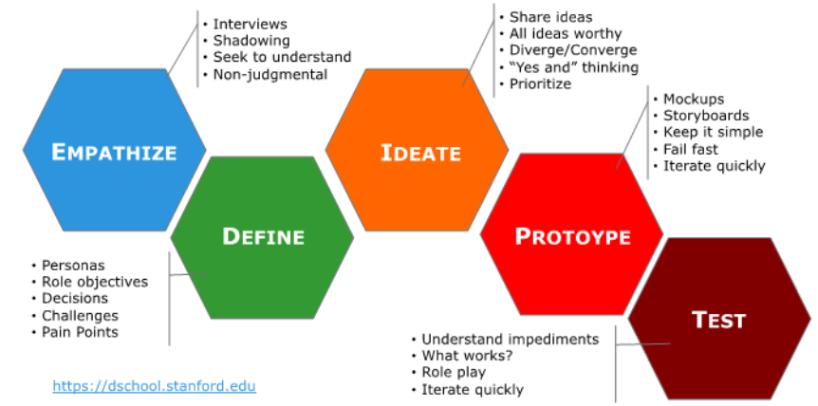

Slide 11
Define a Problem to Work On

Slide 12
How does this work ?
Each member from the team comes up with a problem that he/she thinks is important to solve. Preferably, write that down on a sheet of paper
Each member explains the problem to the team for two minutes
The rest of the team member then try to discuss that problem for five minutes
Repeat the activity for all team members

Slide 13
Decide on a common “PROBLEM STATEMENT”

