Slide 2


Slide 3
What is VS Code ?
Open source code editor from Microsoft
Light weight, easy to use editor
Convenient for web development projects
Supports multiple languages
Runs on all major platforms – Windows, MacOS and Linux

Slide 4
Text Editor vs IDE
Integrated Development Environment (IDE)
Integrated compiler and/or interpreter
Debugger
Autocompletion features
Linting features
Function List
Testing features
Example: Eclipse, PyCharm, Visual Studio
Text Editor
Edit text/code
Example: Notepad, Notepad++, Atom, Sublime Text, Vim

Slide 5
Visual Studio Code: Editor or IDE?
It is a Source Code Editor
It has all the basic functionalities of an editor
Keep adding third party extensions and it can be converted to an IDE
Think of it as an normal car which can be converted to a sports car by adding more features to it
However, there is a limitation where VS Code cannot perform functionalities that of an IDE

Slide 6
Where to download
https://code.visualstudio.com

Slide 7
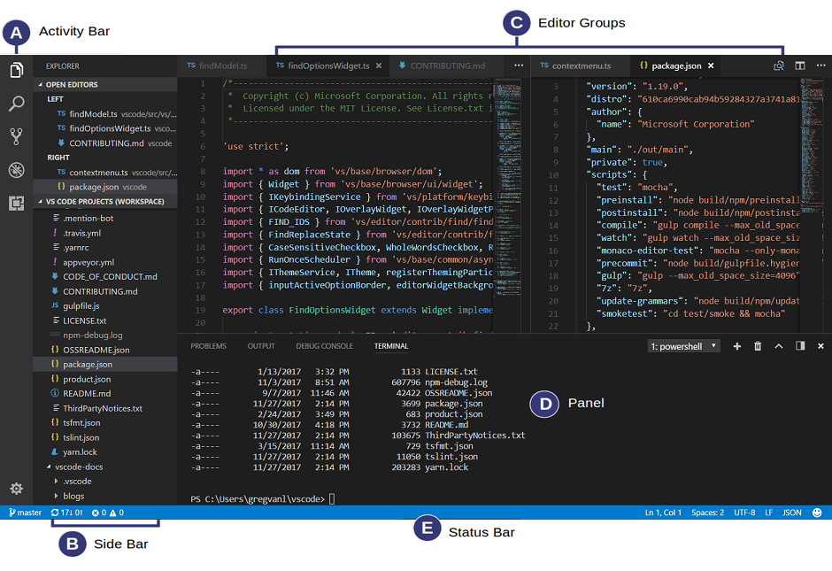
Basic Layout

Slide 8
Hands on

Slide 9
Create a folder

Slide 10
Create a file

Slide 11
Edit the file

Slide 12
Save and Delete the file

Slide 13
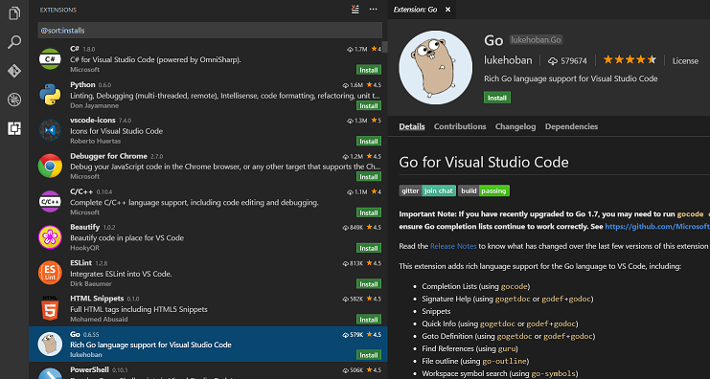
Stretch Goals #1 Install extensions
VS Code lets you extensions through Extension Store (just like an App Store for installing apps on mobile phone)

Slide 14
Stretch Goals #2 Collaborate with others (Live Share)
Live Share is an extension in VS Code
Enables real-time collaboration between developers
You can share your session (screen) with other member and your teammate can read the code you shared without having to clone the repo
Its more than just screen sharing!! Screen sharing just allows just one person to operate at a time
Live Share allows you to do bidirectional collaboration

Slide 15
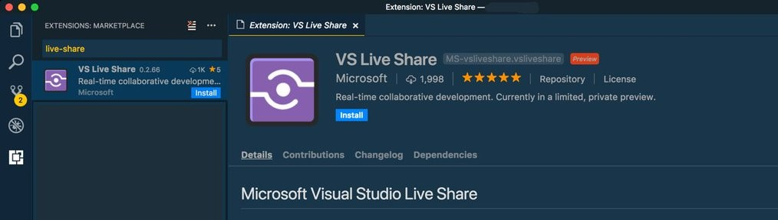
Stretch Goals #2 Collaborate with others (Live Share)
To start Live Share, install the extension VS Live Share from the Extension Store and reload the screen

Slide 16
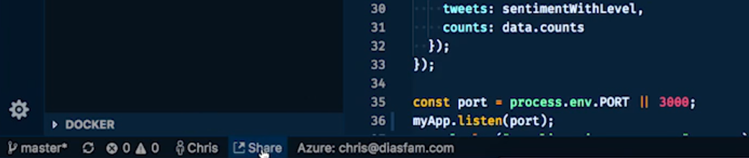
Stretch Goals #2 Collaborate with others (Live Share)
Next step is to click on the “Share” button in the side bar
This will generate a link that can be copied and shared with the teammate

Slide 17
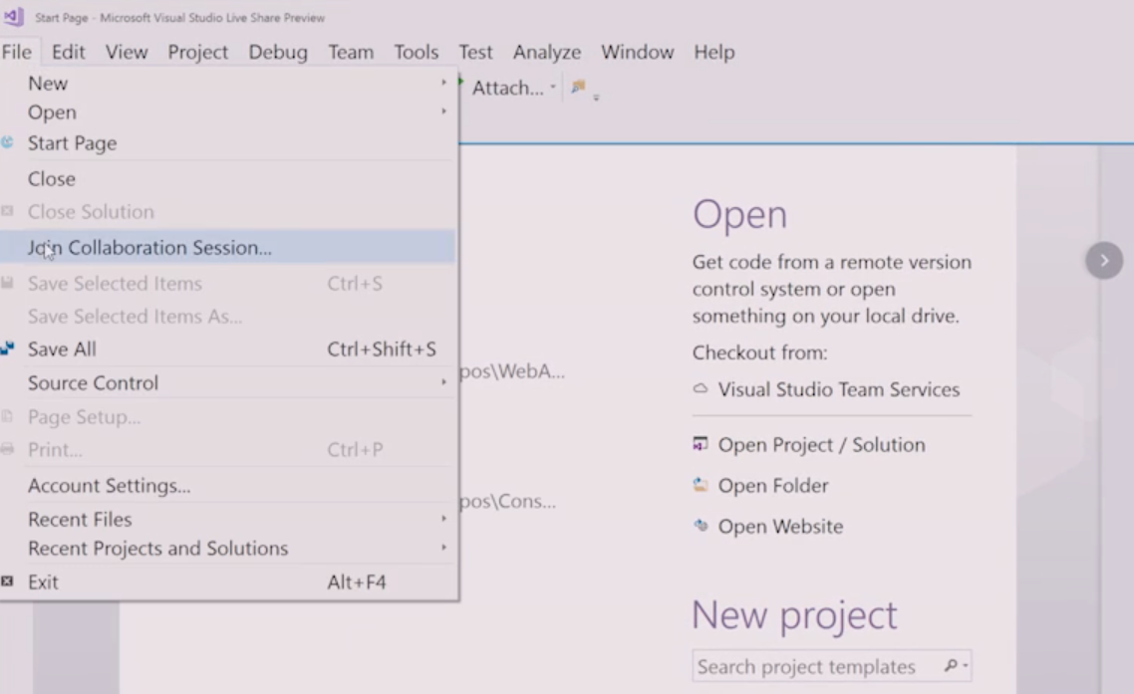
Stretch Goals #2 Collaborate with others (Live Share)
The teammate on the other hand just needs to join the session using the shared link

Slide 18
Stretch Goals #2 Collaborate with others (Live Share)
More information on Live Sharing is available at https://code.visualstudio.com/blogs/2017/11/15/live-share

