Slide 1
AgileU
The Agile Methodology of Software Development

Slide 2
The Agile Manifesto
Individuals and Interactions
Working Software
Customer Collaboration
Responding to Change
Processes and tools
Comprehensive documentation
Contract negotiation
Following a plan
over

Slide 3
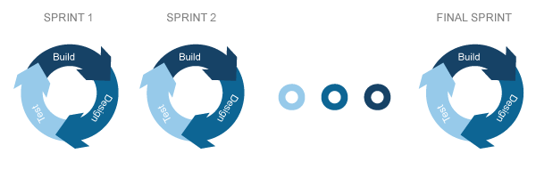
Sprints and Sprint Planning (5 min)
Sprints: 1-3 weeks
Before a sprint starts -> Sprint Planning
Discuss items to fit into the sprint
Drop the rest into a backlog
Notes:
The team of software developers, product owners and QA work seamlessly via agile.
Development is broken down into chunks called Sprints.
Status of the product and features that need to be developed are discussed during On-site Time, a dedicated period of time when everyone is available and on-site.
Features that can to be developed are brought into the sprint during Sprint Planning which happens once every sprint.
Developers assess the complexity of tasks and come up with Story Points which determine the scope of the sprint.
At the end of the sprint is a Sprint Review, in which features that got developed and bugs that got fixed are demoed to the team.
Issues that cannot be fit into the sprint go into the Backlog which is refined every so often so that the list doesn’t get too big or old.
A Team Retrospective discussion is also held every sprint to determine the effectivity of the processes and metrics used within the sprint.
Pain points are addressed and processes are modified to suit the needs of the team.

Slide 4
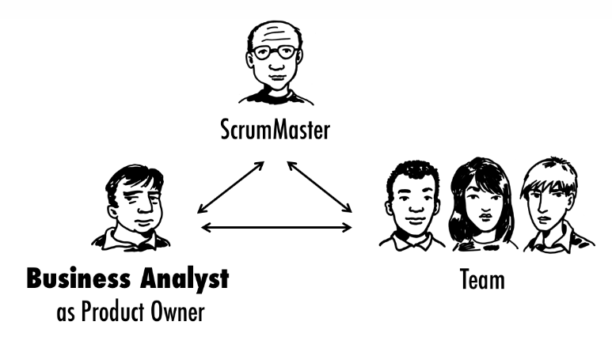
Scrum Master, Product Owner (3 min)
What is the role of a Scrum Master?
What is the role of a Product Owner?
TO DO
Identify a Scrum Master
Identify a Product Owner (= Andrew)

Slide 5
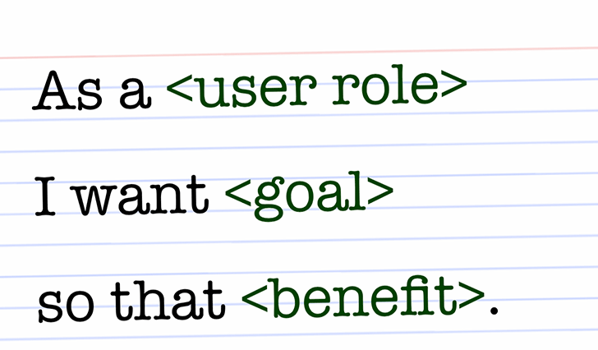
User Story
User Story 1
As a user, I want a listing of all restaurants near me so that I can find a place to eat nearby.
User Story 2
As an authenticated user, I want my preferred restaurants to show up near me so that I can cater to my dietary needs/restrictions.
Notes:
The team of software developers, product owners and QA work seamlessly via agile.
Development is broken down into chunks called Sprints.
Status of the product and features that need to be developed are discussed during On-site Time, a dedicated period of time when everyone is available and on-site.
Features that can to be developed are brought into the sprint during Sprint Planning which happens once every sprint.
Developers assess the complexity of tasks and come up with Story Points which determine the scope of the sprint.
At the end of the sprint is a Sprint Review, in which features that got developed and bugs that got fixed are demoed to the team.
Issues that cannot be fit into the sprint go into the Backlog which is refined every so often so that the list doesn’t get too big or old.
A Team Retrospective discussion is also held every sprint to determine the effectivity of the processes and metrics used within the sprint.
Pain points are addressed and processes are modified to suit the needs of the team.

Slide 6
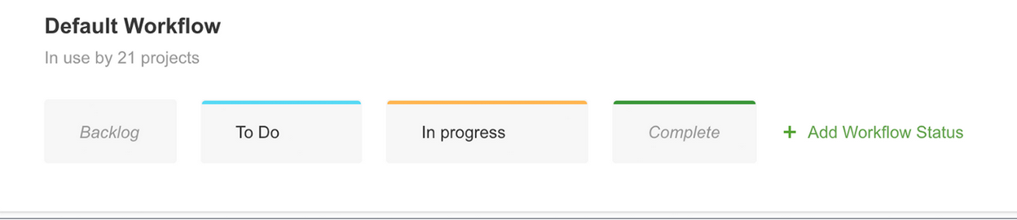
Features and Acceptance Criteria
User Story 1
Ticket/Feature: Restaurant search
Acceptance Criteria: A search of restaurants should return nearest restaurants first.

Slide 7

User stories, features, and
acceptance criteria (30 min)
TO DO
Identify user stories that can be addressed in this sprint.
Identify Acceptance Criteria.
Convert them into tickets/features (on sticky notes), stick them on the Kanban Board

Slide 8

Story Points/Estimates
TO DO
Set an arbitrary complexity (say 1- easy, 5-complex) to each feature and set story points for each feature.
The features that can be fit into the sprint go into the To-Dos
The rest go into the Backlog
EASY
MODERATE
COMPLEX

Slide 9
Notes:
Slide 1: Title slide

