Slide 1
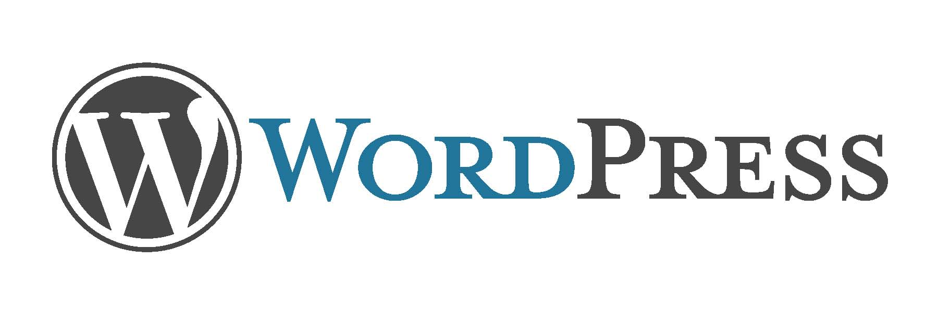
WordPress Into
Chehir Dhawedi
CTO iLi-Studios
Dhawedi@iLi-Studios.tn

Slide 2
Agenda
WordPress
Website
Hosting
Bonus

Slide 3
What is WordPress ?

Slide 4
What is WordPress ?
CMS
Webite
online, open source website creation tool written in PHP.
Easy to Use
Control in your hands
Free
Big Community
Very flexible with Development (PHP)
Notes:
WordPress is highly customizable, and has literally thousands of plugin pieces of software so you can use your site for just about anything.
Since WordPress is open source, it’s free. That’s always a bonus. And again, because it’s open source, it also has a thriving community of developers constantly improving the software and creating plugins to expand the software.

Slide 5
What is Website ?

Slide 6
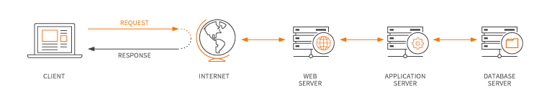
I always ask myself, ‘Does it do something?
The "work" (most of it) is done at the server
Rendered pages (data + UI) are being transferred from the server

Slide 7
Why Hosting?

Slide 8
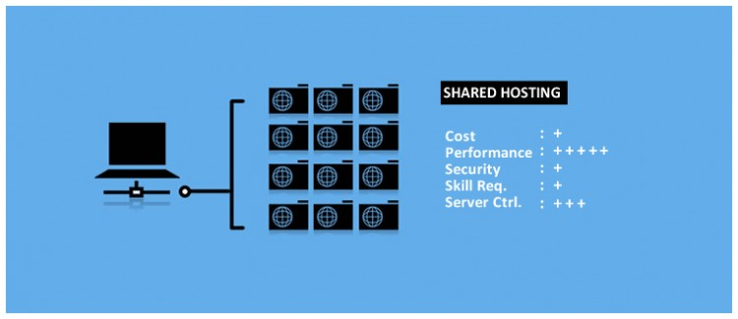
Shared Hosting
Web sites are placed on the same server as many other sites
all domains share a common pool of server resources, such as RAM and the CPU
Notes:
In shared hosting, one’s web site is placed on the same server as many other sites, ranging from a few to hundreds or thousands. Typically, all domains may share a common pool of server resources, such as RAM and the CPU. As cost is extremely low, most websites with moderate traffic levels running standard software are hosted on this type of server. Shared hosting is also widely accepted as the entry level hosting option as it requires minimum technical knowledge.
Disadvantages No root access, limited ability to handle high traffic levels or spikes, site performance can be affected by other sites on the same server.

Slide 9
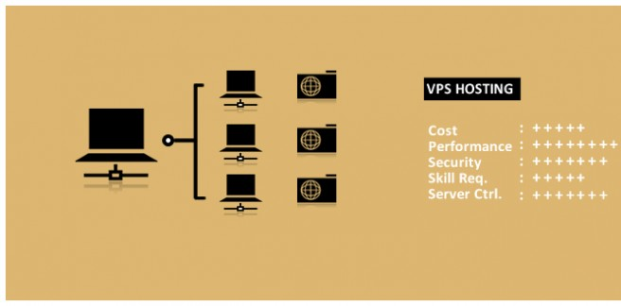
VPS Hosting
Notes:
A virtual private server hosting divides a server into virtual servers, where each websites is like hosted on their own dedicated server, but they’re actually sharing a server with a few different other users. The users may have root access to their own virtual space and better secured hosting environment with this type of hosting. Websites that need greater control at the server level, but don’t want to invest in a dedicated server.
Disadvantages Limited ability to handle high traffic levels or spikes, your site performance can still be somewhat affected by other sites on the server.

Slide 10
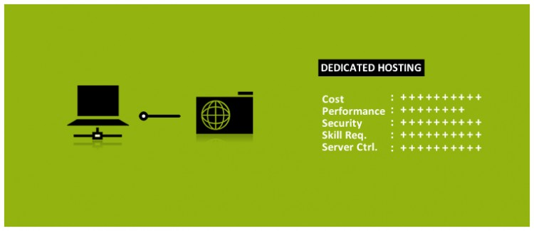
Dedicated Server Hosting
Notes:
A dedicated server offers the maximum control over the web server your website is stored on – You exclusively rent an entire server. Your website(s) is the only website stored on the server.
Disadvantages With great power comes… well, greater cost. Dedicated servers are very expensive and it’s only recommended to those who need the maximum control and better server performance.

Slide 11
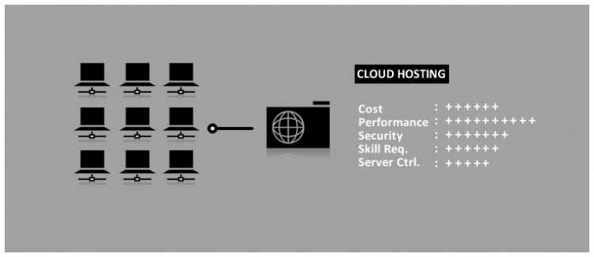
Cloud Hosting
Notes:
Cloud hosting offers unlimited ability to handle high traffic or traffic spikes. Here’s how it works: A team of servers (called a cloud) work together to host a group of websites. This allows multiple computers to work together to handle high traffic levels or spikes for any particular website.
Disadvantages Many cloud hosting setup do not offers root access (required to change server settings and install some software), higher cost.

Slide 12
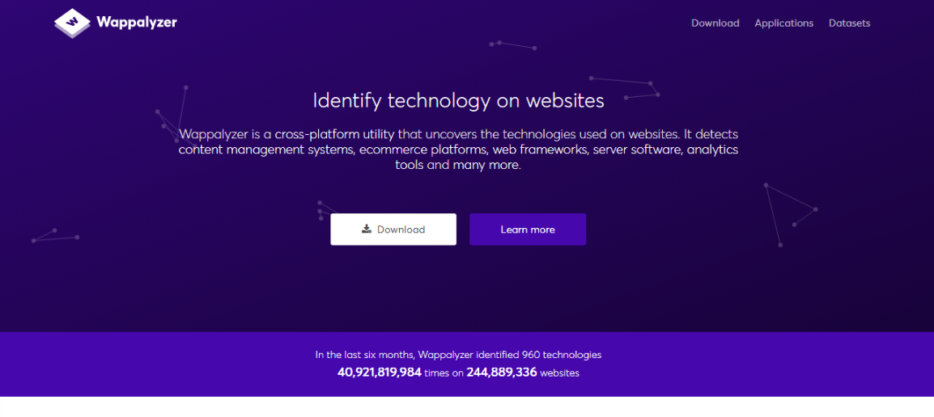
BONUS

Slide 13
Thanks

