Slide 1
SOCNETO

Slide 2
Overview
Data processing framework
Customizable
Focuses on social-network data
Offers data analyses
Used by end users - not businesses

Slide 3
Team
Supervisor: Irena Holubová
Analyses
Jan Pavlovský: Machine learning engineer
Petra Vysušilová: Data scientist
Data platform
Lukáš Kolek: Data engineer
Jaroslav Knotek: Software engineer
Július Flimmel: Web engineer

Slide 4
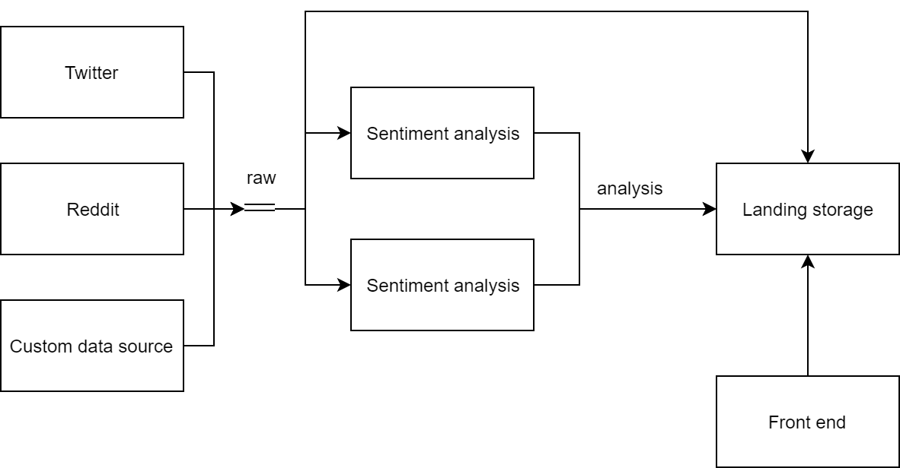
Data flow

Slide 5
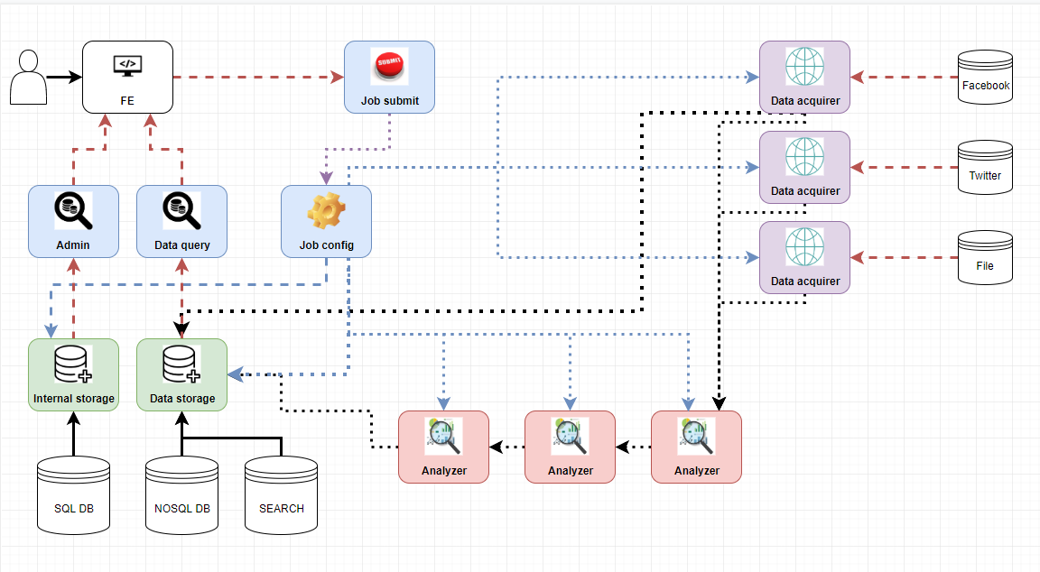
Architecture in detail

Slide 6
Analyses
Example of possible usage of the platform
Using existing libraries and methods
TOPIC MODELING
Methods: LDA, LSA, frequency analysis
Results: list of topics for post + comments structure
SENTIMENT ANALYSIS
Methods: BERT language model + one NN layer
Results: positive/neutral/negative + probabilities (+ subjective-objective on 0-1 scale)
PROBLEMS:
Amount and quality of data

Slide 7
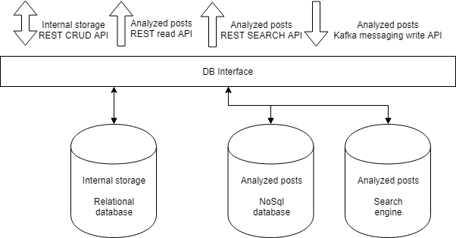
Storage

Slide 8
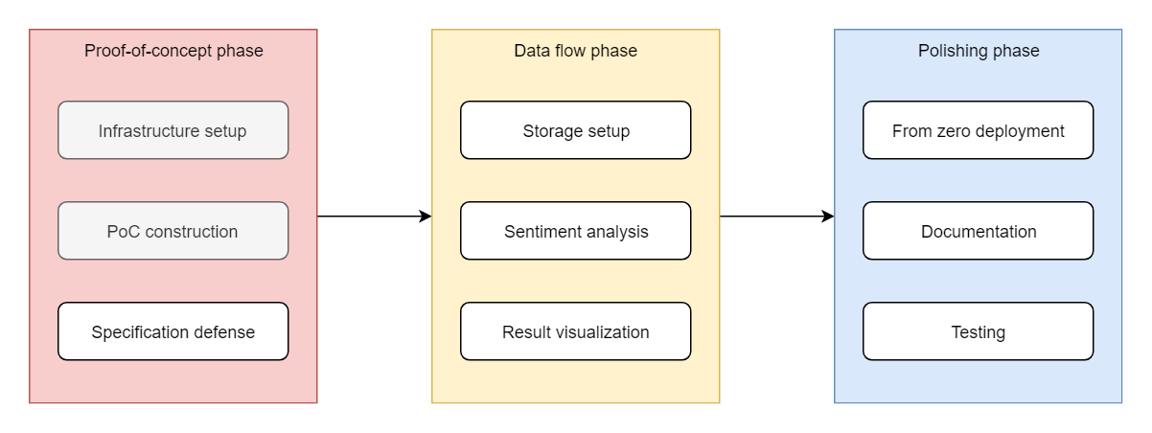
Planning

Slide 9
Risks
Data acquisition restrictions
Low quality data => low accuracy of analysis
Technology

Slide 10
End

