Slide 1

SOCNETO
Notes:
Pustil nějakej job před začátkem.

Slide 2
Team
Jaroslav Knotek
Data Acquisition
Lukáš Kolek
Architecture
Software and Data Engineering
Julius Flimmel
Front End
Petra Vysušilová
Text Analysis
Software and Data Engineering
Software and Data Engineering
Computer Graphics and
Game Development
Artificial Intelligence
Notes:
Netravit vela casu na tomto slide Netreba spominat co sme robili Mozno napisat ze sme z roznych oborov

Slide 3

Motivation
Topic-related question that Google cannot answer
Answer lies in social networks

Slide 4
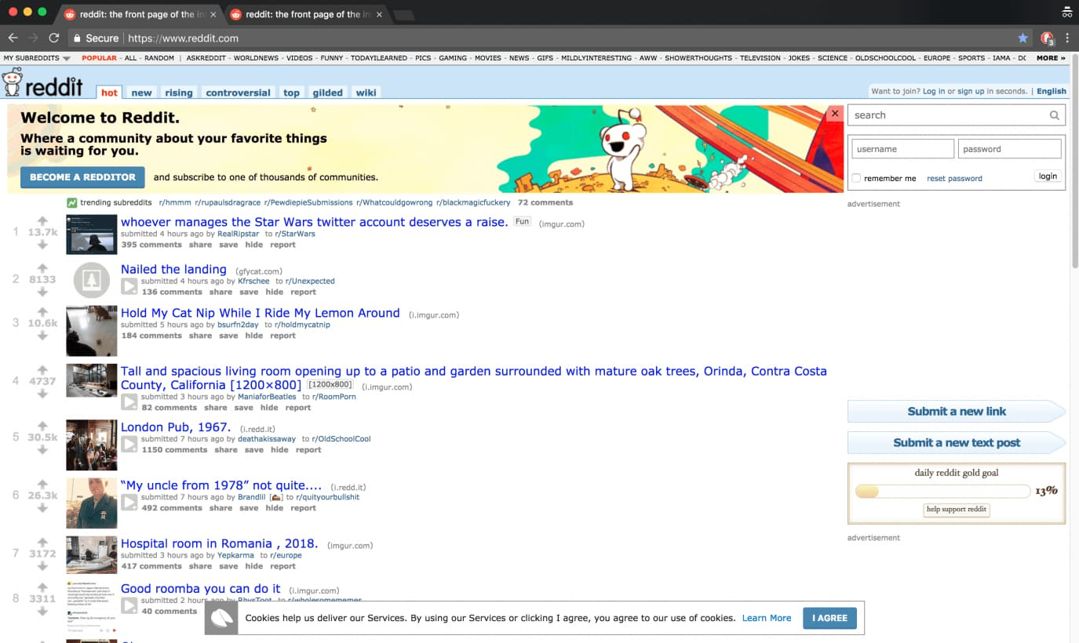
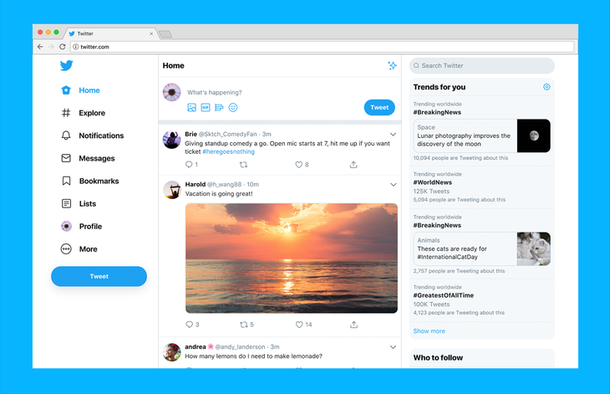
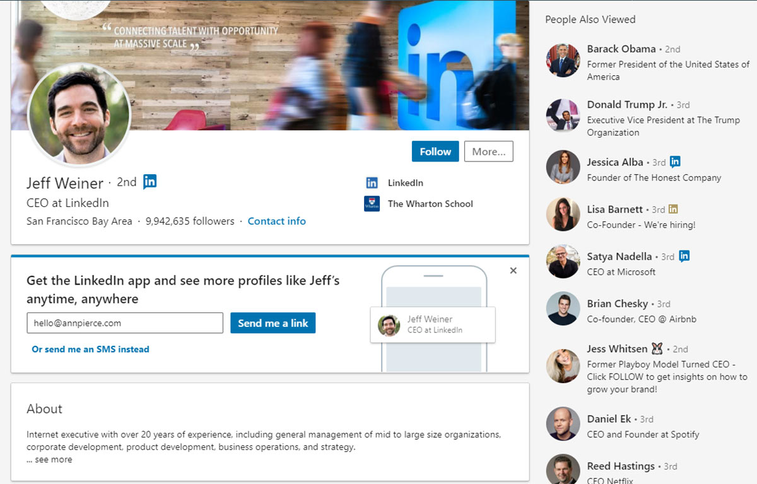
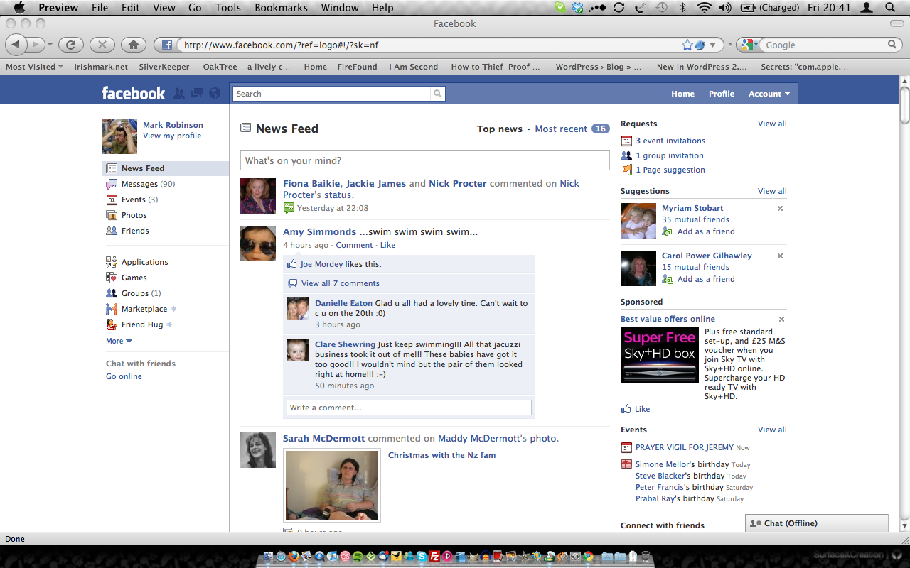
Problems
Too Many Networks
Too Much information
6,000 tweets per second.
or, 350,000 tweets sent per minute
or, 500 million tweets sent each day
or, 200 billion tweets per year

Slide 5


Solution
User asks Socneto

Slide 6
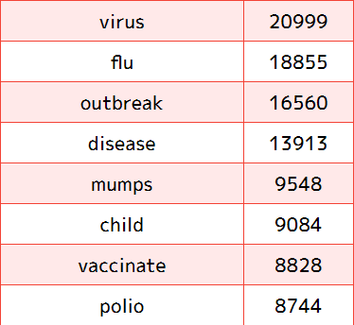
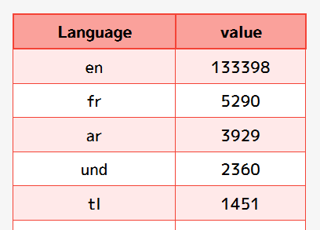
Use Case - Measles
Doctors without Borders

Slide 7
Showtime
Notes:
Vsetci vedia co je web appka :)
Bolo by fajn toto trochu predlzit (casovo)
Nejakym sposobom znovu ukazat, preco je socneto cool
Credentials jobu nie su az take zaujimve

Slide 8
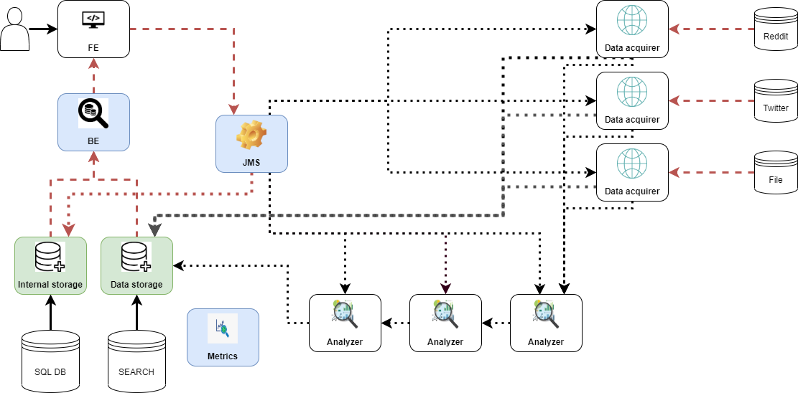
Architecture

Slide 9

Architecture - Communication

Slide 10
Architecture - FE, BE, JMS

Slide 11



Architecture - Data acquirers

Slide 12



Architecture - Analysers

Slide 13


Architecture - Storage

Slide 14

Architecture - Metrics

Slide 15
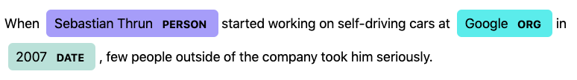

Text Analyses
Topic Modeling
Named Entity Recognition
Latent Dirichlet Allocation
Returns list of most important words for given text with according weights
Sentiment Analysis
Classifies text into positive, neutral or negative class (with some probability)
Implemented using language model BERT (Bidirectional Encoder Representations from Transformers)
Finetuned on Twitter data for US Airlines
14,000 tweets about 6 main companies
70% training data, 30% development data

Slide 16
Highlights
Asynchronous communication
Overcoming social networks’ API limits
No hardcoded parts
Feedback
Translation
UI optimization
Posts Export
Proof of Concept
Notes:
Toto sa asi stihne kedze defense comments je az po prezentacii
Bolo by cool mat toto ako zaverecny slide -> uakze aki sme cool

Slide 17
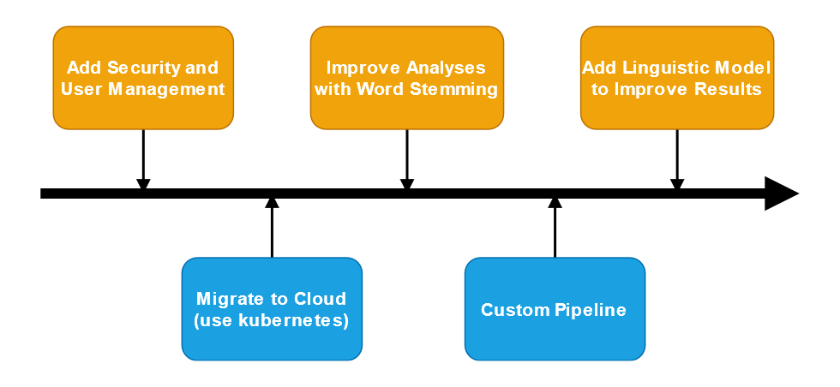
Road Map
Notes:
15 sekundovy quick komentar

Slide 18
Materials
Read Only projekt
http://acheron.ms.mff.cuni.cz:39110
Evaluation
http://acheron.ms.mff.cuni.cz:39109

Slide 19
Defense Comments
On premise deployment - different ports for BE, FE
No extensibility tutorial, just API
Deployment - Kubernetes would be a distant goal
Notes:
Toto je az po prezentacii!
No extensibility -> komunikacia je naj naj naj dolezitejsia, ostatne nie je podstatne
Trochu prediskutovat tie pripomienky (+ vs -)

