Slide 1
Socneto
Get insight into social network posts

Slide 2
Agenda
Features
Typical user and his needs
Comparison to competitors
Cooperation form

Slide 3
Features
Posts are collected and continuously (not just once)
Supporting
Twitter
Reddit (not yet)
Facebook (maybe)
No credentials required
Multiple visualizations
Analyses
Sentiment analysis
Topic modelling
Extensible (requires non-trivial skills)

Slide 4
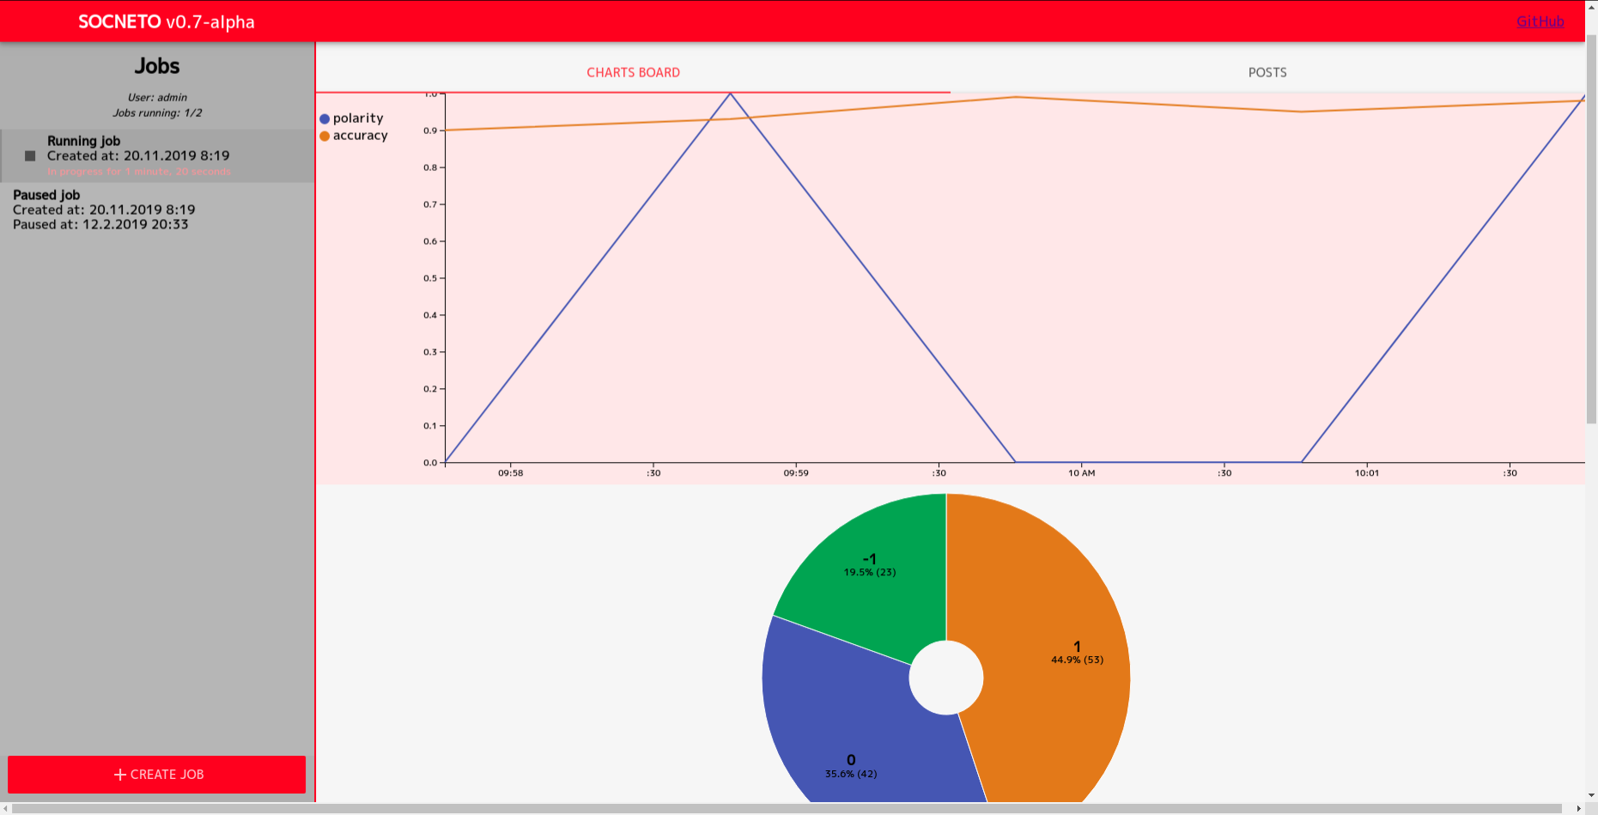

Slide 5
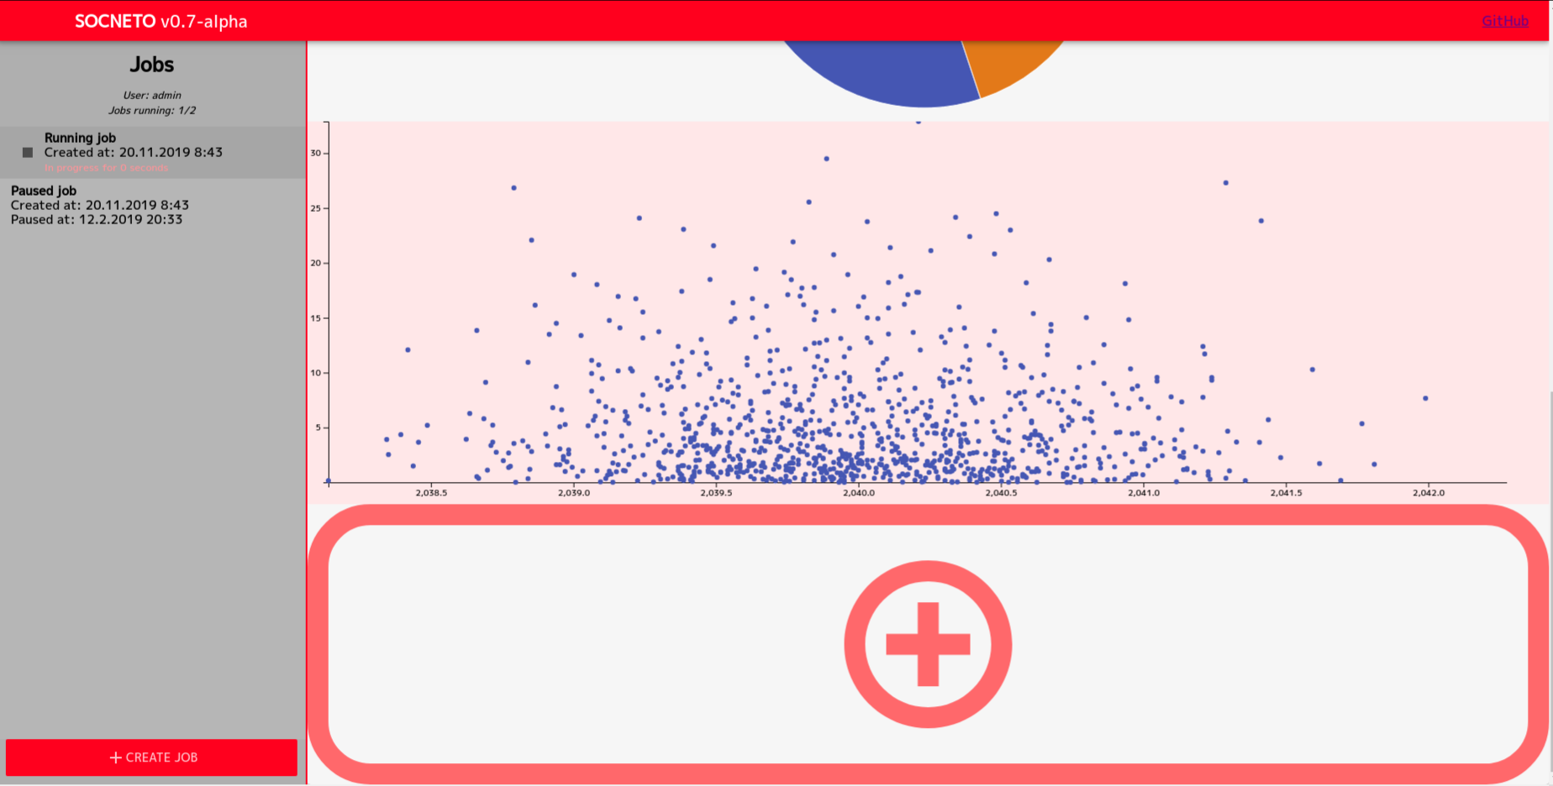

Slide 6
User needs
User should have need the following
Analyse data over time not just once
Multiple sources
Potentially large amount of data
Raw data stored

Slide 7
Typical user
PR keeping eye on a given topic (product, company, person, event ...)
Voter making decisions before election
Consumer making decision about product
The goal would be a tool that would facilitate competitor analysis.
Notes:
How to expand to reviewing products.

Slide 8
Overlaps and differences
IFTTT
Triggers on new posts
Does not send notification (but it could)
Buffer/ZoomSphere
Analyses and aggregations of posts
No posting

Slide 9
Cooperation form
We will make some adjustments to fit your needs
Our product will be used compared to the competitor in a given use case
Your feedback will be use during the defense

Slide 10
Conclusion
Data analyser, not social network management tool
Analyses posts, not users

Slide 11
Intra
Roadmap
Use case
Vizualizace a analýza

