Slide 1

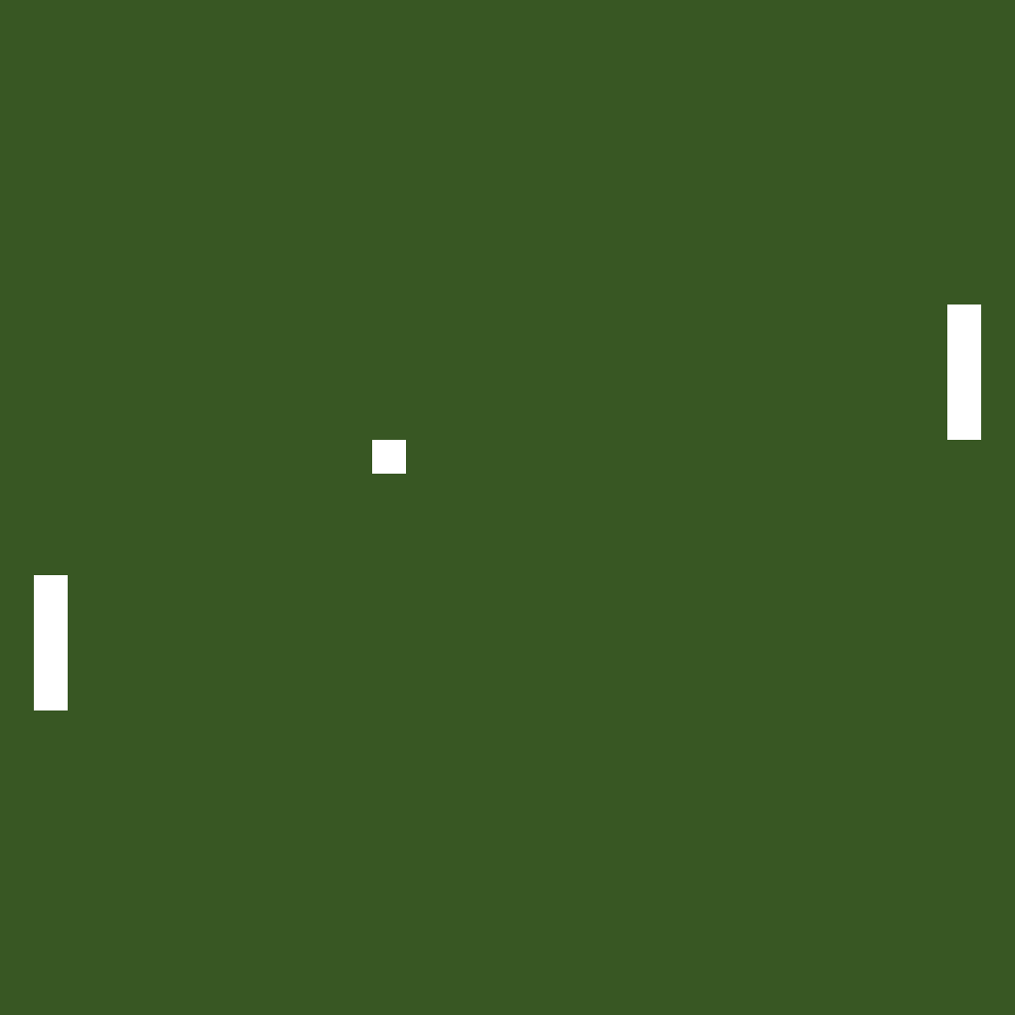
TV-Tennis
Komarov Mikhail 21931
Pimonov Anton 21931
Novosibirsk State University

Slide 2

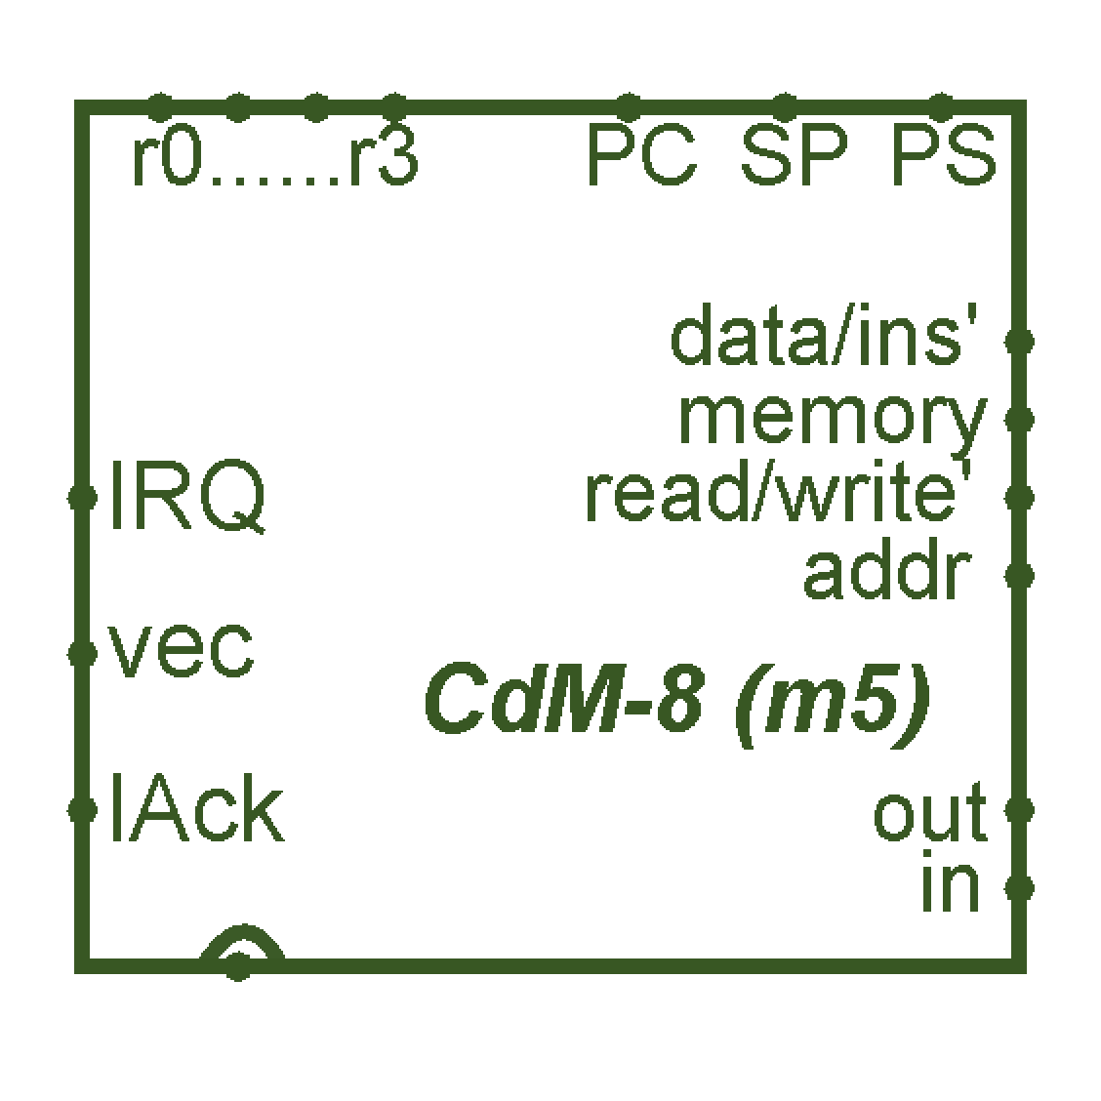
Introduction
As you can see, we chose implementation of “TV-Tennis” as the theme of our project.
To make it real, we used Logisim (to “create” circuits) and CDM-8 assembler (to program some things).

Slide 3

Overview
We divided our presentation into 3 parts:
Design
Hardware
Software

Slide 4
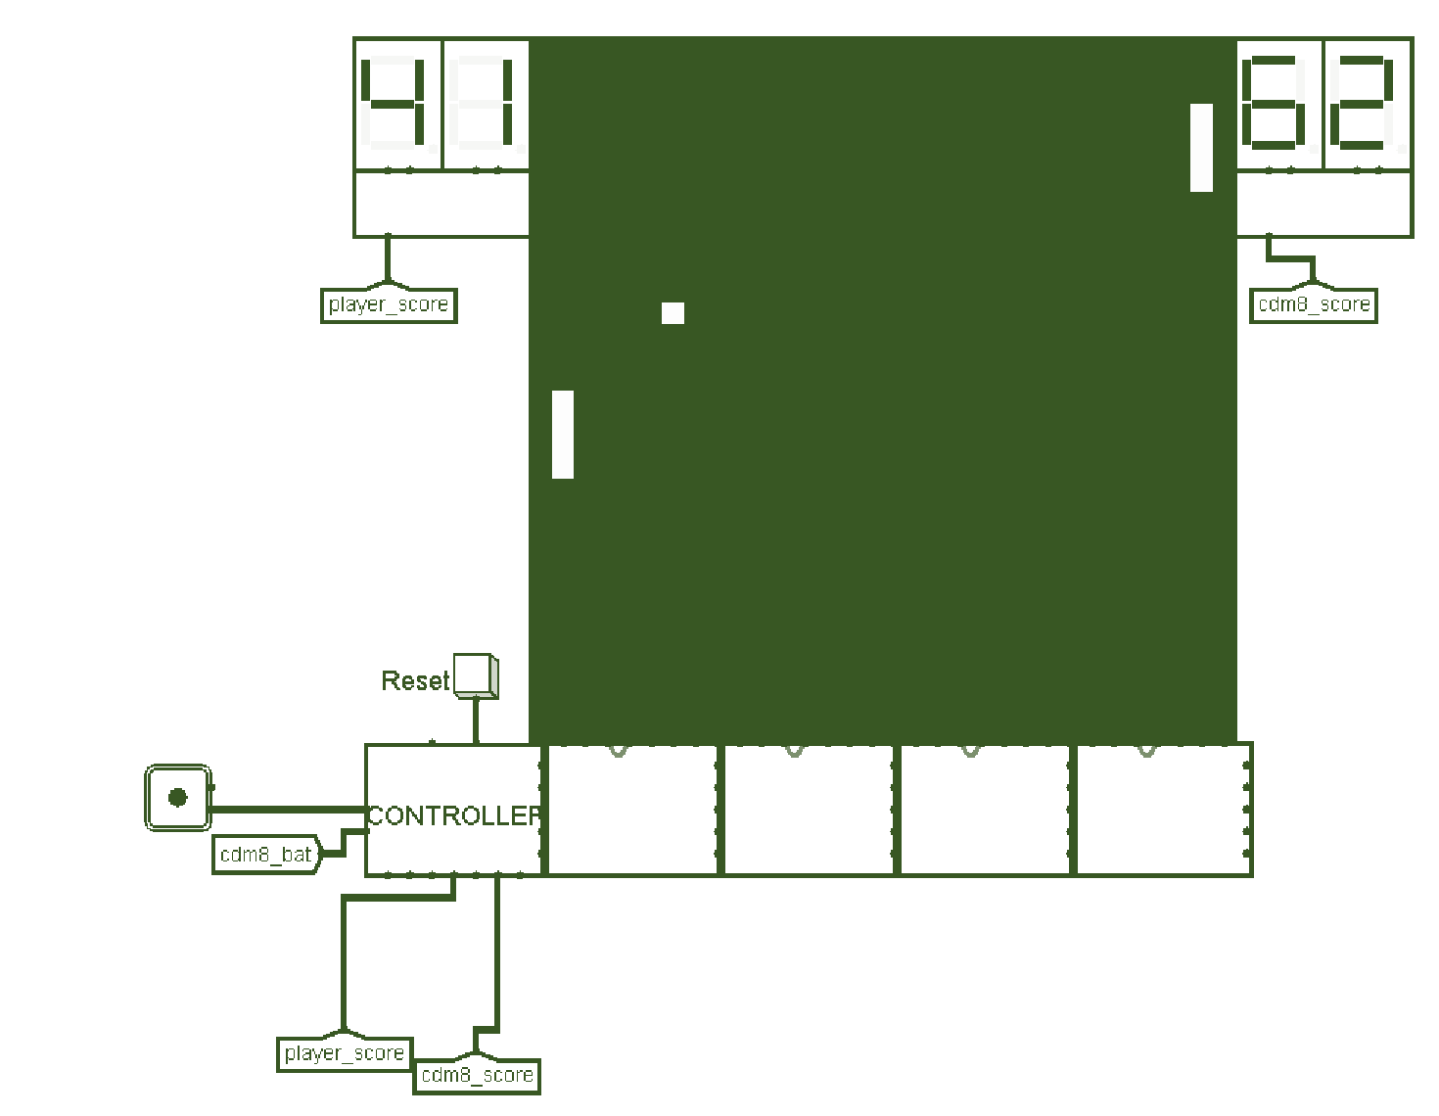
Design
Classic TV-Tennis, actually.
32x32 video display, scores, ball, two bats (one controlled by player, other one by bot), joystick (to control player’s bat).
Game ends when someone gets 24 points.

Slide 5
Hardware

Slide 6
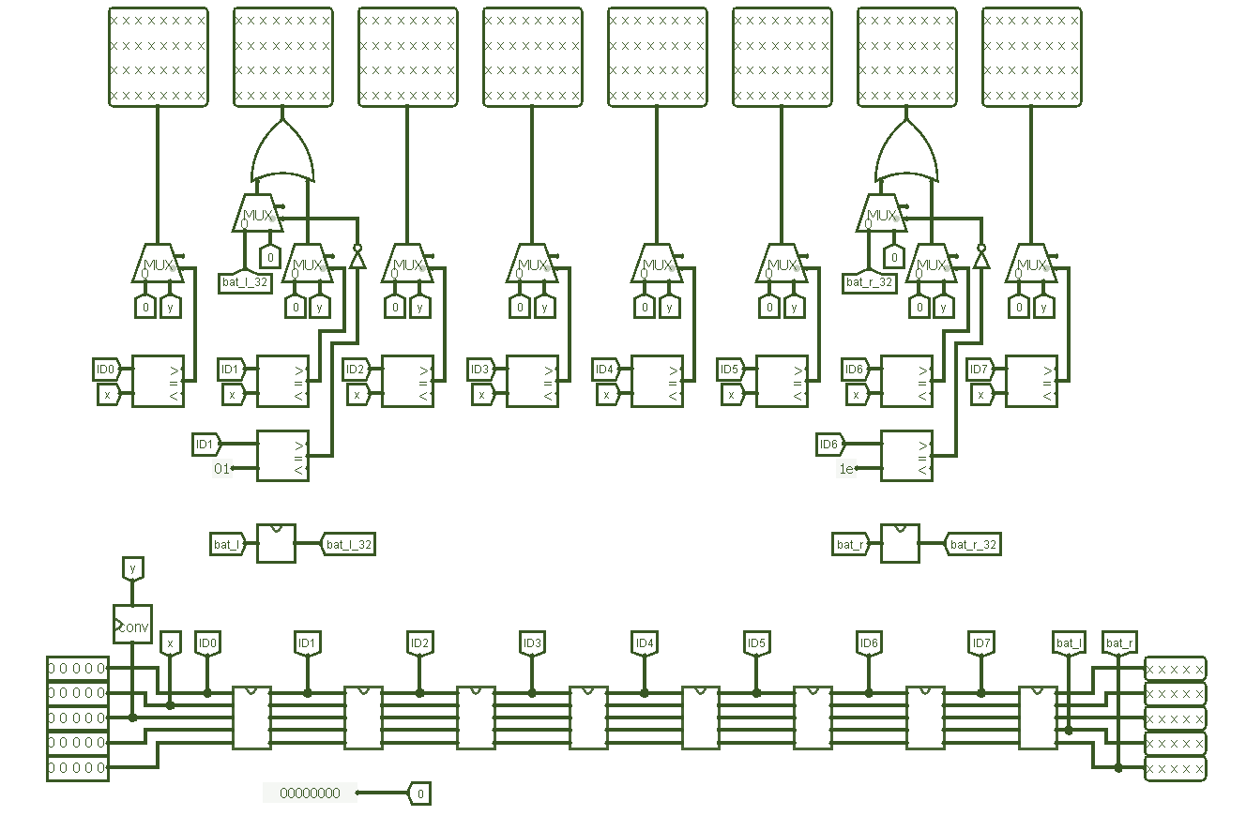
Video system
*some text about it*

Slide 7
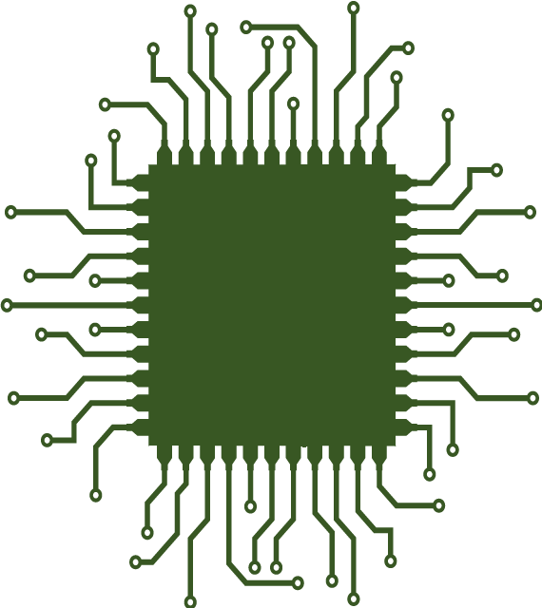
Kinematic controller
*some text about it*

Slide 8
Bats Movement
*some text about it*

Slide 9
Software

Slide 10
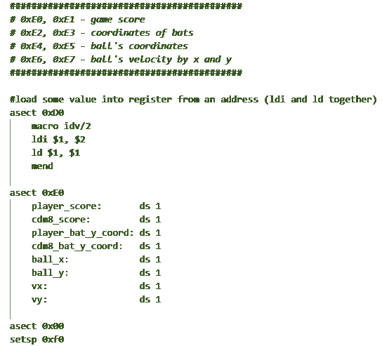
Just bot :/
*some text about it*

Slide 11
Conclusion
To summarize:
We

