Slide 1

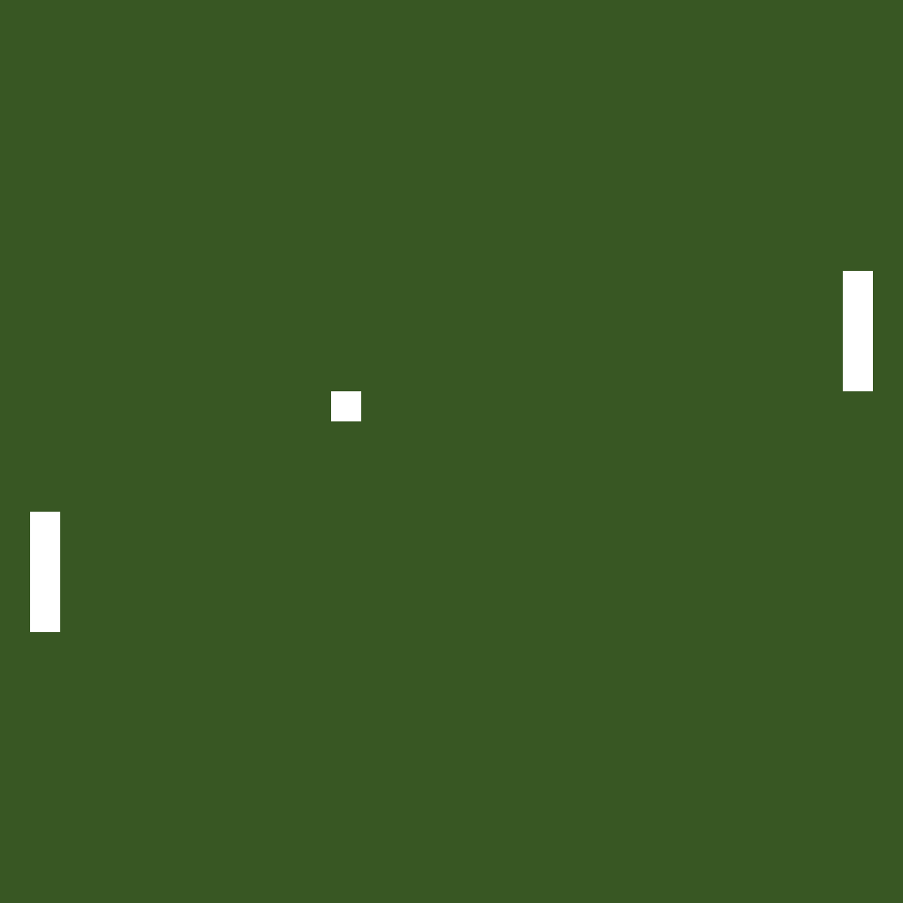
TV-Tennis
Komarov Mikhail 21931
Pimonov Anton 21931
Novosibirsk State University
2022

Slide 2

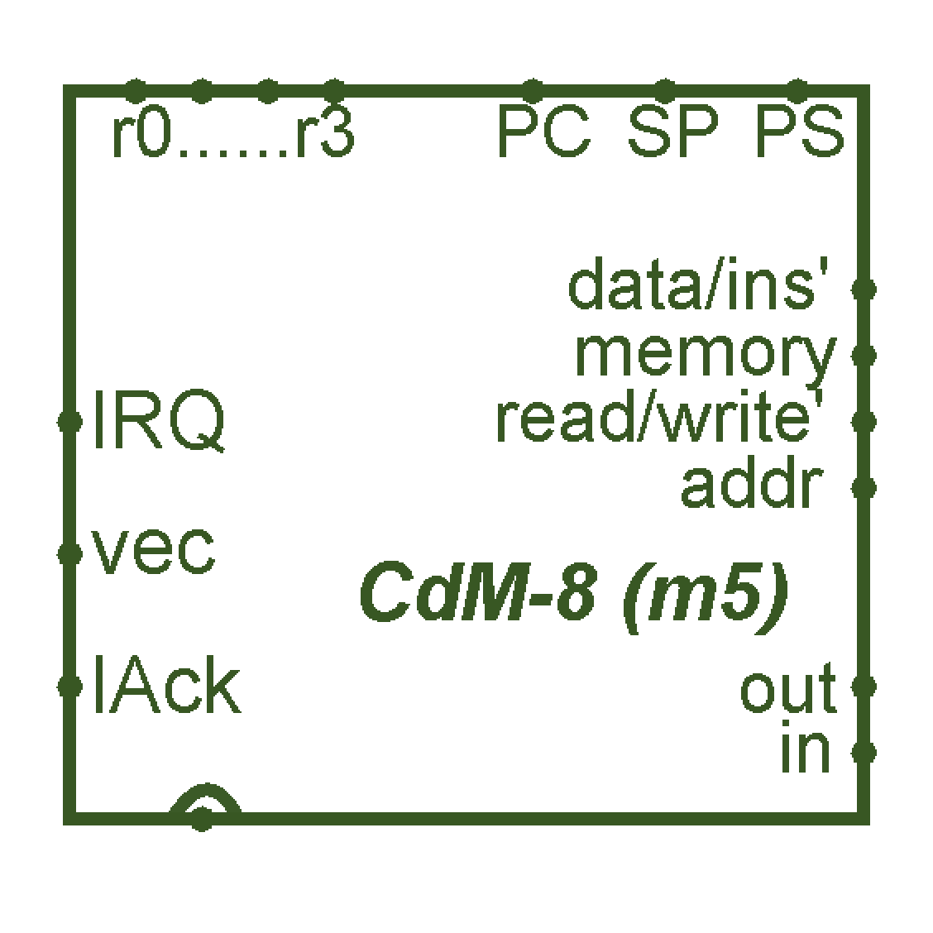
Introduction
As you can see, we chose implementation of “TV-Tennis” as the theme of our project.
To make it real, we used Logisim (to “create” circuits) and CDM-8 assembler (to program some things).

Slide 3


Plan
We have divided our presentation into 3 parts:
Overview
Hardware
Software

Slide 4
Overview
Classic TV-Tennis, actually.
32x32 video display, scores, ball, two bats (one controlled by player, other one by bot), joystick (to control player’s bat) and some LEDs.
24 points = Victory

Slide 5
Hardware

Slide 6
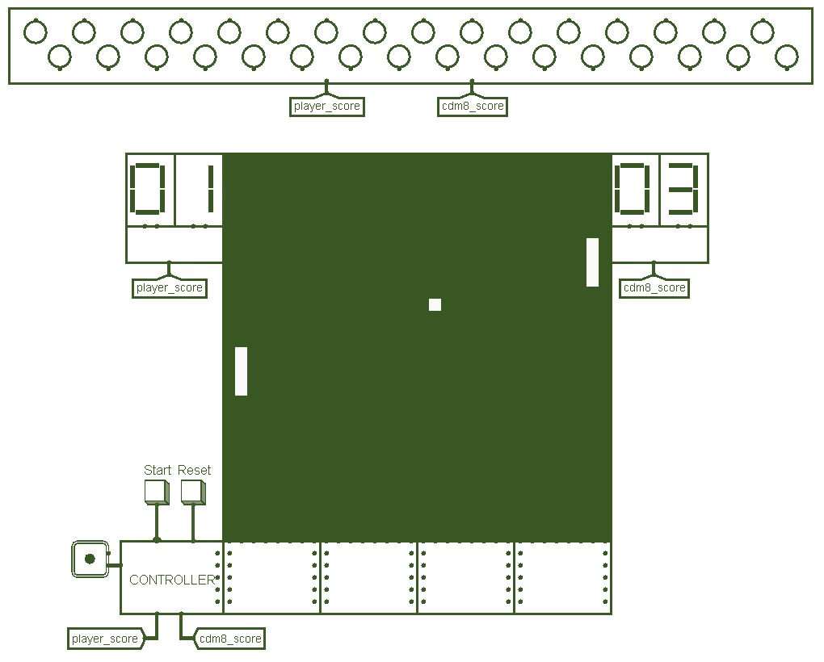
Main circuit
You play here

Slide 7
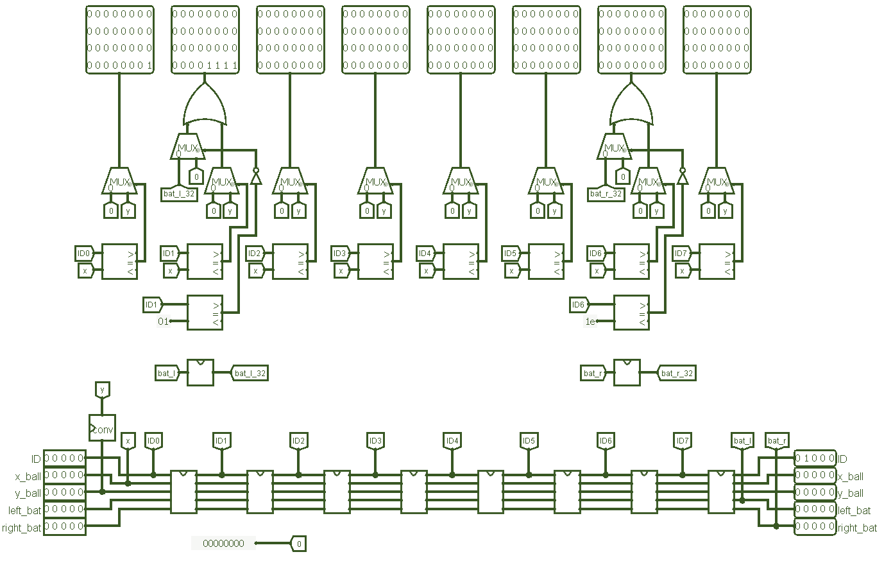
Video system
Displays everything

Slide 8
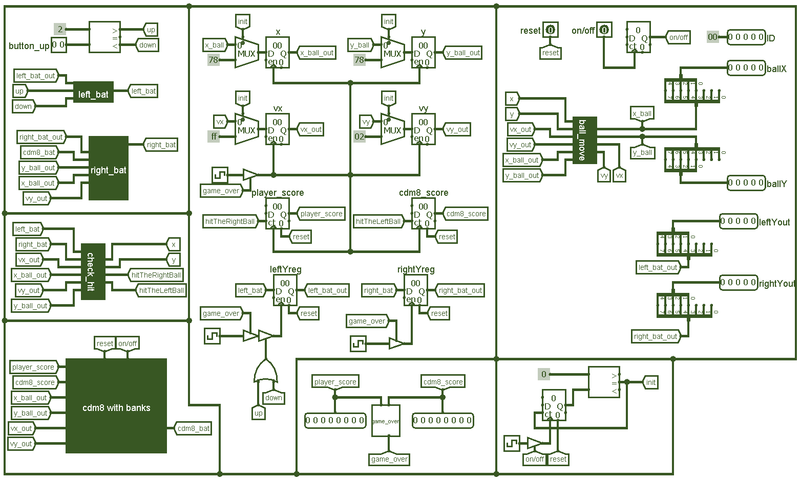
Kinematic controller
Drives everything

Slide 9
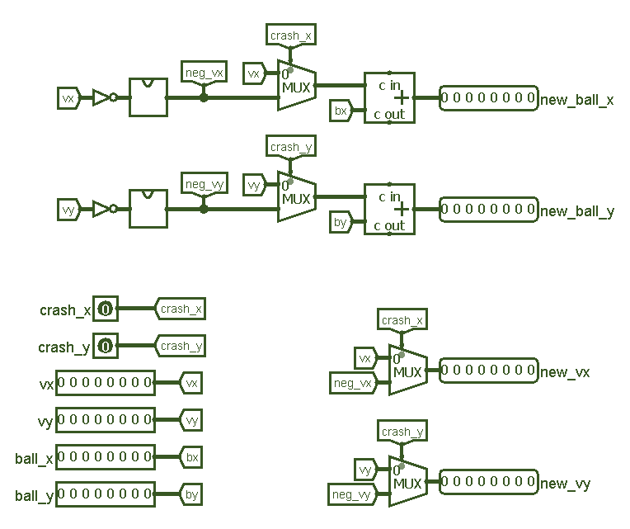
Ball Movement
Any assumptions?

Slide 10
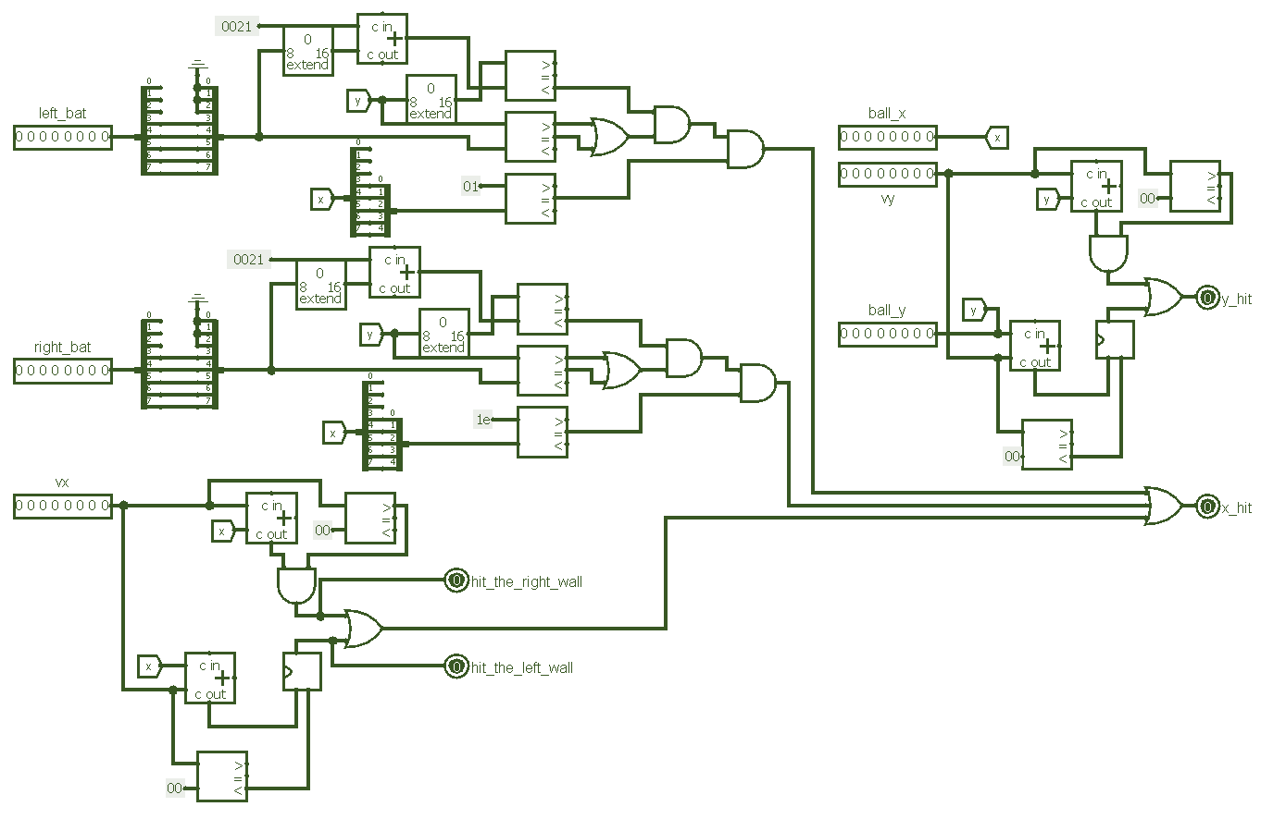
Check hit
Tracks the hitting

Slide 11
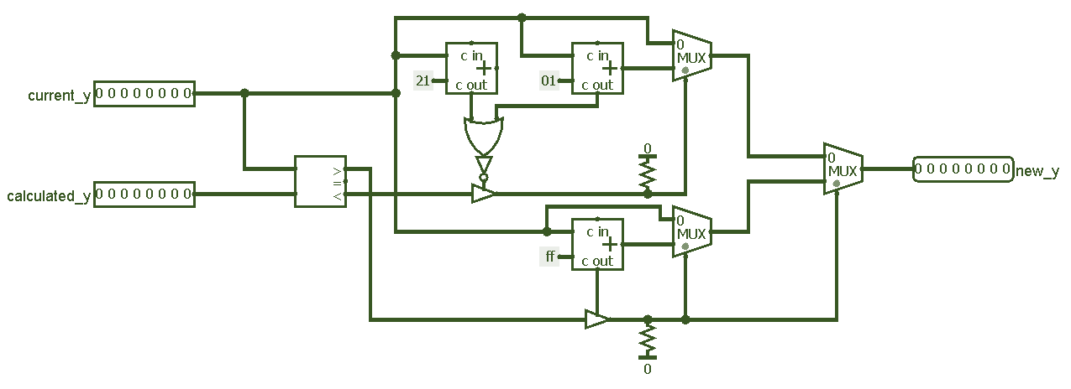
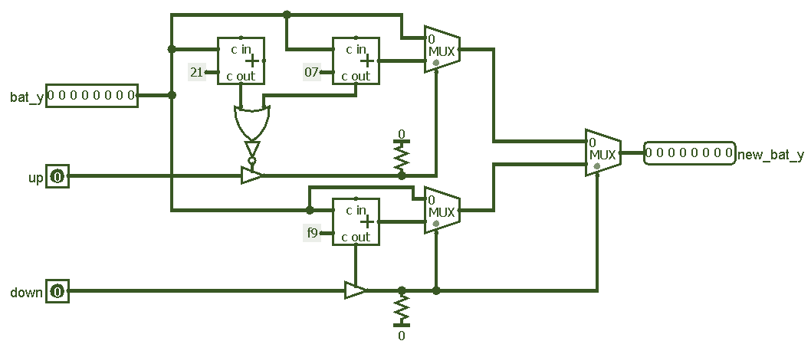
Bats movement
Player’s and CdM-8’s

Slide 12
Software

Slide 13
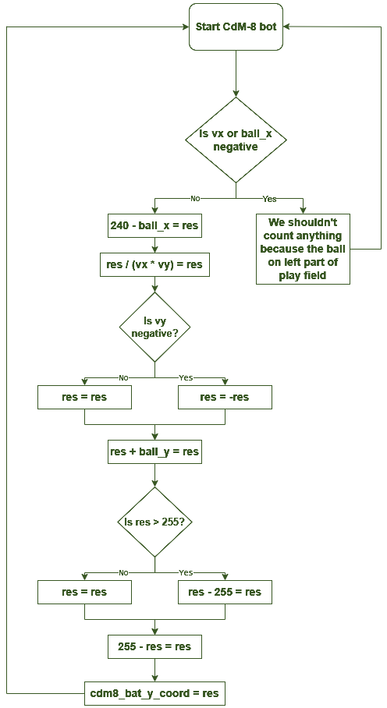
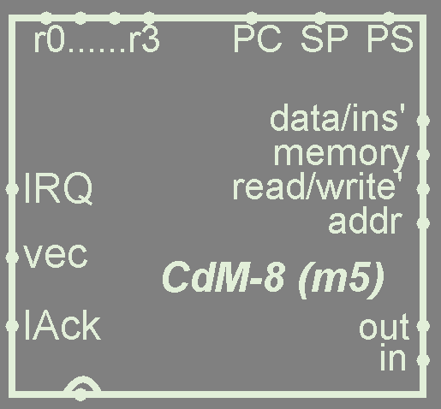
Bot algorithm
Your opponent.
Pretty simple, actually.
Formula is the bot.
255 - (y + (240 - x) / vx * vy - 255)

Slide 14
Conclusion
It works. We used almost everything we have been taught through entire “Digital platforms” course. It was interesting and helpful experience of working in team.
Now we are ready to answer your questions.
Fin.

