Slide 1
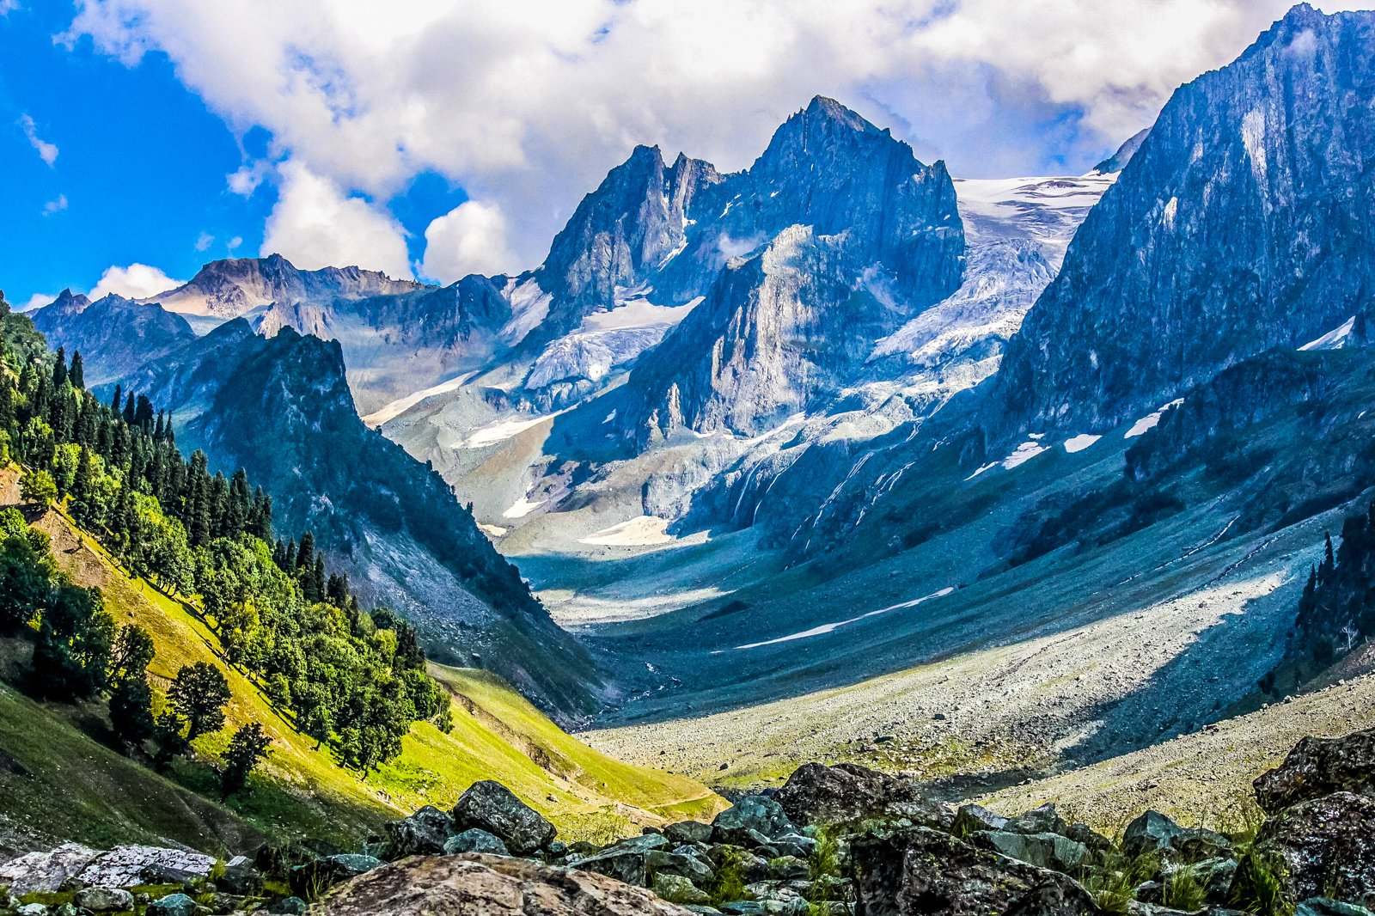


Healthcare
× Kashmir Observer
Positioning KO as the trusted media partner for J&K's health brands
Internship strategy presentation | 2026
Notes:
Good morning. Thank you for this opportunity. Over the last few weeks I studied our media kit, the 2026 rate card and the PRGI circulation certificate, and I asked one question: which industry should Kashmir Observer go after next, and how do we win it? My answer is healthcare. In the next nine minutes I'll show you why, who we should approach, what we should sell, and how we can start within ninety days.

Slide 2



The opportunity on one page
Why healthcare
Why Kashmir Observer
What we propose
A high-trust, high-ticket category. J&K's health budget, hospital network and insurance coverage are all expanding, and providers need to be heard.
PRGI-verified 80,250 daily copies, 2M monthly web page views and 81.6K YouTube subscribers: credibility plus multi-platform reach.
Three packages from ₹68,000 to ₹7.84 L and a 90-day launch plan, targeting about ₹24.6 L in a first cycle.
Notes:
Here is the whole idea on one page. First, the market: healthcare is a high-trust, high-value category, and in J&K it is growing fast. Second, the media: Kashmir Observer offers exactly what health brands need, which is credibility and reach across print, web, video and social. Third, the money: I've built three packages straight from our rate card, from sixty-eight thousand rupees to about seven-point-eight lakh, and a plan that could bring roughly twenty-four lakh in a first cycle.

Slide 3
Healthcare is the strongest sector to pitch
Sector | Trust matters | Ticket size | Fit with KO assets | White space | Growth tailwind | Total /25
Healthcare | 5 | 4 | 5 | 4 | 5 | 23
Banking, finance & insurance | 5 | 5 | 4 | 2 | 4 | 20
Education & coaching | 4 | 4 | 5 | 2 | 3 | 18
Automobiles | 3 | 5 | 3 | 2 | 3 | 16
Real estate & construction | 3 | 4 | 3 | 3 | 3 | 16
BFSI and automobiles are already KO clients (HDFC Bank, J&K Bank, Bajaj Allianz, Maruti, Nissan), so new revenue is limited. Education is crowded: coaching ads already fill the front page. Healthcare is the open, high-trust category.
Team assessment on a 1–5 scale (5 = most attractive). Judgment-based, not market data. Hospitality, fashion and cold storage excluded per brief.
Notes:
Before choosing healthcare, I compared five sectors. I scored each on five points: how much the buyer depends on trust, ticket size, fit with our products, white space, and growth. These scores are my own judgment, not market data. But the reasoning is clear. Banking and automobiles are strong, but HDFC, J&K Bank, Bajaj Allianz, Maruti and Nissan already advertise with us, so the new money there is limited. Education is crowded; coaching ads are already on our front page. Healthcare is the one category where trust matters most and where we still have open space. And as the brief asked, I left out hospitality, fashion and cold storage.

Slide 4
A verified, multi-platform audience
80,250
2 Million
68.9M
PRGI-verified sold copies per publishing day
average monthly website page views
Facebook views, Oct 2024 – Oct 2025
205K
81.6K
9M + 7M
Facebook followers (Instagram 33.2K, X 37.2K)
YouTube subscribers on Observer TV
Instagram + YouTube views, Oct 2024 – Oct 2025
One buy can span print, web, video and social, for residents and the diaspora alike.
Sources: PRGI Circulation Certificate (issued 26.12.2025, FY 2024-25 desk audit); KO media deck; KO Rate Card 2026.
Notes:
Our biggest selling point is that our numbers are verified. The Press Registrar General has certified eighty thousand two hundred and fifty sold copies per day. In a market with more than three hundred newspapers, an audited number is rare. Online, we have about two million page views a month, sixty-eight point nine million Facebook views last year, two hundred and five thousand Facebook followers, and eighty-one thousand YouTube subscribers. So one advertiser can reach readers in print, on the web, on video and on social, at home and in the diaspora.

Slide 5
J&K's healthcare sector is expanding fast
₹8,813 Cr
22,454
health budget 2025-26, up ₹480 Cr
hospital beds across J&K
83.5 lakh
251
SEHAT golden cards issued
hospitals empanelled under PM-JAY SEHAT, 133 of them private
Sources: Daily Excelsior; Kashmir Life (Economic Survey 2025-26); Greater Kashmir; press reports. Verify before client use.
Notes:
Now the market itself. J&K's health budget for 2025-26 is about eight thousand eight hundred crore rupees, up four hundred and eighty crore. Medical colleges went from four in 2019 to seventeen in 2025. There are over twenty-two thousand hospital beds, about eighty-three lakh SEHAT golden cards, and two hundred and fifty-one hospitals empanelled under PM-JAY SEHAT, a hundred and thirty-three of them private. Because of insurance, patients can now choose their hospital. When patients can choose, hospitals need to advertise. That is our opening.

Slide 6




Four audiences a health advertiser wants
Patients and families
Diaspora and visitors
Professionals and leaders
Students and young adults
Residents choosing doctors, hospitals and using schemes like SEHAT.
Kashmiris abroad, intending tourists and outside patients researching care.
Doctors, business leaders and policymakers who shape decisions.
Future clinicians and digital-first families.
KO asset: KO daily print
KO asset: KO Online website
KO asset: Bazar Observer
KO asset: Young Kashmir, Mizraab, social
Source: KO media deck (KO Online readership, Bazar Observer, Young Kashmir and Mizraab positioning). Audience descriptions are qualitative.
Notes:
A health advertiser wants four kinds of people, and we reach all four. Patients and families read our daily paper. The diaspora and visitors read KO Online; many Kashmiris abroad look for doctors for their parents back home. Doctors, business leaders and policymakers read Bazar Observer. And students and young families follow Young Kashmir, Mizraab and our social media. No other single platform covers all four.

Slide 7
Five advertiser segments to approach
Segment | What they want to achieve | Lead KO products
Private hospitals | Fill specialities, announce new departments and build brand preference | Front/inner print, home-page banner, Observer TV features
Diagnostics and labs | Drive walk-ins for health packages and home collection | Local-rate print ads, social posts, banners
Pharma, pharmacy and wellness | Seasonal campaigns and brand recall with families | Print, social video, sponsored content
Insurers and SEHAT-linked services | Educate on cover and cashless claims | Explainer content, print and video
Specialty clinics | Dental, dermatology, IVF, eye and ortho practices winning local patients | Starter package: local print + social
Segment list is our proposal. Prospect names to be built from SEHAT-empanelled private hospitals and local labs in the 90-day plan.
Notes:
I suggest we approach five types of advertisers. Private hospitals want to promote new departments and specialists. Diagnostic labs want walk-ins for health packages. Pharma and wellness brands want seasonal recall. Insurers want to explain cashless claims. And specialty clinics, like dental, skin, IVF and eye, want local patients. I'd start with hospitals and labs because they decide fastest and spend the most.

Slide 8
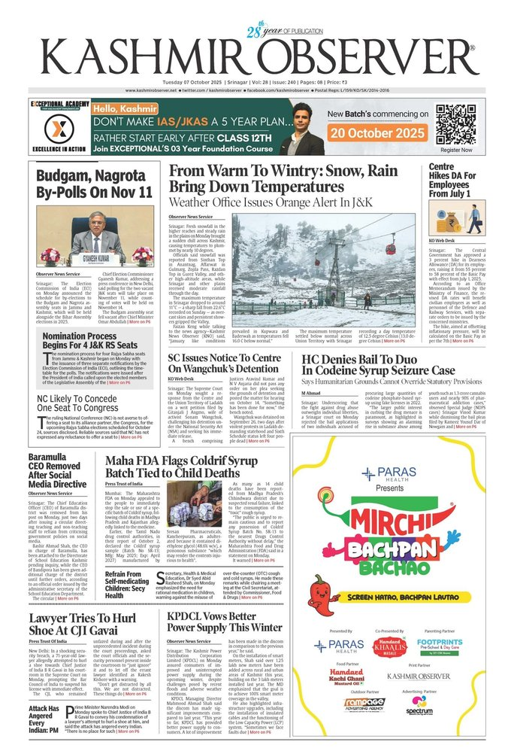



Why Kashmir Observer is the right partner
Credibility
Proof on record
Health choices are trust decisions. Our circulation is government-audited.
Paras Health ran its 'Mirchi Bachpan Bachao' campaign on our front page, 7 Oct 2025.
Integrated reach
Print, web, Observer TV and social in one buy.
Business-grade readers
Bazar Observer reaches entrepreneurs and professionals.
Also trusted by HDFC Bank, J&K Bank, Bajaj Allianz and IndiGo.
Local and global
KO Online serves the diaspora and visitors.
Sources: KO media deck (front page of 7 Oct 2025, client list); PRGI Circulation Certificate.
Notes:
Why should they choose us? Because a health decision is a trust decision, and trust is what Kashmir Observer has built over more than twenty-seven years. We are not asking them to take a risk. A health brand has already done it: Paras Health ran its "Mirchi Bachpan Bachao" campaign on our front page on 7 October 2025. That page on the screen is our best case study. With your permission, I'd like to turn it into a one-page success story for the sales team.

Slide 9
Three entry points, priced from the 2026 rate card
Clinic Starter
Hospital Growth
Flagship Health Partner
₹68,000
₹2,00,000
₹7,84,000
excl. GST, at card rates
excl. GST, at card rates
excl. GST, at card rates
4 inner-page colour ads, 100 col cm each (local rate)
4 designed posts on Facebook and Instagram
2 inner-page colour ads
Home-page middle banner, 1 month
2 Observer TV videos
2 social videos, Facebook + Instagram
2 front-page colour ads
4 inner-page colour ads
Home-page top banner, 3 months
6 Observer TV videos
6 social videos, 4 platforms
Best for: Specialty clinics, labs
Best for: Private hospitals, pharma
Best for: Hospital groups, insurers
KO Rate Card 2026 rates. Corporate ads are quarter-page (400 sq cm). GST extra (print 5%, digital 18%). Illustrative; discounts need approval.
Notes:
To make the sale easy, I've built three ready packages, all priced from our 2026 rate card. The Clinic Starter at sixty-eight thousand rupees gives a small clinic four local print ads and four social posts. The Hospital Growth package, at two lakh, adds a website banner and Observer TV videos. That is the one I expect most hospitals to buy. The Flagship Health Partner, at about seven-point-eight lakh, includes front-page ads, a three-month top banner and a video series. All prices are before GST, and any discount would need your approval.

Slide 10
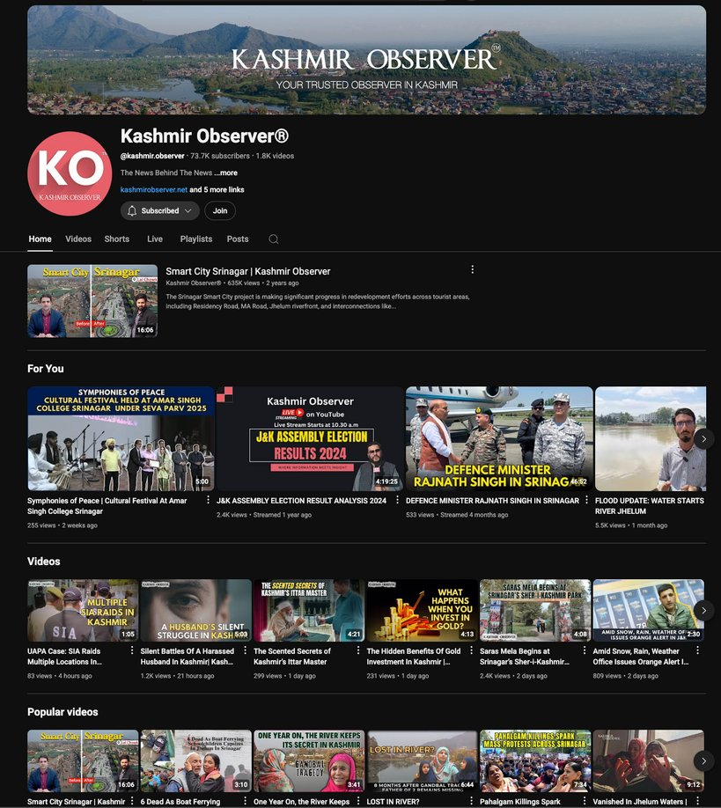


Beyond ads: four formats built for health
Health Matters page
A weekly sponsored page of doctor columns, clearly labelled.
Ask the Doctor on Observer TV
Expert videos on YouTube, from ₹25,000 per video.
Awareness calendar
Campaigns on World Cancer, Health, Heart and Diabetes Days.
Campus and community
Health drives through Young Kashmir and Mizraab.
Sponsored content is always labelled. Screenshot: KO YouTube channel (KO media deck). Video price: KO Rate Card 2026.
Notes:
Health brands don't just want ads; they want to educate people. So I propose four formats: a weekly "Health Matters" page with doctor columns; an "Ask the Doctor" series on Observer TV, which our channel can produce from twenty-five thousand per video; campaigns around World Cancer Day, World Health Day, World Heart Day and World Diabetes Day; and campus health drives through Young Kashmir. One rule protects our credibility: all sponsored content is clearly labelled.

Slide 11
A 90-day plan to open the health vertical
1
Days 1–30 · Prepare
2
Days 31–60 · Pitch
3
Days 61–90 · Convert
Shortlist 40 prospects from SEHAT-empanelled private hospitals, labs and pharma distributors. Draft a health one-pager and a Paras Health case study.
Meet 15 decision-makers. Offer a one-month pilot tied to an awareness day.
Deliver pilots, share a reach report, and move winners to quarterly or annual partnerships.
40 prospects
15 meetings
5 pilots
2 annual partners
Targets are proposed planning numbers, not forecasts.
Notes:
Here is how we start. In the first month we shortlist forty prospects and prepare a one-pager and the Paras Health case study. In the second month we meet fifteen decision-makers and offer a one-month pilot tied to an awareness day. In the third month we deliver the pilots, share a reach report, and convert the best into quarterly or annual partners. The target: forty prospects, fifteen meetings, five pilots, two annual partners. These are planning numbers you can adjust to our real conversion rates.

Slide 12
What a modest win rate could be worth
₹24.6 L
illustrative first-cycle revenue at card rates, excl. GST
Assumes 16 paying clients across three packages
No discount applied
A scenario to size the vertical, not a forecast
Calculation: 10 × ₹68,000 + 5 × ₹2,00,000 + 1 × ₹7,84,000 = ₹24,64,000. Based on KO Rate Card 2026.
Notes:
What could this be worth? If we sign ten Starter clients, five Growth clients and one Flagship partner, that is about twenty-four point six lakh rupees at card rates. This is a scenario to show the size of the opportunity, not a forecast. The Starter package brings volume; Growth and Flagship bring value.

Slide 13
Risks we should plan for
Risk | How we manage it
Payment delays at private hospitals | Press reports describe unpaid SEHAT dues. Prefer advance or staged payments and diversify into labs, pharma and insurers.
Health-claim regulation | Use a pre-clearance checklist aligned with the Drugs and Magic Remedies Act 1954 and ASCI healthcare norms. No cure claims.
Editorial credibility | Label all partner content clearly and keep sales separate from the newsroom.
Price sensitivity of small clinics | Offer the local-rate Starter package and awareness-day pilots.
Proving results | Monthly reach reports, plus QR codes or dedicated helpline numbers in every ad.
Sources: press reports on SEHAT payment disputes (Rising Kashmir, Medical Dialogues); regulations cited by name, confirm with legal before launch.
Notes:
I also want to be honest about the risks. Some private hospitals face delays in SEHAT payments, so we should ask for advance or staged payment and spread across labs, pharma and insurers. Health ads face strict rules, so we need a simple checklist with no cure claims. We must keep sales separate from the newsroom. And to prove results, every ad should carry a QR code or helpline number.

Slide 14
Our ask: make healthcare KO's next growth vertical
1
Approve healthcare as the first sector vertical for the sales team.
We deliver trust, credibility and results.
2
Authorise three packages and a discount band for pilots.
sales@kashmirobserver.net
www.kashmirobserver.net
3
Open five pilot meetings within 30 days, starting with a hospital, a lab and a pharma distributor.
Notes:
So my request is simple. One: approve healthcare as our first sector vertical. Two: approve the three packages and a discount band for pilots. Three: let us set up five pilot meetings in the next thirty days, starting with one hospital, one lab and one pharma distributor. As our own rate card says, we don't just deliver news; we deliver trust, credibility and results. Thank you. I'd be glad to take your questions.

Slide 15
Sources and data notes
KO data: PRGI Circulation Certificate (26.12.2025): 80,250 sold copies per day. KO media deck: views for 07-Oct-24 to 07-Oct-25, client list, publications. KO Rate Card 2026: prices, followers, 81.6K YouTube subscribers, 2M monthly page views.
To reconcile: the media deck says 14M website page views for Oct 2024 – Oct 2025, while the rate card says 2M monthly on average. Confirm the current figure before presenting.
Health data: Daily Excelsior (budget ₹8,813.71 Cr, up ₹480.26 Cr); Kashmir Life (Economic Survey 2025-26: colleges 4 to 17, 22,454 beds); Greater Kashmir (SEHAT cards); press reports on PM-JAY SEHAT empanelment (251 hospitals, 133 private).
Judgment: sector scores, packages, funnel and revenue scenario are our proposals, not market data. Doctor-patient ratios were left out because sources conflict.
Notes:
Keep this ready in case you're asked where a number came from.

