Slide 1

The Server-side JavaScript
Aspire Hackathon – Aspire CLI

Slide 2
WHAT TO EXPECT AHEAD….
CLI Introduction
Problems solved with Using(Aspire CLI)
Benefits and ideas
Example

Slide 3
Definition – WHAT does Command Line Interface (CLI) mean?

Slide 4
INTRODUCTION: BASIC
CLI is an older method for interacting with applications and operating systems and is used to perform specific tasks required by users.
CLI is a text-based interface and allows a user to perform tasks by entering commands. Users enter the specific command, press “Enter”, and then wait for a response. After receiving the command, the CLI processes it accordingly and shows the output/result on the same screen.

Slide 5
Problems solved with Using(Aspire CLI)
Node apps don’t come with a strict file and folder structure. Instead, you can build your web app anyway you like. This is great especially for small apps. However, as your application grows in size and complexity, things might get confusing. Your code becomes messy.
As your team grows, it becomes harder to work on the same code base. You are fighting with conflicts each time the code is merged. Adding new features and handling new situations constantly requires changes in your application structure. Moreover, there are so many different ways to organize your files and your code, and it is hard to choose which one is the right for you.

Slide 6
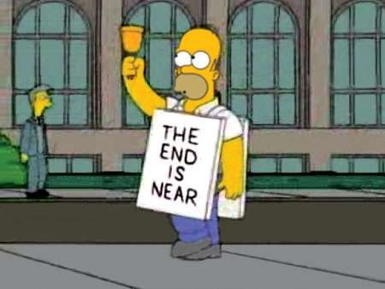
And we are the winner team

Slide 7
Benefit And Ideas:
You would like to have a file structure where different files and folders are responsible for different tasks. You want your project to be easy for multiple people to work on at the same time, and then their work to be merged with as little conflicts as possible. You want to keep your code clean. You want your file structure to allow you to easily add new features.
All above points can be satisfied when using Aspire CLI
You can build your new app structure in less than hour by using Aspire CLI, which is in reality need at least 3 days to be completed.

Slide 8

Example
Let’s look at the demo will be presented by Yaser.

Slide 9

Team Members:
Ady
Adnan
Mutaz
Yaser

