Slide 1
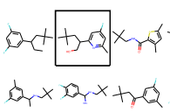
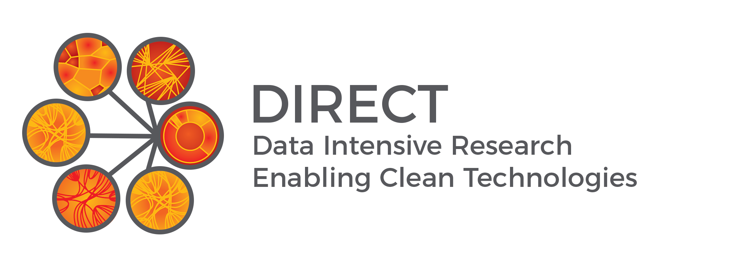
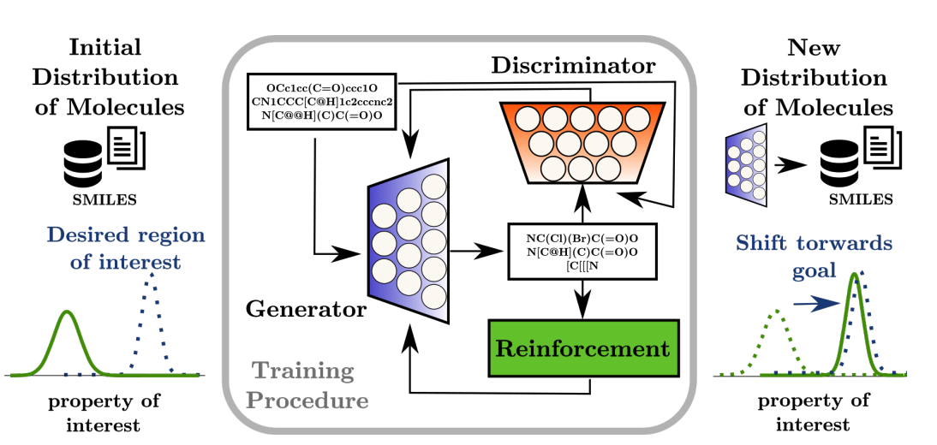
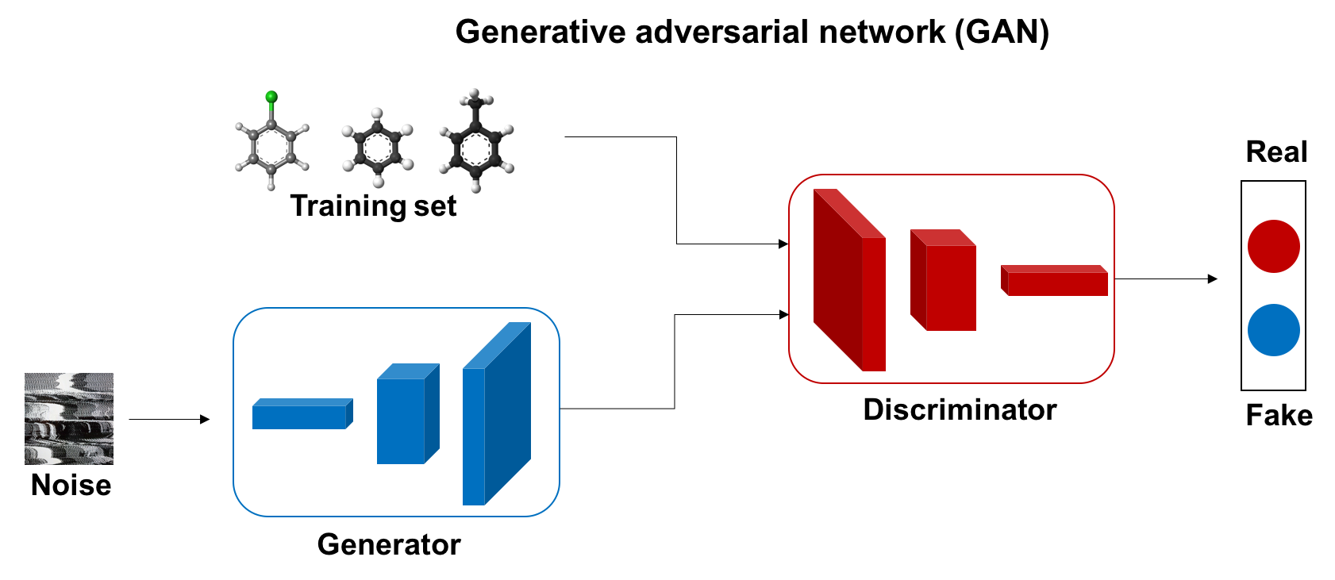
Molecules Design using Deep Generative Models
Project Sponsors : Baosen Zhang, Alex Jen
Team Members: Yize Chen, Xiaoxiao Jia, Jiaxu Qin
Abstract: We proposed a method to convert discrete representations of molecules to a multidimensional continuous representation. By sampling valid structures from the distribution of input molecules, this method can generate new molecules for efficient exploration and optimization through open-ended spaces of chemical compounds
Algorithm: Generative Adversarial Networks (GANs)
The generator (which has previously been trained) generates batches of molecules, which are analyzed by the discriminator and the metric; then the former is trained to simultaneously fool the discriminator and maximize the reward.

