Slide 1

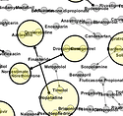
Data Science for Drug Discovery, Health & Translational Medicine
Joanne S. Luciano https://www.linkedin.com/in/joanneluciano
Visiting Associate Professor Indiana University School of Informatics and Computing
DATA SCIENCE FOR DRUG DISCOVERY, HEALTH AND TRANSLATIONAL MEDICINE
Notes:
Hi and Welcome Back to Data Science for Drug Discovery Health and Translational Medicine
This is Module 9. This is also the beginning of Part 3 where we focus our attention on the second framing question, How can Data Science help doctors and other providers treat patients better. This a huge topic that is not only growing as we continue to collect more and more data, but it’s also a moving target. At this and all levels, context is important, and in this area, I would say more than the other two, that policy plays an even larger role.
While the course is partitioned into the background followed by the three framing questions, as I trust you understand by now that the healthcare domain in both highly interconnected and well as complex. So in some cases, there are very specific distinctions, and in some cases, literally life and death, other areas overlap substantially. So some of the tools or concepts or mechanisms will come up in multiple parts. For example social media is used both by companies, government, and individuals.

Slide 2
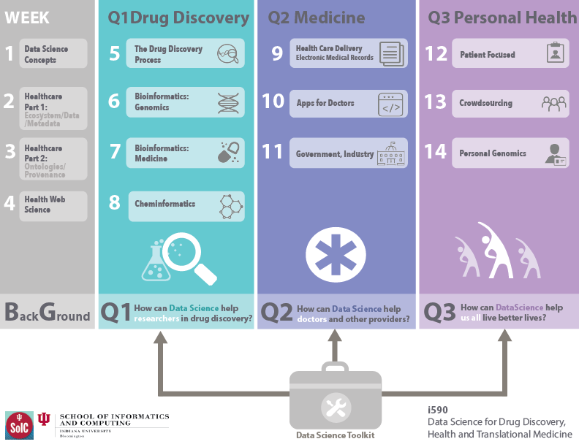
Part 3 – Applications in Medicine

Slide 3
Part 3: Question 2 How can data science help doctors and other providers treat patients better?
Topics:
Healthcare Delivery, Providers
Patient-based data, Evidence Based Medicine
Meaningful Use, Fee for Service, Capitation, Value-based care
Health Information Technology for Economic and Clinical Health Act (HITECH)
Learning Objectives:
After completing this module, the student will be able to explain, summarize and discuss opportunities for data science to in healthcare delivery. Students will be able to explain the transformation underway in the US healthcare system from fee for service to value based care, the use of EMRs, the role of Evidence Based Medicine in achieving Meaningful use or Electronic Medical Records. Additionally, the student will be able to explain the the health related aspects of the American Recovery and Reinvestment Act of 2009.
Notes:
As we now transition from looking at drug discovery and pharmaceutical research to the wider healthcare arena, this module will zoom right out and take a look at how data science is developing as a discipline, and how this is impacting the future of pharmaceutical research and healthcare provision.

