Slide 1
Latin Hypercube Design

Slide 2
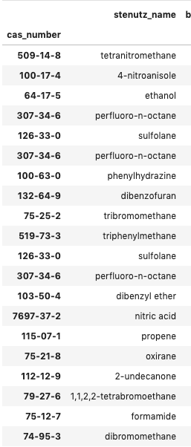
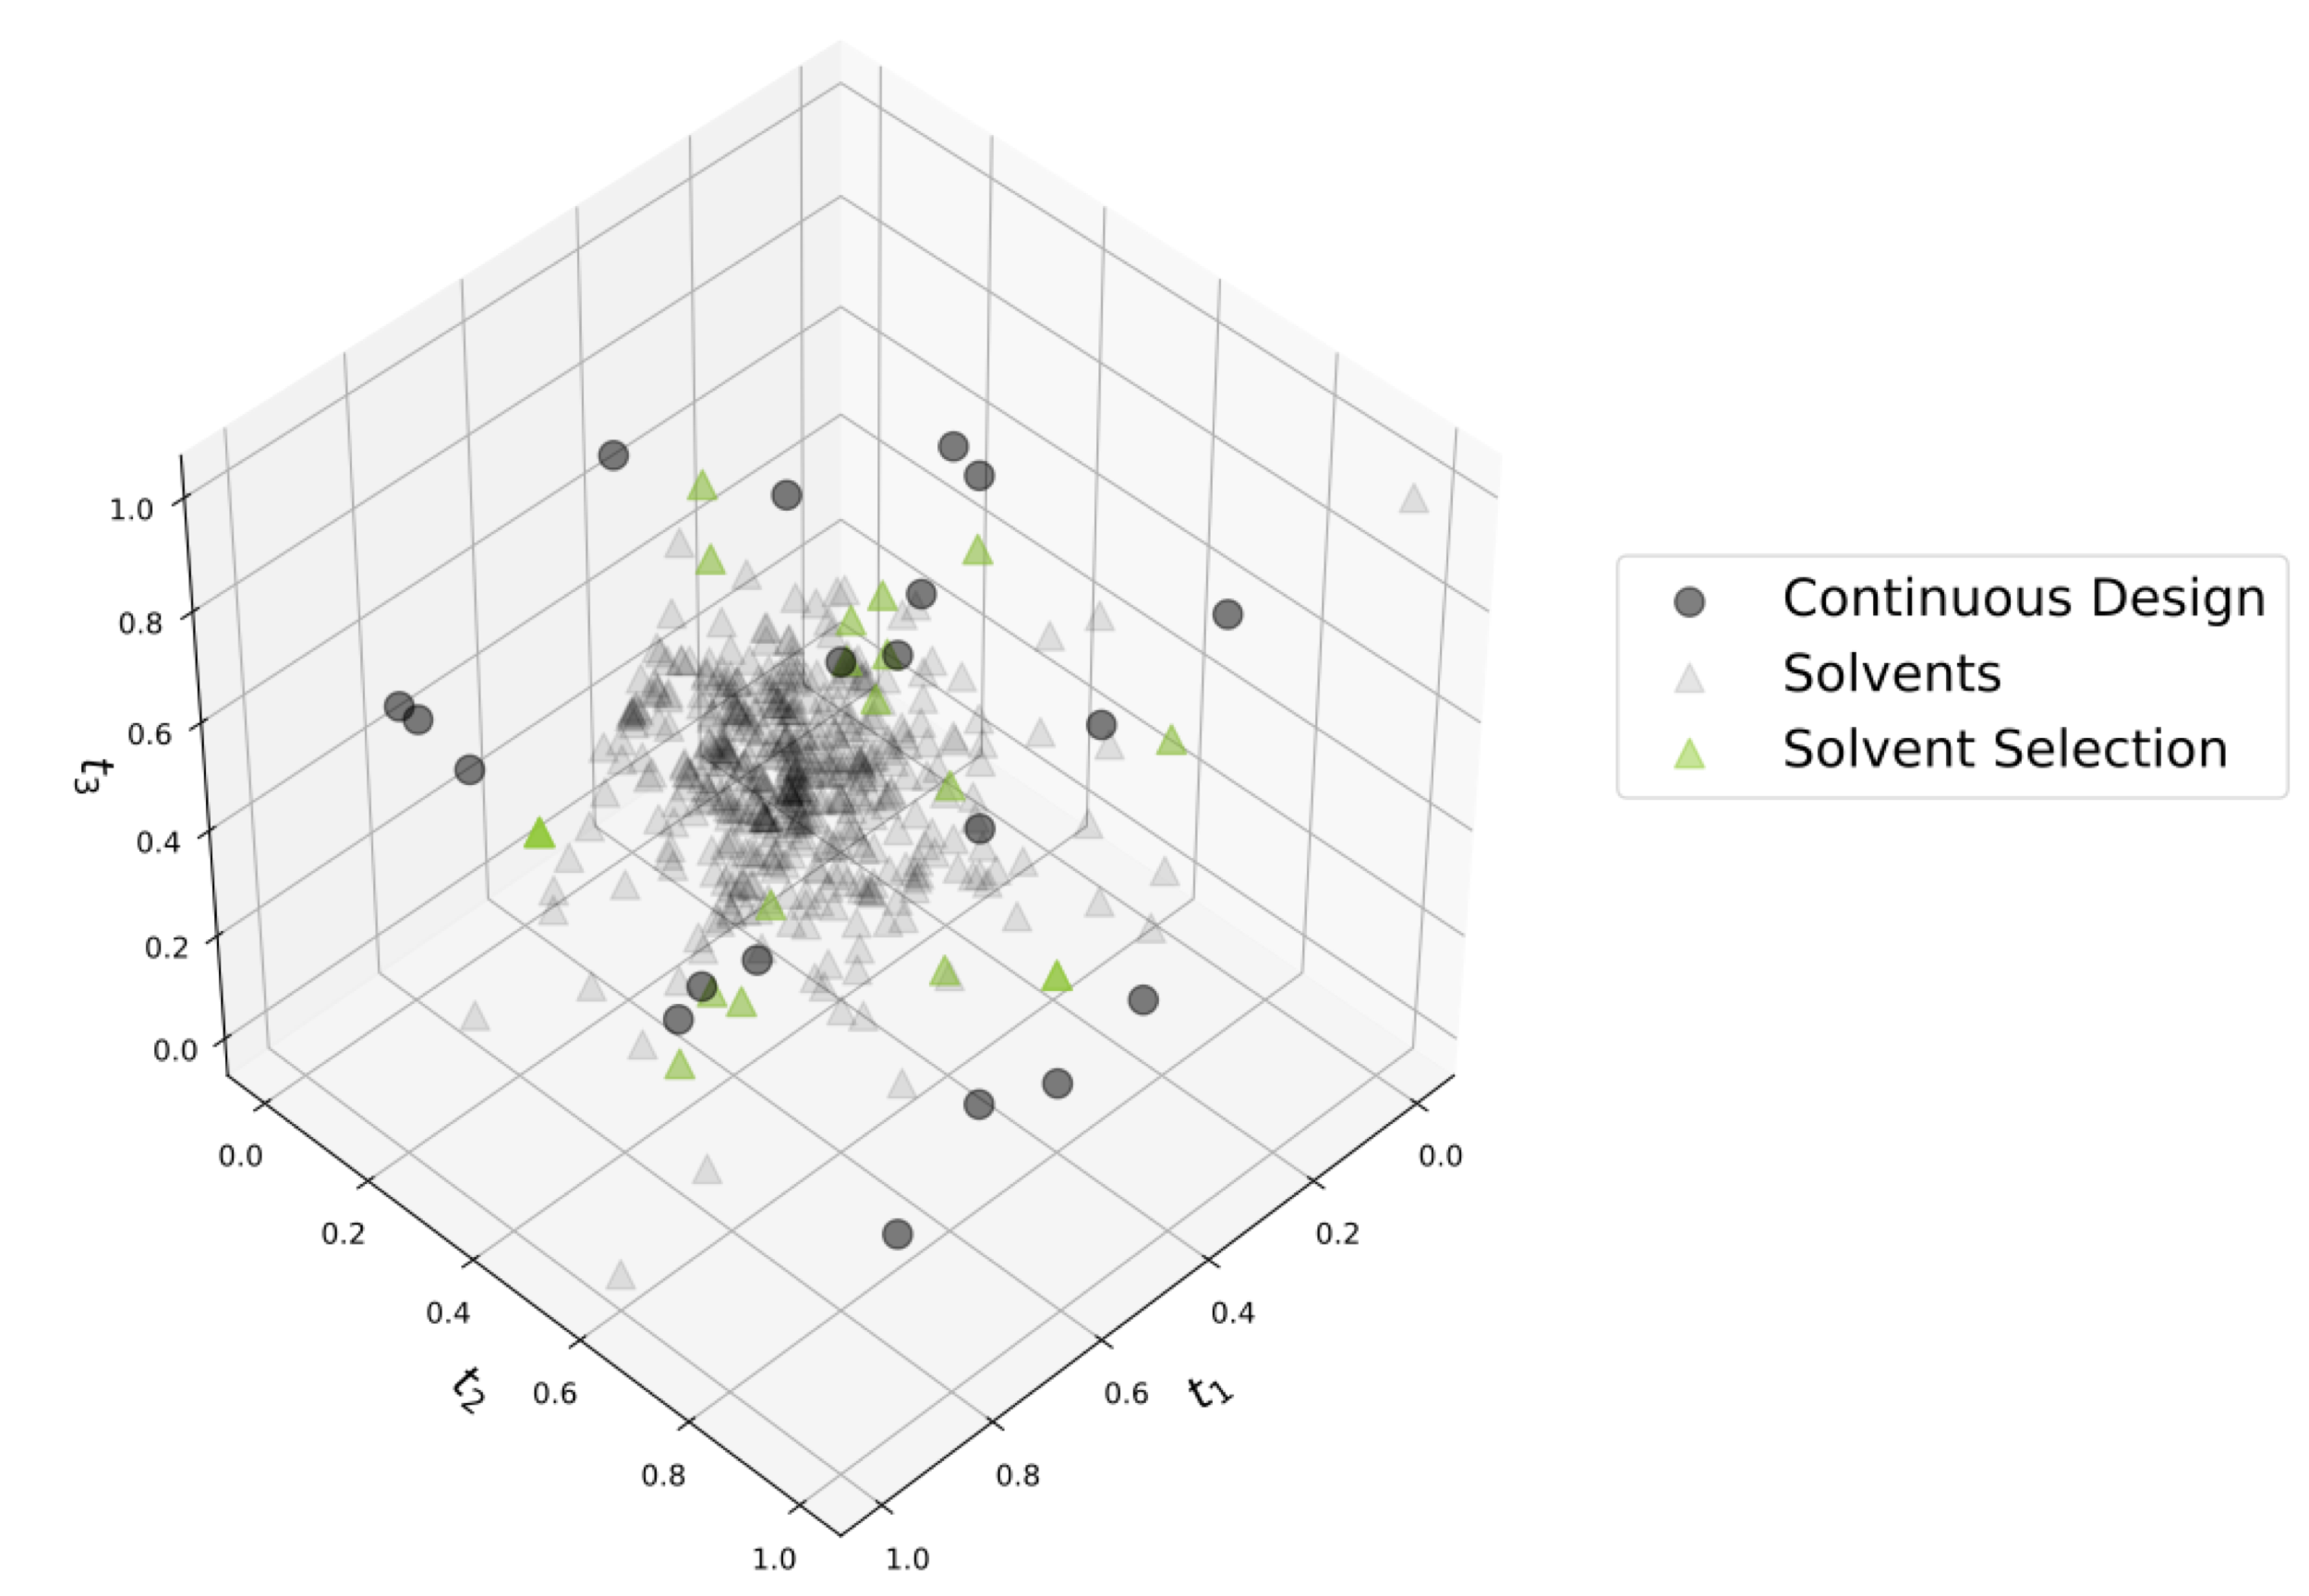
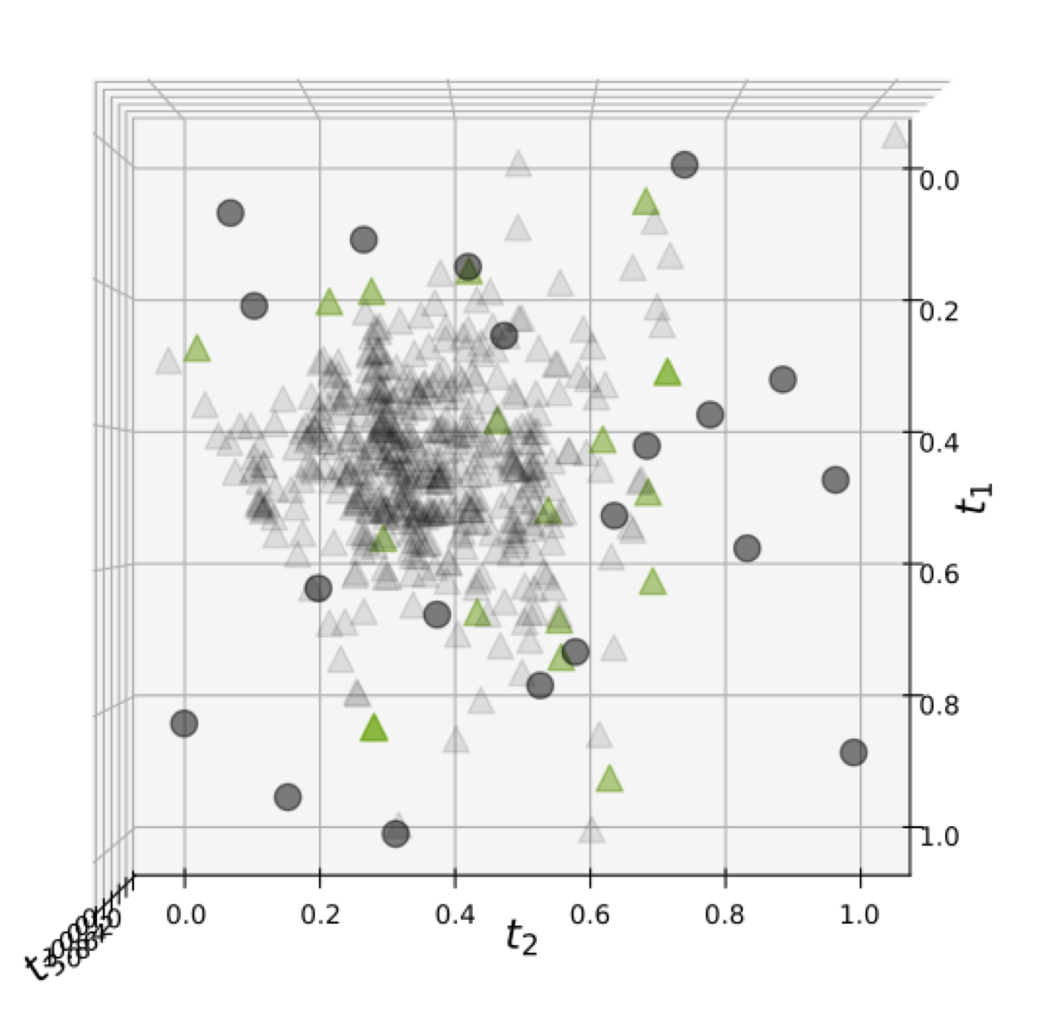
Full Solvent Library (472 solvents)
2D Projection
Decomposed 17 molecular descriptors to 3 principal components (same as Yehia’s work)
Used Latin hypercube design to select continuous points
As shown in 2D projection, outliers caused PCA space to look much more compressed than it is

Slide 3
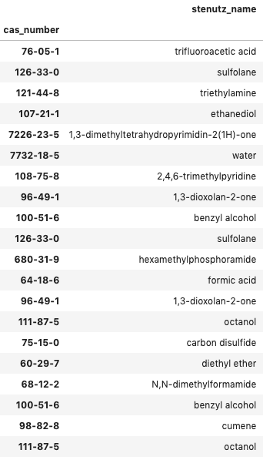
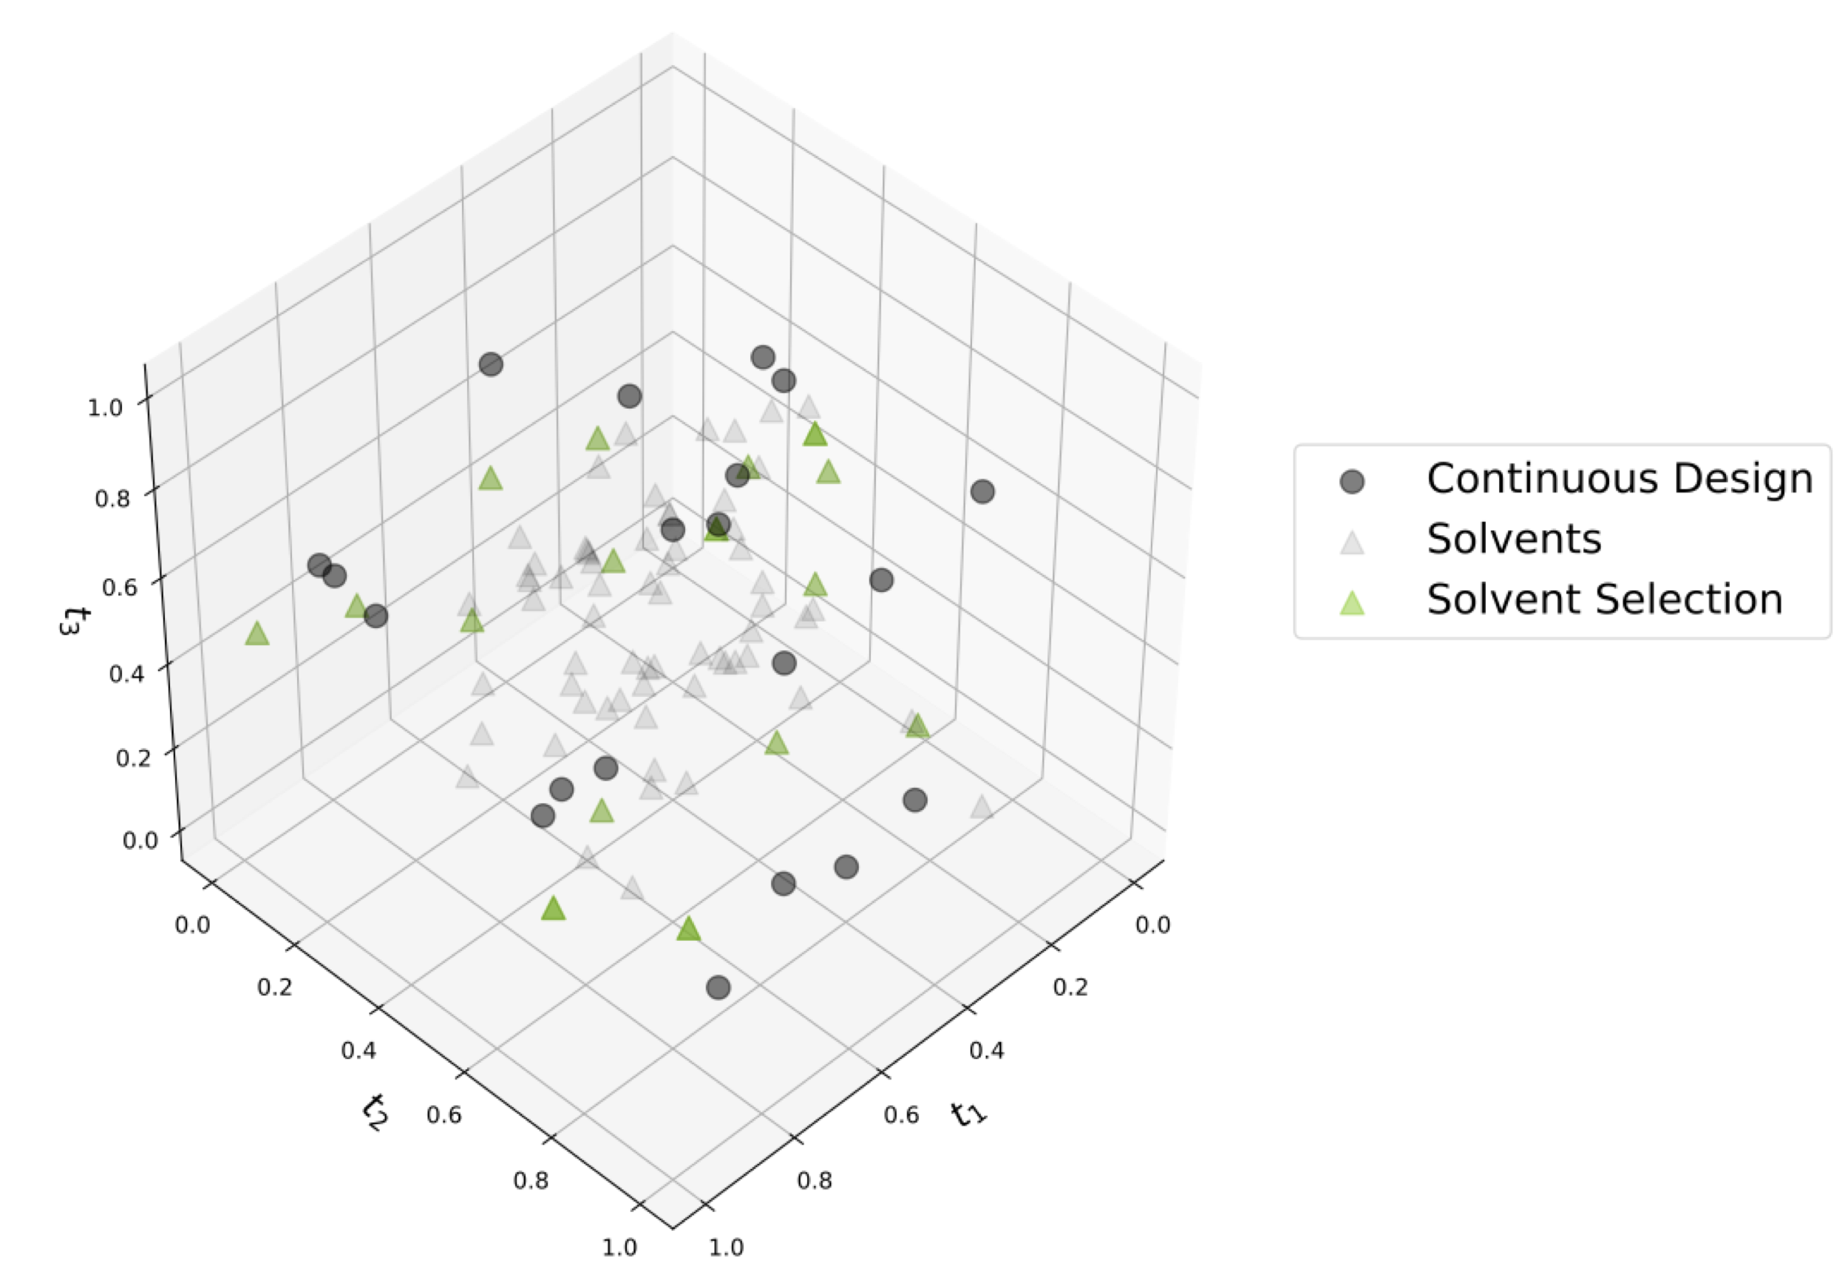
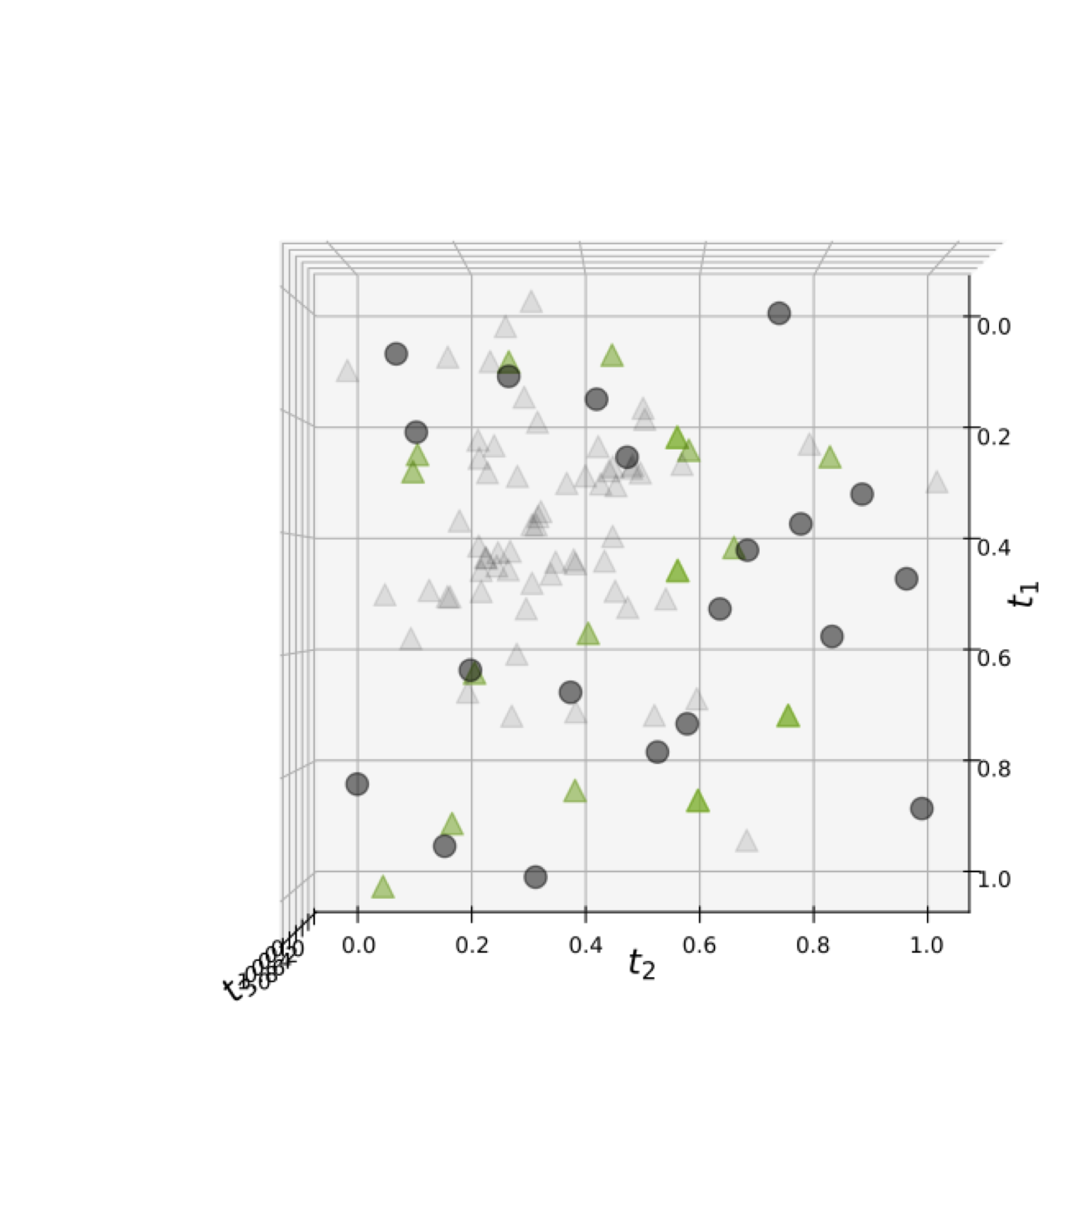
Filtered with UCB Solvent Library (80 solvents)
2D Projection
Filtered to only the UCB solvent library
This removed many outliers
Resulted in a design that better represents variability in solvent space

Slide 4
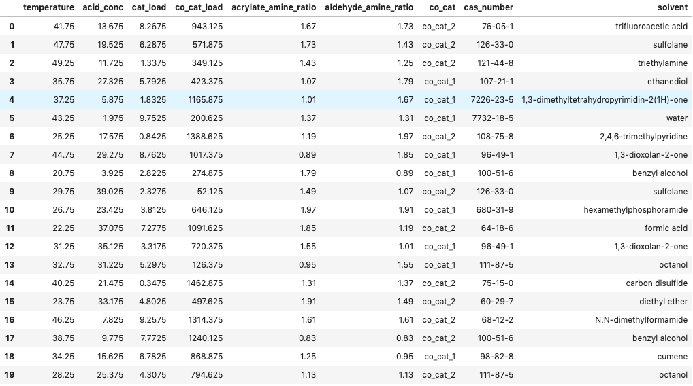
Full Initial Design
T = 20 – 50 °C
Propionic acid = 1 – 40 mM
Amine = 10 – 1000 mM
Catalyst Loading = 0.1 – 10 mM
Co-catalyst = 15 – 1500 mM
Acrylate/amine molar ratio = 0.8 – 2
Aldehyde / amine molar ratio = 0.8 – 2

Slide 5
Other Ideas
Placket-Burman for continuous variables in 5-10 solvents for variable selection
D-optimal design using GP treed LLM
Generate random data using LHS
Build GP treed LLM using random data
Select D-optimal experiments from that GP treed LLM
Modified generalized subset design
Need to modify to work with descriptors variables

Slide 6
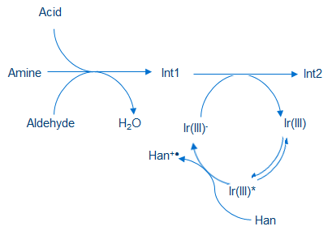

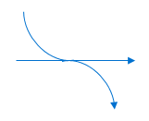
Kinetic model – simplified attempt – chemistry has changed
Int3 + Acid
k₄
k₋₄
Olefin
k₁
k₂
k₅
k₆
Int4
product
Ir(II)⁻
Han⁺*
k₄
k₋₃
k₃

Slide 7
Kinetic model – simplified attempt – might contain mistakes

