Slide 1
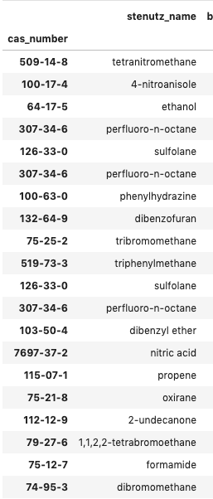
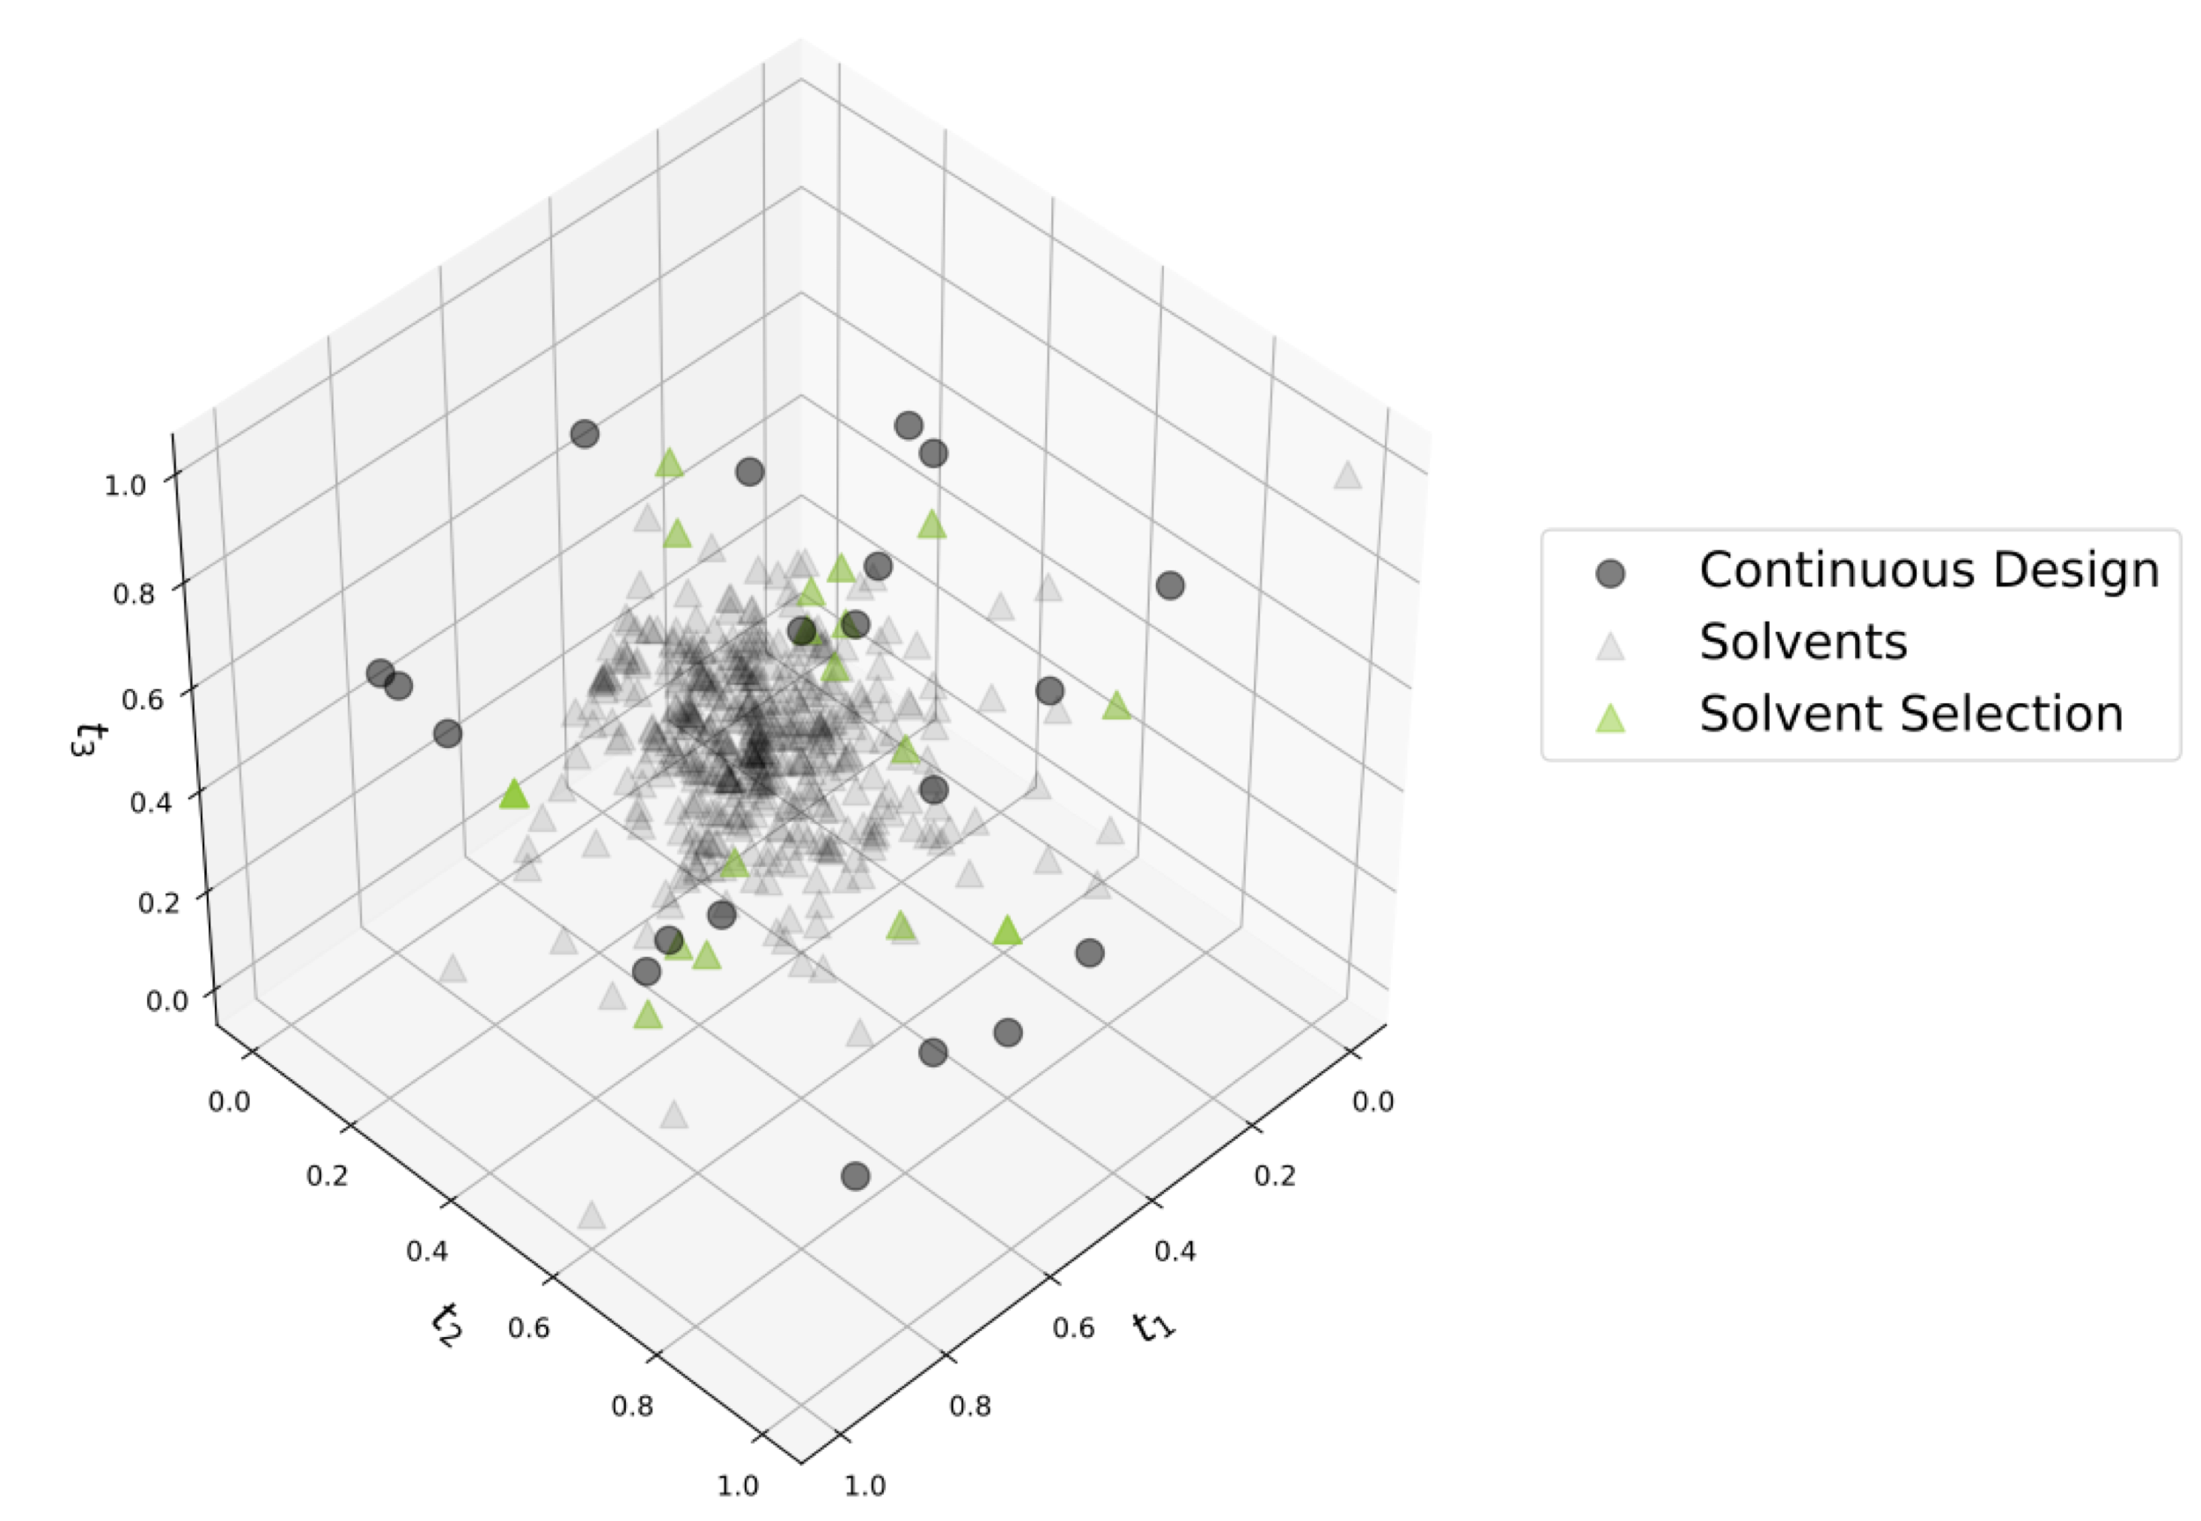
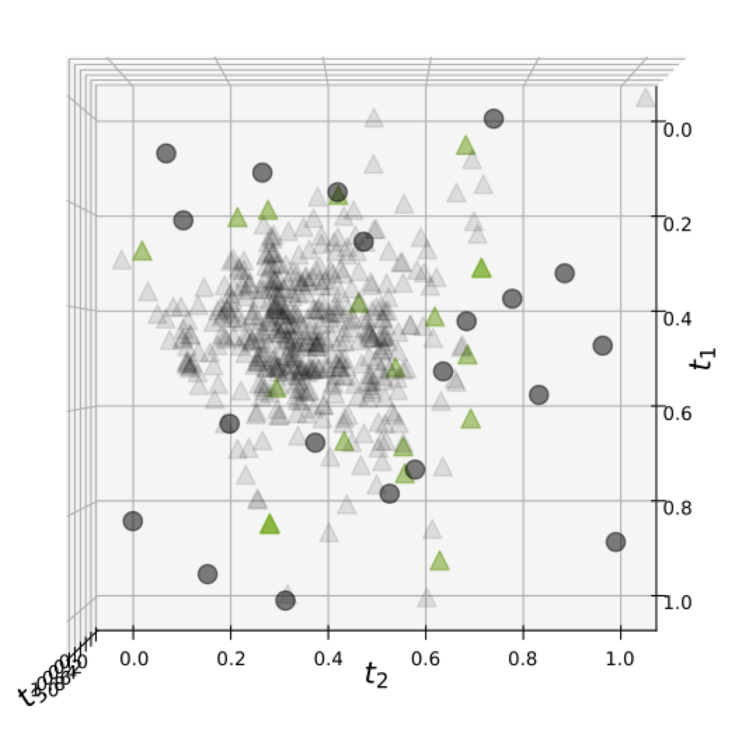
Full Solvent Library (472 solvents)
2D Projection
Decomposed 17 molecular descriptors to 3 principal components (same as Yehia’s work)
Used Latin hypercube design to select continuous points
As shown in 2D projection, outliers caused PCA space to look much more compressed than it is

Slide 2
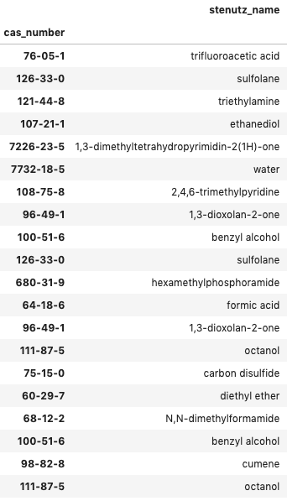
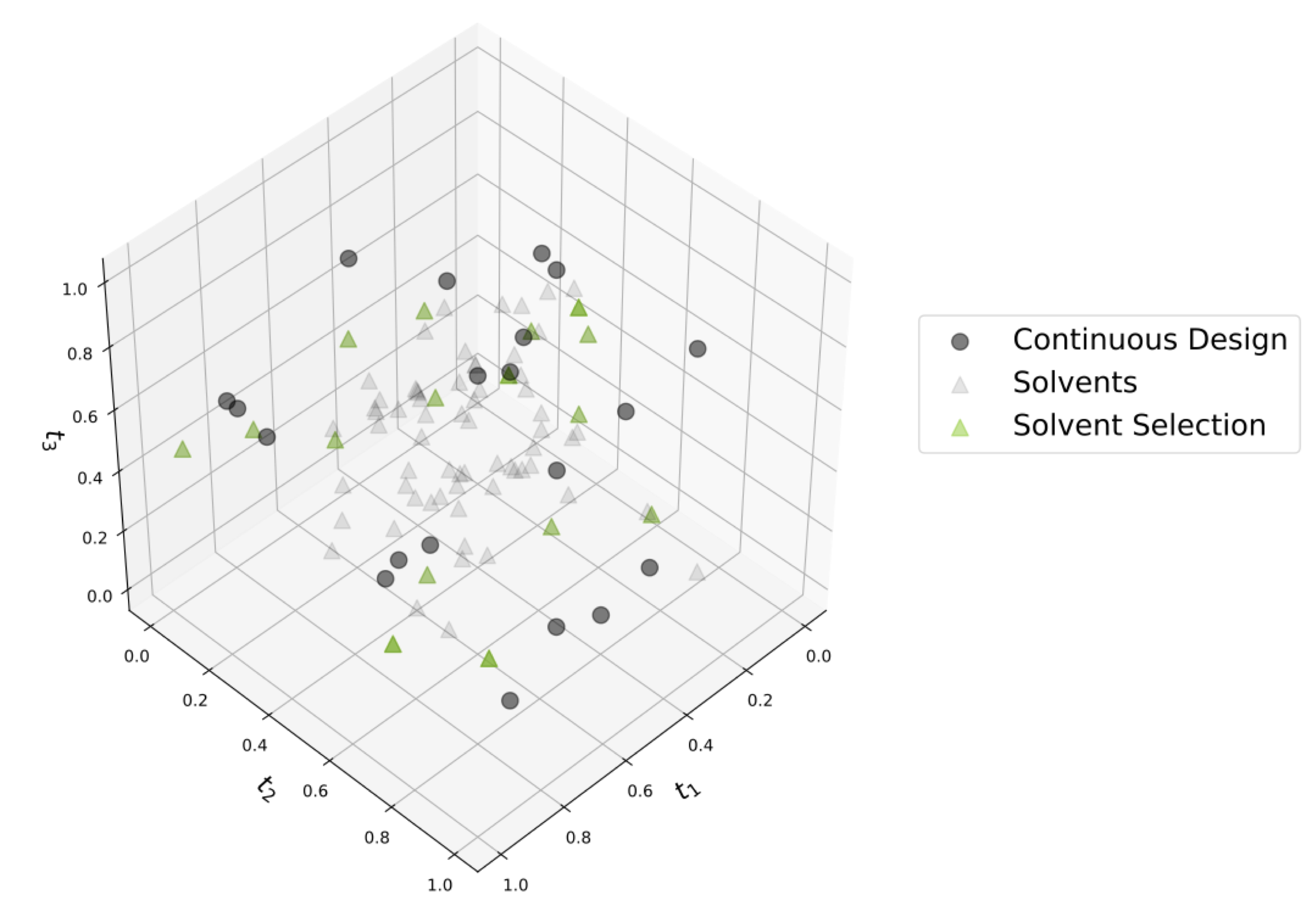
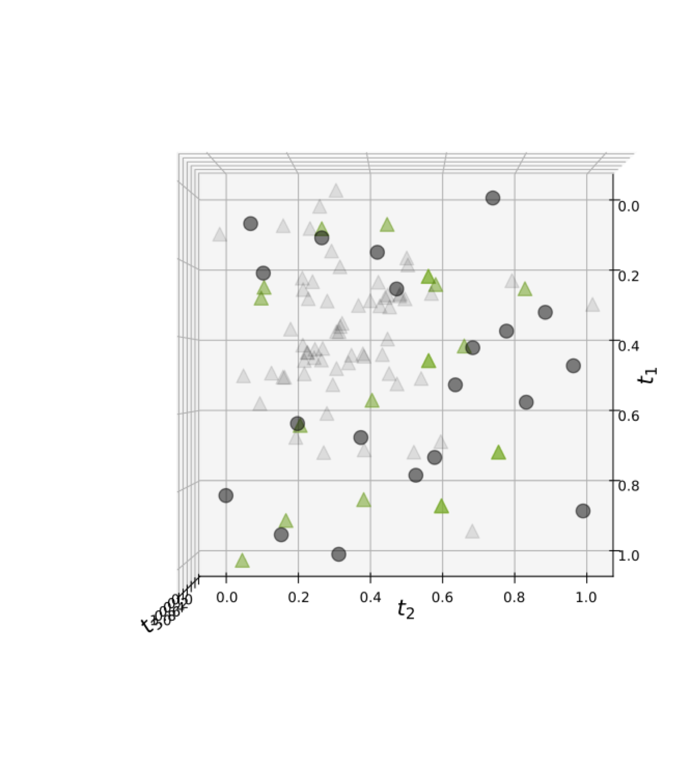
Filtered with UCB Solvent Library (80 solvents)
2D Projection
Filtered to only the UCB solvent library
This removed many outliers
Resulted in a design that better represents variability in solvent space

Slide 3
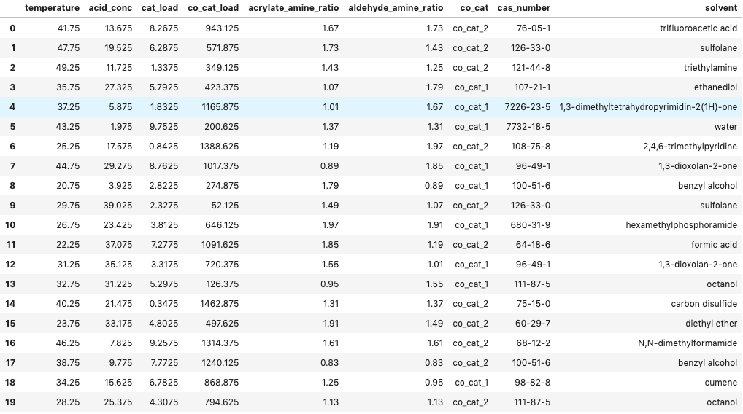
Full Initial Design
T = 20 – 50 °C
Propionic acid = 1 – 40 mM
Amine = 10 – 1000 mM
Catalyst Loading = 0.1 – 10 mM
Co-catalyst = 15 – 1500 mM
Acrylate/amine molar ratio = 0.8 – 2
Aldehyde / amine molar ratio = 0.8 – 2

