Slide 1
Image filtering

Slide 2
This week: three views of filtering
Image filters in spatial domain
Filter is a mathematical operation of a grid of numbers
Smoothing, sharpening, measuring texture
Image filters in the frequency domain
Filtering is a way to modify the frequencies of images
Denoising, sampling, image compression
Image pyramids
Scale-space representation allows coarse-to-fine operations
James Hays

Slide 3
Image filtering
Image filtering:
Compute function of local neighborhood at each position
James Hays

Slide 4
Image filtering
Image filtering:
Compute function of local neighborhood at each position
h=output
f=filter
I=image
2d coords=k,l
2d coords=m,n
[ ]
[ ]
[ ]

Slide 5

Example: box filter
1
1
1
1
1
1
1
1
1
Slide credit: David Lowe (UBC)

Slide 6
Image filtering
1
1
1
1
1
1
1
1
1
0 | 0 | 0 | 0 | 0 | 0 | 0 | 0 | 0 | 0
0 | 0 | 0 | 0 | 0 | 0 | 0 | 0 | 0 | 0
0 | 0 | 0 | 90 | 90 | 90 | 90 | 90 | 0 | 0
0 | 0 | 0 | 90 | 90 | 90 | 90 | 90 | 0 | 0
0 | 0 | 0 | 90 | 90 | 90 | 90 | 90 | 0 | 0
0 | 0 | 0 | 90 | 0 | 90 | 90 | 90 | 0 | 0
0 | 0 | 0 | 90 | 90 | 90 | 90 | 90 | 0 | 0
0 | 0 | 0 | 0 | 0 | 0 | 0 | 0 | 0 | 0
0 | 0 | 90 | 0 | 0 | 0 | 0 | 0 | 0 | 0
0 | 0 | 0 | 0 | 0 | 0 | 0 | 0 | 0 | 0
 | 0
0 | 0 | 0 | 0 | 0 | 0 | 0 | 0 | 0 | 0
0 | 0 | 0 | 0 | 0 | 0 | 0 | 0 | 0 | 0
0 | 0 | 0 | 90 | 90 | 90 | 90 | 90 | 0 | 0
0 | 0 | 0 | 90 | 90 | 90 | 90 | 90 | 0 | 0
0 | 0 | 0 | 90 | 90 | 90 | 90 | 90 | 0 | 0
0 | 0 | 0 | 90 | 0 | 90 | 90 | 90 | 0 | 0
0 | 0 | 0 | 90 | 90 | 90 | 90 | 90 | 0 | 0
0 | 0 | 0 | 0 | 0 | 0 | 0 | 0 | 0 | 0
0 | 0 | 90 | 0 | 0 | 0 | 0 | 0 | 0 | 0
0 | 0 | 0 | 0 | 0 | 0 | 0 | 0 | 0 | 0
Credit: S. Seitz
Notes:
ones, divide by 9

Slide 7
Image filtering
1
1
1
1
1
1
1
1
1
0 | 0 | 0 | 0 | 0 | 0 | 0 | 0 | 0 | 0
0 | 0 | 0 | 0 | 0 | 0 | 0 | 0 | 0 | 0
0 | 0 | 0 | 90 | 90 | 90 | 90 | 90 | 0 | 0
0 | 0 | 0 | 90 | 90 | 90 | 90 | 90 | 0 | 0
0 | 0 | 0 | 90 | 90 | 90 | 90 | 90 | 0 | 0
0 | 0 | 0 | 90 | 0 | 90 | 90 | 90 | 0 | 0
0 | 0 | 0 | 90 | 90 | 90 | 90 | 90 | 0 | 0
0 | 0 | 0 | 0 | 0 | 0 | 0 | 0 | 0 | 0
0 | 0 | 90 | 0 | 0 | 0 | 0 | 0 | 0 | 0
0 | 0 | 0 | 0 | 0 | 0 | 0 | 0 | 0 | 0
 | 0 | 10
0 | 0 | 0 | 0 | 0 | 0 | 0 | 0 | 0 | 0
0 | 0 | 0 | 0 | 0 | 0 | 0 | 0 | 0 | 0
0 | 0 | 0 | 90 | 90 | 90 | 90 | 90 | 0 | 0
0 | 0 | 0 | 90 | 90 | 90 | 90 | 90 | 0 | 0
0 | 0 | 0 | 90 | 90 | 90 | 90 | 90 | 0 | 0
0 | 0 | 0 | 90 | 0 | 90 | 90 | 90 | 0 | 0
0 | 0 | 0 | 90 | 90 | 90 | 90 | 90 | 0 | 0
0 | 0 | 0 | 0 | 0 | 0 | 0 | 0 | 0 | 0
0 | 0 | 90 | 0 | 0 | 0 | 0 | 0 | 0 | 0
0 | 0 | 0 | 0 | 0 | 0 | 0 | 0 | 0 | 0
Credit: S. Seitz
Notes:
ones, divide by 9

Slide 8
Image filtering
1
1
1
1
1
1
1
1
1
0 | 0 | 0 | 0 | 0 | 0 | 0 | 0 | 0 | 0
0 | 0 | 0 | 0 | 0 | 0 | 0 | 0 | 0 | 0
0 | 0 | 0 | 90 | 90 | 90 | 90 | 90 | 0 | 0
0 | 0 | 0 | 90 | 90 | 90 | 90 | 90 | 0 | 0
0 | 0 | 0 | 90 | 90 | 90 | 90 | 90 | 0 | 0
0 | 0 | 0 | 90 | 0 | 90 | 90 | 90 | 0 | 0
0 | 0 | 0 | 90 | 90 | 90 | 90 | 90 | 0 | 0
0 | 0 | 0 | 0 | 0 | 0 | 0 | 0 | 0 | 0
0 | 0 | 90 | 0 | 0 | 0 | 0 | 0 | 0 | 0
0 | 0 | 0 | 0 | 0 | 0 | 0 | 0 | 0 | 0
 | 0 | 10 | 20
0 | 0 | 0 | 0 | 0 | 0 | 0 | 0 | 0 | 0
0 | 0 | 0 | 0 | 0 | 0 | 0 | 0 | 0 | 0
0 | 0 | 0 | 90 | 90 | 90 | 90 | 90 | 0 | 0
0 | 0 | 0 | 90 | 90 | 90 | 90 | 90 | 0 | 0
0 | 0 | 0 | 90 | 90 | 90 | 90 | 90 | 0 | 0
0 | 0 | 0 | 90 | 0 | 90 | 90 | 90 | 0 | 0
0 | 0 | 0 | 90 | 90 | 90 | 90 | 90 | 0 | 0
0 | 0 | 0 | 0 | 0 | 0 | 0 | 0 | 0 | 0
0 | 0 | 90 | 0 | 0 | 0 | 0 | 0 | 0 | 0
0 | 0 | 0 | 0 | 0 | 0 | 0 | 0 | 0 | 0
Credit: S. Seitz
Notes:
ones, divide by 9

Slide 9
Image filtering
1
1
1
1
1
1
1
1
1
0 | 0 | 0 | 0 | 0 | 0 | 0 | 0 | 0 | 0
0 | 0 | 0 | 0 | 0 | 0 | 0 | 0 | 0 | 0
0 | 0 | 0 | 90 | 90 | 90 | 90 | 90 | 0 | 0
0 | 0 | 0 | 90 | 90 | 90 | 90 | 90 | 0 | 0
0 | 0 | 0 | 90 | 90 | 90 | 90 | 90 | 0 | 0
0 | 0 | 0 | 90 | 0 | 90 | 90 | 90 | 0 | 0
0 | 0 | 0 | 90 | 90 | 90 | 90 | 90 | 0 | 0
0 | 0 | 0 | 0 | 0 | 0 | 0 | 0 | 0 | 0
0 | 0 | 90 | 0 | 0 | 0 | 0 | 0 | 0 | 0
0 | 0 | 0 | 0 | 0 | 0 | 0 | 0 | 0 | 0
 | 0 | 10 | 20 | 30
0 | 0 | 0 | 0 | 0 | 0 | 0 | 0 | 0 | 0
0 | 0 | 0 | 0 | 0 | 0 | 0 | 0 | 0 | 0
0 | 0 | 0 | 90 | 90 | 90 | 90 | 90 | 0 | 0
0 | 0 | 0 | 90 | 90 | 90 | 90 | 90 | 0 | 0
0 | 0 | 0 | 90 | 90 | 90 | 90 | 90 | 0 | 0
0 | 0 | 0 | 90 | 0 | 90 | 90 | 90 | 0 | 0
0 | 0 | 0 | 90 | 90 | 90 | 90 | 90 | 0 | 0
0 | 0 | 0 | 0 | 0 | 0 | 0 | 0 | 0 | 0
0 | 0 | 90 | 0 | 0 | 0 | 0 | 0 | 0 | 0
0 | 0 | 0 | 0 | 0 | 0 | 0 | 0 | 0 | 0
Credit: S. Seitz
Notes:
ones, divide by 9

Slide 10
Image filtering
1
1
1
1
1
1
1
1
1
0 | 0 | 0 | 0 | 0 | 0 | 0 | 0 | 0 | 0
0 | 0 | 0 | 0 | 0 | 0 | 0 | 0 | 0 | 0
0 | 0 | 0 | 90 | 90 | 90 | 90 | 90 | 0 | 0
0 | 0 | 0 | 90 | 90 | 90 | 90 | 90 | 0 | 0
0 | 0 | 0 | 90 | 90 | 90 | 90 | 90 | 0 | 0
0 | 0 | 0 | 90 | 0 | 90 | 90 | 90 | 0 | 0
0 | 0 | 0 | 90 | 90 | 90 | 90 | 90 | 0 | 0
0 | 0 | 0 | 0 | 0 | 0 | 0 | 0 | 0 | 0
0 | 0 | 90 | 0 | 0 | 0 | 0 | 0 | 0 | 0
0 | 0 | 0 | 0 | 0 | 0 | 0 | 0 | 0 | 0
 | 0 | 10 | 20 | 30 | 30
Credit: S. Seitz
Notes:
ones, divide by 9

Slide 11
Image filtering
1
1
1
1
1
1
1
1
1
0 | 0 | 0 | 0 | 0 | 0 | 0 | 0 | 0 | 0
0 | 0 | 0 | 0 | 0 | 0 | 0 | 0 | 0 | 0
0 | 0 | 0 | 90 | 90 | 90 | 90 | 90 | 0 | 0
0 | 0 | 0 | 90 | 90 | 90 | 90 | 90 | 0 | 0
0 | 0 | 0 | 90 | 90 | 90 | 90 | 90 | 0 | 0
0 | 0 | 0 | 90 | 0 | 90 | 90 | 90 | 0 | 0
0 | 0 | 0 | 90 | 90 | 90 | 90 | 90 | 0 | 0
0 | 0 | 0 | 0 | 0 | 0 | 0 | 0 | 0 | 0
0 | 0 | 90 | 0 | 0 | 0 | 0 | 0 | 0 | 0
0 | 0 | 0 | 0 | 0 | 0 | 0 | 0 | 0 | 0
 | 0 | 10 | 20 | 30 | 30
?
Credit: S. Seitz
Notes:
ones, divide by 9

Slide 12
Image filtering
1
1
1
1
1
1
1
1
1
0 | 0 | 0 | 0 | 0 | 0 | 0 | 0 | 0 | 0
0 | 0 | 0 | 0 | 0 | 0 | 0 | 0 | 0 | 0
0 | 0 | 0 | 90 | 90 | 90 | 90 | 90 | 0 | 0
0 | 0 | 0 | 90 | 90 | 90 | 90 | 90 | 0 | 0
0 | 0 | 0 | 90 | 90 | 90 | 90 | 90 | 0 | 0
0 | 0 | 0 | 90 | 0 | 90 | 90 | 90 | 0 | 0
0 | 0 | 0 | 90 | 90 | 90 | 90 | 90 | 0 | 0
0 | 0 | 0 | 0 | 0 | 0 | 0 | 0 | 0 | 0
0 | 0 | 90 | 0 | 0 | 0 | 0 | 0 | 0 | 0
0 | 0 | 0 | 0 | 0 | 0 | 0 | 0 | 0 | 0
 | 0 | 10 | 20 | 30 | 30
 |  |  |  | 50
?
Credit: S. Seitz
Notes:
ones, divide by 9

Slide 13
Image filtering
1
1
1
1
1
1
1
1
1
0 | 0 | 0 | 0 | 0 | 0 | 0 | 0 | 0 | 0
0 | 0 | 0 | 0 | 0 | 0 | 0 | 0 | 0 | 0
0 | 0 | 0 | 90 | 90 | 90 | 90 | 90 | 0 | 0
0 | 0 | 0 | 90 | 90 | 90 | 90 | 90 | 0 | 0
0 | 0 | 0 | 90 | 90 | 90 | 90 | 90 | 0 | 0
0 | 0 | 0 | 90 | 0 | 90 | 90 | 90 | 0 | 0
0 | 0 | 0 | 90 | 90 | 90 | 90 | 90 | 0 | 0
0 | 0 | 0 | 0 | 0 | 0 | 0 | 0 | 0 | 0
0 | 0 | 90 | 0 | 0 | 0 | 0 | 0 | 0 | 0
0 | 0 | 0 | 0 | 0 | 0 | 0 | 0 | 0 | 0
 | 0 | 10 | 20 | 30 | 30 | 30 | 20 | 10
 | 0 | 20 | 40 | 60 | 60 | 60 | 40 | 20
 | 0 | 30 | 60 | 90 | 90 | 90 | 60 | 30
 | 0 | 30 | 50 | 80 | 80 | 90 | 60 | 30
 | 0 | 30 | 50 | 80 | 80 | 90 | 60 | 30
 | 0 | 20 | 30 | 50 | 50 | 60 | 40 | 20
 | 10 | 20 | 30 | 30 | 30 | 30 | 20 | 10
 | 10 | 10 | 10 | 0 | 0 | 0 | 0 | 0
Credit: S. Seitz

Slide 14
Box Filter
What does it do?
Replaces each pixel with an average of its neighborhood
Achieve smoothing effect (remove sharp features)
1
1
1
1
1
1
1
1
1
Slide credit: David Lowe (UBC)

Slide 15
Box Filter
What does it do?
Replaces each pixel with an average of its neighborhood
Achieve smoothing effect (remove sharp features)
Why does it sum to one?
1
1
1
1
1
1
1
1
1
Slide credit: David Lowe (UBC)

Slide 16
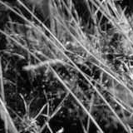
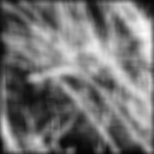
Smoothing with box filter
James Hays

Slide 17
Image filtering
Image filtering:
Compute function of local neighborhood at each position
Really important!
Enhance images
Denoise, resize, increase contrast, etc.
Extract information from images
Texture, edges, distinctive points, etc.
Detect patterns
Template matching
James Hays

Slide 18
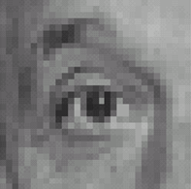

Think-Pair-Share time
0
0
0
1.
0
1
0
0
0
0
0
0
0
2.
0
0
1
0
0
0
1
0
-1
3.
2
0
-2
1
0
-1
0
0
0
-
1
1
1
4.
0
2
0
1
1
1
0
0
0
1
1
1

Slide 19
1. Practice with linear filters
0
0
0
?
0
1
0
0
0
0
Original
Source: D. Lowe

Slide 20
1. Practice with linear filters
0
0
0
0
1
0
0
0
0
Original
Filtered
(no change)
Source: D. Lowe

Slide 21
2. Practice with linear filters
0
0
0
?
0
0
1
0
0
0
Original
Source: D. Lowe

Slide 22
2. Practice with linear filters
0
0
0
0
0
1
0
0
0
Original
Shifted left
By 1 pixel
Source: D. Lowe

Slide 23
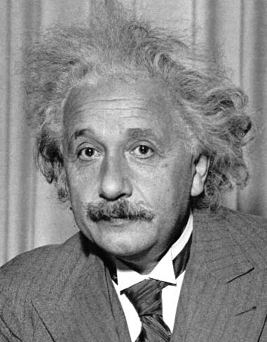
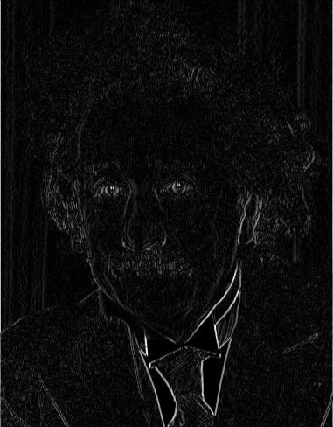
3. Practice with linear filters
1
0
-1
2
0
-2
1
0
-1
Sobel
Vertical Edge
(absolute value)
David Lowe

Slide 24
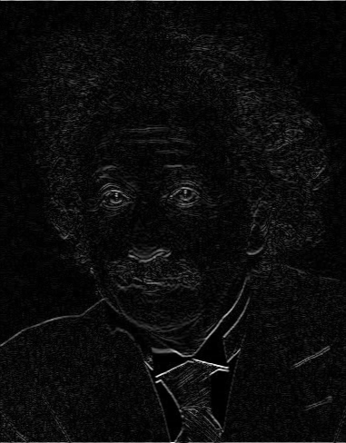
3. Practice with linear filters
1
2
1
0
0
0
-1
-2
-1
Sobel
Horizontal Edge
(absolute value)
David Lowe
Notes:
Questions at this point?

Slide 25
4. Practice with linear filters
0
0
0
-
1
1
1
?
0
2
0
1
1
1
0
0
0
1
1
1
(Note that filter sums to 1)
Original
Source: D. Lowe

Slide 26
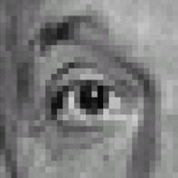
4. Practice with linear filters
0
0
0
-
1
1
1
0
2
0
1
1
1
0
0
0
1
1
1
Original
Sharpening filter
Accentuates differences with local average
Source: D. Lowe

Slide 27
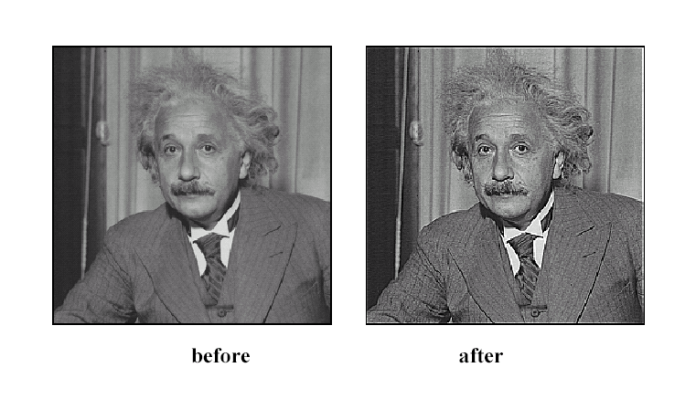
4. Practice with linear filters
Source: D. Lowe

Slide 28
How could we synthesize motion blur?
theta = 30; len = 20;
fil = imrotate(ones(1, len), theta, 'bilinear');
fil = fil / sum(fil(:));
figure(2), imshow(imfilter(im, fil));

Slide 29
Correlation and Convolution
2d correlation
h=filter2(f,I); or h=imfilter(I,f);
James Hays

Slide 30
Correlation and Convolution
2d correlation
2d convolution
h=filter2(f,I); or h=imfilter(I,f);
h=conv2(f,I); or h=imfilter(I,f,’conv’);
conv2(I,f)is the same as filter2(rot90(f,2),I)
Correlation and convolution are identical when the filter is symmetric.
James Hays

Slide 31
Key properties of linear filters
Linearity:
imfilter(I, f₁ + f₂) =
imfilter(I,f₁) + imfilter(I,f₂)
Shift invariance: Same behavior regardless of pixel location
imfilter(I,shift(f)) = shift(imfilter(I,f))
Any linear, shift-invariant operator can be represented as a convolution.
Source: S. Lazebnik
Notes:
f is image

Slide 32
Convolution properties
Commutative: a * b = b * a
Conceptually no difference between filter and signal
But particular filtering implementations might break this equality, e.g., image edges
Associative: a * (b * c) = (a * b) * c
Often apply several filters one after another: (((a * b₁) * b₂) * b₃)
This is equivalent to applying one filter: a * (b₁ * b₂ * b₃)
Source: S. Lazebnik
Notes:
David Jacobs @ UMD http://www.cs.umd.edu/~djacobs/CMSC426/Convolution.pdf
The key difference between the two is that convolution is associative. That is, if F and G are filters, then F*(G*I) = (F*G)*I. If you don’t believe this, try a simple example, using F=G=(-1 0 1), for example. It is very convenient to have convolution be associative. Suppose, for example, we want to smooth an image and then take its derivative. We could do this by convolving the image with a Gaussian filter, and then convolving it with a derivative filter. But we could alternatively convolve the derivative filter with the Gaussian to produce a filter called a Difference of Gaussian (DOG), and then convolve this with our image. The nice thing about this is that the DOG filter can be precomputed, and we only have to convolve one filter with our image.
In general, people use convolution for image processing operations such as smoothing, and they use correlation to match a template to an image. Then, we don’t mind that correlation isn’t associative, because it doesn’t really make sense to combine two templates into one with correlation, whereas we might often want to combine two filter together for convolution. When discussing the Fourier series as a way of understanding filtering, we will use convolution, so that we can introduce the famous convolution theorem.

Slide 33
Convolution properties
Commutative: a * b = b * a
Conceptually no difference between filter and signal
But particular filtering implementations might break this equality, e.g., image edges
Associative: a * (b * c) = (a * b) * c
Often apply several filters one after another: (((a * b₁) * b₂) * b₃)
This is equivalent to applying one filter: a * (b₁ * b₂ * b₃)
Correlation is _not_ associative (rotation effect)
Why important?
Source: S. Lazebnik
Notes:
David Jacobs @ UMD http://www.cs.umd.edu/~djacobs/CMSC426/Convolution.pdf
The key difference between the two is that convolution is associative. That is, if F and G are filters, then F*(G*I) = (F*G)*I. If you don’t believe this, try a simple example, using F=G=(-1 0 1), for example. It is very convenient to have convolution be associative. Suppose, for example, we want to smooth an image and then take its derivative. We could do this by convolving the image with a Gaussian filter, and then convolving it with a derivative filter. But we could alternatively convolve the derivative filter with the Gaussian to produce a filter called a Difference of Gaussian (DOG), and then convolve this with our image. The nice thing about this is that the DOG filter can be precomputed, and we only have to convolve one filter with our image.
In general, people use convolution for image processing operations such as smoothing, and they use correlation to match a template to an image. Then, we don’t mind that correlation isn’t associative, because it doesn’t really make sense to combine two templates into one with correlation, whereas we might often want to combine two filter together for convolution. When discussing the Fourier series as a way of understanding filtering, we will use convolution, so that we can introduce the famous convolution theorem.

Slide 34
Convolution properties
Commutative: a * b = b * a
Conceptually no difference between filter and signal
But particular filtering implementations might break this equality, e.g., image edges
Associative: a * (b * c) = (a * b) * c
Often apply several filters one after another: (((a * b₁) * b₂) * b₃)
This is equivalent to applying one filter: a * (b₁ * b₂ * b₃)
Correlation is _not_ associative (rotation effect)
Why important?
Distributes over addition: a * (b + c) = (a * b) + (a * c)
Scalars factor out: ka * b = a * kb = k (a * b)
Identity: unit impulse e = [0, 0, 1, 0, 0], a * e = a
Source: S. Lazebnik
Notes:
David Jacobs @ UMD http://www.cs.umd.edu/~djacobs/CMSC426/Convolution.pdf
The key difference between the two is that convolution is associative. That is, if F and G are filters, then F*(G*I) = (F*G)*I. If you don’t believe this, try a simple example, using F=G=(-1 0 1), for example. It is very convenient to have convolution be associative. Suppose, for example, we want to smooth an image and then take its derivative. We could do this by convolving the image with a Gaussian filter, and then convolving it with a derivative filter. But we could alternatively convolve the derivative filter with the Gaussian to produce a filter called a Difference of Gaussian (DOG), and then convolve this with our image. The nice thing about this is that the DOG filter can be precomputed, and we only have to convolve one filter with our image.
In general, people use convolution for image processing operations such as smoothing, and they use correlation to match a template to an image. Then, we don’t mind that correlation isn’t associative, because it doesn’t really make sense to combine two templates into one with correlation, whereas we might often want to combine two filter together for convolution. When discussing the Fourier series as a way of understanding filtering, we will use convolution, so that we can introduce the famous convolution theorem.

Slide 35
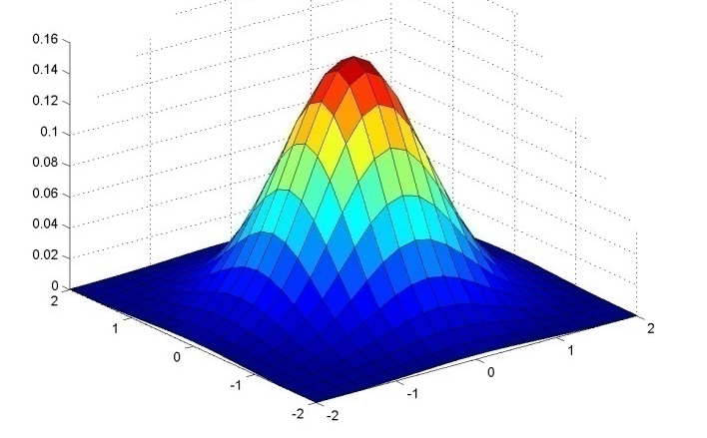
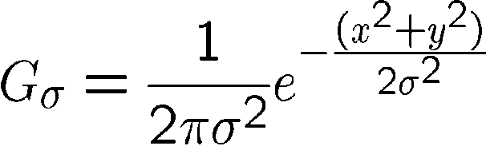
Important filter: Gaussian
Weight contributions of neighboring pixels by nearness
x
0.003 0.013 0.022 0.013 0.003
0.013 0.059 0.097 0.059 0.013
0.022 0.097 0.159 0.097 0.022
0.013 0.059 0.097 0.059 0.013
0.003 0.013 0.022 0.013 0.003
y
x
5 x 5, σ = 1
y
Slide credit: Christopher Rasmussen
Notes:
e^0 = 1, e^-1 = .37, e^-2 = .14, etc.

Slide 36

Smoothing with Gaussian filter
James Hays

Slide 37
Smoothing with box filter
James Hays

Slide 38
Gaussian filters
Remove “high-frequency” components from the image (low-pass filter)
Images become more smooth
Gaussian convolved with Gaussian… …is another Gaussian
So can smooth with small-width kernel, repeat, and get same result as larger-width kernel would have
Convolving two times with Gaussian kernel of width σ is same as convolving once with kernel of width σ√2
Separable kernel
Factors into product of two 1D Gaussians
Source: K. Grauman
Notes:
Linear vs. quadratic in mask size

Slide 39
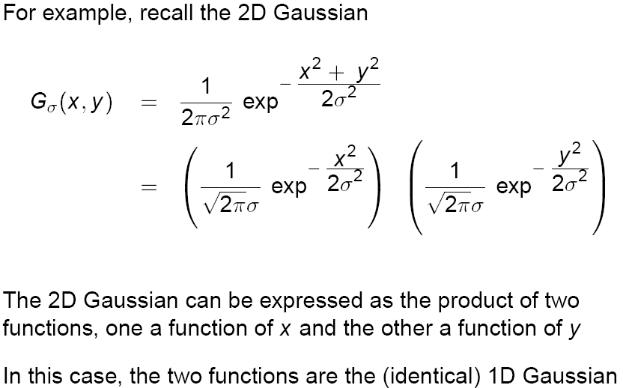
Separability of the Gaussian filter
Source: D. Lowe

Slide 40
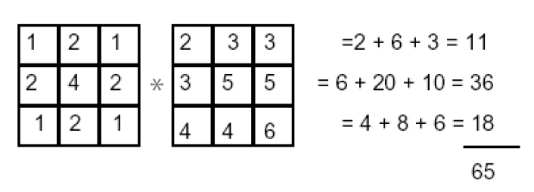
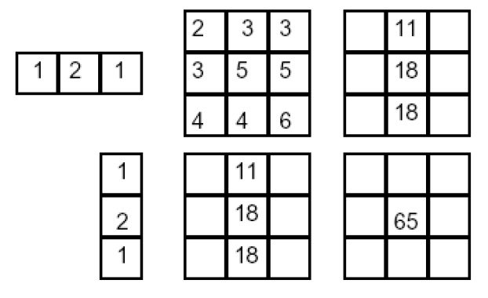
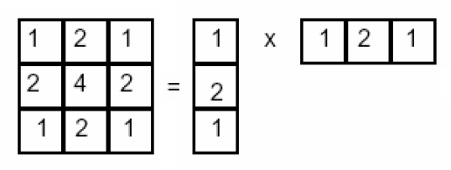
Separability example
2D convolution (center location only)
=
The filter factors into a product of 1D filters:
Perform convolution along rows:
*
=
Followed by convolution along the remaining column:
*
=
Source: K. Grauman
Notes:
Convolution vs filtering doesn’t matter here because the filter is symmetric
9 multiply-add operations at the top for 2D convolution
~11 multiply-add operations at the bottom for the separable 2D convolution

Slide 41
Separability
Why is separability useful in practice?

Slide 42
Separability
Why is separability useful in practice?
MxN image, PxQ filter
2D convolution: ~MNPQ multiply-adds
Separable 2D: ~MN(P+Q) multiply-adds
Speed up = PQ/(P+Q)
9x9 filter = ~4.5x faster
Notes:
https://blogs.mathworks.com/steve/2006/10/04/separable-convolution/

Slide 43
Practical matters
How big should the filter be?
Values at edges should be near zero
Gaussians have infinite extent…
Rule of thumb for Gaussian: set filter half-width to about 3 σ
James Hays

Slide 44













Practical matters
What about near the edge?
the filter window falls off the edge of the image
need to extrapolate
methods:
clip filter (black)
wrap around
copy edge
reflect across edge
Source: S. Marschner

