Slide 1
Sobel filter visualization
What happens to negative numbers?
For visualization:
Shift image + 0.5
If gradients are small, scale edge response
Notes:
- Look at a second filter which is an ‘edge detection’ filter
Negative numbers
Oh. Well, let’s take the absolute value (the magnitude)
Add the mean

Slide 2

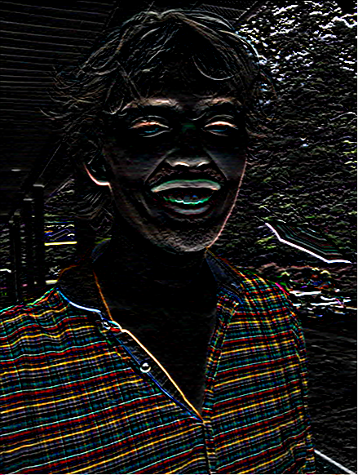
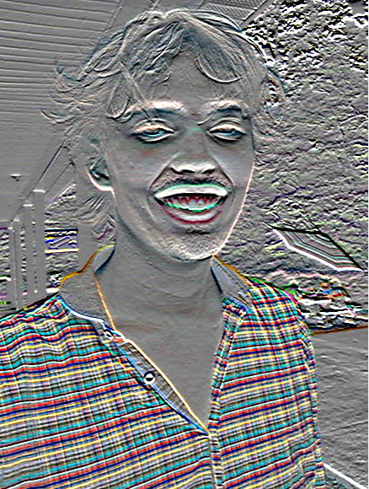
>> I = im2double( imread( ‘luke.jpg’ ) );
>> h = imfilter( I, fspecial(‘sobel’) );
imshow( h );
imshow( h + 0.5 );

Slide 3
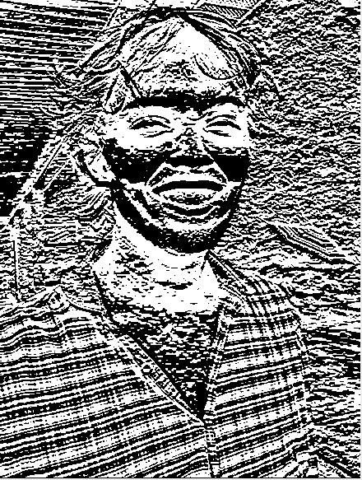
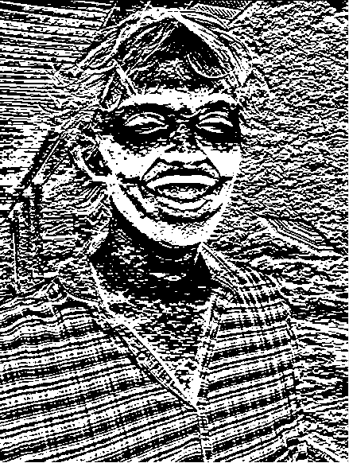
h(:,:,1) < 0
h(:,:,1) > 0

Slide 4
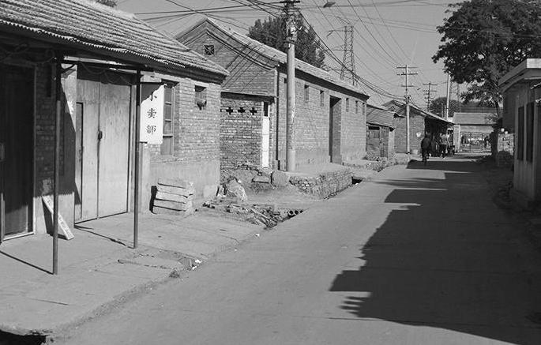

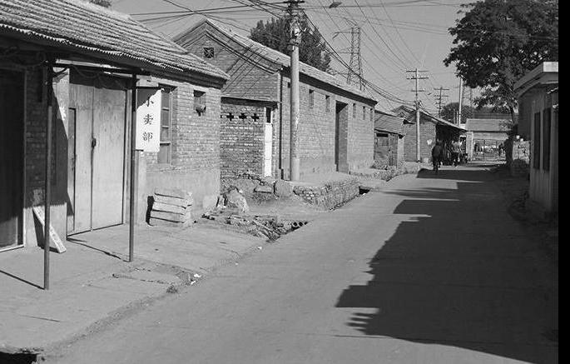
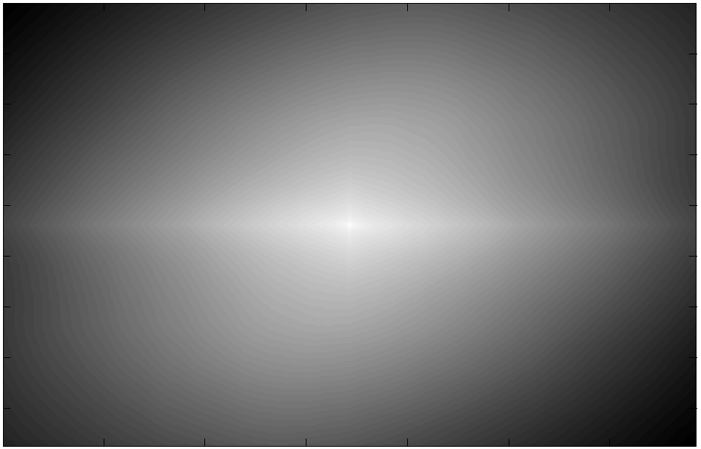
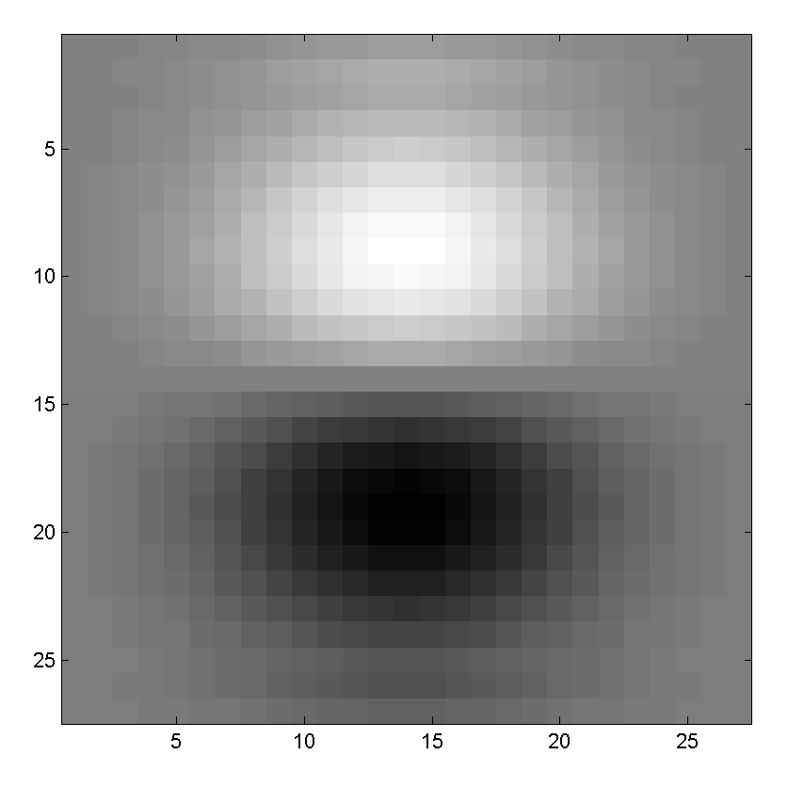
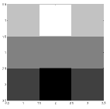
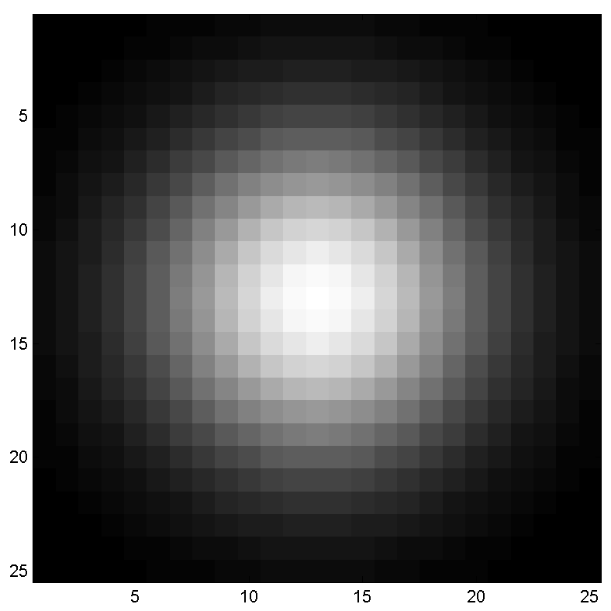
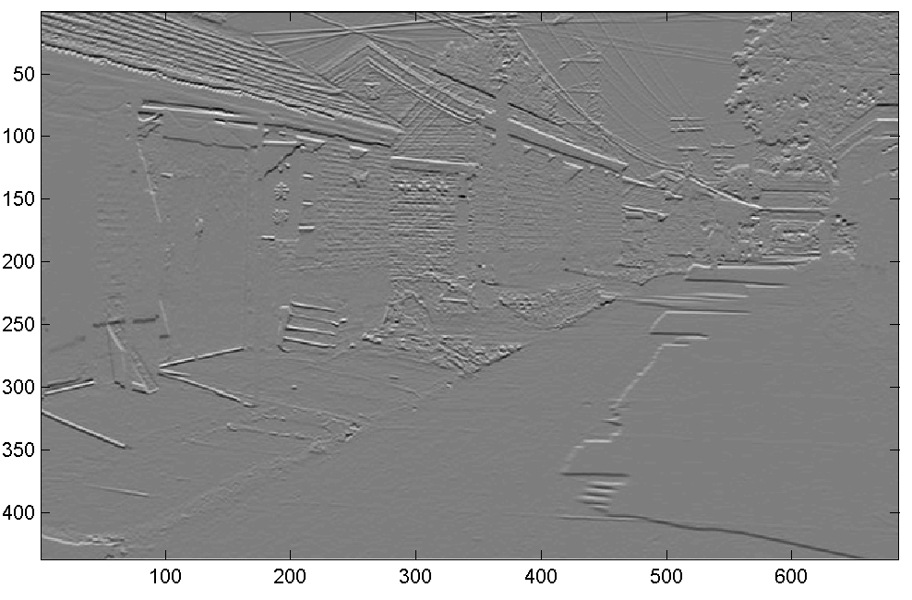
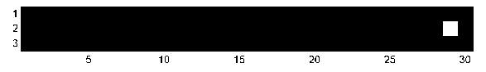
Think-Pair-Share
* = Convolution operator
a) _ = D * B
b) A = _ * _
c) F = D * _
d) _ = D * D
D
H
F
I
A
B
C
G
E
Hoiem
Notes:
a) G = D * B
b) A = B * C
c) F = D * E
d) I = D * D

Slide 5
Non-linear filters

Slide 6
Median filters
Operates over a window by selecting the median intensity in the window.
‘Rank’ filter as based on ordering of gray levels
E.G., min, max, range filters
Steve Seitz, Steve Marschner
Notes:
Better at salt’n’pepper noise
Not convolution: try a region with 1’s and a 2, and then 1’s and a 3

Slide 7

Image filtering - mean
1
1
1
1
1
1
1
1
1
0 | 0 | 0 | 0 | 0 | 0 | 0 | 0 | 0 | 0
0 | 0 | 0 | 0 | 0 | 0 | 0 | 0 | 0 | 0
0 | 0 | 0 | 90 | 90 | 90 | 90 | 90 | 0 | 0
0 | 0 | 0 | 90 | 90 | 90 | 90 | 90 | 0 | 0
0 | 0 | 0 | 90 | 90 | 90 | 90 | 90 | 0 | 0
0 | 0 | 0 | 90 | 0 | 90 | 90 | 90 | 0 | 0
0 | 0 | 0 | 90 | 90 | 90 | 90 | 90 | 0 | 0
0 | 0 | 0 | 0 | 0 | 0 | 0 | 0 | 0 | 0
0 | 0 | 90 | 0 | 0 | 0 | 0 | 0 | 0 | 0
0 | 0 | 0 | 0 | 0 | 0 | 0 | 0 | 0 | 0
 | 0 | 10 | 20 | 30 | 30
?
Credit: S. Seitz
Notes:
ones, divide by 9

Slide 8
Image filtering - mean
1
1
1
1
1
1
1
1
1
0 | 0 | 0 | 0 | 0 | 0 | 0 | 0 | 0 | 0
0 | 0 | 0 | 0 | 0 | 0 | 0 | 0 | 0 | 0
0 | 0 | 0 | 90 | 90 | 90 | 90 | 90 | 0 | 0
0 | 0 | 0 | 90 | 90 | 90 | 90 | 90 | 0 | 0
0 | 0 | 0 | 90 | 90 | 90 | 90 | 90 | 0 | 0
0 | 0 | 0 | 90 | 0 | 90 | 90 | 90 | 0 | 0
0 | 0 | 0 | 90 | 90 | 90 | 90 | 90 | 0 | 0
0 | 0 | 0 | 0 | 0 | 0 | 0 | 0 | 0 | 0
0 | 0 | 90 | 0 | 0 | 0 | 0 | 0 | 0 | 0
0 | 0 | 0 | 0 | 0 | 0 | 0 | 0 | 0 | 0
 | 0 | 10 | 20 | 30 | 30
 |  |  |  | 50
Credit: S. Seitz
Notes:
ones, divide by 9

Slide 9
Median filter?
0 | 0 | 0 | 0 | 0 | 0 | 0 | 0 | 0 | 0
0 | 0 | 0 | 0 | 0 | 0 | 0 | 0 | 0 | 0
0 | 0 | 0 | 90 | 90 | 90 | 90 | 90 | 0 | 0
0 | 0 | 0 | 90 | 90 | 90 | 90 | 90 | 0 | 0
0 | 0 | 0 | 90 | 90 | 90 | 90 | 90 | 0 | 0
0 | 0 | 0 | 90 | 0 | 90 | 90 | 90 | 0 | 0
0 | 0 | 0 | 90 | 90 | 90 | 90 | 90 | 0 | 0
0 | 0 | 0 | 0 | 0 | 0 | 0 | 0 | 0 | 0
0 | 0 | 90 | 0 | 0 | 0 | 0 | 0 | 0 | 0
0 | 0 | 0 | 0 | 0 | 0 | 0 | 0 | 0 | 0
 |  |  |  | ?
Credit: S. Seitz
Notes:
Answer is 90.

Slide 10
Median filters
Operates over a window by selecting the median intensity in the window.
What advantage does a median filter have over a mean filter?
Steve Seitz, Steve Marschner
Notes:
Better at salt’n’pepper noise

Slide 11

Noisy Jack – Salt and Pepper
Notes:
No, not the latest smash hit from early 90’s hip hop group

Slide 12

Mean Jack – 3 x 3 filter

Slide 13

Very Mean Jack – 11 x 11 filter

Slide 14
Noisy Jack – Salt and Pepper
Notes:
No, not the latest smash hit from early 90’s hip hop group

Slide 15

Median Jack – 3 x 3

Slide 16

Very Median Jack – 11 x 11

Slide 17
Median filters
Operates over a window by selecting the median intensity in the window.
What advantage does a median filter have over a mean filter?
Is a median filter a kind of convolution?
Steve Seitz, Steve Marschner
Notes:
Answer: Not convolution: try a region with 1’s and a 2, and then 1’s and a 3

Slide 18
Review: questions
Write down a 3x3 filter that both:
Returns a positive value if the average value of the 4-adjacent neighbors is less than the center,
Returns a negative value otherwise.
Write down a filter that will compute the gradient in the x-direction:
gradx(x,y) = im(x+1,y) - im(x,y) for each x, y
Slide: Hoiem
Notes:
[ 0 -1/4 0;
-1/4 1 -1/4;
0 -1/4 0 ]
[ 0 -1 1 ]

Slide 19
Review: questions
Write down a 3x3 filter that both:
Returns a positive value if the average value of the 4-adjacent neighbors is less than the center,
Returns a negative value otherwise.
Write down a filter that will compute the gradient in the x-direction:
gradx(x,y) = im(x+1,y) - im(x,y) for each x, y
[ 0 -1/4 0;
-1/4 1 -1/4;
0 -1/4 0 ]
[ 0 -1 1 ]
Slide: Hoiem
Notes:
[ 0 -1/4 0;
-1/4 1 -1/4;
0 -1/4 0 ]
[ 0 -1 1 ]

Slide 20
Median filters
Operates over a window by selecting the median intensity in the window.
What advantage does a median filter have over a mean filter?
Is a median filter a kind of convolution?
Secret: Median filtering is sorting.
Notes:
Answer: Not convolution: try a region with 1’s and a 2, and then 1’s and a 3

