Slide 1
IBM University Engagement Project Submission
“Exploring the Power of Agentic AI with IBM Granite and FastAPI”

Slide 2

Project Tile – [ScamShield - AI + Blockchain Scam Protection]
Domain of Project – Cyber Security and Privacy.
Student Name | Recent Passport Photo | Email ID | Mobile number [WhatsApp]
Anirudh Verma |  | techmax1245@gmail.com | 9016703180

Slide 3
Problem Statement -
Problem Statement : ScamShield
The Challenge
Users are increasingly targeted by sophisticated phishing, but often struggle with identifying OTP scams, and detecting fraudulent links on mobile. Information about current scams is scattered. Without personalized, real-time threat detection, many fall victim to fraudulent schemes.
The Objective
Build an AI-powered Scam Protection Agent that delivers real-time risk analysis for individuals The solution should:
Real-time Text Analysis – Analyze screen text via OCR for OTP scams and fraudulent intent.
URL Risk Detection – Evaluate links using Safe Browsing and AI spoof-domain judgment.
Blockchain Ledger – Report and verify known scam numbers/URLs securely via a blockchain ledger.
Privacy-First Execution Perform OCR on-device so sensitive screenshots never leave the phone.
Multi-Agent System –
Scam Text Agent (analyzes text intent)
URL Risk Agent (checks for malicious links)
Ledger Agent (interfaces with scam registry)
Orchestrator Agent (coordinates parallel analysis)
User Interface – Provide on-demand floating widget overlay and Chrome extension alerts.

Slide 4
Proposed Solution -
Proposed Solution: ScamShield
The proposed solution is a multi-agent AI-powered scam protection system built using FastAPI, IBM watsonx.ai, and Granite Models to provide real-time risk analysis. The system addresses challenges in scam detection and reporting through an intelligent, modular architecture.
At its core, the solution uses a parallel agent orchestration pipeline to analyze screen text and URLs. This data is processed securely, enabling the system to detect and flag fraudulent intent using Granite models.
The system consists of four key agents:
Scam Text Agent analyzes text for phishing or OTP fraud intent.
URL Risk Agent checks links against Safe Browsing and Granite spoof-judgment.
Ledger Agent handles secure reporting and verification of malicious entities.
Orchestrator Agent coordinates fan-out requests and aggregates risk scores.
The solution includes a user-friendly Android floating widget (built with Kotlin and Manifest V3) that visualizes risk levels and highlights malicious links.
FastAPI is used to orchestrate workflows, while watsonx.ai ensures scalable model deployment. Granite models power reasoning and spoof-domain judgment.
Overall, this solution delivers an end-to-end intelligent scam protection assistant that promotes digital safety through real-time feedback and preventive alerts.

Slide 5
Technology Used
Langflow platform - For designing and orchestrating high-performance API endpoints
IBM Granite model - for eg - ibm/granite-4-h-small - For natural language understanding and spoof-domain judgment
IBM Cloud - It provides the infrastructure to build, deploy, and scale ScamShield efficiently. IBM Cloud enables a reliable, secure, and scalable environment for deploying ScamShield.
Blockchain / Ledger - Hash-chained fallback or Fabric ledger to store and verify reports, making ScamShield more trustworthy and effective.
IBM Watsonx.ai - For model deployment, embeddings, and AI governance
SQLite / Hyperledger Fabric – For decentralized and tamper-evident scam registry storage

Slide 6
Langflow component Used -
1) Chat Input – Interface where users trigger on-screen text scans or links are auto-scanned.
2) IBM watsonx AI Agent - Processes OCR text and URLs using Granite models to detect fraudulent intent.
3) Name of IBM Granite model - ibm/granite-4-h-small → Fast, efficient for real-time risk assessment
4) Chat output -Displays AI-generated risk levels (low/medium/high) and actionable reasoning.
5) Ledger Component - Stores and retrieves scam reports via hash-chained SQLite or Fabric.

Slide 7
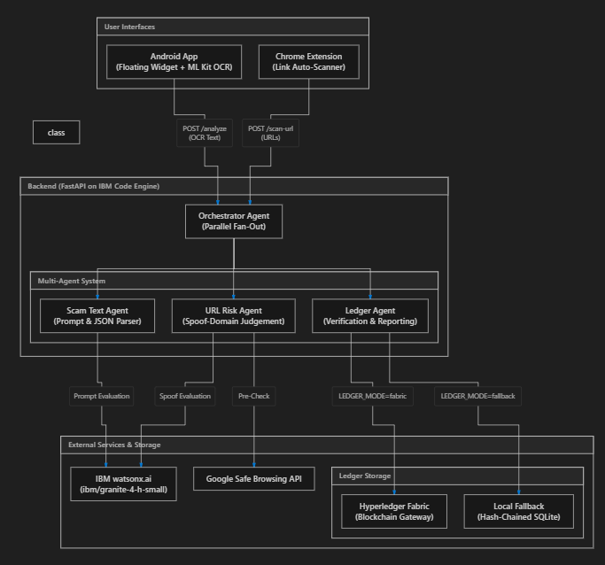
Architecture blueprint

Slide 8

Role of Agentic AI in the solution
Role of Agentic AI in ScamShield
Agentic AI enables ScamShield to function as an intelligent, autonomous system rather than a simple rule-based filter. Using IBM watsonx.ai and IBM Granite models, it coordinates multiple specialized agents to deliver personalized nutrition guidance.
Each agent performs a specific role—such as retrieving nutritional data, generating diet plans, providing health advice, and analyzing food logs—while working collaboratively. This multi-agent approach ensures efficient task execution and accurate results.
Agentic AI also brings context awareness, understanding the nuance in text messages and URLs to distinguish legitimate requests from scams. It supports real-time execution, providing immediate risk feedback as users navigate their digital environment.
Additionally, agents communicate with each other, enabling better decision-making and improved outcomes.
Overall, Agentic AI makes the system proactive, personalized, and goal-driven, acting like a smart digital security guard that helps users maintain a secure digital lifestyle.

Slide 9
Novelty and Uniqueness
The proposed ScamShield stands out by combining Agentic AI, OCR, and Blockchain into a single intelligent system.
Multi-Agent Intelligence – Instead of a single chatbot, multiple specialized agents collaborate to deliver accurate and context-aware security guidance.
Privacy-First OCR – Extracts text directly on-device without sending screenshots to the cloud.
Real-Time Feedback Loop – Instantly highlights dangerous links and evaluates incoming messages.
Multi-Platform – Supports Android overlays and Chrome extension auto-scanning. behavior.
Proactive Security Focus – Goes beyond static blocklists to provide dynamic AI-based intent analysis.
Scalable & Enterprise-Ready – Built on FastAPI and IBM Code Engine for fast performance.
Tamper-Evident Logs – Built on IBM watsonx.ai with IBM Granite models, ensuring reliability and governance.
This makes the solution a smart, adaptive, and proactive digital security guard, not just a static blocklist tool.

Slide 10
Git Hub Link:
https://github.com/Asqi06/IBMhack
·
·
·

Slide 11
Future Scope
1. iOS and Desktop Apps –
Expanding beyond Android and Chrome to offer system-wide protection on all major platforms. This will enable ScamShield to provide a ubiquitous safety net across the entire digital ecosystem.
2.Multilingual Support –
Enhancing the text agent to detect scams in regional languages and translate warnings for diverse user bases. Users can interact safely in their preferred language, making the solution more inclusive for diverse populations.
·
·
·

Slide 12
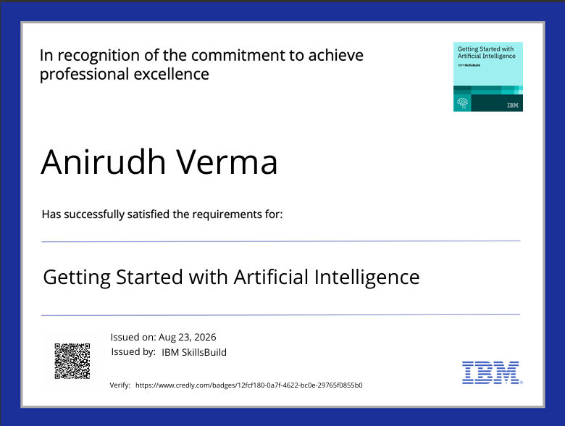
Certificates Earned:
Please add your credly certificate

Slide 13
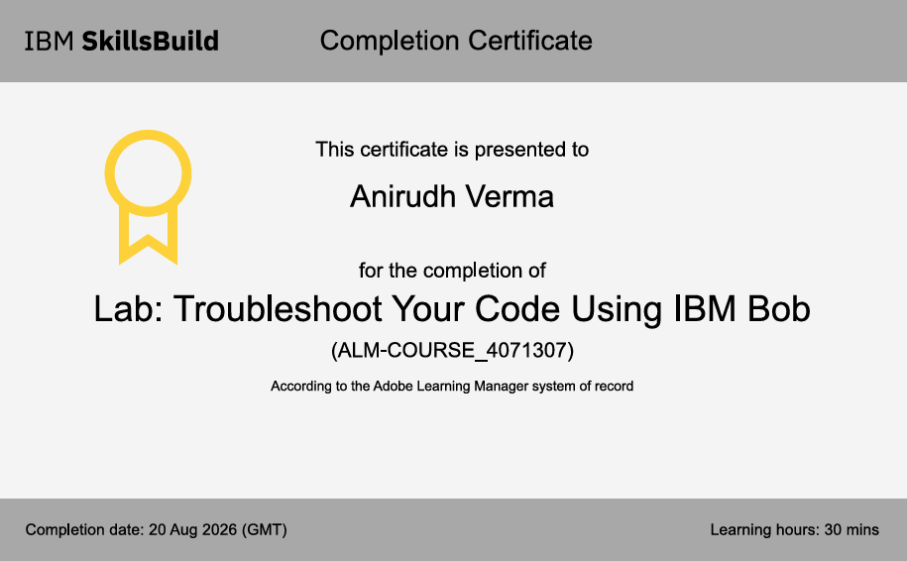
Certificates Earned:​
Add your IBM BOB Certificate

Slide 14


