Slide 1
Copilot Chat Basic Workshop
One-day workshop
Getting real work done with Microsoft Copilot, without the paid license
Asraf Jaafar Sidik | Microsoft Certified Trainer | October 2026
Notes:
Welcome everyone. Introduce yourself. Today is hands-on: you will spend most of the day in Copilot, not watching slides.
Ask the room: who has used Copilot at work before? Who has been told they don't have Copilot because they have no license? Today shows what you can do with what you already have.

Slide 2

Today you run one real purchase, start to finish
Today's task
25
laptops for new hires
You're an executive in the Admin and Facilities department at Teratai Holdings Berhad.
The department needs 25 new laptops for next quarter's hires. Company policy says any purchase above RM20,000 needs three written quotations, a comparison and a justification memo before the HOD signs off.
RM20,000
the policy threshold
3 + 1 + 1
quotations, comparison and memo
Notes:
Read the scenario out. Everything today serves this one purchase, so participants always know why they are doing a step.
Teratai Holdings, the vendors and every person in the sample files are fictional. The policy threshold is RM20,000: above it you need three written quotations, a comparison and a justification memo before the HOD signs off.

Slide 3
Ten stages, one chapter each
The day at a glance
01
02
03
04
05
Check
Explore
Ask
Compare
Chase
Your label and the green shield
Find your way around Copilot
Write the vendor requirements
Check the three quotations
Email vendors with Outlook
06
07
08
09
10
Draft
Organise
Reuse
Extend
Repeat
Comparison and memo on a Page
Everything in one Notebook
Build a Quotation Checker agent
Optional: Word and Excel
Capstone: a second purchase
Notes:
Each chapter moves the purchase one stage on. Chapter 9 is optional: only people whose label is M365 Copilot (Basic) have Copilot inside Word and Excel.
Chapter 10 is the capstone: a second purchase (a training course) that they run on their own.

Slide 4
Morning and afternoon
Today's plan
Morning
Afternoon
01
Which Copilot do I have?
20 min
06
From chat to Pages
40 min
02
Find your way around
30 min
07
Keep it together in a Notebook
30 min
03
Write better prompts
45 min
08
Build a Quotation Checker agent
45 min
04
Compare the quotations
60 min
09
Optional: Word and Excel
30 min
05
Chase vendors in Outlook
45 min
10
Capstone: the training purchase
45 min
Finished early? Chapter 11 has four short extra exercises.
Notes:
Times are the chapter estimates from the notes. Add breaks and lunch to suit the venue. Chapter 4 is the longest and the most important: protect its hour.
Chapter 11 has four short exercises for anyone who finishes early, and for practice after the course.

Slide 5




Everything is on one site
Course site
asraf-js.github.io/Copilot-Chat-Basic-Workshop
Notes
Prompts
Course book
Sample files
Point-and-click steps and screenshots for every chapter
Every prompt you type, with a copy button on each box
All notes and prompts in one PDF to keep
The fictional quotations and policy, in Chapters 4 and 10
Notes:
Put the address on the whiteboard as well. No GitHub account is needed.
Stress copying prompts from the Prompts page, using the copy icon on each grey box. Copying from the PDF can add line breaks in the middle of a prompt.

Slide 6




Four rules for today
Ground rules
Fictional files only
No shield, no upload
Email only yourself
Check every number
Use the sample files. Don't upload real company documents to practise.
Check for the green shield before you upload anything.
Every training subject starts with [CCB TRAINING].
Copilot can be wrong. Treat it like a colleague's draft.
Notes:
These protect the participants and their company. Repeat rule 2 whenever someone is about to upload a file.
Training emails always start with [CCB TRAINING] in the subject and go only to yourself.

Slide 7
Which Copilot do I have?
01
Stage: Check | 20 minutes
Your result: you know your Copilot label, you've seen the green shield, and you've run one safe prompt.
Notes:
Before anyone touches a company document, they need to know which Copilot they are in and whether enterprise data protection applies.

Slide 8

Three work labels, and one consumer app
Chapter 01
Label | Who usually has it | Copilot in Word, Excel, PowerPoint | Busy times
Copilot Chat (Basic) | Organisations over 2,000 users, no paid license | No | Standard access, can slow down
M365 Copilot (Basic) | Smaller organisations, no paid license | Yes, standard access | Standard access, can slow down
M365 Copilot (Premium) | The paid Microsoft 365 Copilot license | Yes, full features | Priority access
Microsoft Copilot is the consumer product.
Signed in with a personal account, it has no green shield. Don't use it for company documents. This course is built for the two Basic labels.
Notes:
The label sits under your name at the bottom left of the Copilot app.
Copilot Chat (Basic): organisations with more than 2,000 users and no paid license. Since 15 April 2026 they have no Copilot inside Word, Excel, PowerPoint or OneNote.
M365 Copilot (Basic): smaller organisations, in-app Copilot with standard access.
Microsoft Copilot at copilot.microsoft.com with a personal account is the consumer product: consumer terms, no shield. Not for company documents.

Slide 9
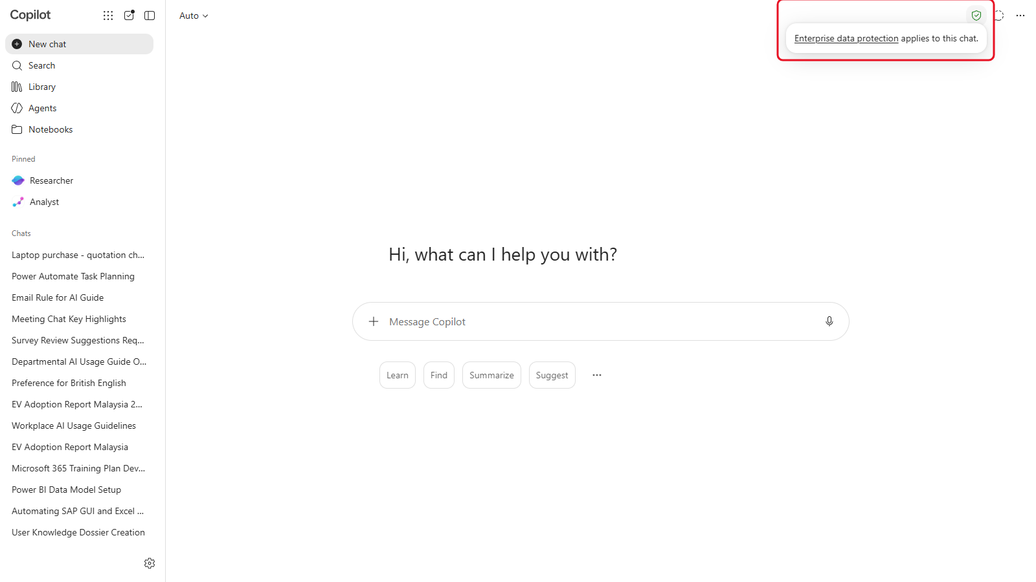
No shield, no upload
Chapter 01
1
Open m365.cloud.microsoft/chat with your work account
2
Look for the small green shield at the top right
3
Point at it: "Enterprise data protection applies to this chat"
4
No shield? Sign out and sign back in with your work account
Notes:
Show the shield live. Point at it, don't click, to show the tooltip.
Enterprise data protection means prompts and uploaded files stay inside the organisation's Microsoft 365 boundary, like email and OneDrive, and aren't used to train the AI models.
If someone has no shield, they are almost always signed in with a personal account.

Slide 10


What Basic can't do, so you can stop looking for it
Chapter 01
In this course
Needs the paid license
Copilot Chat with the web and files you upload
Researcher and Analyst
Copilot in Outlook, for the open email
Cowork
Pages, Notebooks and the Prompt Gallery
Searching work files, Teams chats and meetings
Agent Builder with instructions and websites
Agents with SharePoint or file knowledge
Custom instructions and memory
Custom skills, voice, priority access
Notes:
These features appear in Microsoft videos and articles. They need the paid license or a preview.
Researcher and Analyst may still be listed under Pinned in the left pane. Tell people to leave them alone: they are not part of this course.
If an admin has turned something off (file upload, images, agents), the button can be missing for one person and not the next. Tell the trainer.

Slide 11

Find your label and check the shield
Your turn | Chapter 01
1.1
Find your Copilot label under your name, bottom left
1.3
Point at the green shield and read the tooltip
Checkpoint
1.5
Run your first safe prompt, about enterprise data protection
You know your label, you can see the green shield, and Copilot has answered your first prompt with sources.
1.5
Find the small grey source labels and the Sources button
Prompts: copy them from the Chapter 01 prompts page
Notes:
About 10 minutes. Walk the room and check each person's label. Note anyone without a shield and fix their sign-in before Chapter 2.
Ask two or three people to read out their label: in a large organisation it will be Copilot Chat (Basic), in a smaller one M365 Copilot (Basic). That tells you who can do Chapter 9 later.

Slide 12
Find your way around
02
Stage: Explore | 30 minutes
Your result: a named chat about laptop quotations that you can find again, and a copied answer you can share.
Notes:
The purchase so far: labels and shields checked. Nothing bought yet. The first job is knowing what a good laptop quotation looks like.

Slide 13




Four ways in, one Copilot Chat
Chapter 02
Copilot app
Edge sidebar
Teams
Outlook
m365.cloud.microsoft/chat. The main path for today.
Reads the web page you have open.
Copilot in the left app rail. Same chat, same shield.
Summarise and draft about the open email. Chapter 5.
Notes:
The Copilot app in the browser is the main path today. The others are the same Copilot Chat in different places.
Edge sidebar: can read the web page you have open, useful for a supplier's website.
Teams: Copilot is in the left app rail. Basic can't search Teams messages or meetings from there.
Outlook: Chapter 5.

Slide 14
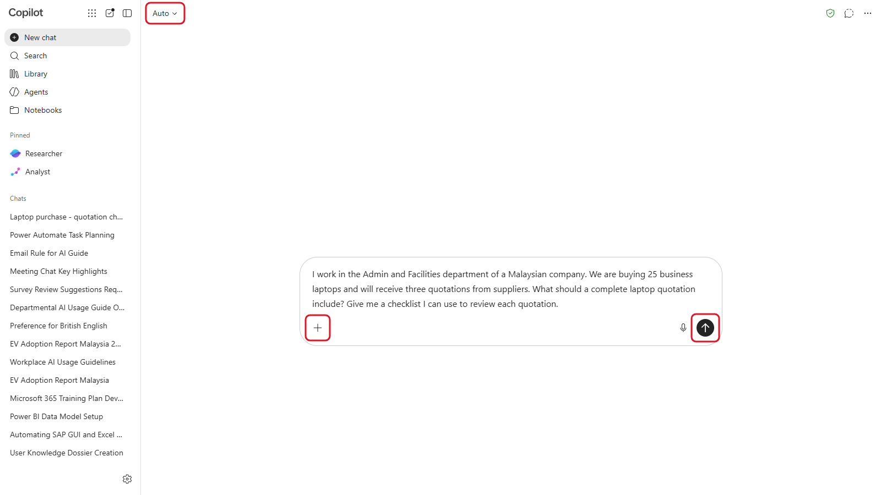
The message box and your chats
Chapter 02
Add (+)
Upload files and images
Prompt Gallery
Ready-made and saved prompts
Auto
Response mode, in the top bar
Chat menu
Rename, Move to notebook, Delete
Copy
The main way to share an answer
Notes:
Walk through the controls live. Add (the plus) uploads files; the Prompt Gallery button disappears once you start typing; Auto in the top bar picks the response mode.
Chats: hover a chat in the left pane, open its menu: Rename, Move to notebook, Delete.
Share response is a Frontier feature, so on Basic, Copy is the main way to pass an answer on.

Slide 15
Run your first prompt and keep the chat
Your turn | Chapter 02
2.1
Open the Copilot app and find New chat, Library and Agents
2.4
Ask for a checklist to review a laptop quotation
Checkpoint
2.5
Rename the chat: Laptop purchase - quotation checklist
You can find the Laptop purchase - quotation checklist chat again from the left pane.
2.6
Copy one of Copilot's answers to share it
2.7
Windows app only: try the screenshot tool
Prompts: copy them from the Chapter 02 prompts page
Notes:
About 20 minutes. The first prompt is on the Prompts page for Chapter 2.
The screenshot tool is only in the Windows desktop app, not in the browser. Skip 2.7 for anyone working in the browser.

Slide 16
Write better prompts
03
Stage: Ask | 45 minutes
Your result: laptop requirements ready to send to vendors, a saved prompt, and your own custom instructions.
Notes:
The purchase so far: they know what a complete laptop quotation should include. Now they write the requirements they'll send to three vendors.

Slide 17
GCSE: the four parts of a good prompt
Chapter 03
G
C
S
E
Goal
Context
Source
Expectations
What do you want Copilot to do?
Who are you, and what's the situation?
What should Copilot use?
What should the result look like?
"Draft the requirements for a laptop quotation request"
"For 25 new hires in Admin and Facilities, at a Malaysian company"
"Current business laptop guidance from reputable sources"
"A numbered list under 200 words, in plain English"
Notes:
You don't need all four every time. The more you include, the less Copilot has to guess.
With Basic, the sources are the public web, files you upload and anything you paste in. Naming the source tells Copilot which to rely on.
In 3.2 they build the prompt one part at a time and watch the answer improve.

Slide 18
A source makes an answer easier to check. It doesn't make it correct.
You're responsible for anything you send to a supplier or your HOD.
Notes:
Sources open in a Sources pane (References). In 3.4 they open at least one source and check that it says what Copilot claims.

Slide 19



Make Copilot work your way
Chapter 03
Prompt Gallery
Custom instructions
Memory
Save a prompt that worked, so you never write it twice.
Tell Copilot your role and how you like answers written.
Copilot remembers preferences across chats. You can delete them.
Hover a prompt > Save prompt
Settings > Personalization
Never budgets, names or passwords
Notes:
Prompt Gallery opens as Prompt Lab. Hover a prompt and choose Save prompt; it appears under Your saved prompts.
Custom instructions: Settings and more (gear, bottom left) > Settings > Personalization > Edit instructions, then Save instructions.
Memory: Saved memories has a switch, a delete for each memory, and Delete all memories. Preferences and role only, never data.

Slide 20
Write the vendor requirements with GCSE
Your turn | Chapter 03
3.2
Build the requirements in four prompts, one part at a time
3.3
Improve the answer with a follow-up
Checkpoint
3.4
Open the sources and check one claim
Your requirements are a numbered list you'd be happy to send to a vendor, and your prompt is saved.
3.5
Save your best prompt in Prompt Gallery
3.6
Add custom instructions and look at your memories
Prompts: copy them from the Chapter 03 prompts page
Notes:
About 35 minutes. The fourth prompt in 3.2 is long, and that's fine: a long, clear prompt gets a usable answer first time.
Remind people not to ask Copilot to remember anything confidential.

Slide 21
Compare the quotations
04
Stage: Compare | 60 minutes
Your result: a checked comparison table of the three quotations, a list of problems to chase, and a recommendation you can defend.
Notes:
The purchase so far: requirements went out to three vendors, and their quotations are back.
This is the core chapter of the day. Don't give away the problems: participants should find them.

Slide 22


Four files, one chat
Chapter 04
Pinnacle Komputer
Seri Mutiara Technology
Cyberjaya Digital Supplies
procurement-policy.pdf
Quotation A
Quotation B
Quotation C
The company's rules
Copilot takes at most three files per message.
Send the policy first, in its own message. Then send the three quotations together, in the same chat.
Notes:
Sample files are in sample-files.zip in the Chapter 4 folder. Extract the zip first.
Copilot takes at most three files per message, and a second upload doesn't add a fourth. So: send the policy first, in its own message, then the three quotations together. Everything must be in the same chat, or Copilot can't compare them.
The policy's Sections 5 to 7 matter later.

Slide 23
Six checks, in order
Chapter 04
4.3
4.4
4.5
4.6
4.7
4.8
Summarise
Compare
Recalculate
Policy
Like-for-like
Recommend
each quotation
figures exactly as printed
every total, yourself too
check each clause
same thing quoted?
then you decide
Copilot does the reading and the layout. You check every number.
Notes:
Each step is a section of the notes with its own prompt.
4.4: the table must show every figure exactly as printed. If Copilot quietly fixes a figure, the evidence is gone.
4.5: participants recalculate with their own calculator too.
4.6 and 4.7: check against the policy and ask whether the three are quoting for the same thing.
4.8: Copilot recommends, the participant decides.

Slide 24
Copilot recommends. You decide.
Your name goes on the memo. You need to explain every number in it without Copilot.
Notes:
Say this before they start, and again at the debrief.

Slide 25
Compare the three quotations
Your turn | Chapter 04
4.1
Download sample-files.zip and extract it
4.2
New chat: policy first, then the three quotations
4.3
Summarise each quotation
Checkpoint
You've found three problems, one per vendor, and can name the policy section for each.
4.4
Build the comparison table, figures as printed
4.5
Check the arithmetic, with your own calculator too
4.6
Check each quotation against the policy
4.7
Ask whether the comparison is like-for-like
Prompts: copy them from the Chapter 04 prompts page
4.8
Ask for a recommendation, then decide
Notes:
About 45 minutes. Name the chat Laptop purchase - comparison: Chapters 6 and 8 come back to it.
Don't reveal the problems. If someone is stuck, point them to the matching section of the notes or ask: is every total right? Is every quotation still valid today? Is each one quoting for the same thing?
Screenshots for 4.5 to 4.8 in the notes are blurred on purpose.

Slide 26


Check your findings
Debrief | Chapter 04
The numbers
The dates
What's included
Which quotation has a problem with its figures?
Which quotation has a problem with its dates?
Which quotation doesn't quote for the same thing?
For each problem: which policy section applies, and what must the vendor do to fix it?
Notes:
Take answers from the room before you confirm anything. The answers are in the trainer answer key, which is kept out of the public repository. This deck is public, so the answers aren't on the slides.
For each vendor, ask: what is the problem, which section of the policy applies, and what must the vendor do? The point to land: it's the vendor's job to fix its quotation, not ours.

Slide 27
Chase vendors with Copilot in Outlook
05
Stage: Chase | 45 minutes
Your result: three vendor emails in your inbox, a summary of one thread, and two reply drafts.
Notes:
The purchase so far: the comparison found a problem in each quotation. Before the HOD sees a memo, each vendor has to fix theirs.

Slide 28
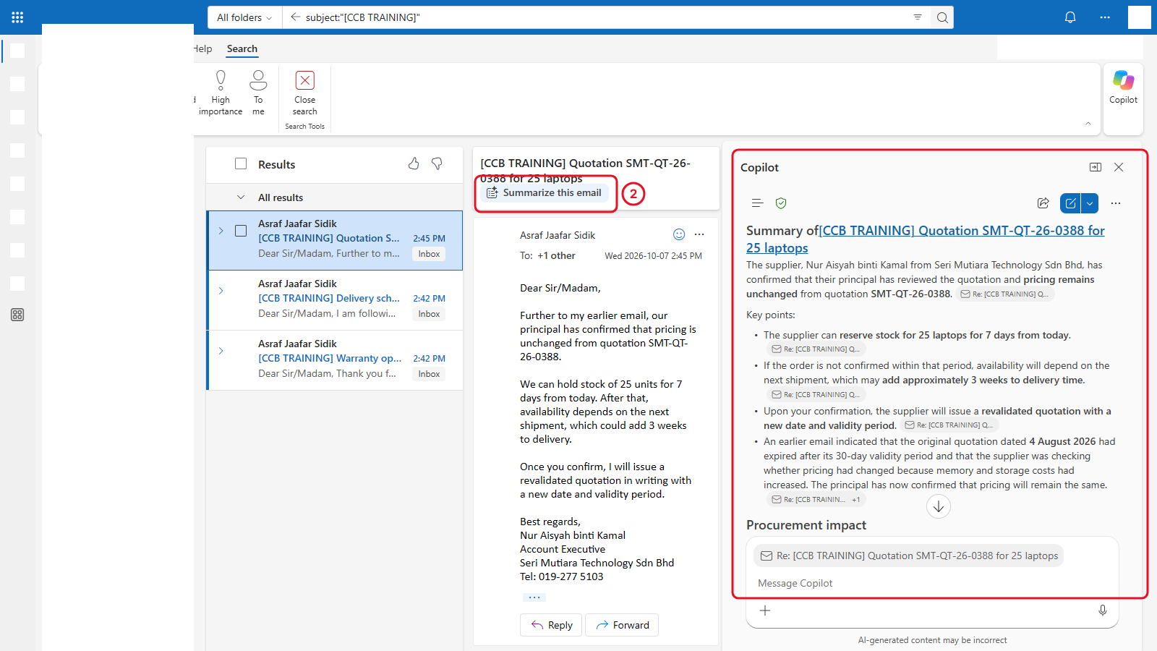
What Copilot in Outlook does with Basic
Chapter 05
Summarize this email
Opens the Copilot pane with key points
Ask about it
Answers come from the open email only
Draft in the pane
Copy the text into your reply
Not on Basic
Draft with Copilot in compose
Notes:
Summarize this email sits above the open message and opens the Copilot pane.
Questions in the pane are answered from the open email only. In testing, an inbox-wide question about all three vendors found just the open thread.
There's no Draft with Copilot in compose on Basic. Draft in the pane, then copy the text into your reply.

Slide 29
Always ask what Copilot was looking at.
An answer that looks complete may only cover the email you had open.
Notes:
The 5.4 exercise shows this: a question about all three vendors comes back with one. To ask about another vendor, open that email first.

Slide 30
Summarise, ask and draft
Your turn | Chapter 05
5.1
Send the three vendor emails to yourself
5.3
Summarise the Seri Mutiara thread
Checkpoint
5.4
Ask Copilot a question about the open email
Two drafts you've read line by line. Check names, numbers and any promise made on your behalf.
5.5
Draft a request for a revalidated quotation
5.6
Draft a request to correct a total
Prompts: copy them from the Chapter 05 prompts page
Notes:
About 35 minutes. Emails go only to the participant's own address. Never to a real vendor or a colleague.
Summaries can give equal weight to an early message and a later one that replaced it: check the summary against the latest email.

Slide 31
From chat to Pages
06
Stage: Draft | 40 minutes
Your result: a Copilot Page with the checked comparison and the justification memo, exported as Word and PDF.
Notes:
The purchase so far: quotations compared, vendors chased. Now the HOD needs a memo.

Slide 32
Long chats drift
Chapter 06
Round 1
Round 2
Round 3
Round 4
Your checked table
"Shorten it to 8 rows"
"Make it more formal"
"Give me the final table"
Corrected total
Corrected total
Corrected total
Corrected total
Validity
Validity
Validity
Validity
Warranty adjustment
Warranty adjustment
Warranty adjustment
Warranty adjustment
When an answer matters, stop changing it in the chat. Ask for one complete version, then move it to a Page.
Notes:
Copilot reads the whole chat each time, but doesn't treat every earlier message equally. After several rounds of changes, a settled point can quietly disappear.
In 6.1 they send three changes in the comparison chat and check whether their Chapter 4 findings survived. In most classes at least one doesn't.

Slide 33
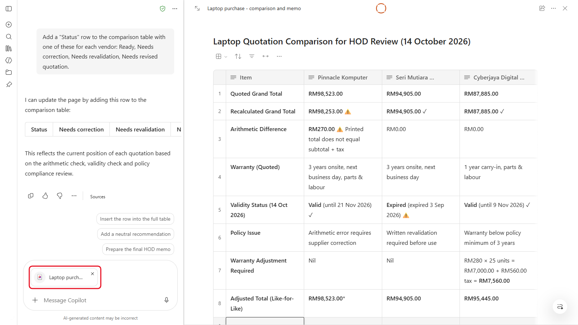
From chat to a Page you can share
Chapter 06
1
One complete version
List everything it must include
2
Edit in Pages
More options under the answer
3
Write the memo
Same chat, then Add to page
4
Share and export
Copy link, then Word or PDF
Notes:
6.2: ask for one complete comparison that lists everything it must include, then More options > Edit in Pages. Name the Page Laptop purchase - comparison and memo.
6.3: Copilot on the Page suggests changes in chat rather than editing the Page directly. Add to page appends a response.
6.4: write the memo in the same chat, where the policy is uploaded, following Section 7.
6.5: Share offers Copy link. 6.6: More actions > Export gives Document or PDF.

Slide 34
Build the Page and write the memo
Your turn | Chapter 06
6.1
Watch a chat drift, then check your findings
6.2
Ask for one complete comparison, then Edit in Pages
Checkpoint
6.3
Add a Status row with Copilot on the Page
The memo covers every item in Section 7, the recommendation is conditional, and every figure matches your checks.
6.4
Write the justification memo against Section 7
6.5
Copy a link to the Page
6.6
Export the Page to Word and PDF
Prompts: copy them from the Chapter 06 prompts page
Notes:
About 30 minutes. Read every sentence of the memo as if you'd written it: you're the one signing it. Delete anything you can't back up from the quotations or the policy.
Placeholders: budget code ADM-IT-2026-07, HOD Encik Faizal Rahman (both fictional).

Slide 35
Keep it together in a Notebook
07
Stage: Organise | 30 minutes
Your result: a Notebook called Laptop purchase 2026 with the quotations, the policy and the memo, and a status update written from all of them.
Notes:
The purchase so far: comparison and memo on a Page and exported to Word. The vendors' revised quotations are still on their way.

Slide 36
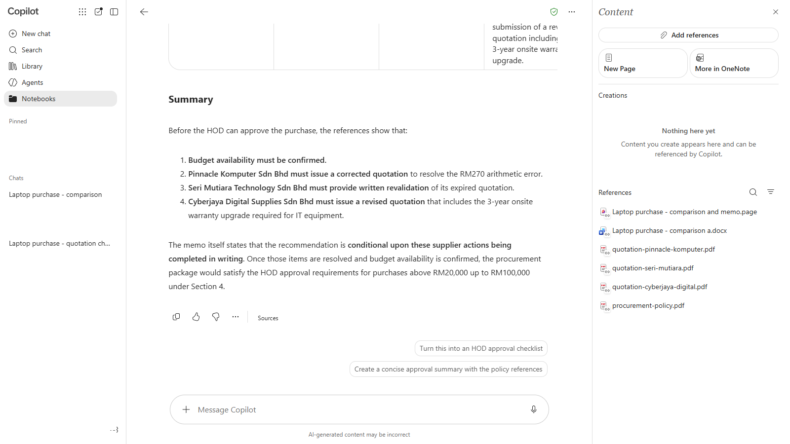
A Notebook answers from its references
Chapter 07
Create
Name, Next, Create
Add references
Upload files or OneDrive files
Inbox facts
Add a New Page under Creations
Keep it current
Remove superseded documents
Notes:
Creating a Notebook: name, Next, Create.
Add references offers Upload files and OneDrive files.
There are no notes in a Notebook, so a fact that lives only in your inbox (such as Seri Mutiara's 7-day stock hold) goes in a New Page under Creations, or in your prompt.
Remove superseded documents: if both the expired and the revalidated quotation are in, Copilot may quote the wrong one.

Slide 37
File the purchase in one Notebook
Your turn | Chapter 07
7.1
Create a Notebook called Laptop purchase 2026
7.2
Add the quotations, the policy and your memo
Checkpoint
7.3
Ask questions across everything, with citations
Copilot answers "what's still outstanding?" correctly, and cites the references it used.
7.4
Add the stock-hold fact on a New Page
Prompts: copy them from the Chapter 07 prompts page
Notes:
About 20 minutes. Copilot answers only from the references added. If an answer is missing a fact, ask where that fact lives.

Slide 38
Build a Quotation Checker agent
08
Stage: Reuse | 45 minutes
Your result: a Quotation Checker agent that checks validity, arithmetic, tax, warranty and delivery on any quotation, shared with a colleague.
Notes:
The purchase so far: everything sits in one Notebook. Before the next purchase comes along, make the Chapter 4 checks reusable.

Slide 39

What goes into an agent
Chapter 08
Name and description
Instructions
Suggested prompts
Web search off
Quotation Checker, and what it's for
The Chapter 4 checks, written once as numbered steps
Buttons people see when they open it
It sticks to the quotations you upload
An agent is only as good as its instructions.
Notes:
Agents > New agent > Skip opens the form.
The instructions are the Chapter 4 checks, written once. Rule 1 (ask for today's date) and the never-correct-silently line fix the two mistakes Copilot made most often in Chapter 4.
Under Knowledge, turn Web search off so the agent sticks to the uploaded quotations. Basic can't add files or SharePoint as knowledge.
Writing Coach (8.1) can be blocked by an admin. If it is, skip to 8.2.

Slide 40
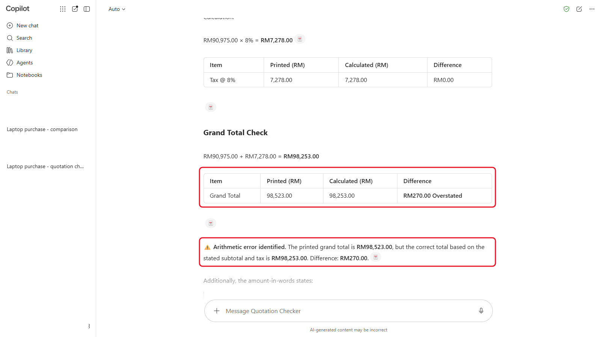
Create it, test it, then fix the instructions
Chapter 08
The fix line
Before comparing, write out subtotal + tax = your total as a sum. Never assume the printed grand total is correct.
If the agent misses something, change the instructions, not just the prompt.
Notes:
There's no test pane in Agent Builder on Basic: create the agent, then test it in its own chat.
In testing, the agent missed the Pinnacle total until this line was added to the instructions. That's the lesson: when an agent misses something, don't just re-ask, change the instructions so it can't miss it again.
The screenshot shows the agent catching the RM270 difference after the fix.

Slide 41
Sharing an agent shares its instructions, not your files.
Anyone who opens it can read the instructions. Keep budgets and preferred suppliers out.
Notes:
Share has a name field, Org-wide sharing and Copy chat link. For today, copy the link only.

Slide 42
Build and share the Quotation Checker
Your turn | Chapter 08
8.1
Try a prebuilt agent: Writing Coach
8.2
Agents > New agent > Skip
Checkpoint
8.3
Name and describe the agent
Your agent flags the arithmetic difference, asks for today's date, and lists questions for the supplier.
8.4
Paste the instructions, turn Web search off
8.5
Add three suggested prompts
8.6
Create, test with a quotation, add the fix line
8.7
Copy the sharing link
Prompts: copy them from the Chapter 08 prompts page
Notes:
About 35 minutes. The instructions are on the Prompts page for Chapter 8.
When testing, give the agent today's class date: 14 October 2026.

Slide 43
Optional: Copilot in Word and Excel
09
Stage: Extend | 30 minutes
Your result: a tightened memo in Word and an Excel comparison with a checked total column.
Notes:
Only for people whose label is M365 Copilot (Basic). Everyone else moves on to the capstone or Chapter 11.

Slide 44
Only if Copilot is inside your apps
Chapter 09
M365 Copilot (Basic)
Copilot Chat (Basic)
9.1 Check the Copilot button in Word
No Copilot inside Word or Excel
9.2 Tighten the memo's recommendation
Start the capstone (Chapter 10) early
9.3 Add a check row in Excel
Or try an exercise from Chapter 11
Read any rewrite against the original before you keep it.
Notes:
Use the labels you collected in Chapter 1. Copilot Chat (Basic) users have had no Copilot inside Word, Excel, PowerPoint or OneNote since 15 April 2026.
For those who can: 9.2 tightens the memo in Word (check every figure against the old version before keeping a rewrite). 9.3 adds a TRUE or FALSE check row in Excel that catches the same arithmetic error.

Slide 45
Capstone: the training vendor purchase
10
Stage: Repeat | 45 minutes
Your result: a checked comparison of three training quotations, chasing emails, a memo on a Page, and everything in a Notebook.
Notes:
A second purchase lands on their desk, and this time they run it themselves. Each stage gives a goal, a hint and how to know they're done.
Don't reveal the problems in the three training quotations. They're in the trainer answer key, not in this public deck.

Slide 46


The brief from your HOD
Chapter 10
"The department needs a two-day in-house Effective Business Writing course for 30 executives, at Menara Teratai, in November 2026. HR says it must be HRD Corp claimable. Please check the quotations, compare them, and send me a recommendation with a memo."
Every quotation must match all four
Two days
30 participants
In-house
HRD Corp claimable
Notes:
Read the brief aloud. Ask the room to name the four things every quotation must match before anyone opens the files.
Sample files: sample-files.zip in the Chapter 10 folder. Three fictional training providers plus the same policy.

Slide 47
Run the second purchase on your own
Your turn | Chapter 10
10.3
Draft the requirements with GCSE
10.4
Check with your agent, then compare in Copilot Chat
Checkpoint
10.5
Draft one chasing email per provider
One problem found in each quotation, the policy section named for each, and every number in the memo explained without Copilot.
10.6
Write the memo on a Page
10.7
File it all in a Training purchase 2026 Notebook
10.8
Run your Quotation Checker as a final check
Prompts: copy them from the Chapter 10 prompts page
Notes:
About 40 minutes. Step back: let them use the notes from earlier chapters. Hints only if someone is stuck, such as: read the pricing lines carefully, and check each quotation quotes for the same course as the brief.
The capstone checklist is at the end of Chapter 10 in the notes.

Slide 48

Finished early? Four short exercises
Chapter 11 | Self-paced
A. Polish an announcement
B. Make a notice image
C. Improve a weak prompt
D. Research with sources
Laptop collection day, under 120 words, in your voice
An image with no text in it, for the notice board
Fix a colleague's four-word memo prompt
Disposing of old laptops properly in Malaysia
Notes:
Each takes 10 to 15 minutes and uses skills from Chapters 2 to 8. Good for fast finishers, and for practice after the course.
B: AI images often get text wrong. Ask for an image without words and put the date and place in the notice text yourself. No logos or real brand names.

Slide 49
Five habits to take back to your desk
Wrap-up
Check the label and the shield
before you paste or upload anything
Use GCSE
Goal, Context, Source, Expectations
Check every number yourself
Copilot recommends, you decide
Move answers that matter to a Page
so they can't drift
Read every draft before you send it
names, numbers and promises
Notes:
Ask each person which habit they'll use first, and on what task.
Recap the purchase: requirements, comparison, chasing, memo, Notebook, and an agent for next time, all without the paid license.

Slide 50
Keep practising
Thank you
Notes, prompts, the course book and the sample files stay online after today.
asraf-js.github.io/Copilot-Chat-Basic-Workshop
Notes:
Point them to Chapter 11 for practice and to What to Learn Next on the home page for free Microsoft resources.
After the course, questions go to the training coordinator who arranged the class.

