Slide 1
Note: The data and information in this document is reflective of a hypothetical situation and client. This document is to be used for KPMG Virtual Internship purposes only.
Sprocket Central Pty Ltd
Data analytics approach
Asraful Islam, Junior Data Analyst
asrafuldu126@gmail.com

Slide 2
Note: The data and information in this document is reflective of a hypothetical situation and client. This document is to be used for KPMG Virtual Internship purposes only.
Agenda
Introduction
Data Exploration
Model Development
Interpretation

Slide 3
Sprocket Central Pty Ltd provided us a dataset of 1000 customers with their demographics and attributes consisting of the following fields
Note: The data and information in this document is reflective of a hypothetical situation and client. This document is to be used for KPMG Virtual Internship purposes only.
Introduction
gender
past_3_years_bike_related_purchases
DOB
job_title
job_industry_category
wealth_segment
owns_car
tenure
address
postcode
state
country
property_valuation
rank
value
Our job is to analyse the dataset and recommend which of these 1000 customers should be targeted to drive the most value for the organisation

Slide 4
Note: The data and information in this document is reflective of a hypothetical situation and client. This document is to be used for KPMG Virtual Internship purposes only.
Data Exploration
Dataset has 15 fields and 1000 records
Our main focus is on the field value and other fields that value depends on
Eventually, the fields address, postcode, country are redundant
past_3_years_bike_related_purchases is renamed as purchases and DOB is transformed to age
gender, job_title, job_industry_category, wealth_segment, owns_car, state are categorical fields and purchases, tenure, property_valuation, rank, value, age are numerical fields
There is no duplicate records
job_title, job_industry_category, and age has 106, 165, and 17 blank records respectively

Slide 5
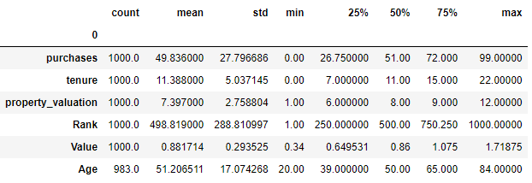
Note: The data and information in this document is reflective of a hypothetical situation and client. This document is to be used for KPMG Virtual Internship purposes only.
Data Exploration
The numerical fields have the following statistics:

Slide 6
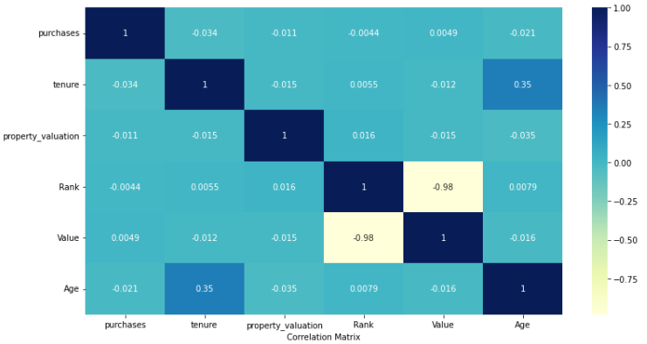
Note: The data and information in this document is reflective of a hypothetical situation and client. This document is to be used for KPMG Virtual Internship purposes only.
Data Exploration
The numerical fields have the following correlation:
The correlation coefficient –0.98 between value and rank indicates that the fields are significantly and negatively correlated.

Slide 7
Note: The data and information in this document is reflective of a hypothetical situation and client. This document is to be used for KPMG Virtual Internship purposes only.
Model Development
Place headline insight or information here. This should be the most important point for this slide.
Place any information about this point here.
Place any supporting images, graphs, data or extra text here.

Slide 8
Note: The data and information in this document is reflective of a hypothetical situation and client. This document is to be used for KPMG Virtual Internship purposes only.
Interpretation
Place headline insight or information here. This should be the most important point for this slide.
Place any information about this point here.
Place any supporting images, graphs, data or extra text here.

Slide 9
Note: The data and information in this document is reflective of a hypothetical situation and client. This document is to be used for KPMG Virtual Internship purposes only.
Appendix

Slide 10
Note: The data and information in this document is reflective of a hypothetical situation and client. This document is to be used for KPMG Virtual Internship purposes only.
Appendix
This is an optional slide where you may place any supporting items.

