Slide 1
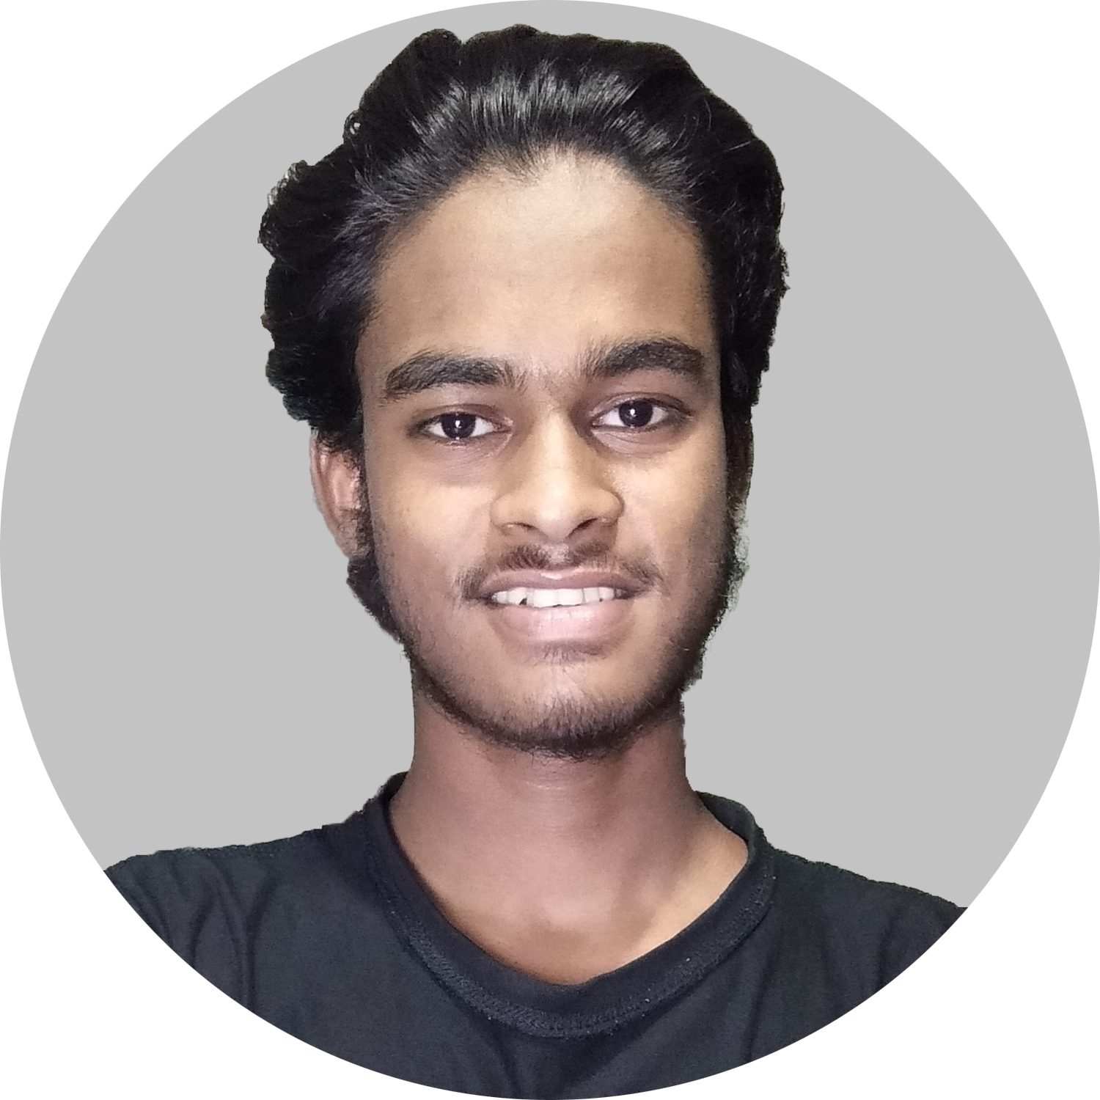
Asraful Islam
Professional Web Developer

