Slide 1
Imagista: Bidirectional AI for Text-to-Image and Image-to-Text Generation
By Sanjana Asrani, D17B, 01

Slide 2
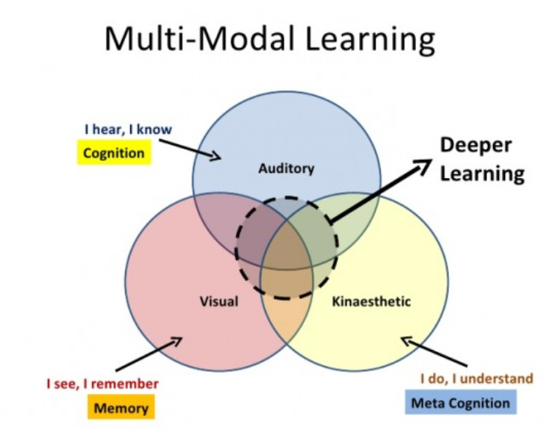
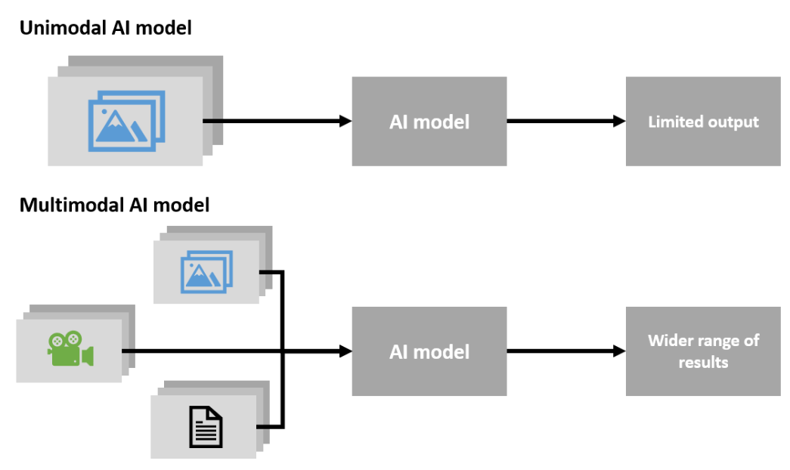
INTRODUCTION
Significance of Multimodal AI: Multimodal AI is a cutting-edge field that allows machines to understand and generate data across multiple modalities, such as text and images. It offers new possibilities for creativity and practical applications.

Slide 3
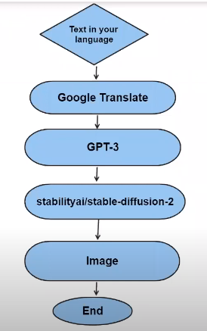
PART 1 - Text-to-Image Generation:
In the first part of our presentation, let’s explore the process of generating images from text descriptions. This technology has profound implications for fields like creative content generation and visual storytelling.

Slide 4
PROCESS:
Text Input: The process begins with a text input that describes the content or concept for the image to be generated.
Translation: The text input can be optionally translated into a target language using a translation model to ensure the generated image aligns with the desired linguistic context.
Input Processing: The text is processed using a Natural Language Processing (NLP) model. This model extracts the semantic meaning, context, and details from the text.
Multimodal Fusion: The processed text features are combined with visual context information to create a unified representation. This fusion of modalities enhances the understanding of the textual description.
Image Generation Model: An image generation model, often based on generative adversarial networks (GANs) or transformers, takes the multimodal representation as input. This model leverages this information to generate an image that aligns with the textual description.
Guidance Mechanism: To fine-tune the image generation process, a guidance mechanism can be applied. This mechanism provides additional instructions or constraints to ensure the image's alignment with the text.
Image Output: The output of the image generation model is a visual representation of the input text. This image can be displayed, saved, or further processed as needed.

Slide 5
PART 2: Image-to-Text Generation
Now, let's explore the reverse process of generating text descriptions from images. This technology is crucial in the field of image captioning and accessibility, making visual content more accessible to all.

Slide 6
PROCESS
Image Input: The process begins with an image as input. This image can be of any content or scene.
Image Captioning Model: An image captioning model, often based on pre-trained vision encoders combined with language decoders, processes the image to generate textual descriptions. This model encodes the visual information and decodes it into natural language.
Text Output: The output of the image captioning model is a textual description that provides a detailed account of the content, scene, or objects in the image.
Language Understanding: The textual description is understood using NLP models. This step involves syntactic and semantic analysis to extract meaning and context.
Multimodal Fusion: If desired, the textual description can be fused with other textual or visual information to create a unified representation. This fusion enhances the overall understanding of the content.
Translation (Optional): The text can be optionally translated into a target language to accommodate linguistic preferences or localization.
Text Output: The final textual description can be used for various applications, such as image captioning, content indexing, accessibility solutions, and more.

Slide 7
CONCLUSION
In wrapping up our exploration of bidirectional AI for text-to-image and image-to-text generation, we've witnessed the powerful synergy between NLP (Natural Language Processing) and computer vision. This dynamic partnership transcends the boundaries between text and images, offering new horizons in AI. It becomes evident that the foundation of this remarkable technology lies in Natural Language Processing (NLP). NLP serves as the cornerstone that enables machines to understand, interpret, and generate content that seamlessly bridges the gap between text and images.

