Slide 1

Hosting a Dynamic Website using AWS Services CC Mini Project
Project Mentor : Indu Dokare
Group Number : 08
Group Members : D12B
01-Sanjana Asrani
15-Abhishek Chhabria
22-Varad Deshmukh

Slide 2
Content
Introduction to Project
Literature Survey
Architecture
Procedure
Applications
Implementation
Conclusion

Slide 3
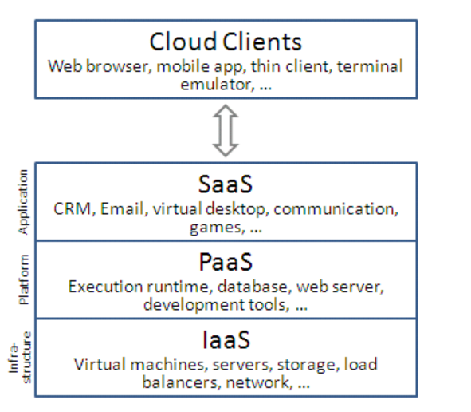
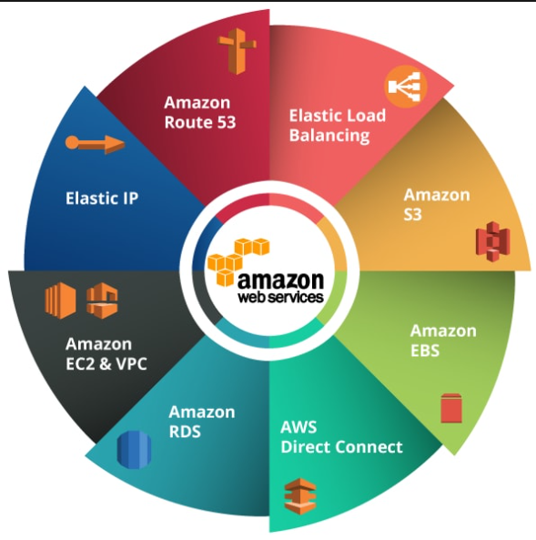
Introduction

Slide 4
AWS SERVICES USED
EC2:
Amazon takes the responsibility of networking, storage, server and virtualization and the user is responsible for managing the Operating System, middleware, runtime, data and application.
configure virtual machines (referred to as instances) and choose from a variety of operating systems, manage them and execute own application.
They also have full control over the instances and by giving them access to computing resources amd the underlying infrastructure including virtual machines, storage, and networking, security, and software.
S3:
Provides Reduced Redundancy Storage (RRS), which reduces latency by storing data in regionally segregated buckets. This saves resources and facilitates application efficiency for users in geographically dispersed locations.
Strong authentication ensures the security of regionally stored data.
Provides Representational State Transfer (REST) and Simple Object Access Protocol (SOAP) Web service interfaces that are built to operate with any type of Web development toolkit.

Slide 5
AWS SERVICES USED
IAM: Identity and Access Management (IAM) lets administrators authorize who can take action on specific resources, giving you full control and visibility to manage Google Cloud resources centrally. For enterprises with complex organizational structures, hundreds of workgroups, and many projects, IAM provides a unified view into security policy across your entire organization, with built-in auditing to ease compliance processes.
SES:
Amazon Simple Email Service (SES) lets you reach customers confidently without an on-premises Simple Mail Transfer Protocol (SMTP) system.
Amazon SES is a cloud email service provider that can integrate into any application for bulk email sending.

Slide 6
AWS SERVICES USED
LAMBDA FUNCTION: AWS Lambda is a compute service that lets you run code without provisioning or managing servers. Lambda runs your code on a high-availability compute infrastructure and performs all of the administration of the compute resources, including server and operating system maintenance, capacity provisioning and automatic scaling, and logging. With Lambda, all you need to do is supply your code in one of the language runtimes that Lambda supports.
RDS: Amazon Relational Database Service (RDS) is a managed SQL database service provided by Amazon Web Services (AWS). Amazon RDS facilitates the deployment and maintenance of relational databases in the cloud. A cloud administrator uses Amazon RDS to set up, operate, manage and scale a relational instance of a cloud database. Amazon RDS is not itself a database; it is a service used to manage relational databases.

Slide 7
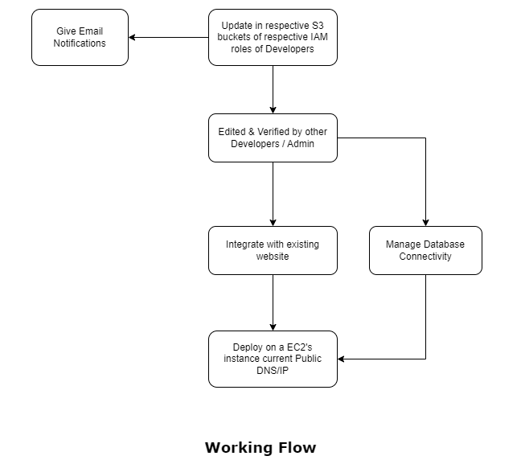
Working Flow

Slide 8
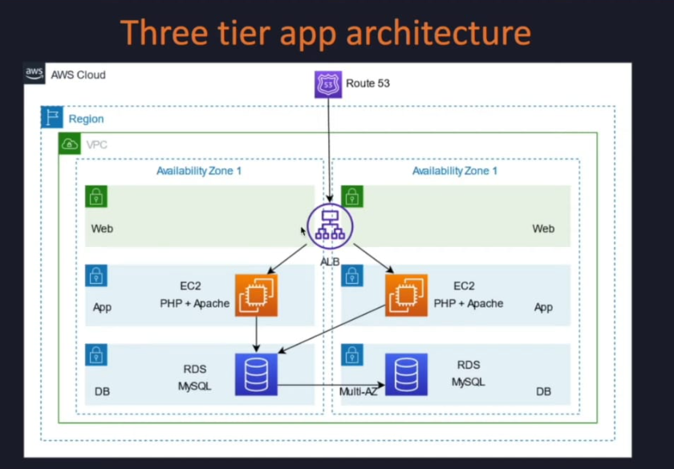
Architecture

Slide 9
Procedure
EC2 INSTANCE
Setting Up Your EC2 Instance.
Installing a Web Server to Host a Website on AWS EC2.
Changing firewall Settings.
Installing XAMPP and getting the project files locally stored.
Setting up the databases required.
Running the website on localhost using xampp & phpmyadmin
Hosting it using the ec2 instance's public ip address.
RDS
Creating a MYSQL database.
Connecting it with the already existing phpmyadmin database.
performing CRUD operations.

Slide 10
Procedure
SES
Create a S3 Bucket.
Create an IAM Role and set Permssion policies
Create Lambda Function that will allow us to send an email to admin as soon as a user with an IAM role uploads something in the S3 bucket.
LAMBDA
Create a Lambda Function.
Set Execution role.
Add S3 Trigger.
Wrte the corresponding code and deploy.
Monitor your bucket.

Slide 11
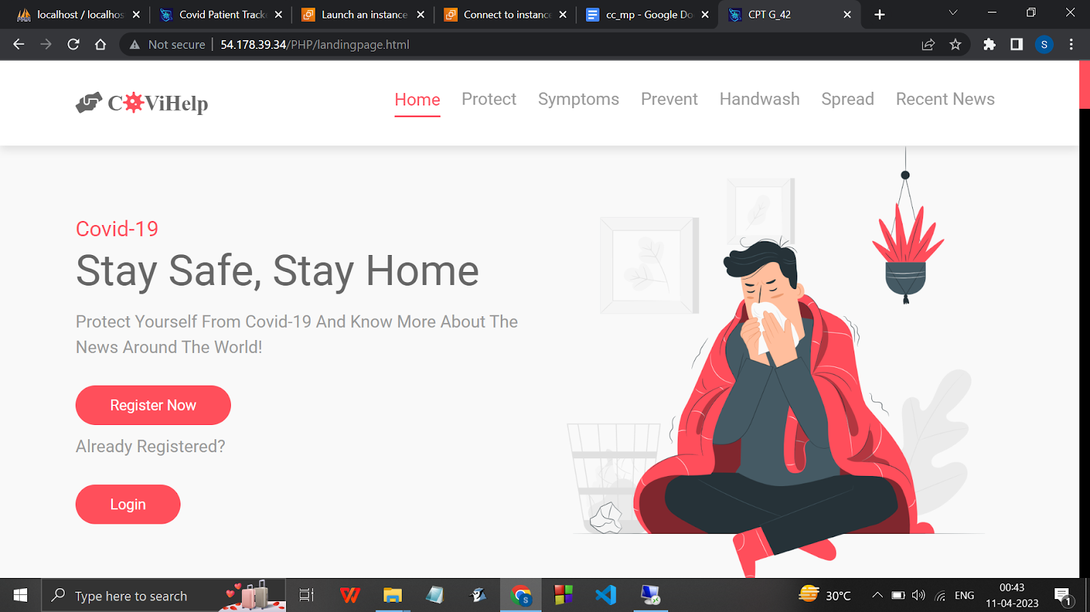
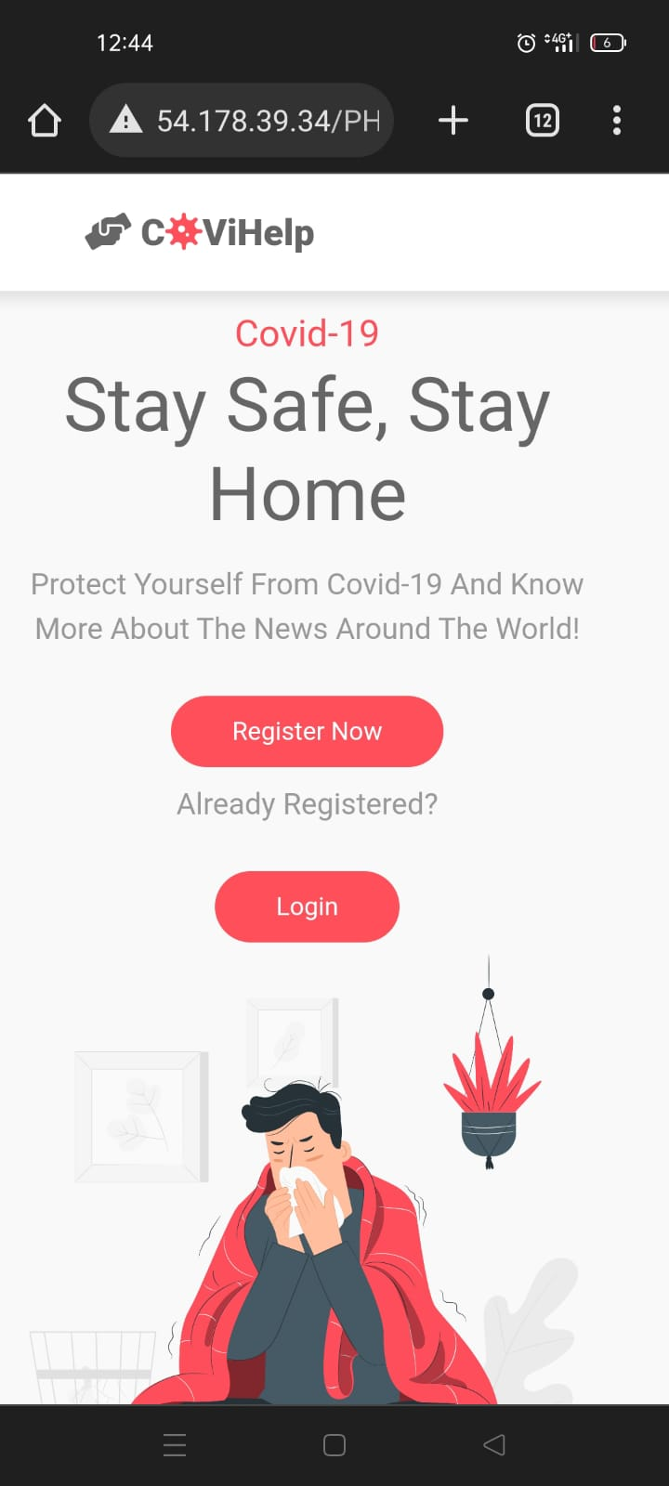
Implementation: hosted at IP Address : currentPublicIPA/landingpage.html

Slide 12
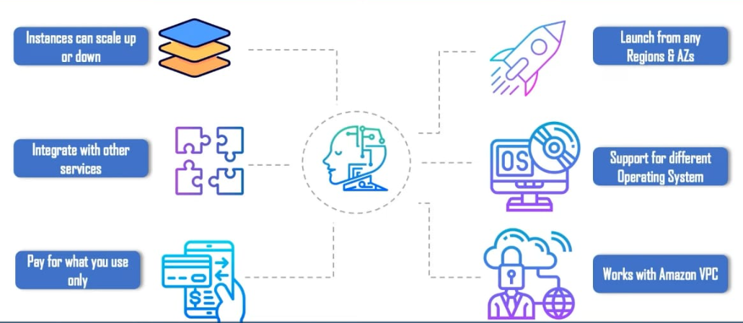
Applications

Slide 13
Conclusion
This is how you can host your dynamic website using the specified instances. Everytime, You close and open the remote desktop connection with the same EC2 instance also, it generates a new Public IP address for that instance. Hence the link of the website will change accordingly, by just replacing the localhost with the current public IP address of the instance in
localhost/ProjectFilePath
Since this is just for practising how to host the website with the Free tier account, terminating the instance once hosting is done is a must.
Before Terminating the instance, it is to be made sure that in the firewall settings of the instance, inbound connections of public have to be changed back to blocked as default again.

